Slide 1
Soldering 100
By Gerry Crenshaw WD4BIS
www.qsl.net/wd4bis
wd4bis@arrl.net

Slide 2
Soldering
The process of making an electrical connection by melting low temperature metal alloys around the connection leads.
The most common solder alloys usually consist of tin and lead and sometimes silver.
The most common for electronics work is 60% tin, 40% lead (AKA 60/40) melting point about 370F.

Slide 3
Soldering
63/37 is also very common for electronics work. Melting point about 360F.
Lead free solder is becoming the industry standard for EPA concerns. Usually a tin-silver-copper alloy. Melting point about 428F.

Slide 4
Solder Core
Most solder will have a core of an acid or rosin to clean the material being soldered.
Acid core is typically used for plumbing work. This is to etch the copper pipes for a water tight seal.
Rosin core is typically used for electronics work. The rosin core removes oxidation on component leads.

Slide 5
Soldering Iron
Most electronics work is done with a soldering iron of 25 to 60 watts.
The size of Iron will depend on the amount of material being heated.
25 watts good for most electronics assembly or small repair jobs.
60 watts or more, good for large mass soldering, such as soldering wires to chassis frames.

Slide 6
The Process
Soldering is as much art and experience than science.
Plug in/turn on Iron and let it heat up.
Clean soldering iron tip on damp sponge or cloth. A dirty iron tip will not transfer heat.
“Tin” the tip of the iron. Apply some solder to the iron tip so it will have a coating of solder. The iron tip should be shiny.
If the tip wont take solder, scrape with a knife blade or file and try again.

Slide 7
The Process
Heat component lead and circuit board pad.
Touch solder to heated joint, let a little solder melt onto pad and component lead.
Remove solder when the pad seems full.

Slide 8
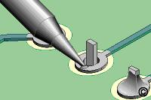
The Process
Remove heat and let cool.
The art of this is to apply enough heat, solder, then remove. Too much heat and the circuit board “land” (the copper) will lift.
Try to apply the solder to the parts to that will be soldered, not the tip of the iron.

Slide 9
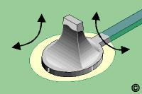
The Process
The melting process lets to solder flow around the joint. The surface tension lets the solder “wick” into the joint.
Called “wetting”, the resulting joint should look like a small volcano.

Slide 10
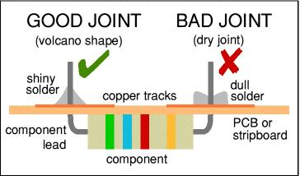
Good Vs Bad Solder Joints
A bad joint is usually referred to as a dry or cold solder joint. They are the cause of many joint failures.
A good joint will be volcano shaped and shiny.
A cold joint will be dull, granular and concave in shape.

Slide 11
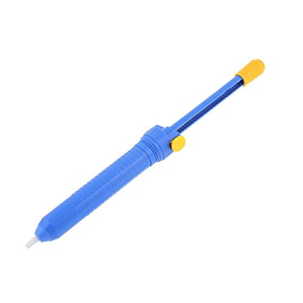
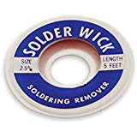
Solder Rework/Repair
Solder Vacuum.
Solder Wick

Slide 12
A Small Project
Anderson Power Pole Polarity Tester
Bend 1.2k Resistor .5”. Insert, Solder and cut leads.
Save a lead clipping, bend .4” for the Jumper. Insert, Solder and cut leads.
Insert LED’s into board. Bend the leads of the LEDS so the body is just at the edge of board. Pay attention to long and short leads. Insert, Solder and clip leads.
Add probe wires made out of paper clips, Solder and clip.

Slide 13
Time Permitting
Surface mount/Solder Paste demo

