Slide 1
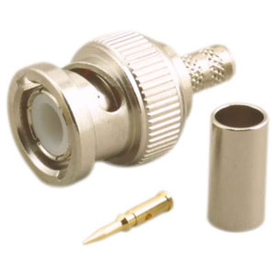
Coax Connector
3 Piece Connector Assembly
Gerry Crenshaw WD4BIS www.qsl.net/wd4bis

Slide 2
Three Piece Coax Connectors
Advancements in materials and tooling now make the 3 piece connector the preferred connector for many types of coax.
Regardless of the connector type, they all work the same.
Results are consistent and repeatable time after time.
NASA has a requirement of “crimped wherever possible” due to launch “G” forces and out gassing.

Slide 3
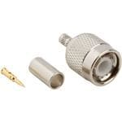
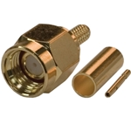
The Connector
Regardless of the connector type, the assembly typically consists of three parts
The Center Pin
The Crimping Ferrule
Connector Body

Slide 4
Connector Types
Connectors types available include:
BNC
TNC
Type N
SMA
UHF/PL259
Mini UHF
FME
Vendor proprietary (Such as Erricson, Hirose)

Slide 5
Coax Types
The connectors are cable specific. This has to do with the dimensions of the cable, center conductor and dialectic.
They are available for coax types:
RG6
RG8X
RG58A (solid center) RG58AU (stranded center)
RG59
RG174
Type 734A/735
LMR

Slide 6
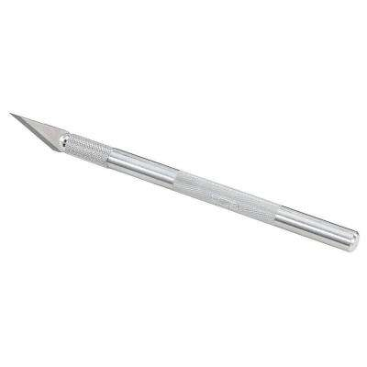
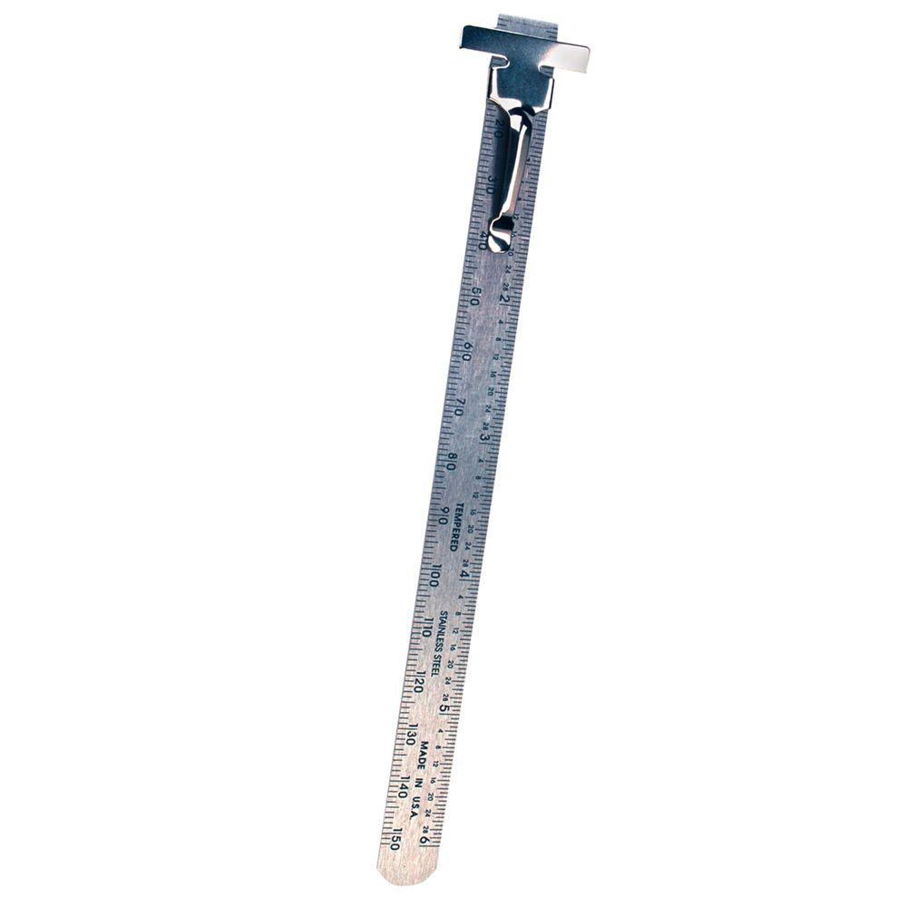
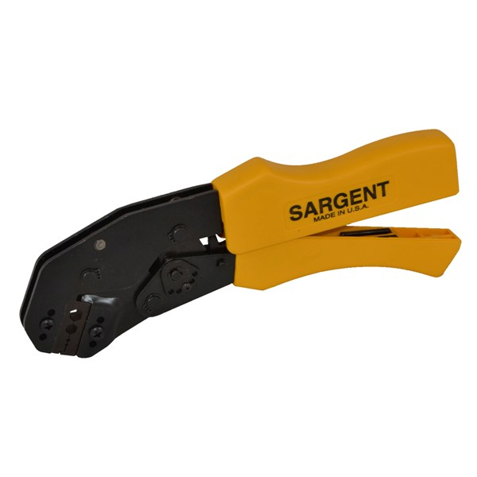
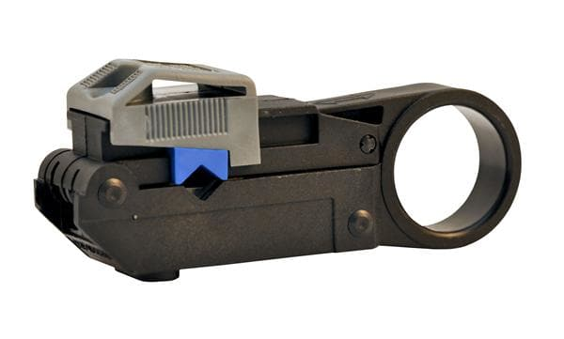
Tooling
You will need
Crimper
Coax Strip tool or…..
Knife and ruler
Scissors to trim stray strands

Slide 7
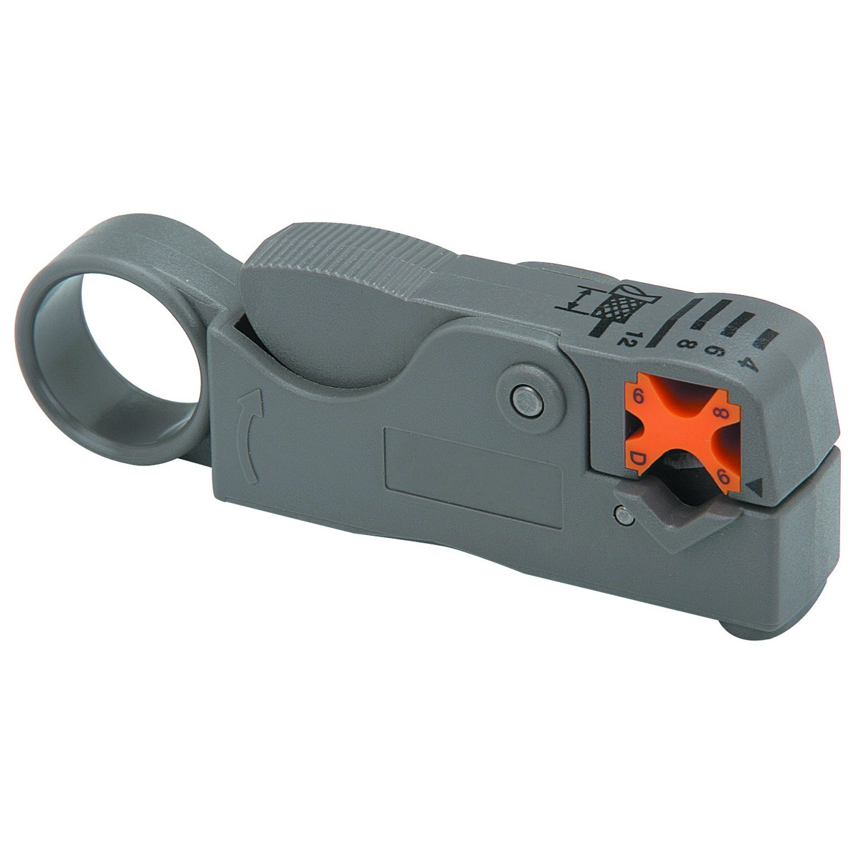
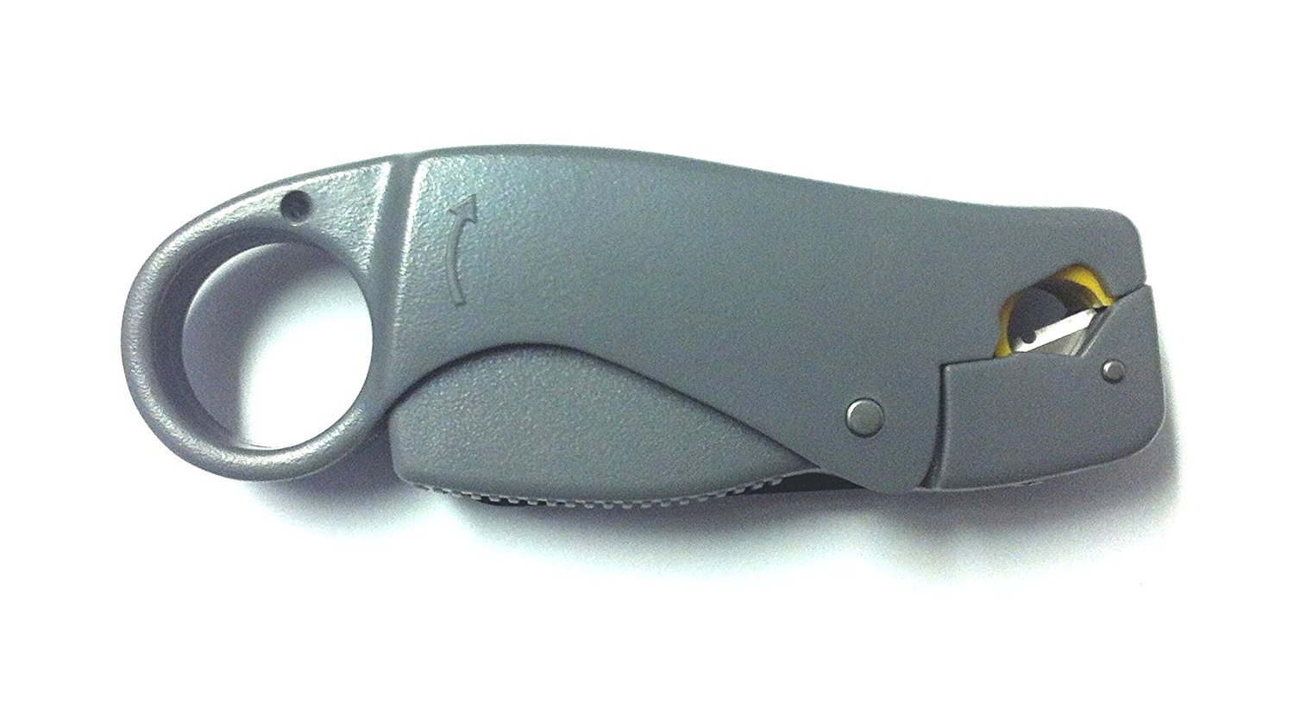
Tooling, Coax Strip tool
A coax strip tool listed as 2 Level, makes 2 cuts.
A coax strip tool listed as 3 Level, makes 3 cuts.
The tools are usually specified for per coax type.
  RG58, RG59, RG8, RG213, etc.
The depth of the cuts may have to be adjusted by the included hex wrench, or a fine screwdriver.
The more expensive tools have various “V” groves for different coax types and depths and replaceable blades.

Slide 8
Cable Preparation
Slide the crimping ferrule on coax

Slide 9
Cable Preparation
Make three cuts to expose the individual elements.

Slide 10
Assembly
Trim center conductor and slide on center pin.
Crimp

Slide 11
Assembly
Insert pin into Connector Body. Push
Listen or feel for the click that says its seated.

Slide 12
Assembly
Slide Crimping ferrule down coax until it bumps the body.
Crimp

Slide 13
Workshop
Time permitting, we will connectorize some coax.

