Slide 1
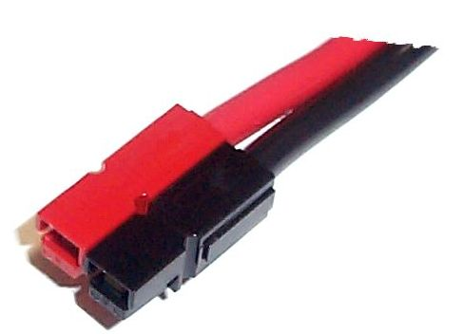
Anderson Power Pole Connectors By Gerry Crenshaw WD4BIS

Slide 2
Why the Power Pole Connector?
As radio/solid state technology has matured, the power outputs on mobile radios have increased from the 10 to 20 watt range to 50 or more watts.
The need for a larger more robust, higher amperage DC power connector became apparent.
The Power Pole connector has been adopted by many Amateur radio, RACES and ARES groups as the standard for DC connections for Radios, Power Supplies, Batteries, and DC Distributors.
Recommended by the American Radio Relay League (ARRL) and the Radio Society of Great Britain (RSGB).

Slide 3
Why the Power Pole Connector?
Currently the standard for Dallas Area RACES organizations.
Replaced the Molex Connector locally in 2004
Scalable, contacts available in 15 Amp, 30 Amp and 45 Amp sizes.
Stackable
Gender Neutral, no pin and socket orientation.

Slide 4
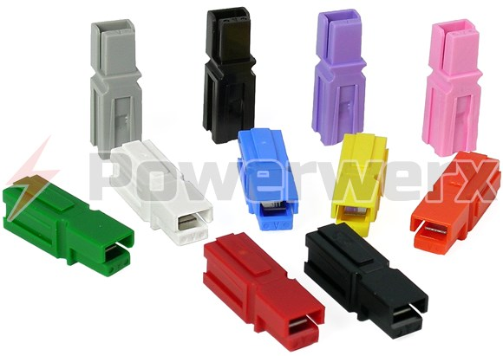
The Housing
The PP15/45 housing used by the amateur radio community will accept 15, 30, or 45 Amp contacts.
Color coded shell with a locking spring

Slide 5
The Housing
Housings are interconnected by a Dovetail joint
Always slide the joints together.
DO NOT try to snap the dovetails together.
Red Housing for +12-13.8 volts
Black Housing for Ground

Slide 6
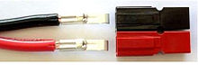
The Housing
The housing has a wire side and a contact side.
When dovetailing together.
Red contact side on the right.
Use the mnemonic R&R
Black contact side on the left.
Wire Side
Contact Side

Slide 7
To Roll Pin, or not to Roll Pin
Many vendors provide a roll pin to bond the housings together.
Use if desired, but a small drop of super glue in the center hole works as well.
Reports of the roll pin working out and causing problems should not be ignored. Murphy is still among us.
Some vendors now provide sonic sealed pairs in the correct orientation.

Slide 8
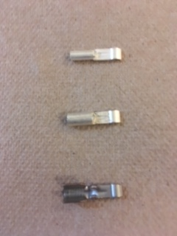
The Contacts
Contacts are silver plated. (They do tarnish.)
The only difference between the contacts is the size of the wire receiving barrel.
15 Amp Contacts
Recommended for for 16-18 AWG wire.
30 Amp Contacts
Recommended for 14-12 AWG wire
45 Amp Contacts
Recommended for 10 AWG Wire

Slide 9
The Tooling
You will need
Soldering Iron and solder or…
Crimping tool
Wire stripper
Needle Nose Pliers
Jewelers Screwdriver if you make a mistake and need to depress the locking spring.

Slide 10
Crimpers
Works Ok, Kline or DeWalt Crimper from Home Depot/Lowes.
Works Better, TRIcrimp tool from Powerwerx.

Slide 11
Putting it all together
Strip wire about a 1/4 to 5/16” (.25 to .3125”).
Twist end on stranded wire to get rid of strays strands.
Insert wire into receiving barrel .
Crimp or solder wire.
Insert crimped or soldered contact into housing. Listen or feel for the click that says the contact locked on the spring.
Inspect, is the Red wire going into the Red housing? Black wire to Black housing?

Slide 12
We have contact!

Slide 13
Houston, we have a problem

Slide 14
Houston, we have a problem

Slide 15
The Cost
About $1.00 per pair of housings and a pair of contacts.
Many vendors sell kits of 10 or more connectors in a specific amperage.
They run about $11.00 for the kit of 10.
Or kits of multiple amperage contacts and housings.
Start with the 30 amp kits. They are most useful generally.

Slide 16
Other Housing Color Codes
Green, widely used for earth, generator or frame ground.
Orange, widely used for 24 volt systems including Telecom equipment and photocell charging systems.
Blue or White , widely used for 5 volt systems such as USB power.

Slide 17
Vendors
Amazon
Powerwerx (www.powerwerx.com)
West Mountain Radio (www.westmountainradio.com)
RF Parts (https://www.rfparts.com)
Ebay (www.ebay.com)
Use with caution. A few years ago a few of APP’s patents expired and knock offs were being offered that were at best marginal.
Google Search, new vendors show up all the time now.

Slide 18
What If
Its late Saturday afternoon.
UPS just delivered your new dream mobile radio from (insert favorite vendor here).
You just cant wait to get it on the air.
OMG I don’t have a spare Anderson power pole pair in the house.
wd4bis@arrl.net or call 972 475 9664 (leave message due to outrageous telemarketing)

Slide 19
Workshop
Time permitting, lets make a Anderson Power Pole cable.

