Slide 1
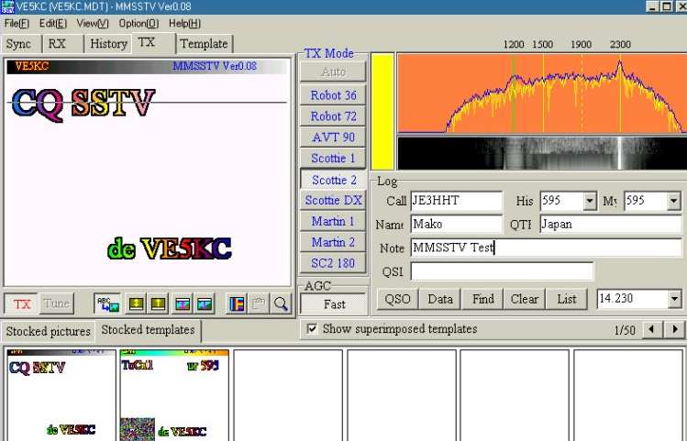
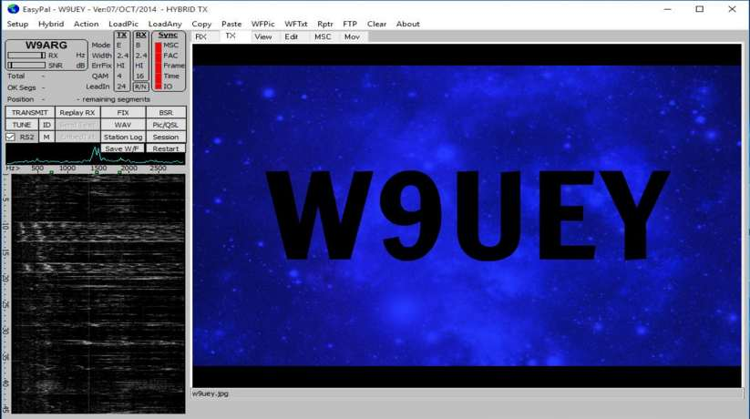
Slow Scan Television SSTV
MMSSTV
EasyPal DRM
WAØKKE - AGØH
Stillwater Amateur Radio Association

Slide 2
Topics of Discussion
History of SSTV
What Equipment is Needed?
Slow Scan vs Fast Scan
Some favorite Circuits.
How Much Does it Cost?
What Kind of Images are Sent?
Where do I look for SSTV Signals?
Why SSTV?
Etiquette
Resources
Demo Time

Slide 3
History of SSTV
Amateur SSTV has been around since 1957.
SSTV started out with surplus radar display tubes with very long persistence ("P7") phosphors. This allowed an image to be painted on the screen over a period of a few seconds.
Flying Spot scanners Were used to “look at pictures” and send signals to Tape Recorders.
Pictures were stored on tape recorders and on Polaroid pictures.

Slide 4
History of SSTV
1981: First combined high-resolution color sstv and fax scanconverter SC-1. This unique system did not only allow to easily generate live sstv pictures with any standard black&white camera but also allowed reception of high resolution fax and wefax images from polar orbiting and geostationary weather satellites and to convert fax to sstv and vice versa.

Slide 5
History of SSTV
1986: High resolution color sstv & fax scanconverter SC-2, allowed higher than tv-quality images (512 pixels per line) to be transmitted via ham radio. Became a difficult to reach standard for all software developers.
1993: SC-3 SSTV & FAX-PC-Scanconverter with DK7BO-DOS-Software.

Slide 6
History of SSTV
1995: First true Windows SSTV-Program "Charly" developed by DJ6PS for the SC-3 PC-Scanconverter.
1997: SC-4 SSTV-PC-Scanconverter designed by DL2RZ with fully multitasking Windows 95/98 Software "Charly 4.0" written by DJ6PS
2002: Version 1.06 of MMSSTV by Makoto Mori JE3HHT, First program utilizing a PC Sound Card

Slide 7
Slow Scan vs Fast Scan
Slow scan is sending an audio signal with the information embedded. Similar to a FAX.
Fast scan is a wide bandwidth rf signal (Wider than the 2 Meter band) similar to broadcast TV.
We will be talking about Slow Scan TV

Slide 8
What is Slow Scan Television?
A means to transmit & receive still photos on HF, VHF and UHF bands
There are two methods of transmission:
Analog (MMSSTV)
50 Hz (Can be used in the CW bands & 30 meters)
3000 Hz (Can only be used in the phone bands)
Digital (EasyPal DRM)
3000 Hz (Can only be used in the phone bands)

Slide 9
What Equipment Do I Need?
Transceiver w/antenna
Capable of SSB or FM transmission
Computer
Microsoft, Apple or Linux OS
Access to internet not mandatory but….
Interface
Routes Audio & PTT signals between computer and transceiver

Slide 10
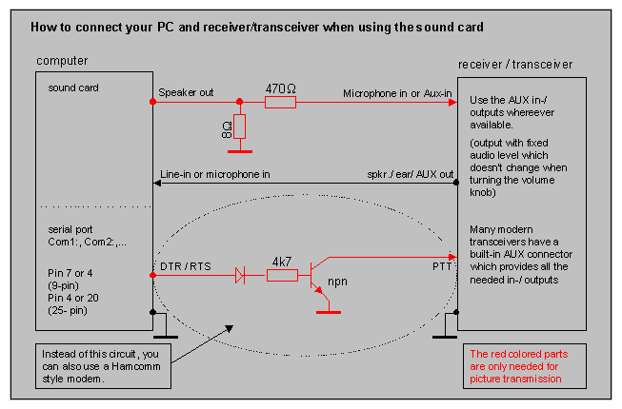
All You Need to get Started

Slide 11
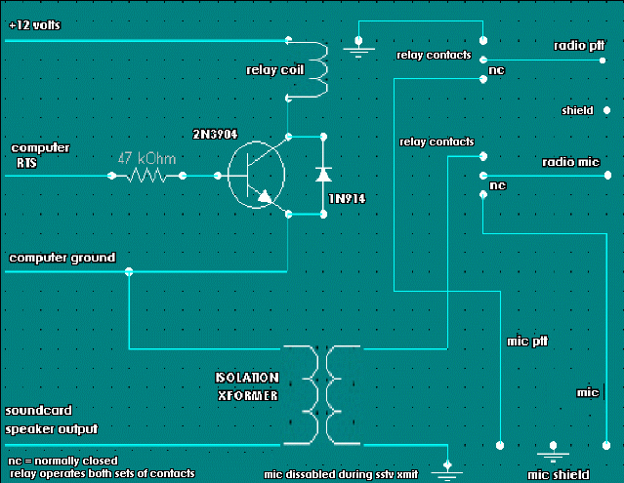
Another Circuit

Slide 12
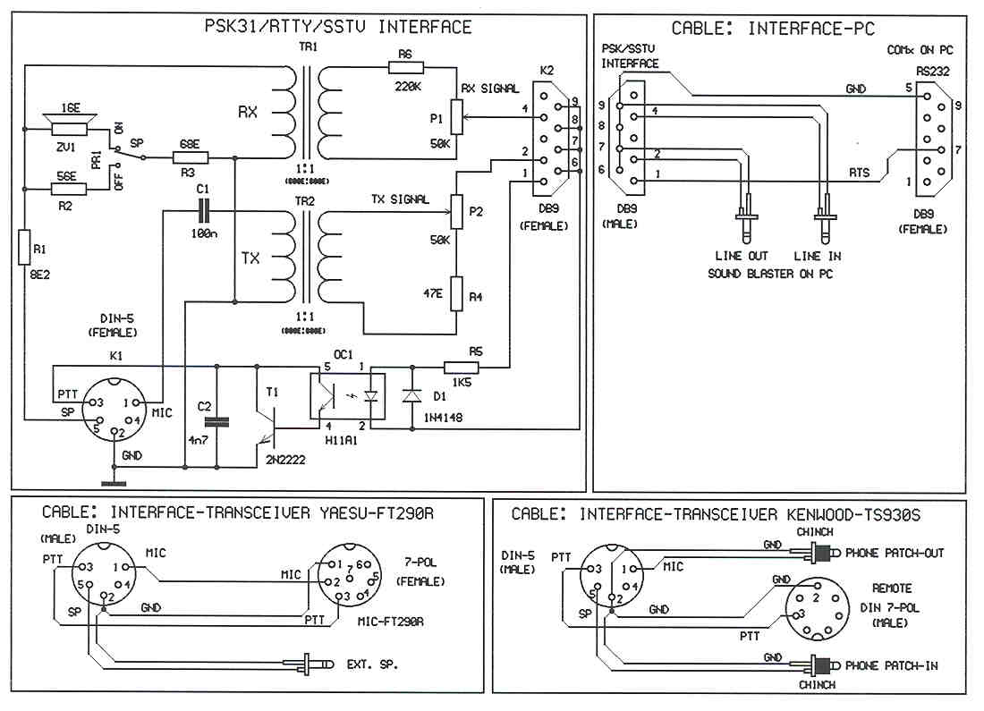
And Another…

Slide 13
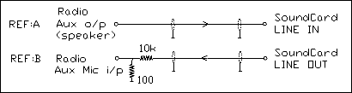
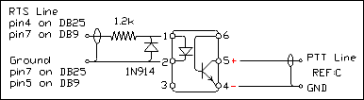
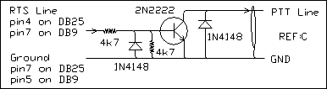
Additional Circuits

Slide 14
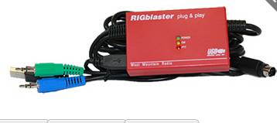
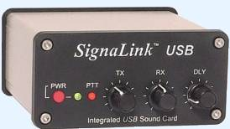
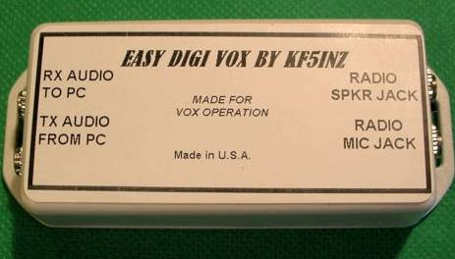
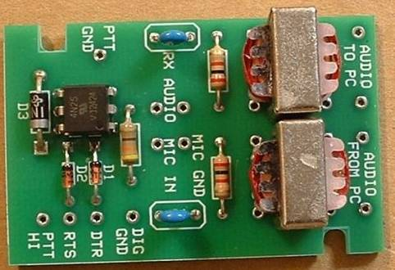
Some Interface Types
Rigblaster - $119.95
SignaLink - $109.00
Easy Digi Vox - $36.95
Easy Digi Card - $15.95

Slide 15

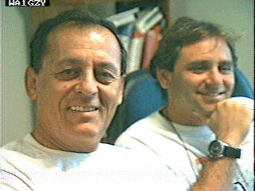
What Kind of Pictures are Sent Today?

Slide 16
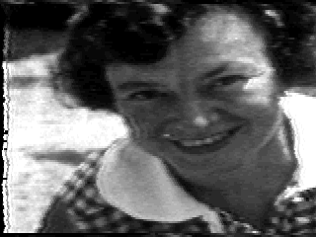
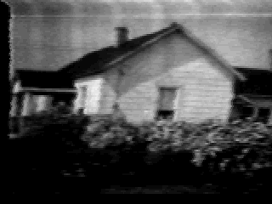
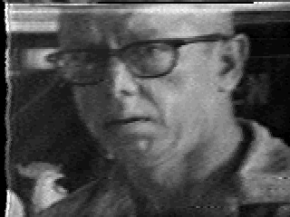
Pictures From the Past

Slide 17
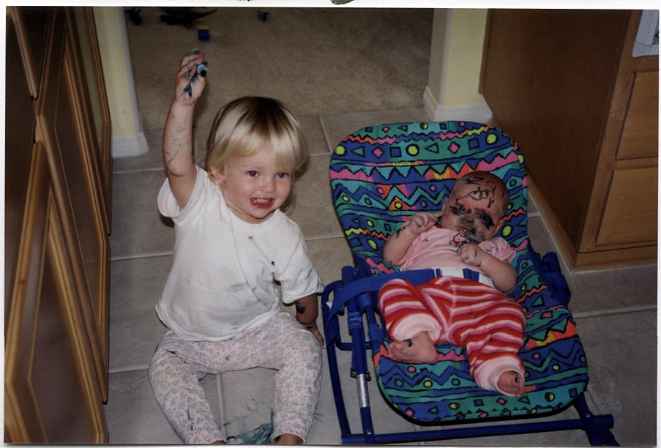
What Not to Send

Slide 18


What Kind of Pictures are Sent Today?

Slide 19
What Frequencies?
3.845
3.857
7.171
14.230
14.233 (Mainly used for Digital SSTV)
21.340
28.680
145.5 MHz

Slide 20
What This All Means
SSTV is a way of SEEING who you are talking to.
One of the many MODES of Amateur Radio.
Anyone can get into it.

Slide 21
What We Need to Do
Get MORE Folks on SSTV.
Start a Slow Scan Net?
Get (OXB) Dave to Take More Pictures of Shacks.

Slide 22
Etiquette
VERY IMPORTANT: Before starting to TX a picture on a frequency, please ask in PHONE "Is this frequency in use for SSTV ??" Never transmit if you hear any other signals !
SSTV is a lot more than "TX pictures". Use your mic between pictures ! Give comments about the RX/TX pictures ! Ask if the station is ready for your next picture ! When you want to answer a CQ picture, first ask the CQ'ing station in PHONE if he's ready for your picture ! This will avoid a lot of doubles and QRM !!!!!
Never BREAK INTO a SSTV QSO by sending a picture ! Again BREAK IN in PHONE !!! Transmitting a "QRZ ?? QRZ ??" Picture is also not the right way to get a contact if there is QRM. Try a PHONE contact !

Slide 23
Etiquette
28.680, 21.340 and 14.230 are calling frequencies for analog (MMSSTV). Try to QSY to a clear spot when you want to make a QSO with another station. The chance your QSO will be disturbed by a CQ picture is a lot less.
20 meters is really overcrowded (and not only with SSTV!). Try the higher bands. 10 meters for example has a sea of (unused !!) space. Send a CQ picture on a "dead" band. You will be surprised at the answering station !! And mostly QRM free! (SSTV gets through when voice doesn't).
Try to be original in your pictures ! Station related pictures (shack, antennas, QTH, area, family etc) make SSTV really attractive ! Please don't transmit pictures containing PORNO, politics, commercials etc.

Slide 24
Etiquette
Very important: Use the suggested SSTV frequencies with 3Kc spacing !!!
Here are the suggested SSTV frequencies :
10 Meters : 28.673 28.677 28.680=calling frequency 28.683, 28.686, 28.690=K3ASI repeater 28.700=ON4VRB repeater.
15 Meters : 21.334, 21.337, 21.340=calling frequency 21.343, 21.346 Avoid SSTV around 21.350 because there is a Phone DX Net there !
20 Meters : 14.230=calling frequency 14.233 14.236 14.239 Avoid SSTV on 14.227 because there is a Phone DX Net there!
80% of all SSTV traffic is done on those frequencies so please don't transmit SSTV pictures BETWEEN those suggested frequencies, it will create QRM!!! 3Kc spacing is really a must for not interfering with nearby stations !!

Slide 25
Etiquette
Don't hesitate to help (and sometimes even blame) stations who are not using the right operating practices.
And think about this; everybody makes mistakes.

Slide 26
EASY PAL DRM SSTV
What is it?
EasyPal is a piece of software by Erik, VK4AES (SK) that uses DRM encoding to send a file
‘DRM’ stands for ‘Digital Radio Mondiale’
‘Mondiale’ is Italian and means Worldwide in French
a newer digital mode used by broadcasters.
‘PAL’ is European standard that corresponds to our NTSC video standard
EasyPal uses OFDM modulation which results in a 2.5 Khz bandwidth
A large number of closely spaced orthogonal sub-carrier signals (4-64)
Images are disassembled pixel by pixel and sent as a digital stream

Slide 27
LIVE DEMO OF MMSSTV

Slide 28
MMSSTV Resources
MMSSTV by JE3HHT
sstv.ccome.at/mmsstv.html
G0HWC-MMSSTV & EasyPal
g0hwc.com
WA0KKE Website
www.qsl.net/wa0kke

Slide 29
EASY PAL DRM SSTV
All types of files and pictures can be sent
Jpeg, Text, XLS, PDF
Files or pictures can be sent in two ways
Station to station
Info sent via RF on HF or VHF bands
Hybrid Assisted
Only station header with call sign and FTP address is sent
File information is sent over the Internet to a server
Receive station automatically grabs the file from the server and displays it on the screen
Advantage over Analog SSTV
No distortion in a received picture or file
“Either you get the complete picture or you don’t.”

Slide 30
Where Do I get EasyPal?
Download EasyPal Ver. 07 Oct 2014
www.g0hwc.com
This site provides all of the info you need
www.vk2evl.com
www.kc1cs.com/

Slide 31
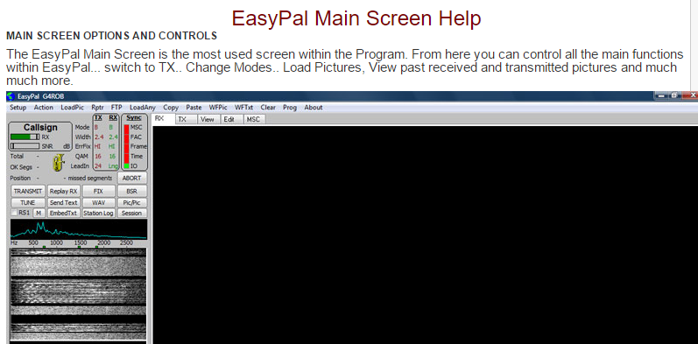

Slide 32
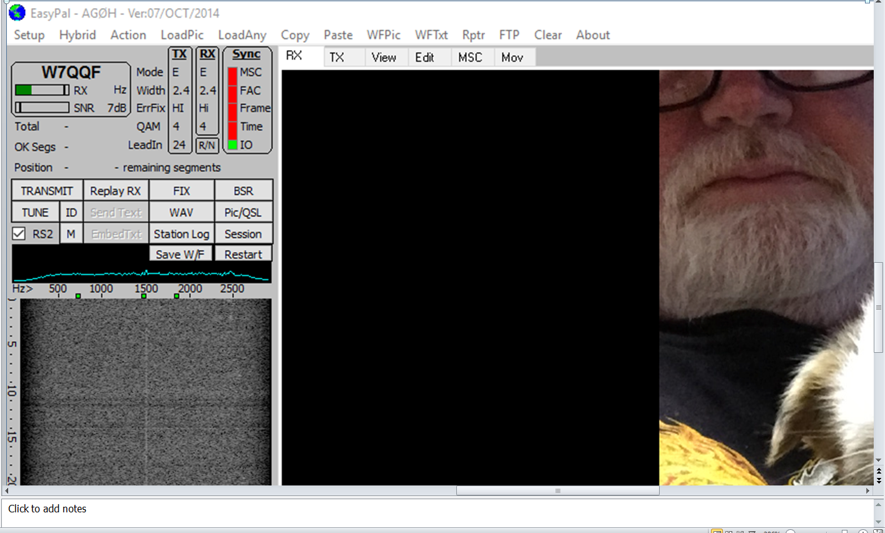
Easy Pal Main Screen

Slide 33
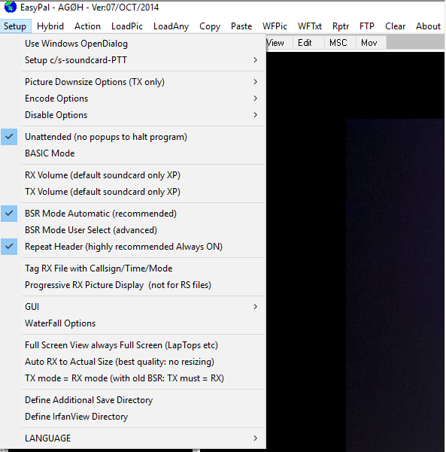
EasyPal SSTV Initial Setup
1. Leave these checked

Slide 34
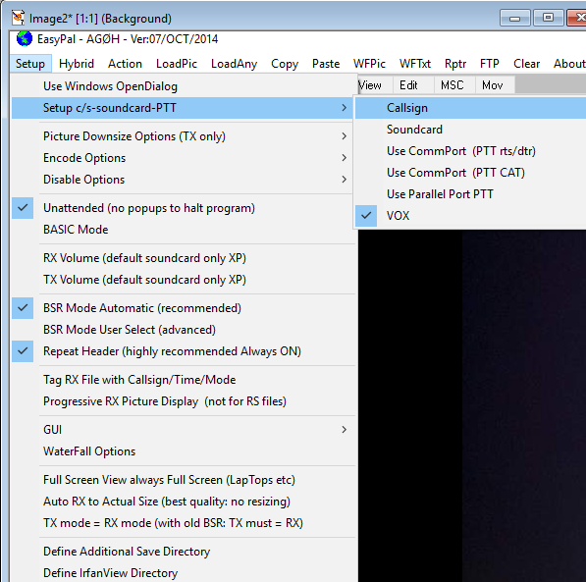
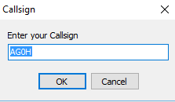
EasyPal SSTV Initial Setup
Click Setup c/s and select ‘Callsign’
Enter your call sign in box and click ok.

Slide 35
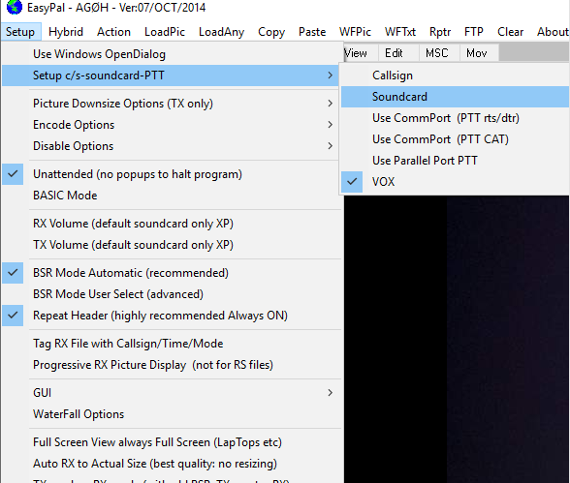
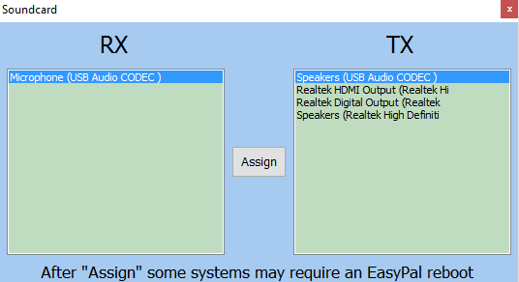
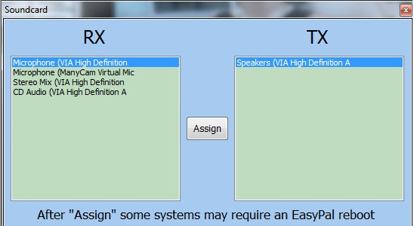
EasyPal SSTV Initial Setup
Click on Setup then ‘Soundcard’
Select RX and TX devices
Click ‘Assign’
Select PTT or VOX

Slide 36
LIVE DEMO OF EASYPAL

Slide 37
Easy Pal Resources
Easy Pal Setup
http://www.g0hwc.com/easypal_setup_help.html
DIGSSTV Group Help (Yahoo.com)
http://groups.yahoo.com/group/digsstv
WA0KKE Website
www.qsl.net/wa0kke
Digi-Sites Download
www.w3wvg.com

Slide 38
QUESTIONS?

Slide 39
Join us on 3.737 Khz every Wednesday morning at 0900
For the MMSSTV/EASYPAL ‘PJ’ Net.
We think you’ll enjoy rag chewing at it’s best over a great assortment of pictures sent by all who check in.

