Slide 1
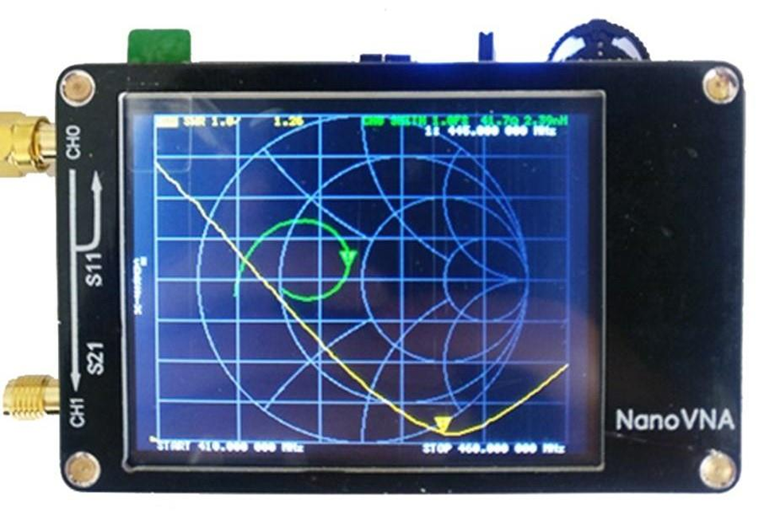
NanoVNA and Ham Radio
Why you want a NanoVNA but may not know it yet!

Slide 2
What is a NanoVNA?
A dual (1-1/2?) port analyzer that can measure SWR, resistance, reactance, cable length, and frequency response. Information is displayed in graphical and numeric formats. Can use software to display and store data on PC.
Notes:
This a portable and inexpensive version of a Vector Network Analyzer. It has two ports, although it can only source RF from one of them.
A NanoVNA can display multiple types of data simultaneously, in a variety of graphical formats.

Slide 3
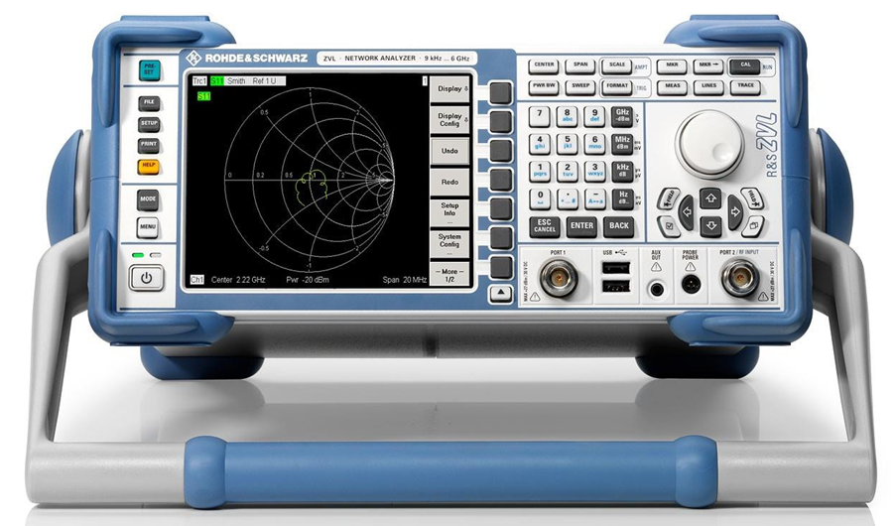
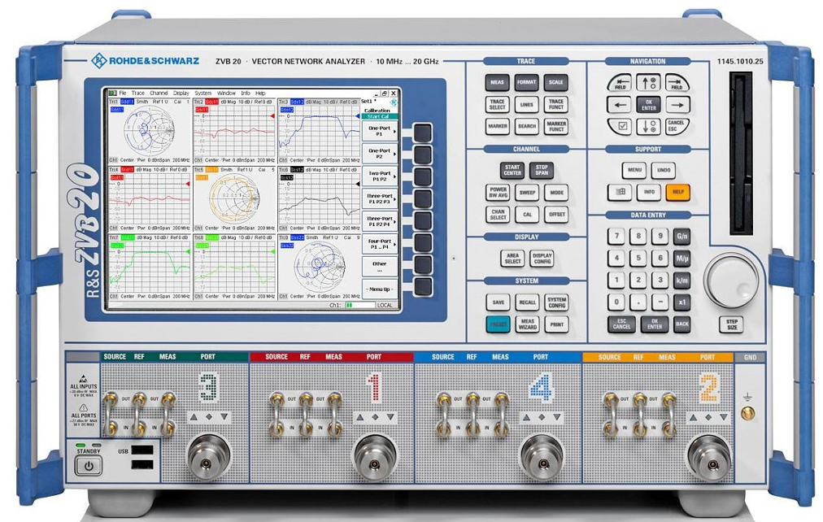
Professional Vector Network Analyzers
A professional Vector Network Analyzer can have much wider operating bandwidth and more bi-directional channels. They are much more expensive than a NanoVNA.
These are a two-channel portable that operates from 9 KHz to 6 GHz and a four-channel model that operates from 10 MHz to 20 GHz. Some models operate up to 40 GHz and have up to 8 active channels.

Slide 4
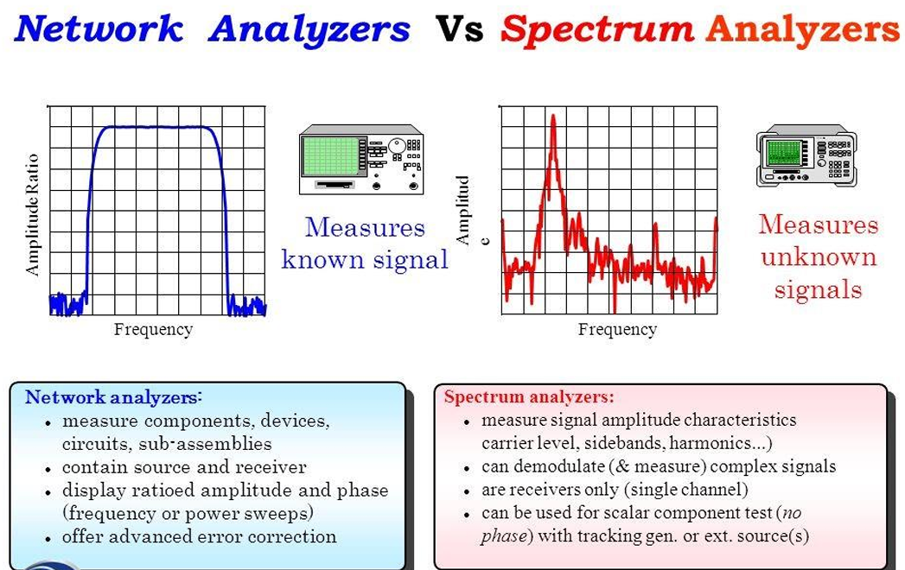
A Nano VNA should not be confused with a TinySA!

Slide 5
Common uses for a NanoVNA
Antenna testing and tuning
Standing Wave Ratio measurements
Resonance Measurements
Complex Impedance Measurements
Resistance
Reactance
Cable testing and fault isolation
Length Measurements
Distance to impedance changes
Distance to faults.
Testing tuned circuits
Filter bandpass
Trap resonance
Analyze duplexers
Measure Insertion Loss

Slide 6
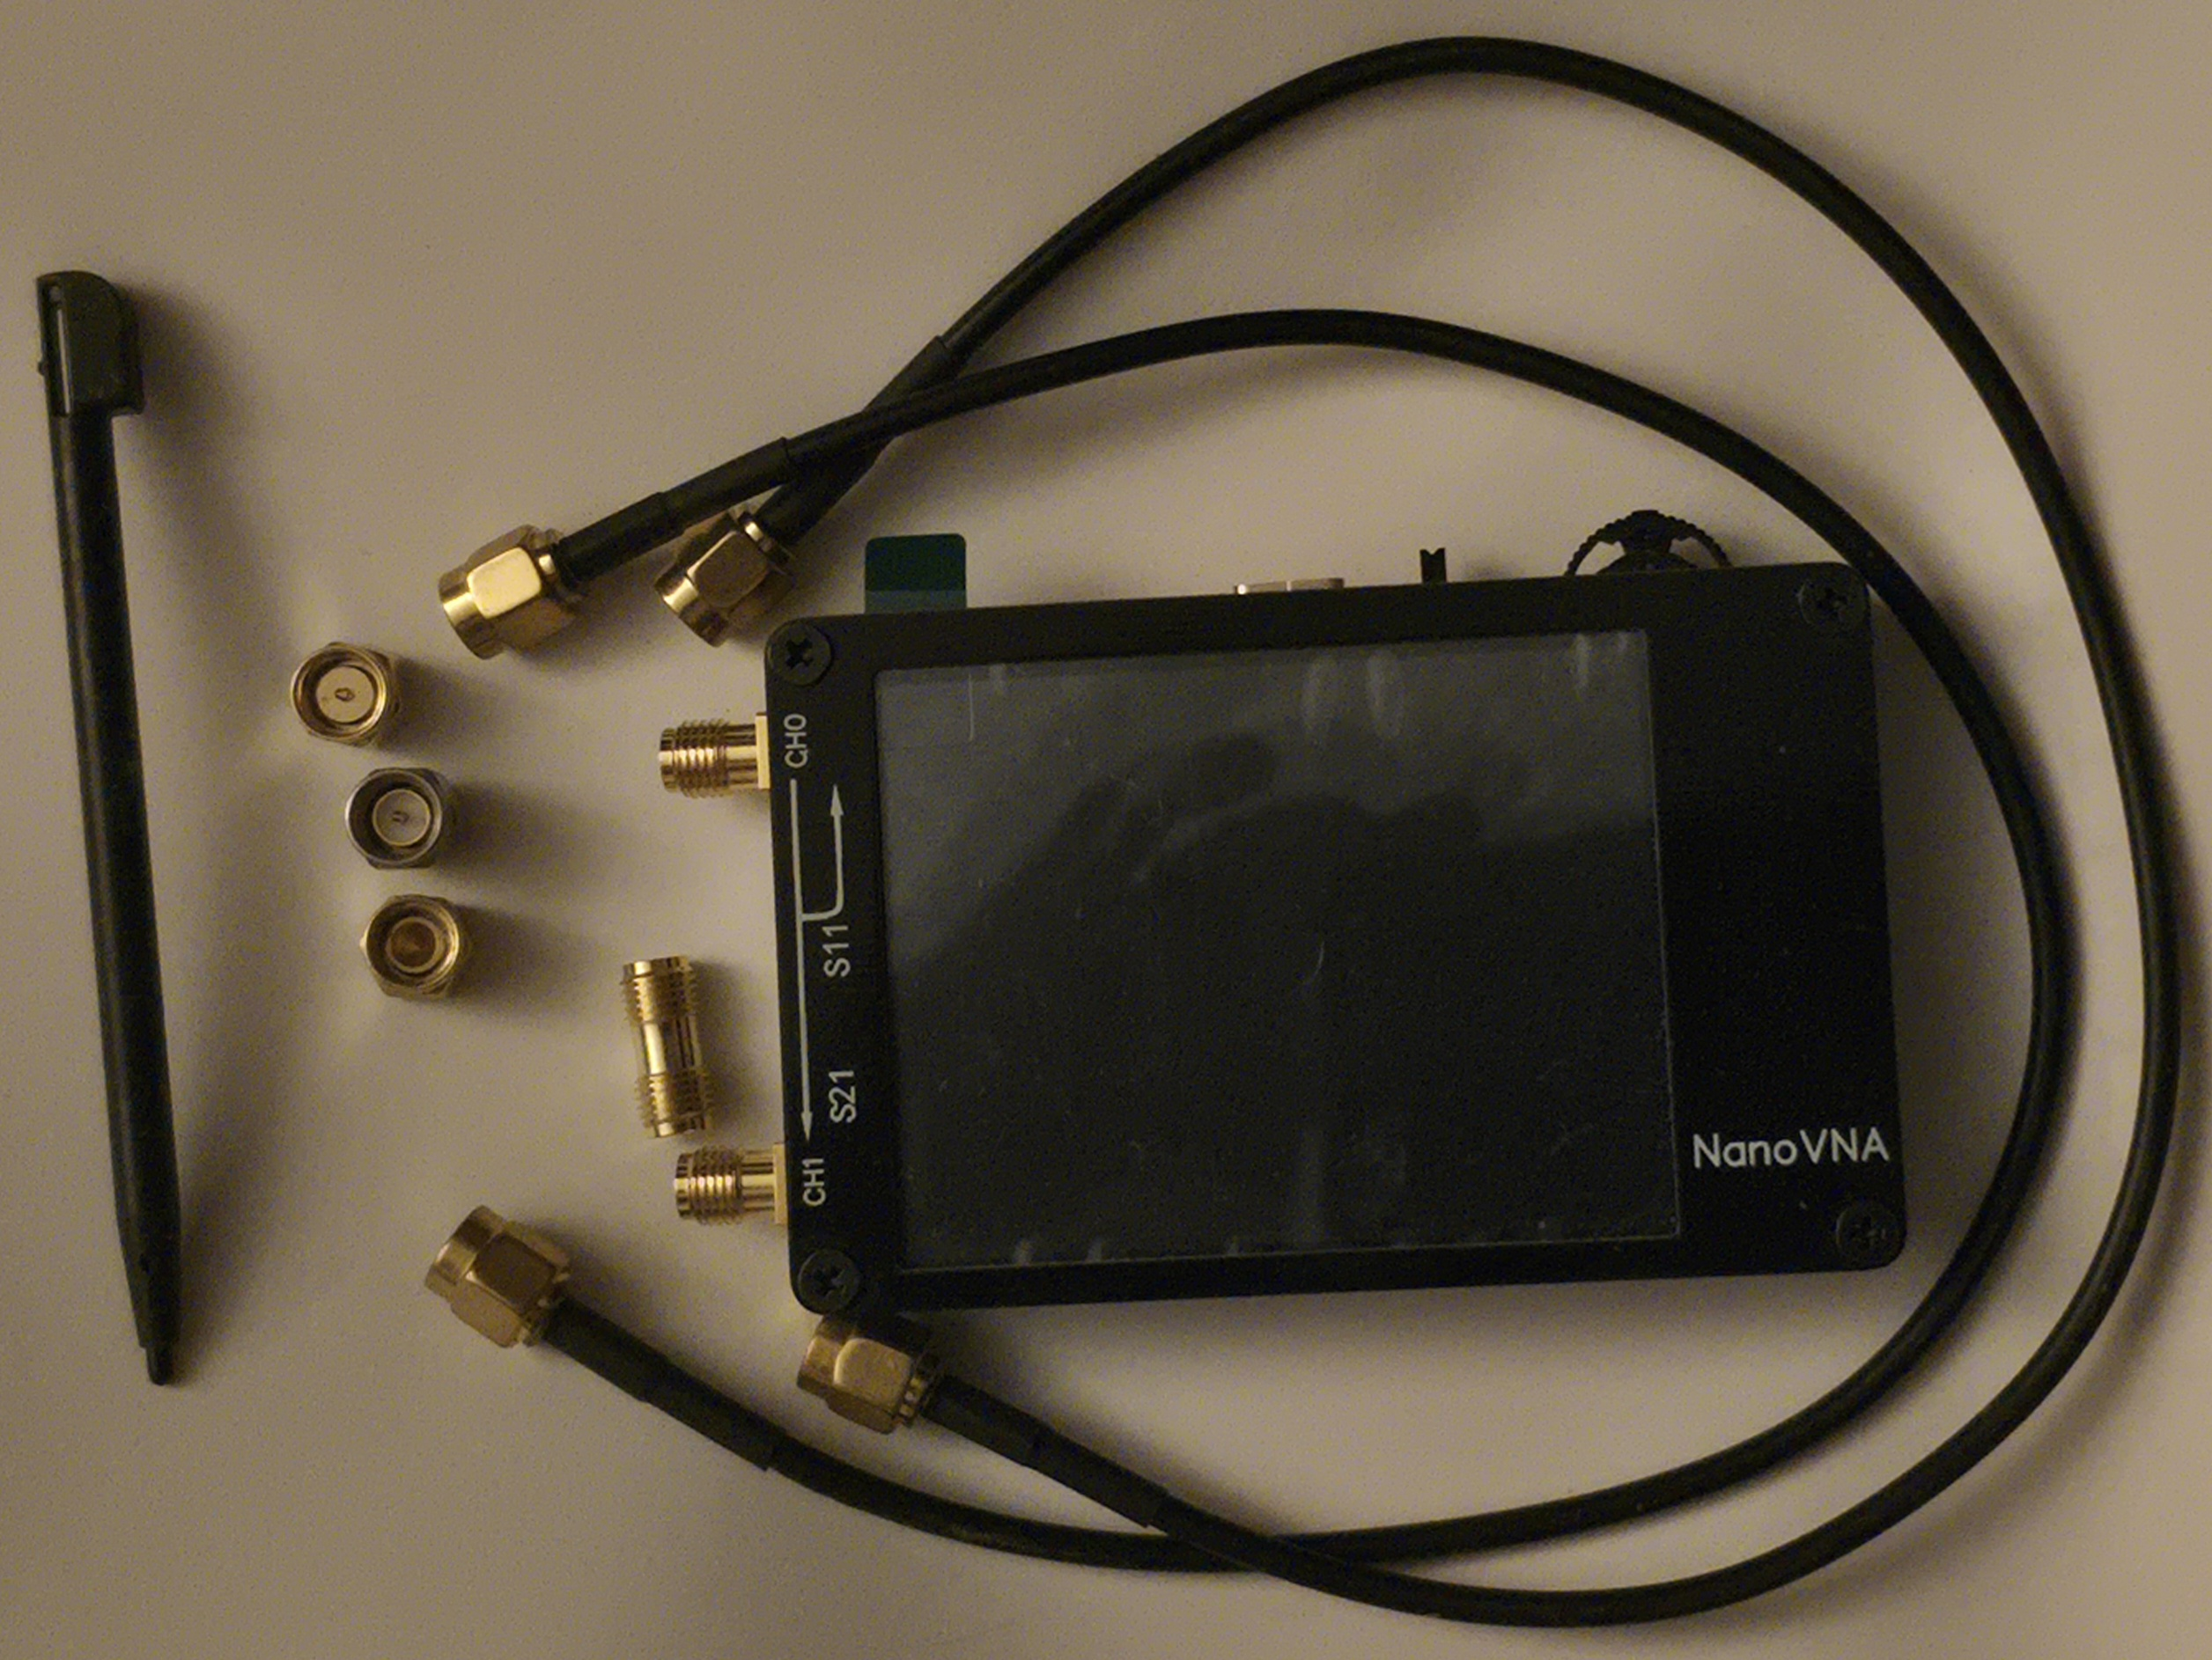
What do we need to use a NanoVNA?
NanoVNA body
SMA 50Ω LOAD
SMA SHORT
SMA OPEN
SMA F to F Barrel Connector
SMA Male to Male cable x 2
Stylus (Optional)
Not included are adapters need to connect to Device Under Test (DUT)

Slide 7
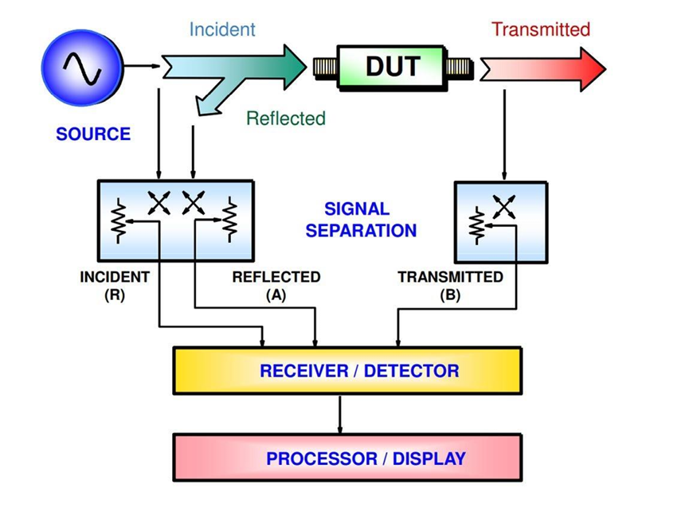
How does a NanoVNA work?
VNA (Vector Network Analyzer) measures the frequency characteristics of reflected power and passing power of an RF Network. NanoVNA measures the following elements:
Input voltage I/Q signal
Reflected voltage I/Q signal
Pass voltage I/Q signal
From here we calculate:
Reflection coefficients S11
Transmission coefficient S21

Slide 8
NanoVNA Output
NanoVNA measures the reflection coefficient and transmission coefficient for 101 points in the frequency band to be measured. It measures the Start Frequency and then steps up 100 times, measuring at each step.
The local frequency of NanoVNA is 50kHz to 300MHz. For higher frequencies, use harmonic mode. The fundamental wave is not attenuated even in harmonic mode.
The usage modes for each frequency are as follows.
Up to 300 MHz: fundamental wave
300MHz to 900MHz: 3rd harmonic
900MHz to 1500MHz: 5th harmonic
Note that there is always a fundamental wave input, especially when checking a dual band antenna. The 2 Meter band is in the fundamental range and the 70 Centimeter band is in the third order harmonic range.
Digital data is signal processed by the MCU.
Notes:
The 101 point limit means we should limit the range of our “sweep” to a specific band or sub-band. We can also set for a single frequency if appropriate.
The fundamental frequency being present can cause false readings on devices like dual-band antennas. You may think you are measuring the 440 band, but have interference from the 2 meter band.

Slide 9
To Prepare for Use
Determine the frequency range to be measured
The NanoVNA measures at 101 points within the range selected
The range should be limited to the relevant band
Determine the type of measurement
SWR, Return Loss, other S11 measurements only require a partial calibration
Insertion loss, filter bandwidth, other S21 measurements require full calibration
Calibrate for the frequency range and type
Set start and stop frequencies, or center frequency and span
Calibrate as needed: Open, Short, Load, Isolation, Through

Slide 10
Calibration
Open Menu
Cal
Reset current calibration state. Select CAL MENU →RESET
Then →CALIBRATE
Connect OPEN standard to CH0 port and execute →OPEN
Connect SHORT standard to CH0 port and execute →SHORT
Connect the LOAD standard to the CH0 port and execute →LOAD
Connect the LOAD standard to CH0 and CH1 ports and execute →ISOLN
(If there is only one load, the CH0 port can be left unconnected)
Connect a cable between the CH0 and CH1 ports, and execute →THRU
Finish calibration and calculate error correction information →DONE
Specify the dataset number (0 to 4) and save.
Menu
Cal
→RESET
→CALIBRATE
→OPEN
→SHORT
→LOAD
→ISOLN
→THRU
→DONE
→SAVE 0

Slide 11
Select Measurement(s)
LOGMAG : Logarithm Magnitude of absolute value of measured value of the Return Loss
PHASE : Phase in the range of -180° to +180°
DELAY : Delay
SMITH : Smith Chart
SWR : Standing Wave Ratio
POLAR : Polar coordinate format
LINEAR : Absolute value of the measured value
REAL : Real number of measured value
IMAG : Imaginary number of measured value
RESISTANCE : Resistance component of the measured impedance
REACTANCE : The reactance component of the measured impedance

Slide 12
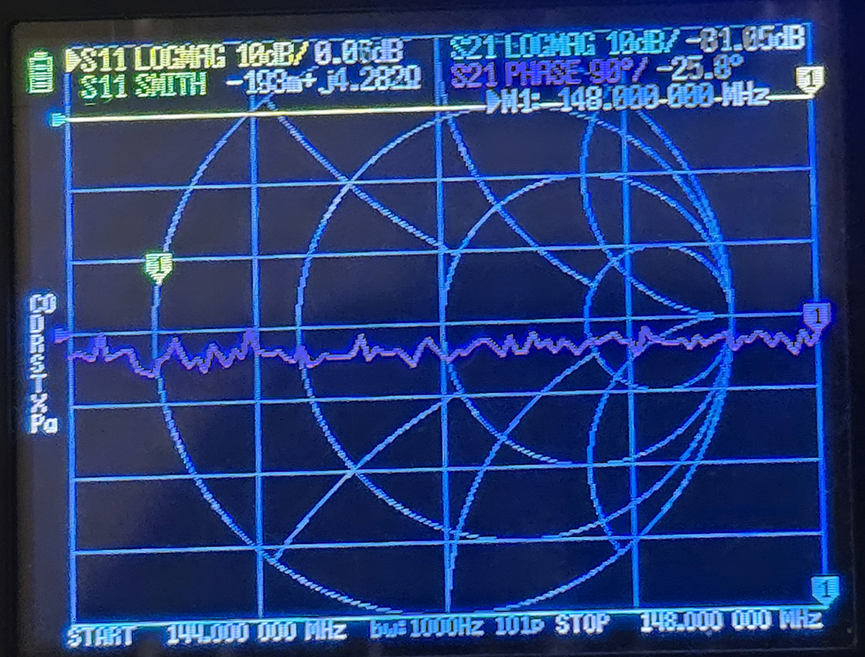
Select Display Trace
Four Traces available, with different colors
Multiple Markers can be displayed and selected
Display shows start and stop frequencies
Display shows calibration information

Slide 13
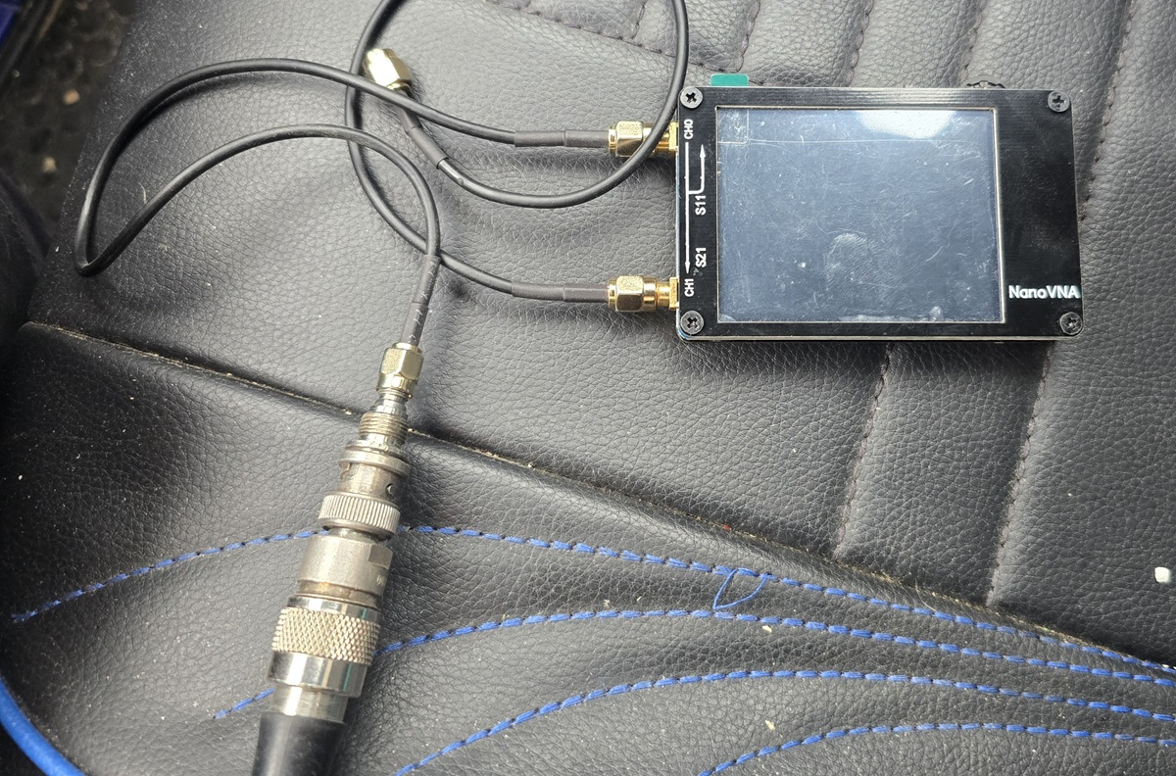
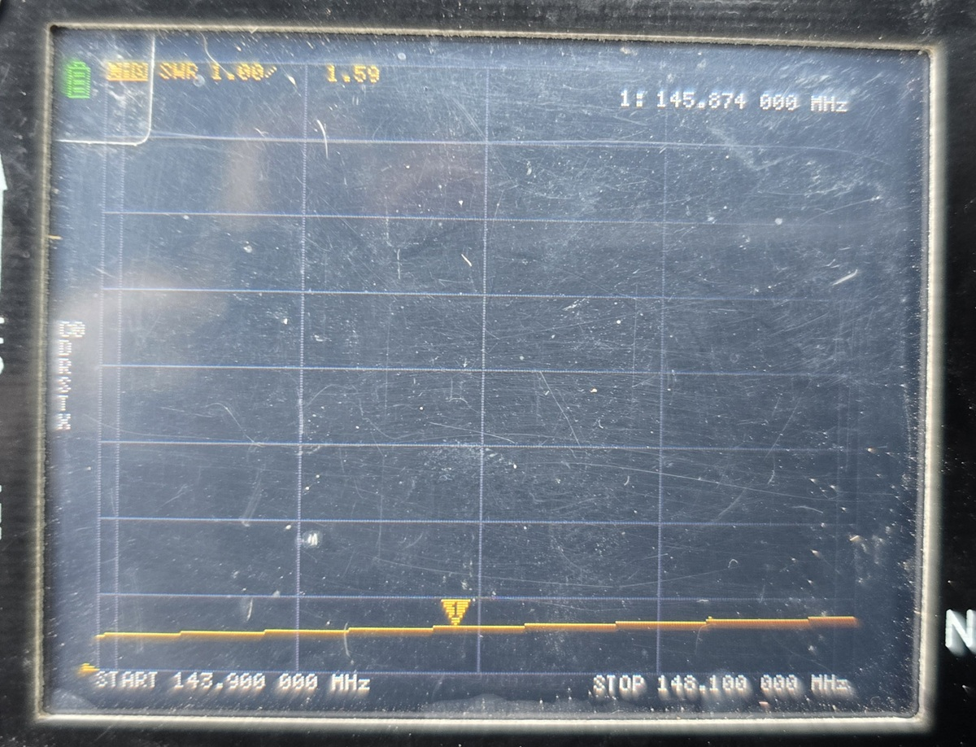
Connect and Measure
Adapt as needed, paying attention to characteristic impedance
Measure!

Slide 14
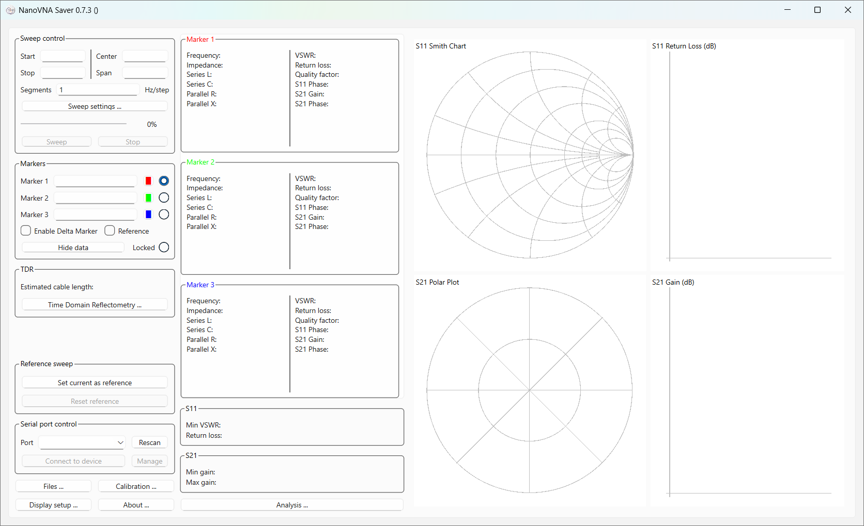
NanoVNA Saver
Windows Software
Interfaces with USB port on NanoVNA
Controls NanoVNA and displays data
Saves data
Can compare current data to saved reference

Slide 15
Summary
NanoVNA is an inexpensive and versatile piece of test equipment
A NanoVNA can make a variety of measurements
Antennas
Filters
Duplexers
Cables
Components
You need to Calibrate your NanoVNA before use
Calibrate for the band/mode to be tested
Calibration can be saved for later use
NanoVNA Saver software allows saving of reference and data files

