Slide 1
Successful SOTA Activations
From Planning to Logging
Stephen Denison, W5SMD
Hamcom 2014
Notes:
Welcome to the Successful SOTA Activations presentation.

Slide 2
Topics
Introduction
Planning
  Timeline
  Identifying Summits
  Equipment
Activating
  Important Rules for Activators
  Spotting
  Logging
Submitting the Log

Slide 3
Introduction

Slide 4
What is SOTA?
SOTA is an award program for amateur radio operators that encourages portable operation in mountainous areas
3 classes of participants
  Activators
  Chasers
  Short Wave Listeners
Participants collect points and earn awards
Notes:
SOTA was started in Europe in 2002. It came to NA in 2012.

Slide 5
Topics
Introduction
Planning
  Timeline
  Identifying Summits
  Equipment
Activating
  Important Rules for Activators
  Spotting
  Logging
Submitting the Log

Slide 6
Planning
He who fails to plan is planning to fail.
-Winston Churchill

Slide 7
Planning Timeline
1 month before activation (or earlier)
  Identify Summit(s) to be activated
  Research Summits, access, necessary equipment
  Plan itinerary
1 week before activation
  Post alerts to NASOTA Yahoo Group, SOTAWatch
  Begin gathering equipment
  Practice setting up equipment in the park or yard
1 day before activation
  Make sure everything is packed for the trip
  Fill up car with gas
  Make sure all batteries are charged
  Get a good night’s sleep!

Slide 8
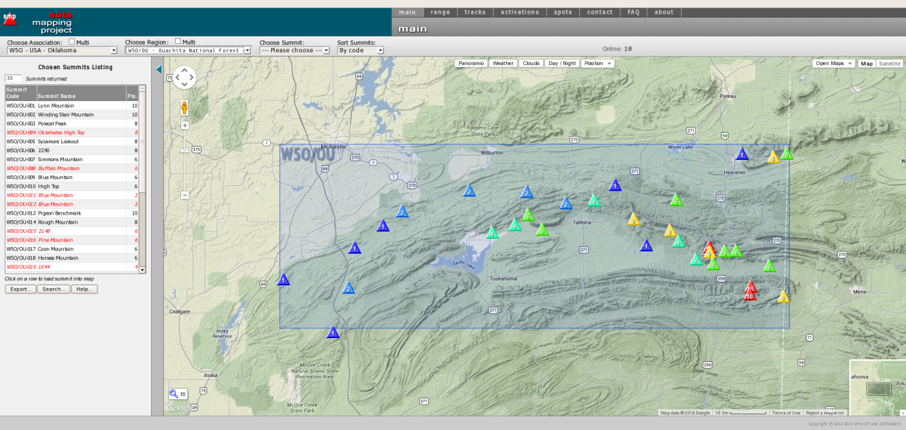
Identifying and Researching Summits
SOTAMaps http://sotamaps.wsstvc.org/
Displays Summits from the SOTA Database.
Displays Point Value for each Summit.

Slide 9
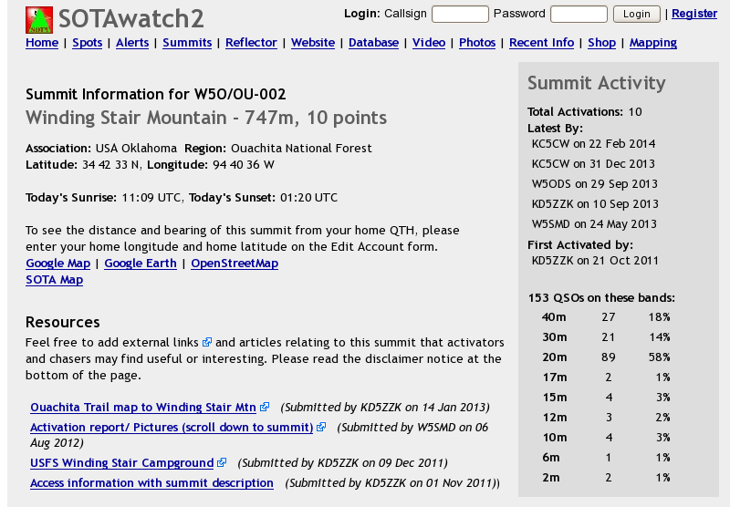
Identifying and Researching Summits
Summit Info on SOTAWatch http://sotawatch.org/summits.php
Displays Latest Activations, GPS Coordinates.
Articles and Links From Previous Activators.

Slide 10
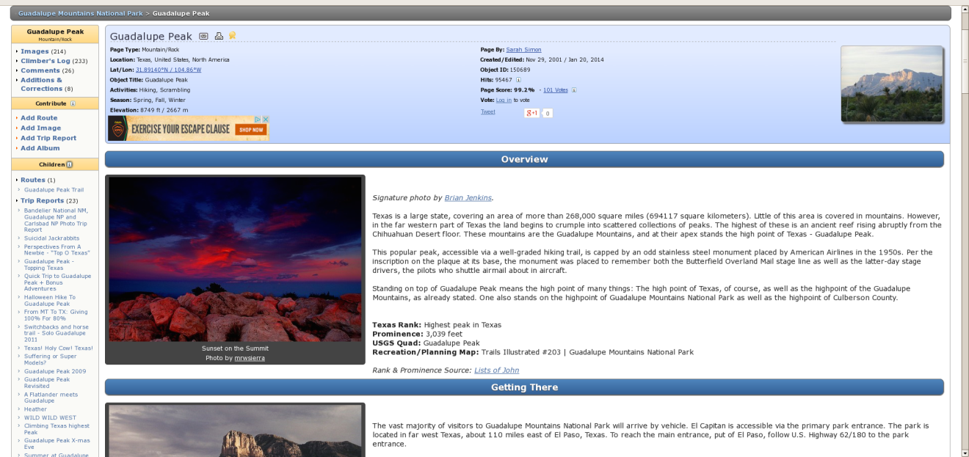
Identifying and Researching Summits
Summit Info on SummitPost http://www.summitpost.org
Information From Other Mountain Climbers.
Includes places to stay, seasons to climb, routes, etc.

Slide 11
Identifying and Researching Summits
Summits on Private Property
  Always Ask Permission
  Use Tax Records available from the county to determine the name and address of the landowner
  Use phone books (print and online) to find a phone number for the landowner
  Explain what you want to do and that you will Leave No Trace
  Remember, you are an ambassador for Ham Radio and SOTA.

Slide 12
Planning an Itinerary
How long does it take to get from point “A” to point “B”?
  Driving (Paved Roads): Check Online Maps
  Driving (Forest Roads): 5 to 10 mph
  Hiking (on trail): 1 to 2 miles per hour in the Mountains
  Hiking (off trail): ¼ to 1 mile per hour
How long will I spend on the summit?
  Include setup time, time spent on the radio and teardown time
  1 ½ to 2 hours is usually adequate
Remember to include time for meals and rest breaks

Slide 13

Planning an Itinerary

Slide 14
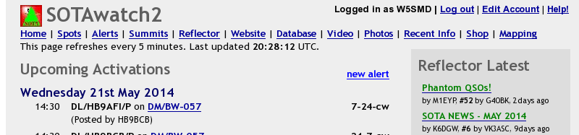
Posting an Alert
Sign in to SOTAWatch
Under “Alerts”, click on “new alert”
Fill out the form. Remember that times are in UTC, and dates follow the international standard (DD/MM/YYYY)
An alert is a “best guess” of what time and frequency you will be on which summit

Slide 15
Equipment
Make sure all of your equipment works
  Do a “dry run” in the park
  Take your pack for a walk to make sure it is loaded correctly and is comfortable
Always have the “10 Essentials”
  Navigation (Map and Compass)
  Sun Protection
  Extra Clothing
  Flashlight
  First Aid Kit
  Fire Starters
  Repair Kit (sewing kit/ duct tape)
  Extra Food
  Extra Water
  Emergency Shelter

Slide 16
Topics
Introduction
Planning
  Timeline
  Identifying Summits
  Equipment
Activating
  Important Rules for Activators
  Spotting
  Logging
Submitting the Log

Slide 17
Activating
Every mountain top is within reach if you just keep climbing. -Barry Finlay

Slide 18
Rule #1: Be Safe
No amount of points is worth risking life and limb
Plan for safety
Dead men don’t brag

Slide 19

Rule #2: Leave No Trace
Leave the area just as you found it
The next person to walk through should not be able to tell you were there.
“Take only pictures, leave only footprints”
For more information: https://lnt.org/

Slide 20
Spotting
Self-Spotting is encouraged in SOTA
Spots can be sent via Texting, Smartphone, or the RBN
Send spots early
  “QRV in 15 minutes. MHz +- QRM”
Spot for every band, mode or frequency change

Slide 21
Spotting via Text Message
Before spotting via text message, register your phone number with Andy MMØFMF (mmØfmf AT hotmail.com)
Message must be formatted correctly:
  $ REF MHz Mode Comments
  $ Inserts your callsign (taken from the callsign used when registering your phone number)
  REF is the Summit Reference. Can be entered with “-” or “ “ (W5O/OU-001 or W5O OU-001)
  MHz is the actual operating frequency in MHz (one decimal point allowed)
  Mode is the operating mode (CW, SSB, FM, AM, Data, Other)
  Comments is 60 characters max
In North America, the phone number to text is 1-530-430-SOTA
www.intermoose.com/SMSBOT-usage.txt

Slide 22
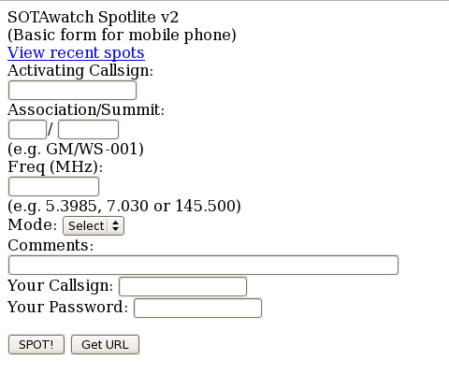
Spotting via Smartphone
http://www.sota.org.uk/Spotlite/spot

Slide 23
Spotting via the Reverse Beacon Network
Only works for CW
Must have an Alert Posted to SOTAWatch
Computers connected to radios all over the world searching for “CQ”
Computers stream information (Callsign, WPM, Signal Strength) to the internet
The RBNGate compares the RBN stream to the Alerts posted on SOTAWatch and will spot an activator from 1 hour before to 3 hours after the time posted in the Alert
If you cancel your activation, make sure to cancel the alert (or don’t call CQ)
http://www.grizzlyguy.tv/rbngate.htm

Slide 24

Logging
Logging can be done by paper or electronic means
The database requires Callsigns, Summit Reference, Time, Date, Band and Mode for each QSO.

Slide 25
Paper Logging
Electronic Logging
Make sure to have enough paper and keep accurate records
Some activators use waterproof logbooks
Carry extra pencils and pens
Enter each QSO into the database one by one or convert to digital log
Device needs to be charged
If the device is damaged, your logbook may be toast
Can upload the entire log to the SOTA Database

Slide 26
Topics
Planning
  Timeline
  Identifying Summits
  Equipment
Activating
  Important Rules for Activators
  Spotting
  Logging
Submitting the Log

Slide 27
Submitting the Log
The Job’s Not Finished Until the Paperwork is Complete.
-Unknown

Slide 28
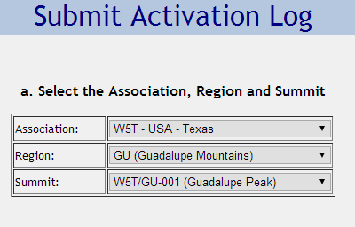
Submitting Single Entries
Login to www.sotadata.org.uk
Select “Submit Log” → ”Submit Activator Entry”
Fill in the appropriate summit information
Fill in QSO data

Slide 29
Uploading a Complete Log
Compile your log as a CSV or TSV format with the following fields:
<V2> <My Callsign><My Summit> <Date> <Time> <Band> <Mode> <His Callsign><His Summit> <Notes or Comments>
Upload to SOTAData using the Submit Log→Import Activator CSV/TSV
You can upload the same log as both an Activator and Chaser log with this format.

Slide 30
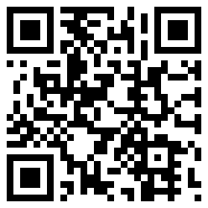
Questions?
www.sota.org.uk
www.sotawatch.org
Download this PowerPoint from
  www.qsl.net/w5smd/SOTA.htm
  or scan the QR code →

