Slide 1
D-STAR InfoCon 2015 at Big Spring TX
Part 3 – Doing More With D-STAR
John Davis WB4QDX
Lloyd Duck W5LND

Slide 2
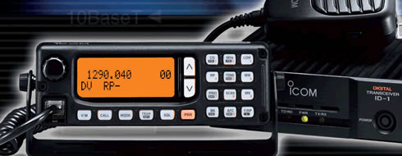
D-STAR’s 1.2 GHz Radio
Icom ID-1
Operates FM Voice or GMSK (D-STAR) modes
D-STAR modes include voice, low speed data (1200 bps) or high speed data (128 kbps)
10W transmit output

Slide 3
ID-1 High Speed Data
Mode
Radio acts as Ethernet wireless bridge
Has RJ-45 Ethernet connector for HS data
Can be used for Internet connectivity through D-STAR repeater with DD module
Can be used to create wireless bridge between two points
When communicating through DD repeater, know assigned IP address (10.x.x.x)

Slide 4
High Speed Data –
DD Mode
Ethernet connection to PC
PC must use assigned IP address assigned at registration (10.x.x.x)
Gateway is 10.0.0.1
Use known DNS addresses
…or the easy way is to insert a router between ID-1 and PC and use DHCP!

Slide 5
Setup With Router
ID-1
Radio
Router
PC
WAN
IP: 10.x.x.x / 255.0.0.0
Gateway: 10.0.0.1
DNS: Use any DNS
PC
Wired or Wi-Fi
DHCP Enabled
Radio Programming
UR: WD4STR
RPT1: WD4STR A
RPT2: WD4STR G
Mode: RPS
LAN
DHCP Enabled
192.168.0.x

Slide 6
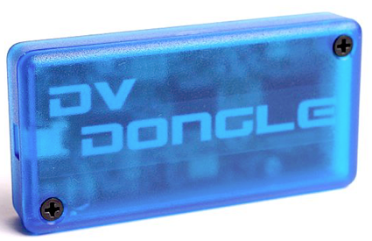
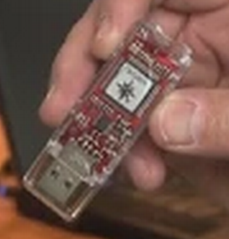
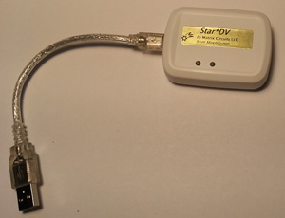
DV Dongles
Different styles available from Internet Labs (DV Dongle), NW Digital (Thumb DV) and MoenComm (Star*DV)
Attaches to USB port on PC
Accesses D-STAR network using sound card in PC connected to Internet
A new Dongle product to be announced in D-STAR Forum today

Slide 7
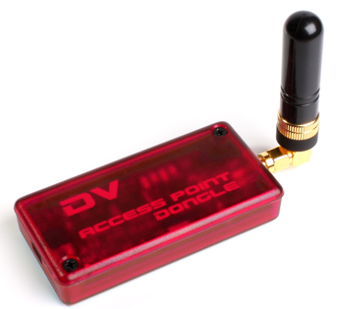
DVAPs
DV Access Point is low power hotspot providing radio access to D-STAR network through PC
Developed by Internet Labs (Robin Cutshaw, AA4RC)
Connects to PC, Raspberry Pi by USB
10mW RF power for 100m range
D-STAR radio uses standard commands for linking
Software on PC, Pi (DVAPtool or DVAPnode)
Internet access on PC, Pi to network

Slide 8
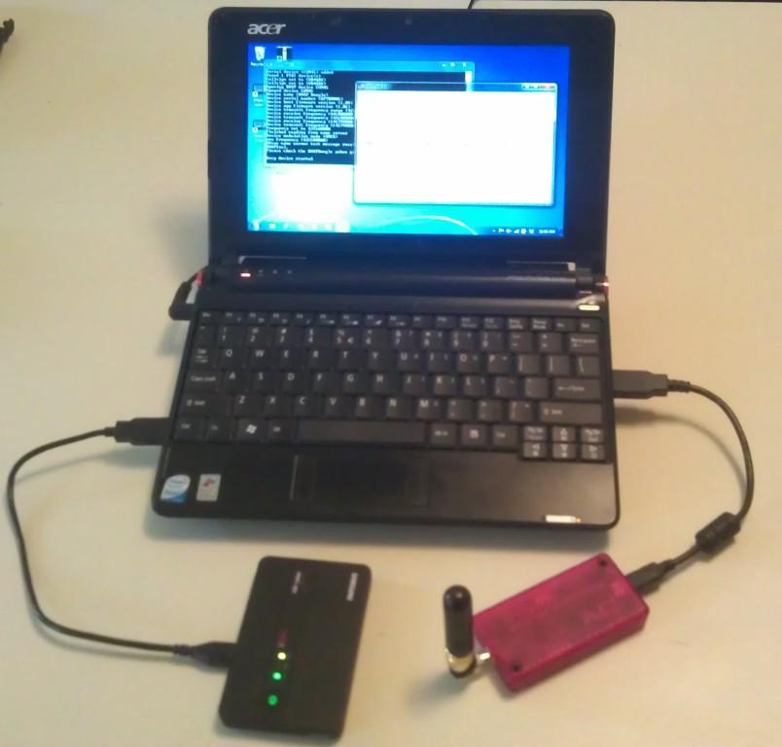
Using a DVAP
Normal connection to DVAP is a PC, Laptop or Netbook (bulky) with Internet connection

Slide 9
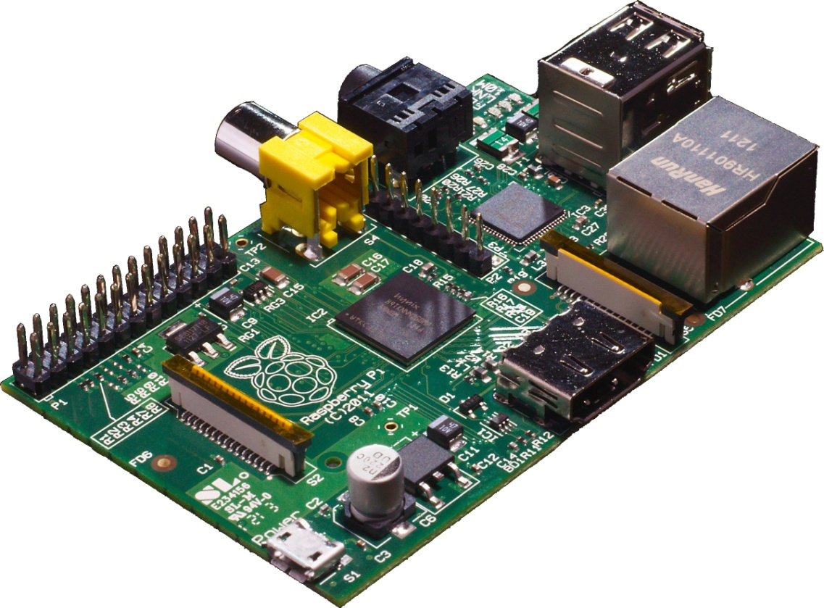
Add a Raspberry Pi?
Credit card sized Linux computer with SD Card slot, 2 USB, Ethernet and HDMI ports powered by 5VDC micro-USB adapter

Slide 10
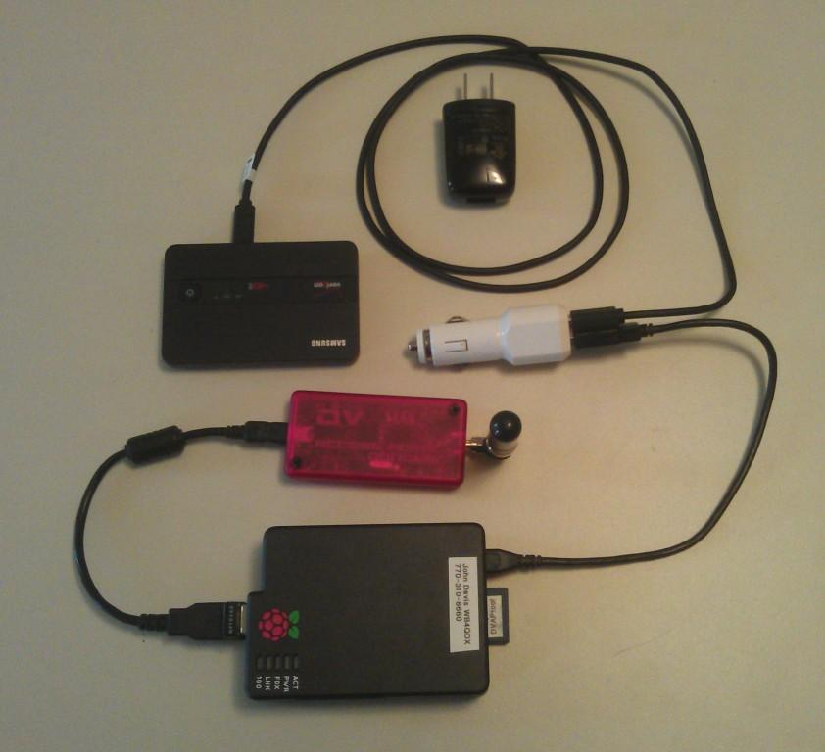
DVAP / Pi Configuration
DVAP connects to Pi through USB
Wi-Fi adapter on 2nd USB (external Internet source required)
SD card with OS and DVAP software
Micro USB power to AC or DC source

Slide 11
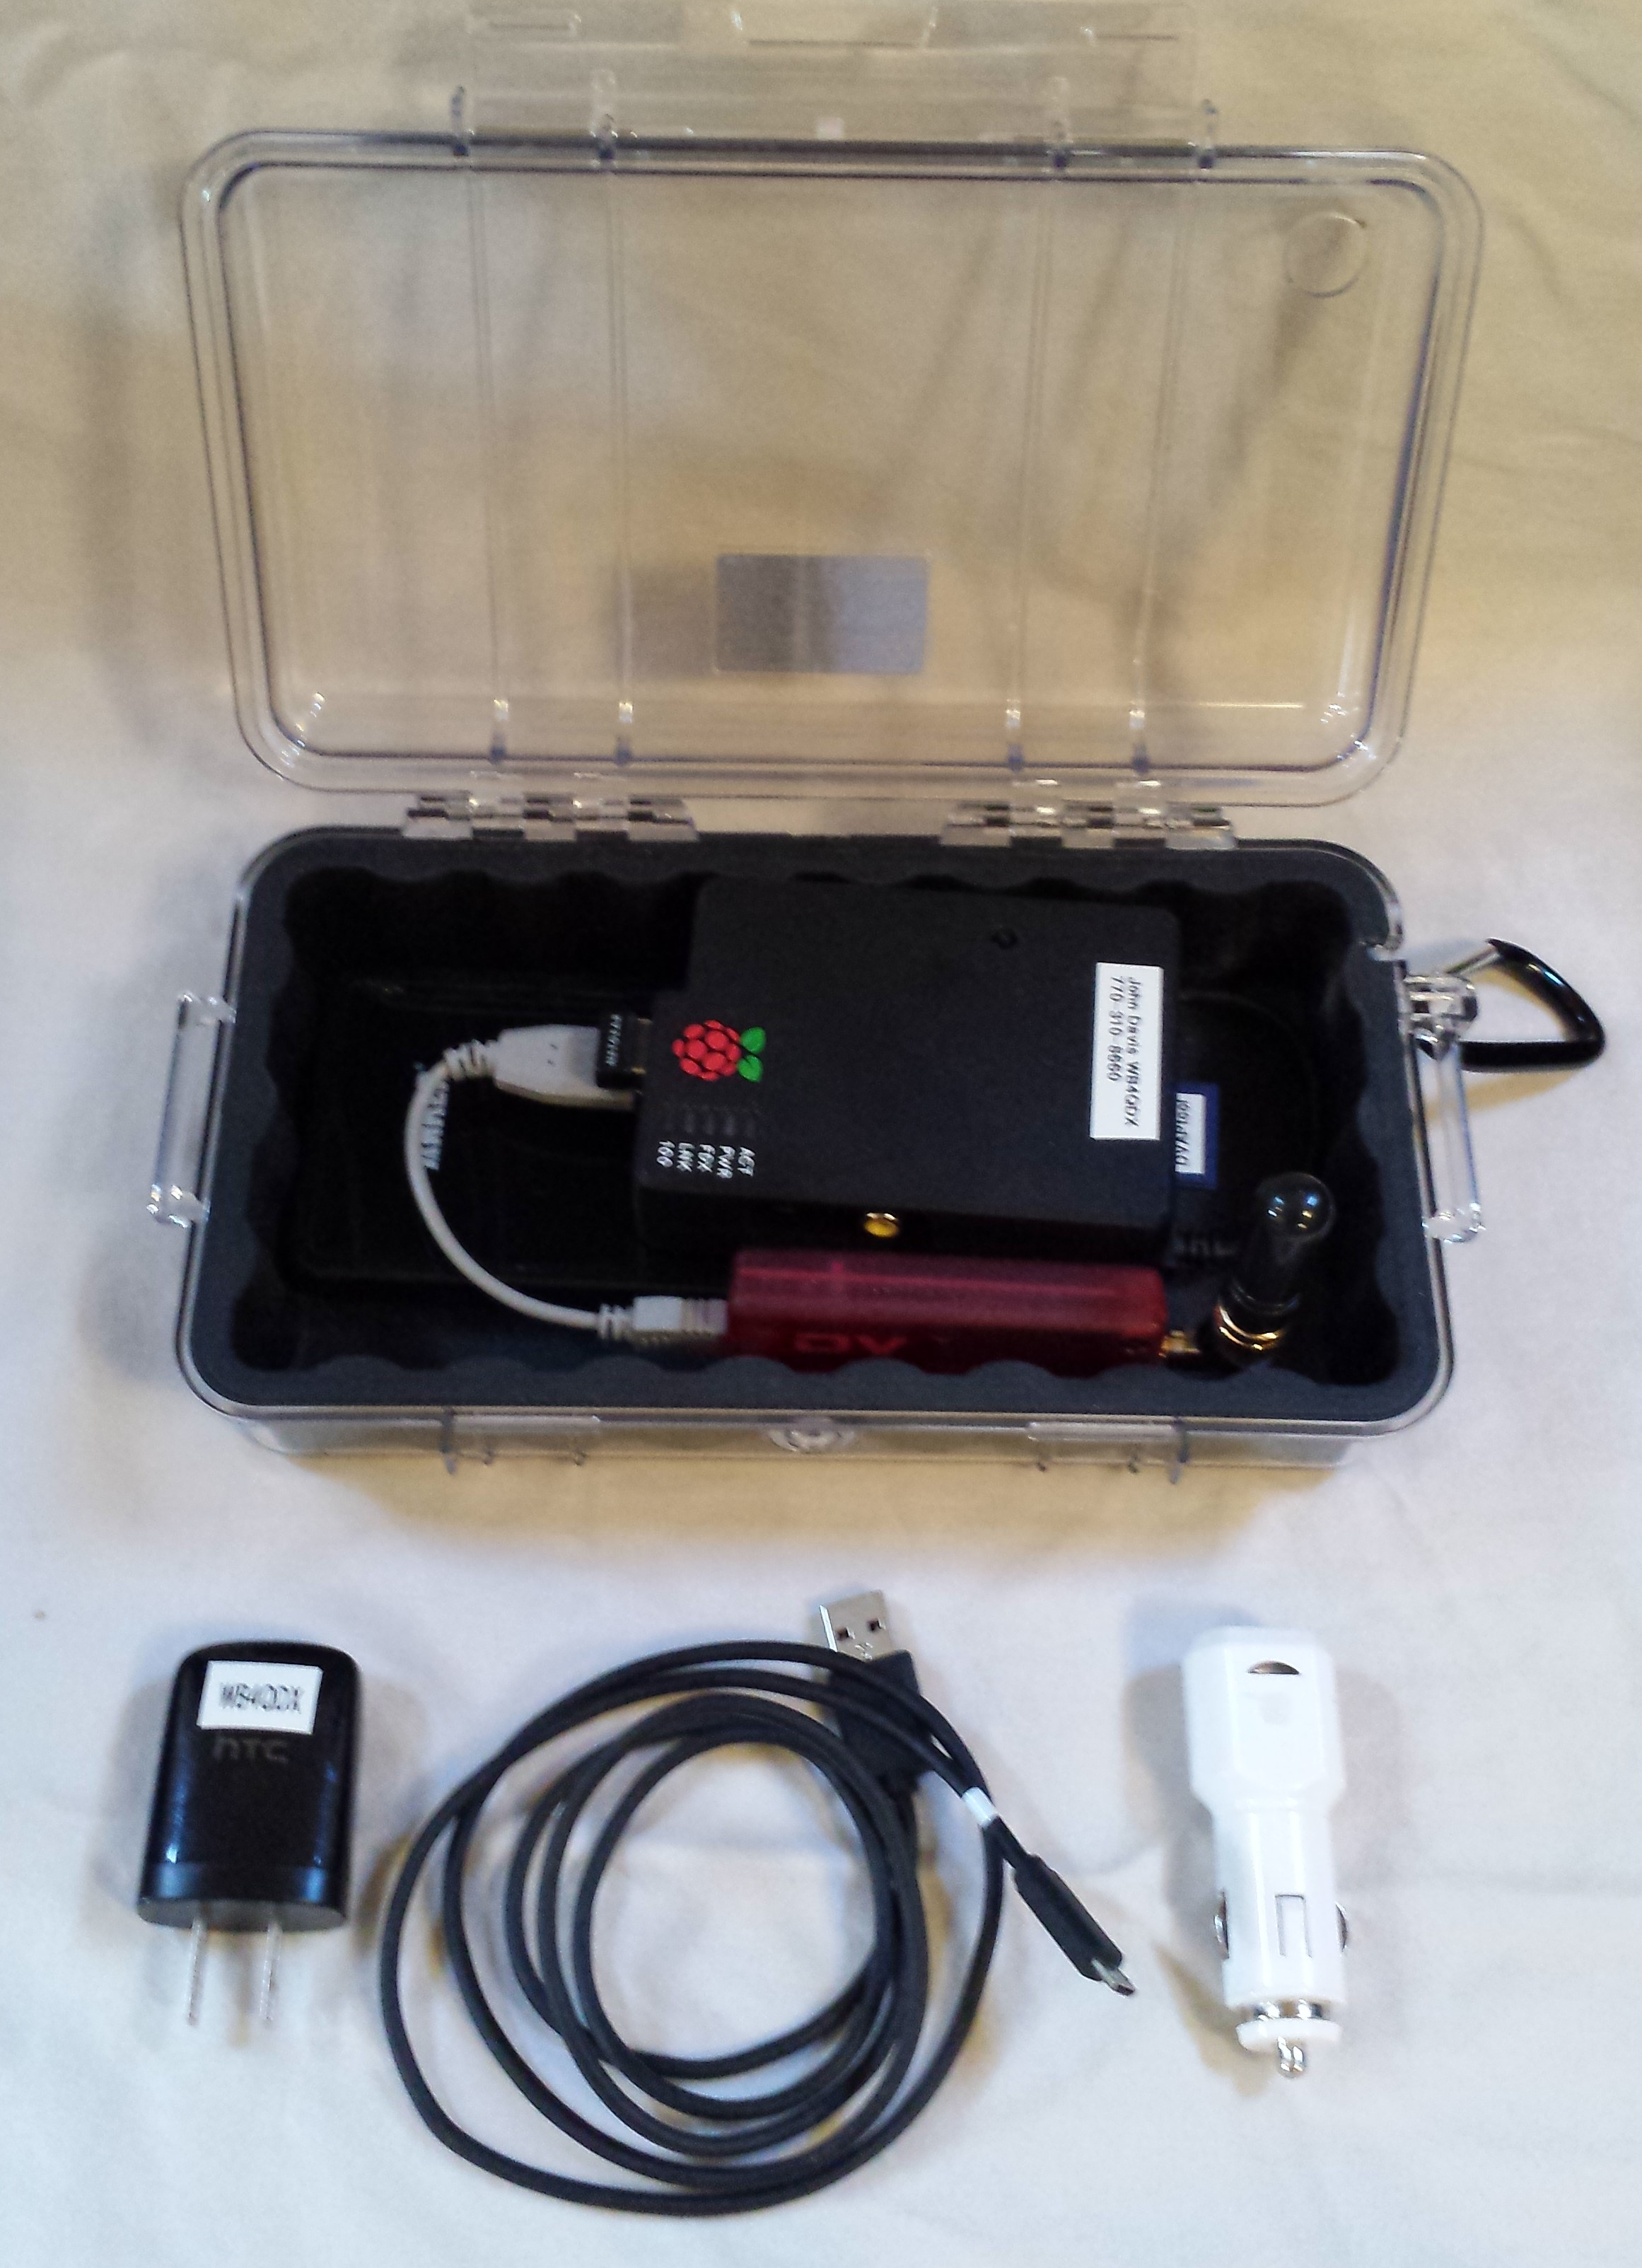
Homebrew DVAP Package
Pelican 1050 or 1060 Case
Raspberry Pi Model B
USB Charger/5VDC Supply
Anker 10,000 mAH or
equivalent
DV Access Point
USB Adapter
(120VAC to 5V USB)
USB CLA (12V to 5V USB)
Micro-USB Cable

Slide 12
Making It Work
Download image file and instructions
  DVAPtool version:
  https://www.dropbox.com/sh/mfyw3j6dwkpmriz/V56pE5JqTL
  ircDDB version:
  http://www.westerndstar.co.uk/Downloads/DVAP+ircDDB+VNC.rar or
  http://maryland-dstar.org/html/raspiberry.html
Install OS image to SD card using Win32DiskImager
Power up Pi with SD card installed, HDMI monitor, keyboard, mouse and Internet connection (Ethernet or Wi-Fi)
Configure DVAPtool or DVAPnode and ircDDB per instructions
Configure WiFi sources (Mobile Hotspots, home WiFi, etc)
Can run “headless” after that…just power up, finds defined WiFi sources

Slide 13
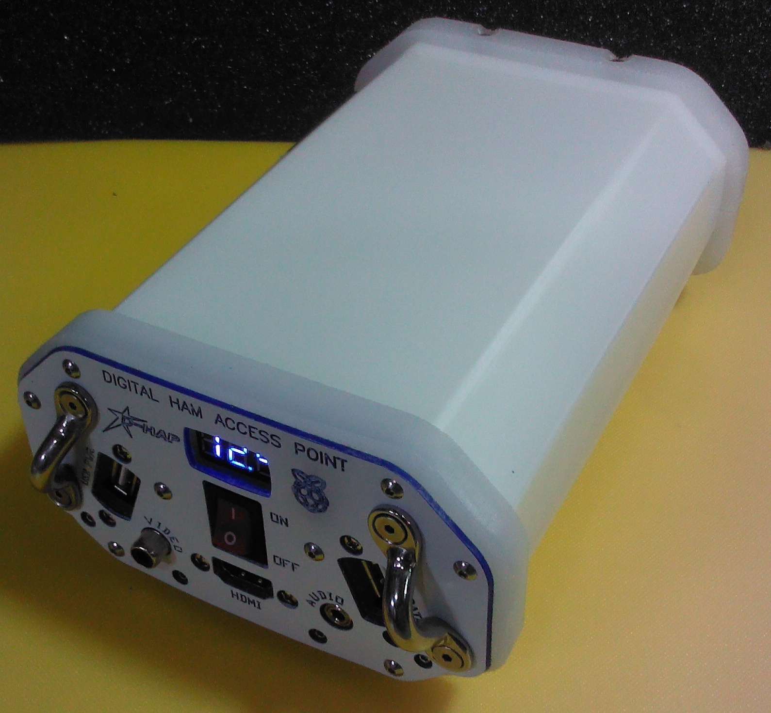
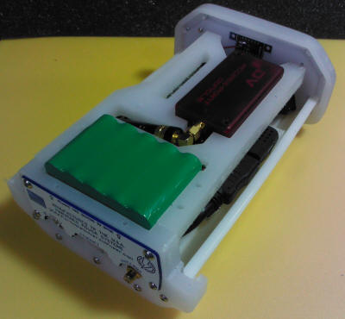
DHAP
Commercially available from Hardened Power Systems
http://www.portableuniversalpower.com/DHAP.htm
Includes case, battery, Raspberry Pi
User supplies DVAP (2m or 70cm)

Slide 14
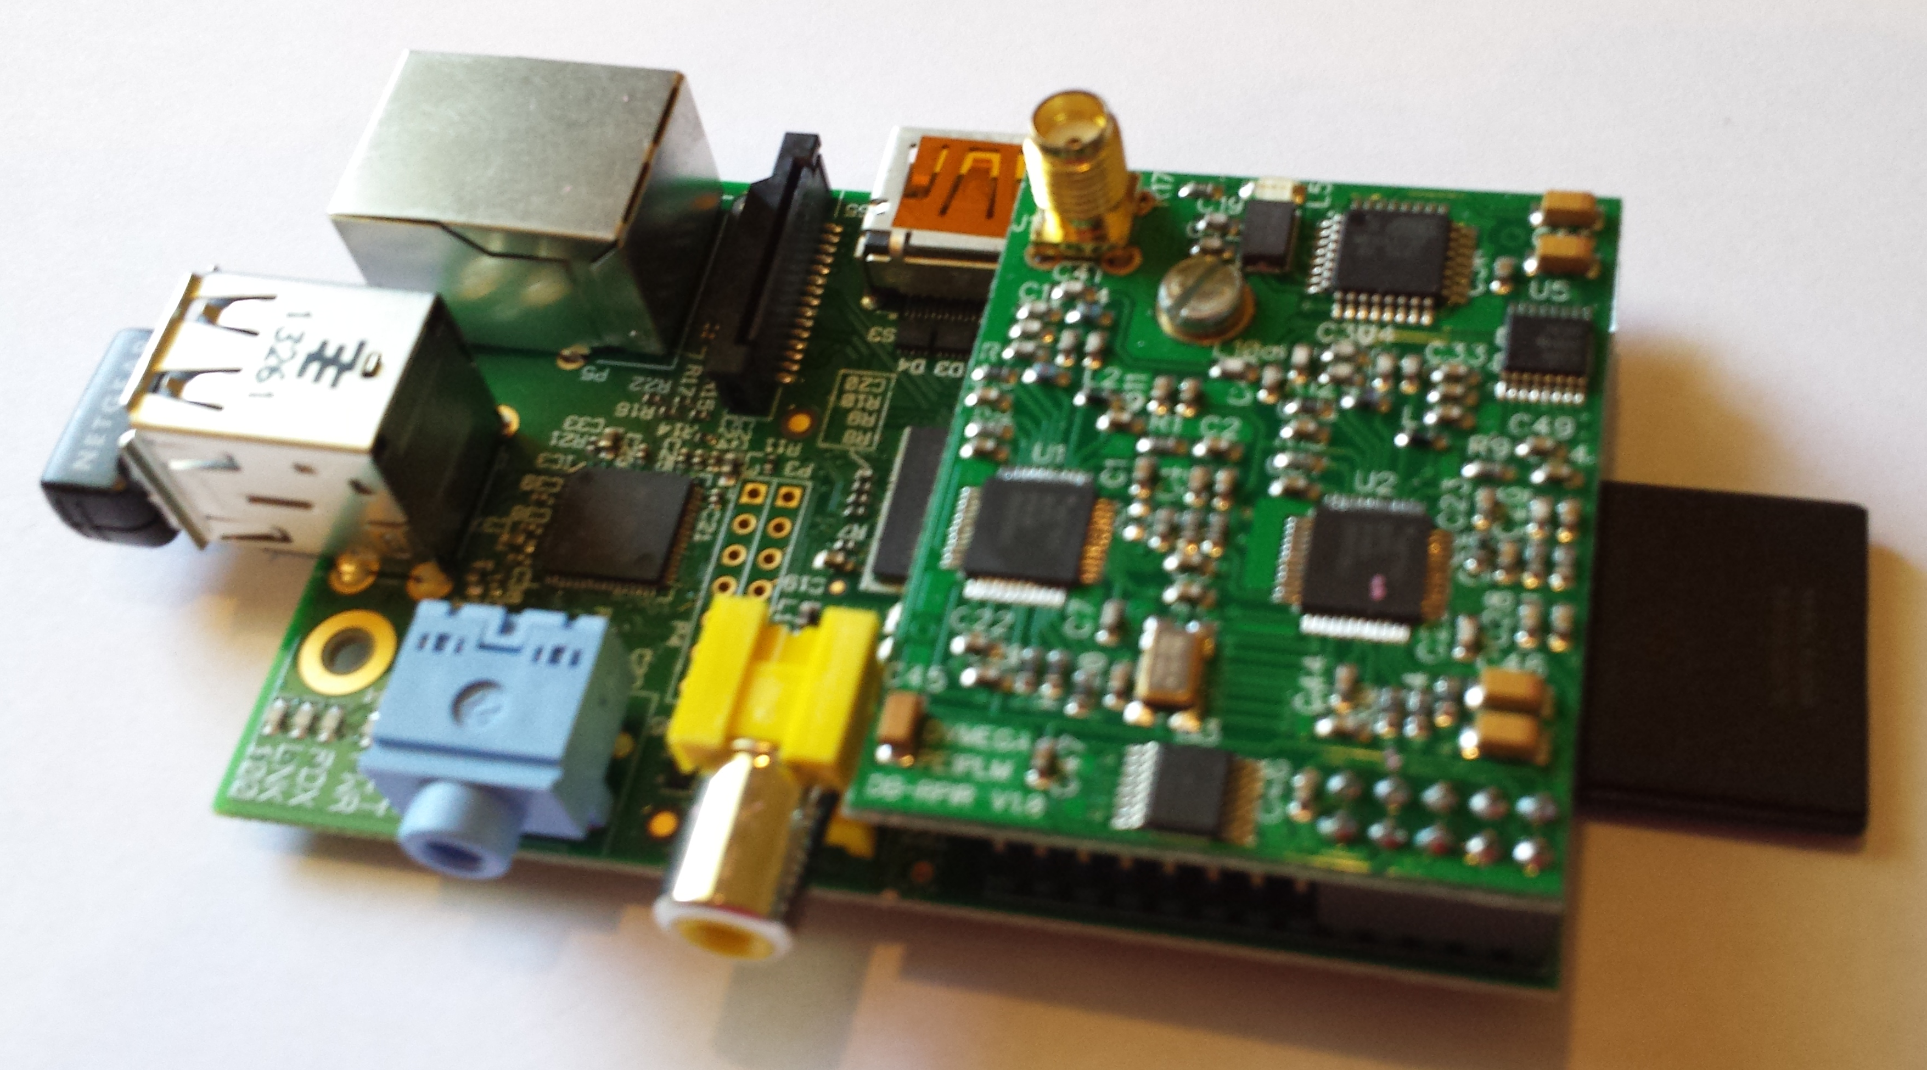
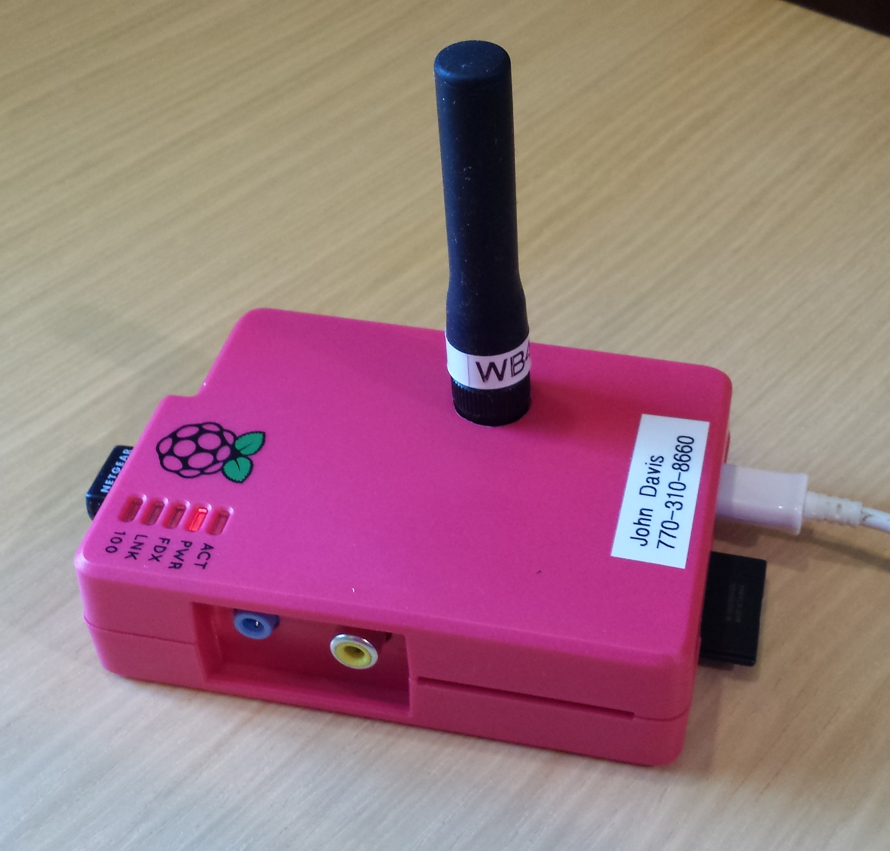
DV Mega
Low power hotspot similar to DVAP (single or dual band versions)
Attaches to Raspberry Pi GPIO connector (Pi Model B, B+, Pi 2) or Arduino
SD card with OS and ircDDBgateway software
Use Wi-Fi dongle or wired Ethernet
Micro USB power to AC or DC source
Use ircDDBgateway SD card images from Maryland D-STAR and Western D-STAR

Slide 15
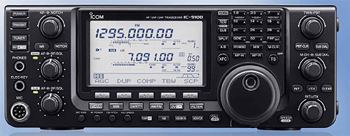
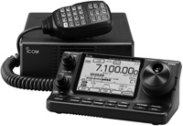
D-STAR on HF
Icom IC-7100 and IC-9100 are both DV capable on HF
Operates at similar bandwidth to AM
D-STAR HF nets now operating several nights a week
Net info at
http://www.dstarinfo.com/DSTARHFNet.aspx

Slide 16
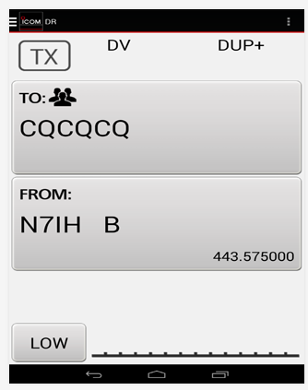
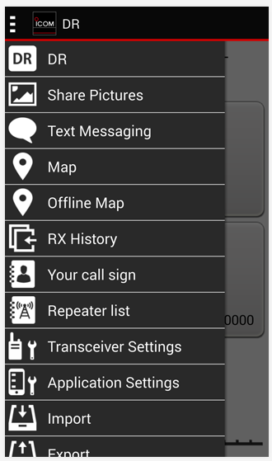
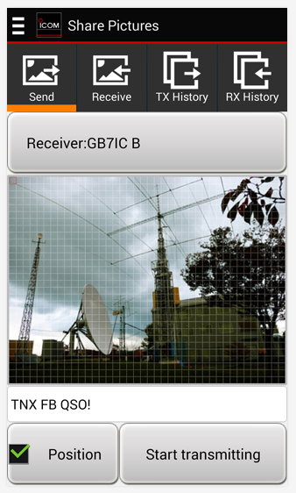
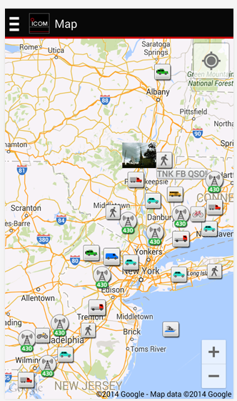
D-STAR Android App
Remote control app for certain Icom radios (ID-5100, ID-31, ID-51, IC-7100)
Connect by OPC-2350LU cable or Bluetooth to Android device
DR function control
Text messaging
Map
Send/receive photos (camera or file)
RX history

Slide 17
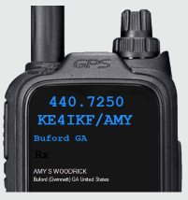
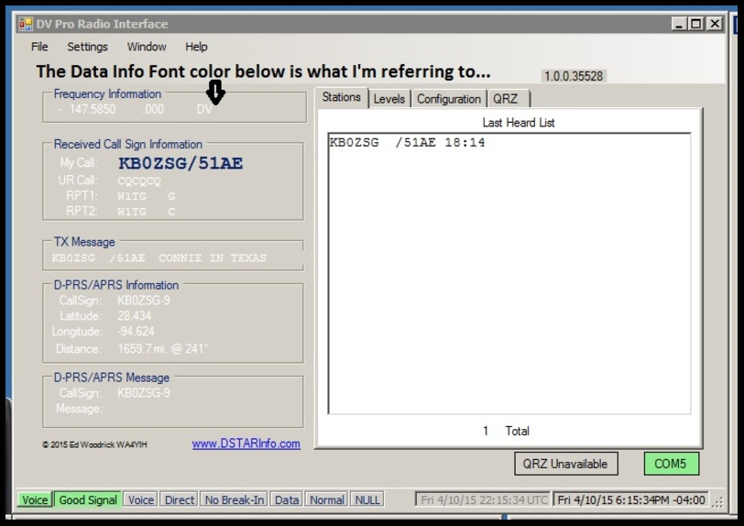
DV Pro
PC application to display radio information
Works with ID-51 AE, ID-51 Plus and ID-5100 radios
Useful for monitoring, D-STAR Net NCS, radio control
Data cable connects PC to radio
Free download at www.dstarinfo.com/dv-pro.aspx

Slide 18
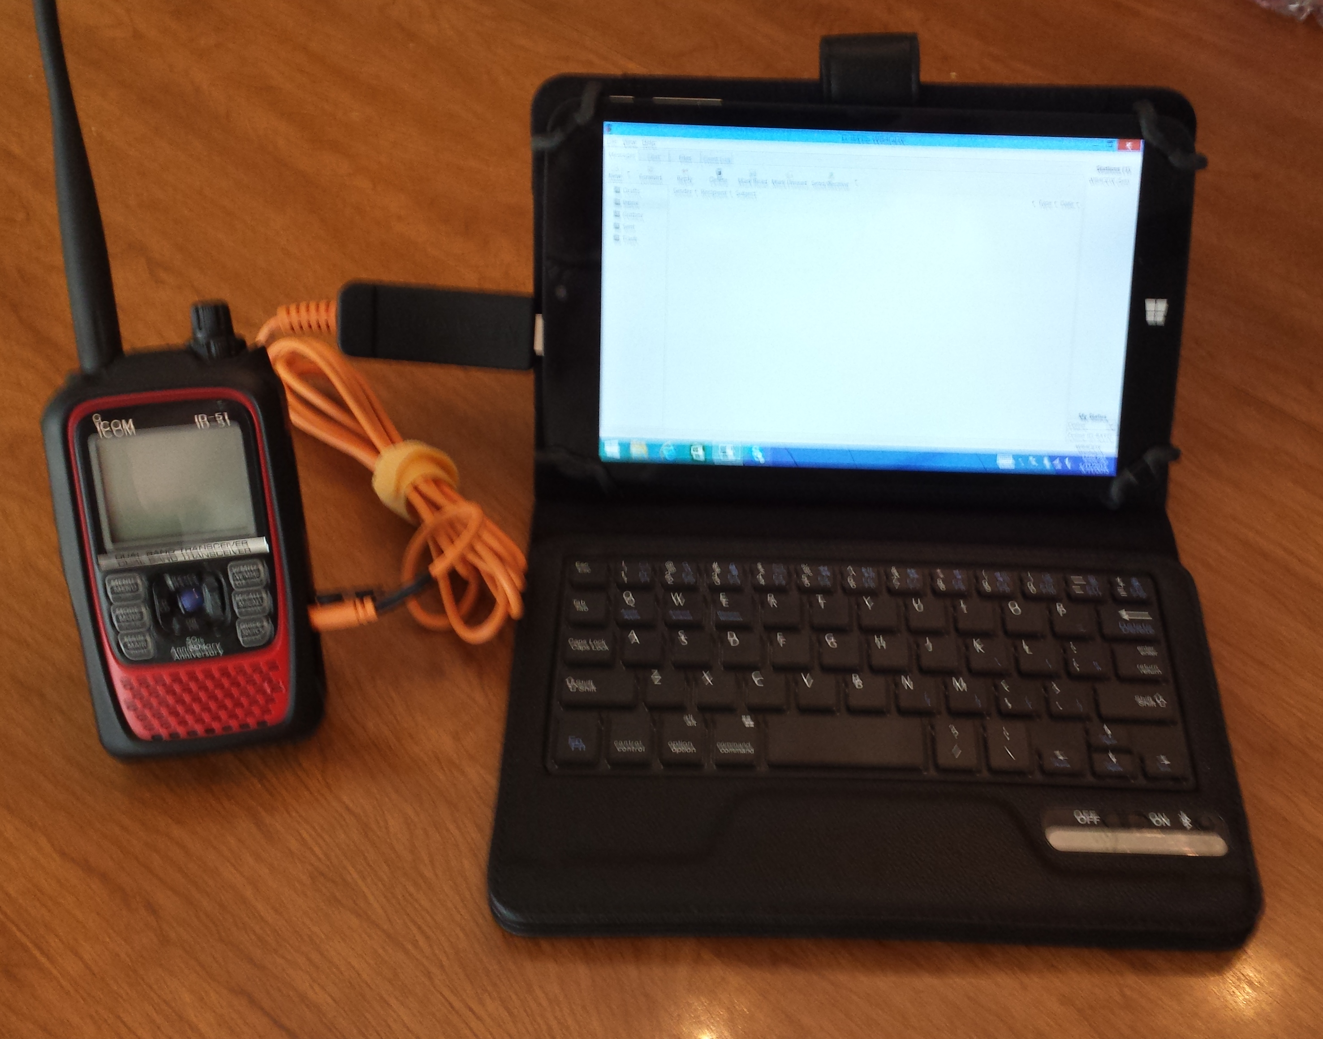
D-RATS for Data
D-RATS is full featured program for D-STAR data
Features messaging, forms, file transfer and mapping
May be used with D-STAR radio or Internet
Runs on Windows, Mac or Linux
www.d-rats.com

Slide 19
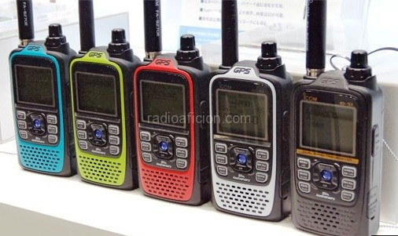
Anyone ready to take home an
ID-51A Anniversary Edition handheld?

