Slide 1

Technician Licensing Class
Safety First!
Section 20
Valid July 1, 2014
Through
June 30, 2018
Notes:
1

Slide 2
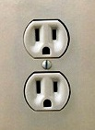
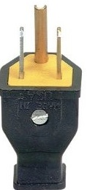
Safety First!
Electrical shock can be a problem at your station.
1. Use three-wire cords and plugs for all AC powered equipment.
2. Connect all AC powered station equipment to a common safety ground

Slide 3
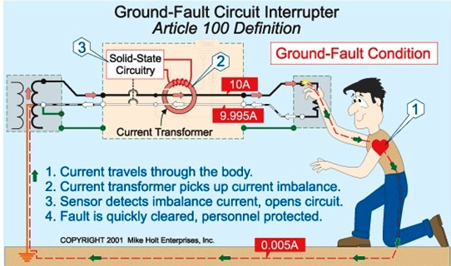
Safety First!
3. Use a circuit protected by a ground-fault interrupter.
T0A06 All three are good ways to guard against electrical shock at your station
Use three-wire cords and plugs for all AC powered equipment
Connect all AC powered station equipment to a common safety ground
Use a circuit protected by a ground-fault interrupter

Slide 4
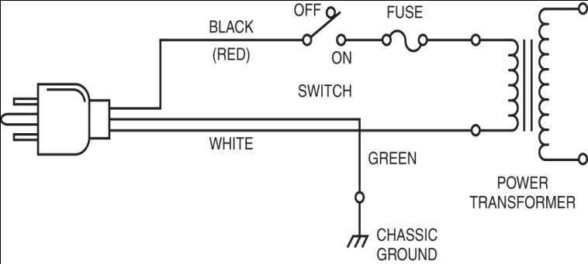
Safety First!
T0A03 The green wire in a three-wire electrical AC plug is safety ground.
Hot (Live)
Neutral
Ground
AC Line Connections

Slide 5

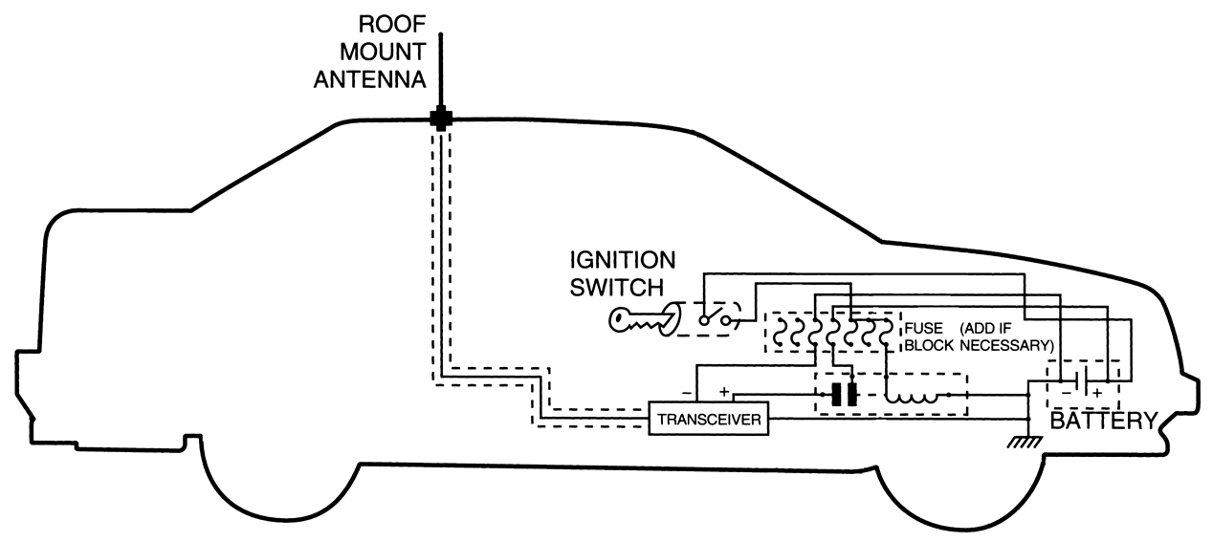
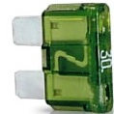
Safety First!
T0A11 A fuse or circuit breaker in series with the AC "hot" conductor is safety equipment that should always be included in home-built equipment that is powered from 120V AC power circuits.
T0A04 The purpose of a fuse in an electrical circuit is to interrupt power in case of overload.
Fuses
Slow-Blow fuse
Automobile fuse
Place the fuses as close to the battery as possible

Slide 6
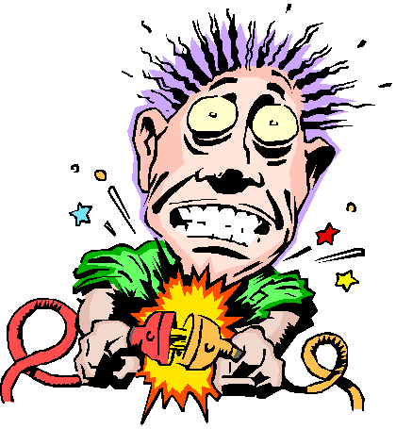
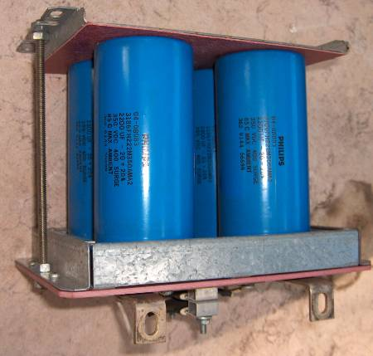
Safety First!
T0A05 It is unwise to install a 20-ampere fuse in the place of a 5-ampere fuse because excessive current could cause a fire.
T0A11 The kind of hazard that might exist in a power supply when it is turned off and disconnected is that you might receive an electric shock from stored charge in large capacitors.
Charges stored from capacitors can HURT !
Filter Capacitors

Slide 7
Safety First!
T7D12 When measuring high voltages with a voltmeter ensure that the voltmeter and leads are rated for use at the voltages to be measured.
T0A02 Current flowing through the body cause a health hazard:
By heating tissue;
It disrupts the electrical functions of cells;
It causes involuntary muscle contractions.
T2C02 One way to recharge a 12-volt lead-acid station battery, if the commercial power is out, is to connect the battery in parallel with a car's battery and run the engine.

Slide 8
Safety First!
T0A10 If a lead-acid storage battery is charged or discharged too quickly it could overheat and give off flammable gas or explode
T0A01 Shorting the terminals of a 12-volt storage battery can cause burns, fire, or an explosion.
T0A09 A hazard is presented by a conventional 12-volt storage battery with its explosive gas that can collect if not properly vented.
T0B09 You should avoid attaching an antenna to a utility pole as the antenna could contact high-voltage power wires.
And it may be illegal to do

Slide 9
Safety First!
T0B04 Looking for and staying clear of any overhead electrical wires is an important safety precaution to observe when putting up an antenna tower.
Overhead electrical wires carry more than 120 VAC
Use common sense and think safety first
Have help, don’t work alone
Always look UP first
T0B06 The minimum safe distance to allow from a power line when installing an antenna is to ensure that no part of the antenna can come closer than 10 feet to the power wires if antenna falls unexpectedly.
This is a ‘minimum’ distance
Keep away from all wires

Slide 10
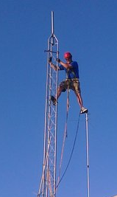
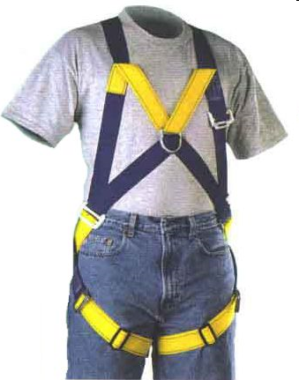
Safety First!
T0B02 Putting on a climbing harness and safety glasses is a good precaution to observe before climbing an antenna tower.
Climbing Harness
Safety Glasses
And
Hard Hat

Slide 11
Safety First!
T0B03 It is never safe to climb a tower without a helper or observer.
Never work on a tower without a helper
T0B07 An important safety rule to remember when using a crank-up tower is that this type of tower must never be climbed unless it is in the fully retracted position.
Think weight overload and never climb a cranked up tower
T0B11 Grounding requirements for an amateur radio tower or antenna are established by local electrical codes
Check local codes before putting up an antenna
T0B08 Proper grounding method for a tower is to have separate eight-foot long ground rods for each tower leg, bonded to the tower and each other.

Slide 12
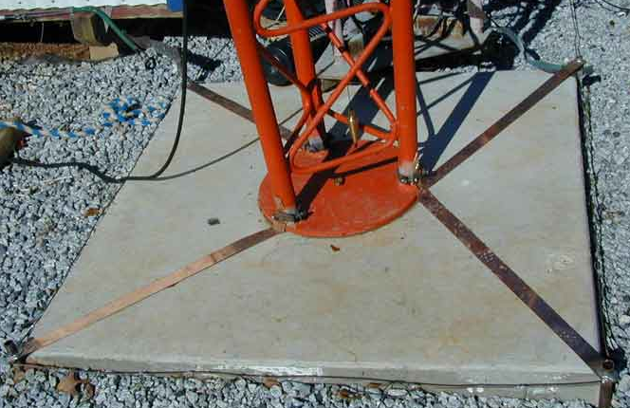
Safety First!
T4A08 A Flat strap conductor is best to use for RF grounding.
Offers best surface area
Bleed off static and minimize ground currents
Straps usually are 3 inches wide
Folding okay to snake down to a healthy ground rod
Copper Ground Strap provides good surface area ground

Slide 13
Safety First!
T0B12 A good practice when installing ground wires on a tower for lightning protection is to ensure that connections are short and direct.
T0B10 Sharp bends must be avoided in grounding conductors used for lightning protection,.
T0A07 Precautions should be taken when installing devices for lightning protection in a coaxial cable feedline by grounding all of the protectors to a common plate which is in turn connected to an external ground.
Good for nearby lightning strikes
Direct hits, forget it, kiss everything goodbye for good
T0B01 Members of a tower work team should wear a hard hat and safety glasses at all times when any work is being done on the tower.
On ground or up the tower; Wear hard hat and safety glasses

Slide 14
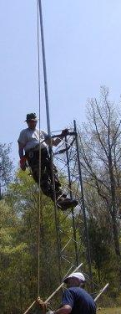
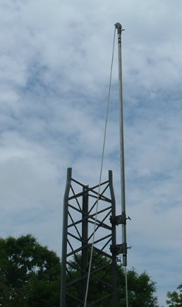
Safety First!
T0B05 The purpose of a gin pole is to lift tower sections or antennas.
Gin Pole

Slide 15
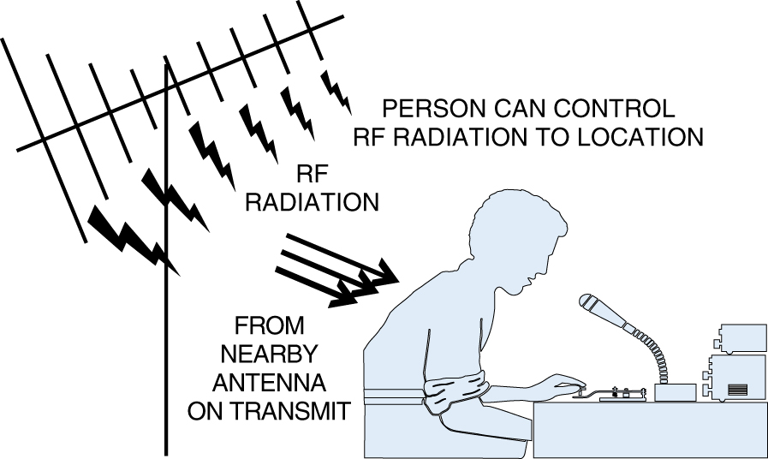
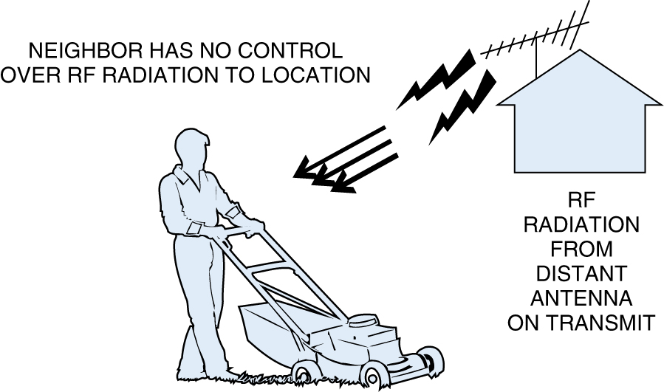
Safety First!
T0C04 Factors affecting the RF exposure of people near an amateur station antenna:
Frequency and power level of the RF field
Distance from the antenna to a person
Radiation pattern of the antenna
Controlled
Uncontrolled

Slide 16
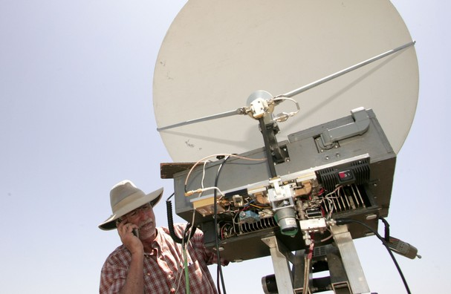
Safety First!
T0C05 Exposure limits vary with frequency because the human body absorbs more RF energy at some frequencies than at others.
T0C02 Of the following frequencies - 3.5 MHz, 50 MHz, 440 MHz, and 1296 MHz - a 50 MHz frequency has the lowest Maximum Permissible Exposure limit.
T0C03 The maximum power level that an amateur radio station may use at VHF frequencies before an RF exposure evaluation is required is 50 watts PEP at the antenna.
Never stand in front of a microwave feedhorn antenna. On transmit, it radiates a concentrated beam of RF energy.

Slide 17
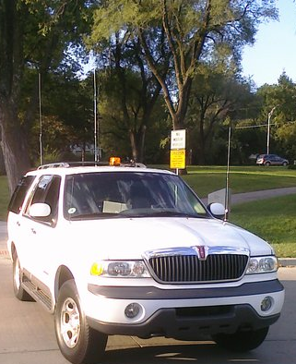
Safety First!
T0C01 VHF and UHF radio signals are non-ionizing radiation.
Quite different from X-ray, gamma ray, and ultra violet radiation
T0C06 Acceptable methods to determine that your station complies with FCC RF exposure regulations:
By calculation based on FCC OET Bulletin 65
By calculation based on computer modeling
By measurement of field strength using calibrated equipment
T0C08 An action amateur operators might take to prevent exposure to RF radiation in excess of FCC-supplied limits is to relocate antennas.
The safest place to mount the mobile antenna for minimum RF exposure is on the metal roof as shown.
17

Slide 18
Safety First!
T0C09 To make sure your station stays in compliance with RF safety regulations, re-evaluate the station whenever an item of equipment is changed.
T0C11 When referring to RF exposure, "duty cycle" is the percentage of time the transceiver is transmitting.
T0C10 Duty cycle is one of the factors used to determine safe RF radiation exposure levels because it affects the average exposure of people to radiation.

Slide 19
Safety First!
T0C12 RF radiation differs from ionizing radition (radioactivity) because RF radiation does not have sufficient energy to cause genetic damage.
T0C13 If the averaging time for exposure is 6 minutes, 2 times the power density is permitted if the signal is present for 3 minutes and absent for 3 minutes rather than being present for the entire 6 minutes. This is based on exposure limits for a given frequency from the FCC OET Bulletin 65 or computer modeling tools. Duty cycle is used as the time the signal is present.

Slide 20
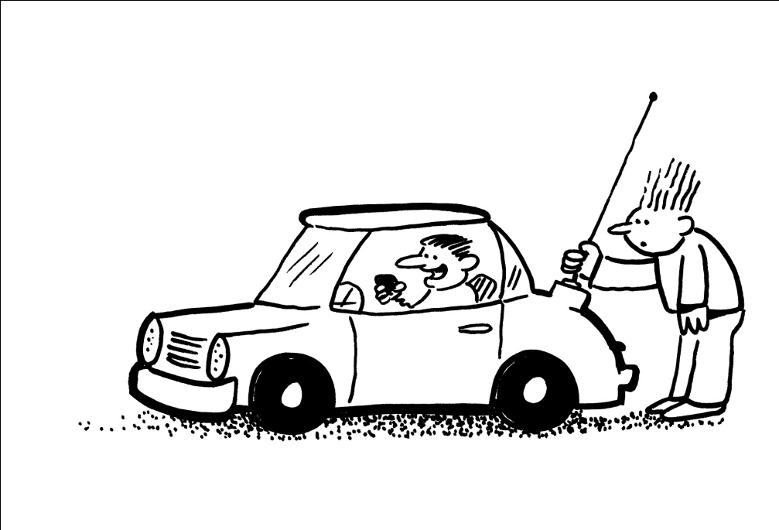
Safety First!
T0C07 If a person accidentally touched your antenna while you were transmitting they might receive a painful RF burn.
Be sure to place your antennas where no one can touch them. All antennas, not just the mobile ones.

Slide 21
Take Aways
Notes:
21

Slide 22
Take Aways
All three are good ways to guard against electrical shock at your station
Use three-wire cords and plugs for all AC powered equipment
Connect all AC powered station equipment to a common safety ground
Use a circuit protected by a ground-fault interrupter
Current flowing through the body can cause a health hazard all of the following:
By heating tissue
It disrupts the electrical functions of cells
It causes involuntary muscle contractions
Safety ground is connected to the green wire in a three-wire electrical AC plug.
The purpose of a fuse in an electrical circuit is to interrupt power in case of overload.

Slide 23
Take Aways
It is unwise to install a 20-ampere fuse in the place of a 5‑ampere fuse because excessive current could cause a fire.
ALL of these are a good way to guard against electrical shock at your station:
Use three-wire cords and plugs for all AC powered equipment
Connect all AC powered station equipment to a common safety ground
Use a circuit protected by a ground-fault interrupter
Precautions that should be taken when installing devices for lightning protection in a coaxial cable feedline include grounding all of the protectors to a common plate which is in turn connected to an external ground.

Slide 24
Take Aways
One way to recharge a 12-volt lead-acid station battery, if the commercial power is out, is to connect the battery in parallel with a car's battery and run the engine.
If a conventional 12-volt storage battery is not properly vented, explosive gas can collect and present a hazard.
If a lead-acid storage battery is charged or discharged too quickly, the battery could overheat and give off flammable gas or explode.
Shorting the terminals of a 12-volt storage battery can cause burns, fire, or an explosion.
A good practice when installing ground wires on a tower for lightning protection is to ensure that connections are short and direct.

Slide 25
Take Aways
A fuse or circuit breaker in series with the AC "hot" conductor should always be included in home-built equipment that is powered from 120V AC power circuits
The kind of hazard that might exist in a power supply when it is turned off and disconnected is that you might receive an electric shock from stored charge in large capacitors
Members of a tower work team should wear a hard hat and safety glasses at all times when any work is being done on the tower.
A good precaution to observe before climbing an antenna tower is put on a climbing harness and safety glasses.

Slide 26
Take Aways
It is never safe to climb a tower without a helper or observer.
An important safety precaution to observe when putting up an antenna tower is look for and stay clear of any overhead electrical wires.
The purpose of a gin pole is to lift tower sections or antennas.
The minimum safe distance from a power line to allow when installing an antenna is so that if the antenna falls unexpectedly, no part of it can come closer than 10 feet to the power wires. (Look Up)
An important safety rule to remember when using a crank-up tower is this type of tower must never be climbed unless it is in the fully retracted position.

Slide 27
Take Aways
A Flat strap type of conductor is best to use for RF grounding.
A separate eight-foot long ground rods for each tower leg, bonded to the tower and each other, is considered to be a proper grounding method for a tower.
You should avoid attaching an antenna to a utility pole because the antenna could contact high-voltage power wires.
Avoid sharp bends when routing ground conductors used for lightning protection.
When measuring high voltages with a voltmeter ensure that the voltmeter and leads are rated for use at the voltages to be measured.

Slide 28
Take Aways
Local electrical codes establish grounding requirements for an amateur radio tower or antenna
VHF and UHF radio signals are non-ionizing radiation.
50 MHz has the lowest Maximum Permissible Exposure limit.
ALL of these factors affect the RF exposure of people near an amateur station antenna:
Frequency and power level of the RF field
Distance from the antenna to a person
Radiation pattern of the antenna
Notes:
Local electrical codes establish grounding requirements for an amateur radio tower or antenna
VHF and UHF radio signals are non-ionizing radiation.
50 MHz has the lowest Maximum Permissible Exposure limit.
ALL of these factors affect the RF exposure of people near an amateur station antenna:
Frequency and power level of the RF field
Distance from the antenna to a person
Radiation pattern of the antenna
The maximum power level that an amateur radio station may use at VHF frequencies before an RF exposure evaluation is required is 50 watts PEP at the antenna.

Slide 29
Take Aways
The maximum power level that an amateur radio station may use at VHF frequencies before an RF exposure evaluation is required is 50 watts PEP at the antenna.
Exposure limits vary with frequency because the human body absorbs more RF energy at some frequencies than at others.
ALL of these are acceptable methods to determine that your station complies with FCC RF exposure regulations:
By calculation based on FCC OET Bulletin 65
By calculation based on computer modeling
By measurement of field strength using calibrated equipment

Slide 30
Take Aways
If a person accidentally touched your antenna while you were transmitting they might receive a painful RF burn.
An action amateur operators might take to prevent exposure to RF radiation in excess of FCC-supplied limits includes relocating the antenna.
You can make sure your station stays in compliance with RF safety regulations by re-evaluating the station whenever an item of equipment is changed.
Duty cycle is one of the factors used to determine safe RF radiation exposure levels because it affects the average exposure of people to radiation.

Slide 31
Take Aways
When referring to RF exposure, duty cycle is the percentage of time that a transceiver is transmitting
RF radiation differs from ionizing radition (radioactivity) because RF radiation does not have sufficient energy to cause genetic damage.
If the averaging time for exposure is 6 minutes, 2 times the power density is permitted if the signal is present for 3 minutes and absent for 3 minutes rather than being present for the entire 6 minutes. This is based on exposure limits for a given frequency. Duty cycle is used as the time the signal is present.

Slide 32
Element 2 Technician Class Question Pool
Element 2 Technician Class Question Pool
Safety First!
Valid July 1, 2014
Through
June 30, 2018

Slide 33
T0A06 What is a good way to guard against electrical shock at your station?
Use three-wire cords and plugs for all AC powered equipment
Connect all AC powered station equipment to a common safety ground
Use a circuit protected by a ground-fault interrupter
All of these choices are correct

Slide 34
T0A03 What is connected to the green wire in a three- wire electrical AC plug?
Neutral
Hot
Safety ground
The white wire

Slide 35
T0A08 What safety equipment should always be included in home-built equipment that is powered from 120V AC power circuits?
A fuse or circuit breaker in series with the AC hot conductor
An AC voltmeter across the incoming power source
An inductor in series with the AC power source
A capacitor across the AC power source

Slide 36
T0A04 What is the purpose of a fuse in an electrical circuit?
To prevent power supply ripple from damaging a circuit
To interrupt power in case of overload
To limit current to prevent shocks
All of these choices are correct

Slide 37
T0A05 Why is it unwise to install a 20-ampere fusein the place of a 5-ampere fuse?
The larger fuse would be likely to blow because it is rated for higher current
The power supply ripple would greatly increase
Excessive current could cause a fire
All of these choices are correct

Slide 38
T0A11 What kind of hazard might exist in a power supply when it is turned off and disconnected?
Static electricity could damage the grounding system
Circulating currents inside the transformer might cause damage
The fuse might blow if you remove the cover
You might receive an electric shock from stored charge in large capacitors

Slide 39
T7D12 Which of the following precautions should be taken when measuring high voltage with a voltmeter?
Ensure that the voltmeter has very low impedance
Ensure that the voltmeter and leads are rated for use at the voltage to be measured
Ensure that the circuit is grounded through the voltmeter
Ensure that the voltmeter is set to the correct frequency

Slide 40
T0A02 How does current flowing through the body cause a health hazard?
By heating tissue
It disrupts the electrical functions of cells
It causes involuntary muscle contractions
All of these choices are correct

Slide 41
T2C02 What is one way to recharge a 12-volt lead-acid Station battery if the commercial power is out?
Cool the battery in ice for several hours
Add acid to the battery
Connect the battery in parallel with a vehicle’s battery and run the engine
All of these choices are correct

Slide 42
T0A10 What can happen if a lead-acid storage battery is charged or discharged too quickly?
The battery could overheat and give off flammable gas or explode
The voltage can become reversed
The memory effect will reduce the capacity of the battery
All of these choices are correct

Slide 43
T0A01 Which of the following is a safety hazard of a 12 voltage storage battery?
Touching both terminals with the hands can cause electrical shock
Shorting the terminals can cause burns, fire, or an explosion
RF emissions from the battery
All of these choices are correct

Slide 44
T0A09 What kind of hazard is presented by a conventional 12-volt storage battery?
It emits ozone which can be harmful to the atmosphere
Shock hazard due to high voltage
Explosive gas can collect if not properly vented
All of these choices are correct

Slide 45
T0B04 Which of the following is an important safety precaution to observe when putting up an antenna tower?
Wear a ground strap connected to your wrist at all times
Insulate the base of the tower to avoid lightning strikes
Look for and stay clear of any overhead electrical wires
All of these choices are correct

Slide 46
T0B06 What is the minimum safe distance from a power line to allow when installing an antenna?
Half the width of your property
The height of the power line above ground
1/2 wavelength at the operating frequency
So that if the antenna falls unexpectedly, no part of it can come closer than 10 feet to the power wires

Slide 47
T0B09 Why should you avoid attaching an antenna to a utility pole?
The antenna will not work properly because of induced voltages
The utility company will charge you an extra monthly fee
The antenna could contact high-voltage power wires
All of these choices are correct

Slide 48
T0B02 What is a good precaution to observe before climbing an antenna tower?
Make sure that you wear a grounded wrist strap
Remove all tower grounding connections
Put on a climbing harness and safety glasses
All of the these choices are correct

Slide 49
T0B03 Under what circumstances is it safe to climb a tower without a helper or observer?
When no electrical work is being performed
When no mechanical work is being performed
When the work being done is not more than 20 feet above the ground
Never

Slide 50
T0B01 When should members of a tower work team wear a hard hat and safety glasses?
At all times except when climbing the tower
At all times except when belted firmly to the tower
At all times when any work is being done on the tower
Only when the tower exceeds 30 feet in height

Slide 51
T0B05 What is the purpose of a gin pole?
To temporarily replace guy wires
To be used in place of a safety harness
To lift tower sections or antennas
To provide a temporary ground

Slide 52
T0B07 Which of the following is an important safety rule to remember when using a crank-up tower?
This type of tower must never be painted
This type of tower must never be grounded
This type of tower must never be climbed unless it is in the fully retracted position
All of these choices are correct

Slide 53
T0B11 Which of the following establishes grounding requirements for an amateur radio tower or antenna?
FCC Part 97 Rules
Local electrical codes
FAA tower lighting regulations
Underwriters Laboratories' recommended practices

Slide 54
T0B08 What is considered to be a proper grounding method for a tower?
A single four-foot ground rod, driven into the ground no more than 12 inches from the base
A ferrite-core RF choke connected between the tower and ground
Separate eight-foot long ground rods for each tower leg, bonded to the tower and each other
A connection between the tower base and a cold water pipe

Slide 55
T4A08 Which type of conductor is best to use for RF grounding?
Round stranded wire
Round copper-clad steel wire
Twisted-pair cable
Flat strap

Slide 56
T0B12 Which of the following is good practice when installing ground wires on a tower for lightning protection?
Put a loop in the ground connection to prevent water damage to the ground system
Make sure that all bends in the ground wires are clean, right angle bends
Ensure that connections are short and direct
All of these choices are correct

Slide 57
T0B10 Which of the following is true concerning grounding conductors used for lightning protection?
Only non-insulated wire must be used
Wires must be carefully routed with precise right-angle bends
Sharp bends must be avoided
Common grounds must be avoided

Slide 58
T0A07 Which of these precautions should be taken when installing devices for lightning protection in a coaxial cable feedline?
Include a parallel bypass switch for each protector so that it can be switched out of the circuit when running high power
Include a series switch in the ground line of each protector to prevent RF overload from inadvertently damaging the protector
Keep the ground wires from each protector separate and connected to station ground
Ground all of the protectors to a common plate which is in turn connected to an external ground

Slide 59
T0C04 What factors affect the RF exposure of people near an amateur station antenna?
Frequency and power level of the RF field
Distance from the antenna to a person
Radiation pattern of the antenna
All of these choices are correct

Slide 60
T0C05 Why do exposure limits vary with frequency?
Lower frequency RF fields have more energy than higher frequency fields
Lower frequency RF fields do not penetrate the human body
Higher frequency RF fields are transient in nature
The human body absorbs more RF energy at some frequencies than at others

Slide 61
T0C02 Which of the following frequencies has the lowest Maximum Permissible Exposure limit?
3.5 MHz
50 MHz
440 MHz
1296 MHz

Slide 62
T0C03 What is the maximum power level that an amateur radio station may use at VHF frequencies before an RF exposure evaluation is required?
1500 watts PEP transmitter output
1 watt forward power
50 watts PEP at the antenna
50 watts PEP reflected power

Slide 63
T0C01 What type of radiation are VHF and UHF radio signals?
Gamma radiation
Ionizing radiation
Alpha radiation
Non-ionizing radiation

Slide 64
T0C06 Which of the following is an acceptable method to determine that your station complies with FCC RF exposure regulations?
By calculations based FCC OET Bulletin 65
By calculation based on computer modeling
By measurement of field strength using calibrated equipment
All of these choices are correct

Slide 65
T0C08 Which of the following actions might amateur operators take to prevent exposure to RF radiation in excess of FCC-supplied limits?
Relocate antennas
Relocate the transmitter
Increase the duty cycle
All of these choices are correct

Slide 66
T0C09 How can you make sure your station stays in compliance with RF safety regulations?
By informing the FCC of any changes made in your station
By re-evaluating the station whenever an item of equipment is changed
By making sure your antennas have low SWR
All of these choices are correct

Slide 67
T0C11 What is the definition of duty cycle during the averaging time for RF exposure?
The difference between lowest power output and highest output power of a transmitter
The difference between the PEP and average power output power of a transmitter
The percentage of time that a transmitter transmits
The percentage of time that a transmitter is not transmitting

Slide 68
T0C12 How does RF radiation differ from ionizing radiation (radioactivity)?
RF radiation does not have sufficient energy to cause genetic damage
RF radiation can only be detected with an RF dosimeter
RF radiation is limited in range to a few feet
RF radiation is perfectly safe

Slide 69
T0C13 If the averaging time for exposure is 6 minutes, how much power density is permitted if the signal is present for 3 minutes and absent for 3 minutes rather than being present for the entire 6 minutes?
3 times as much
1/2 as much
2 times as much
There is no adjustment allowed for shorter exposure times

Slide 70
T0C10 Why is duty cycle one of the factors used to determine safe RF radiation exposure levels?
It affects the average exposure of people to radiation
It affects the peak exposure of people to radiation
It takes into account the antenna feedline loss
It takes into account the thermal effects of the final amplifier

Slide 71
T0C07 What could happen if a person accidentally touched your antenna while you were transmitting?
Touching the antenna could cause television interference
They might receive a painful RF burn
They might develop radiation poisoning
All of these choices are correct

