Slide 1
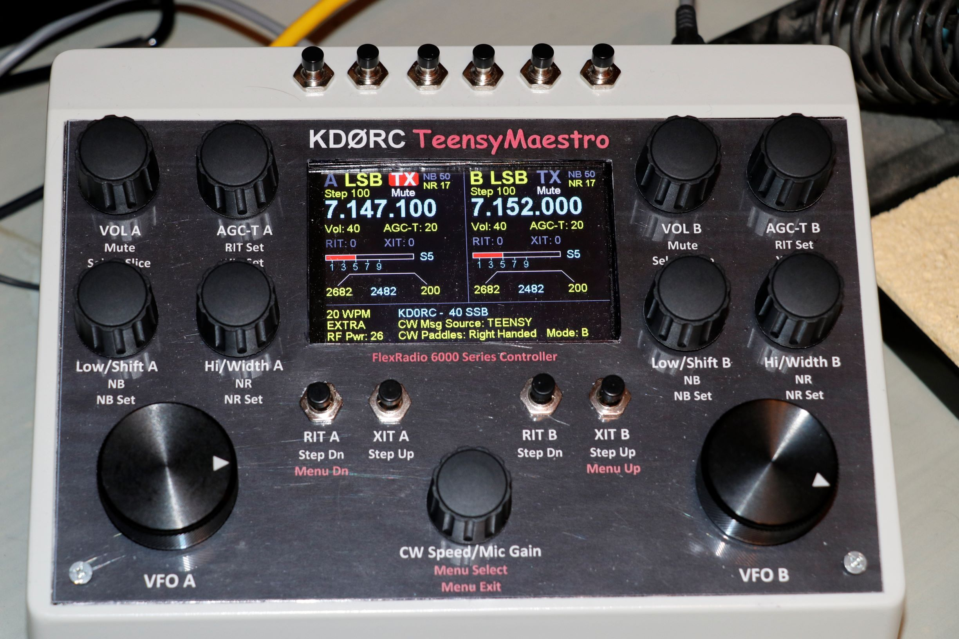
KDØRC TeensyMaestro
Boulder Amateur Radio Club Presentation
Len Koppl, KDØRC

Slide 2
Overview
Homebrew gizmo that provides knobs, buttons, touch display and CW memory keyer for Flex 6000 Signature Series SDR radios
Operates in conjunction with (not instead of) SmartSDR software
Uses Teensy 4.1 board (Arduino work-alike) using the TeensyDuino addin to the Arduino IDE
Programmed in Arduino-flavored C++ using the IW7DMH Flex API library
Connects to the radio with TCP/IP over ethernet using the Flex API, not CAT commands over a serial port
Can connect remotely using SoftEther VPN

Slide 3
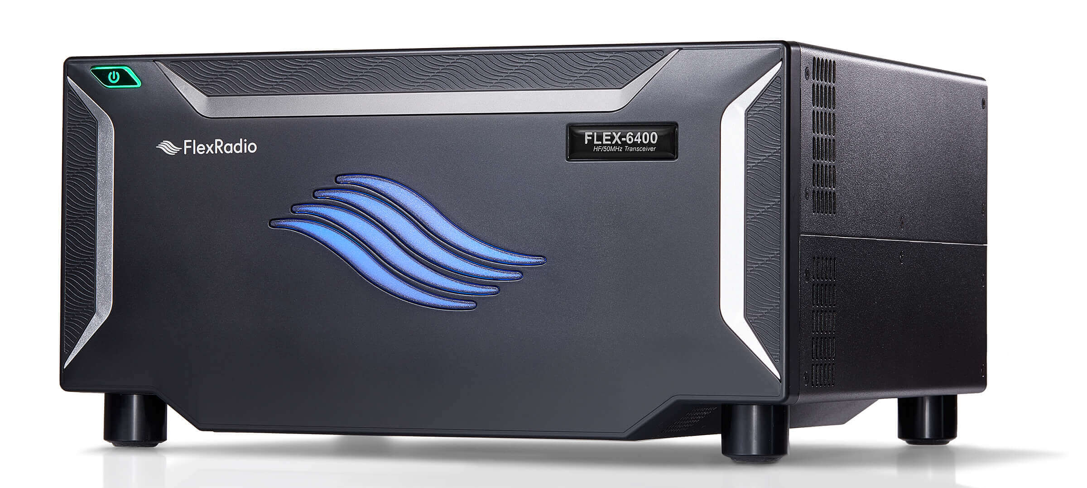
Flex 6400 Software Defined Radio
Look Ma, no knobs!

Slide 4
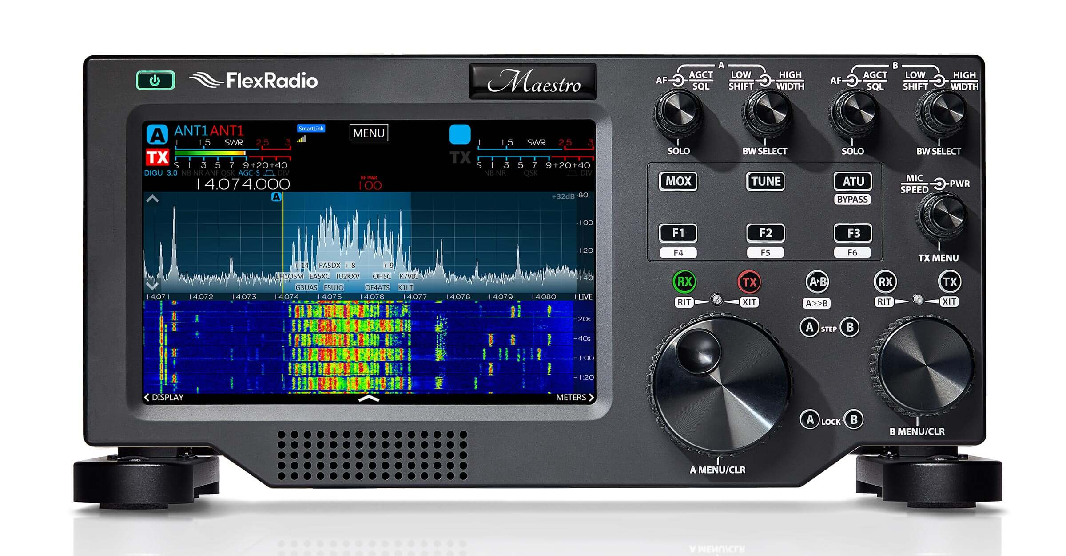
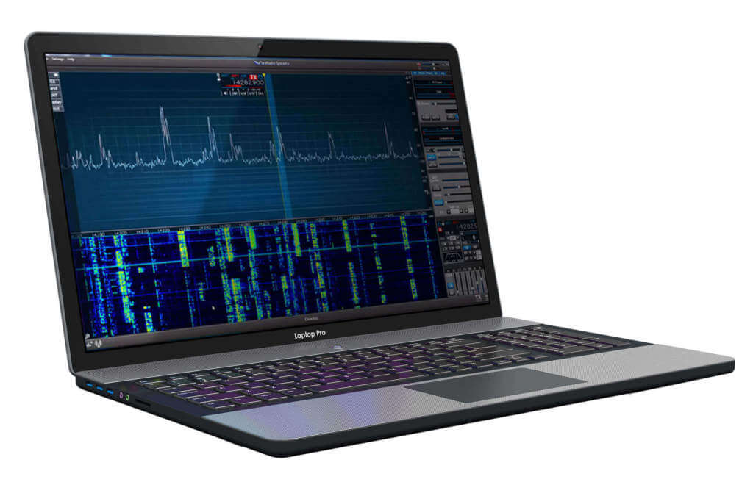
SmartSDR/Maestro
Mouse and keyboard or Maestro operation of Flex radios is mostly great.

Slide 5

TeensyMaestro
Mouse and keyboard operation combined with physical controls is really great.

Slide 6
Building the TeensyMaestro
Bought a Flex 6400 in February, 2020
Found an interesting Arduino project for Flex radios by Enzo, IW7DMH
In May, 2020 I ordered the parts I could find, then discovered I couldn’t proceed due to some unobtanium parts… DOH!!
Played with some C++ using the IW7DMH library, and got my Arduino Due to connect to the Flex
Started adding controls, and got a working set of knobs and buttons built into a cardboard box

Slide 7
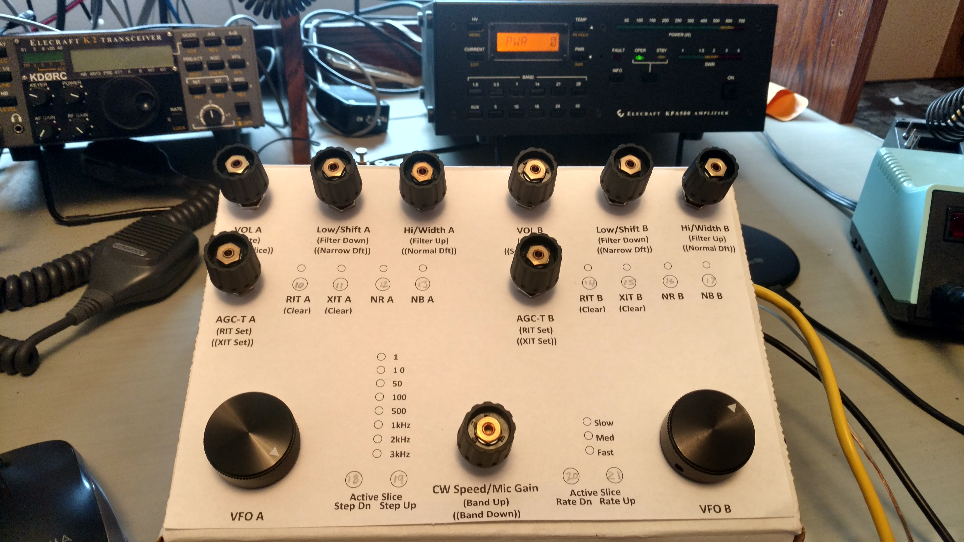
MiniMaestro in Prototype Box
Mostly operational, but only a few buttons and no LEDs are wired in. Nonetheless, it really worked great and was so much fun, progress on the project slowed to a virtual halt.

Slide 8
Some Poor Design Decisions
I ran out of Arduino GPIO pins for all the encoders, buttons, ethernet shield and the vast array of planned LED indicators
I generated an impossible-to-solder matrix for the buttons which took 10 pins to interface 25 buttons (the first few buttons were easy, so I really thought I had it made…)
The resultant rat’s nest of wiring stopped me from getting past the first few buttons
Use of .1” header pins instead of soldering to the proto board (proto board was a good decision. Header pins, not so much…)
If you haven’t guessed yet, I am not an Engineer…

Slide 9
Flex Community Forum to the Rescue
FlexRadio hosts a user forum that is unbelievably helpful
John, G3WGV was able to answer some questions I had about the API and got me past a couple of initial sticking points; he steered me toward the use of multiplexers for the buttons
Once I figured out the multiplexers, I got the ability to address 32 buttons using only 7 GPIO pins (I am currently using 20 buttons)
Mike, Tim and Eric from FlexRadio jumped in on a couple of my questions and got me squared away very quickly (reading the documentation and understanding the documentation are two distinctly different things…)

Slide 10
Scope Creep to the Max
PJRC came out with the Teensy 4.1 board with built-in ethernet giving me back a bunch of GPIO pins
I pulled apart my Arduino Due mess and re-built using the Teensy 4.1 (99.999% of the code ported across with no changes)
I took a color TFT touch screen off a start-and-forget project and got immediate relief from wiring and coding the myriad buttons and LED indicators (not to mention drilling all those mounting holes)

Slide 11
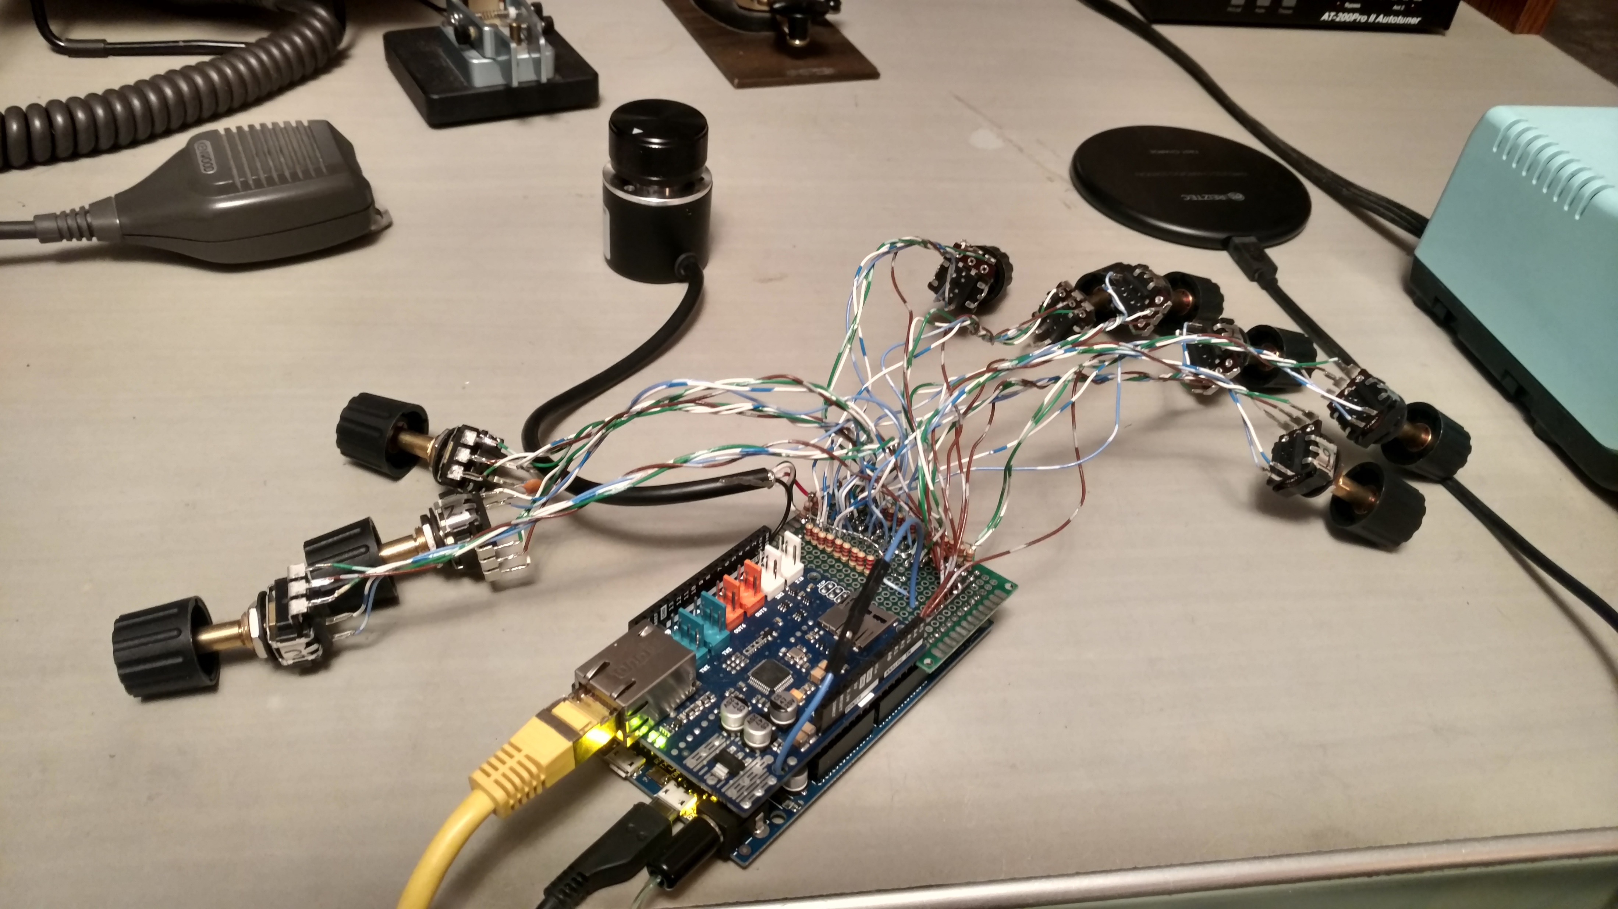
Rat’s Nest
This wiring matrix seemed like a good idea at the time. Most of the encoders are wired in, but only a few buttons are connected. It was getting exponentially more difficult to wire in each switch.

Slide 12
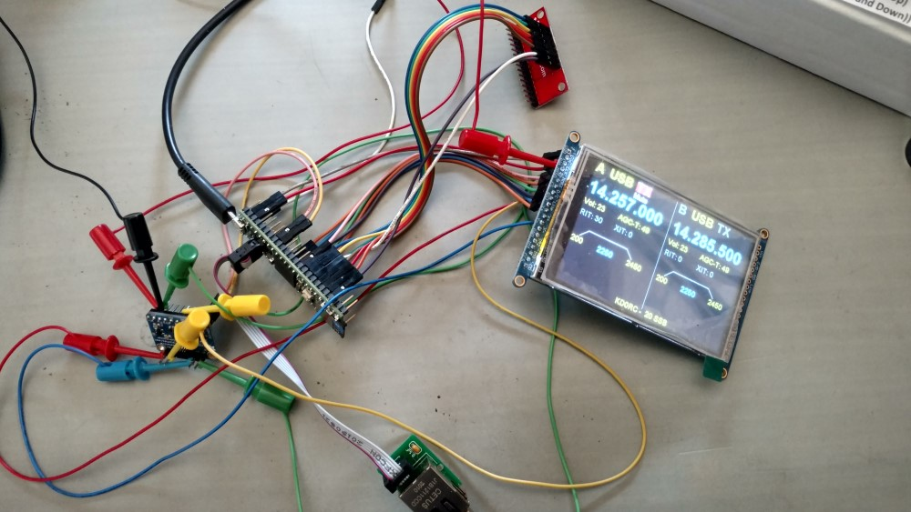
More Better
The first of two multiplexers is at the top of the picture. What a difference that made in wiring the buttons! This is also when I decided to add the touch screen. The Teensy board is much smaller, much much faster (600 MHz M7 vs 84 MHz M3) and is cheaper than the Arduino Due.

Slide 13
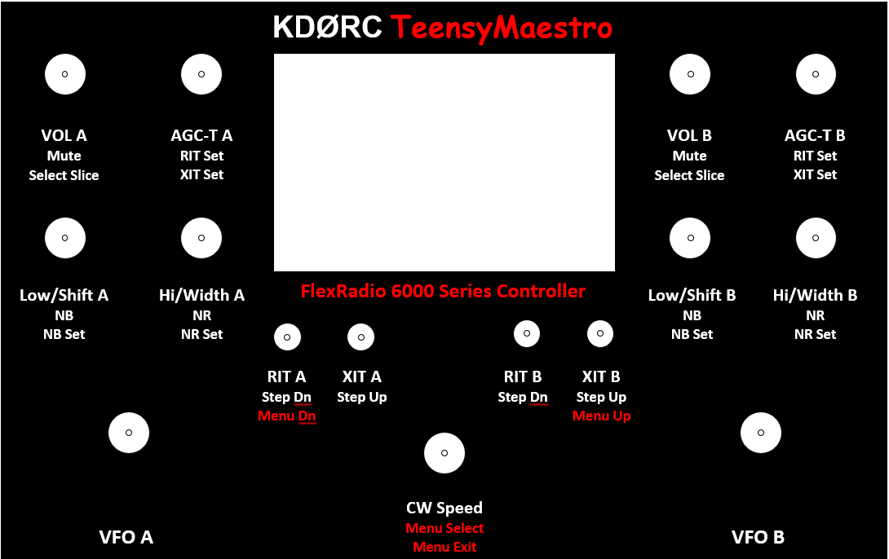
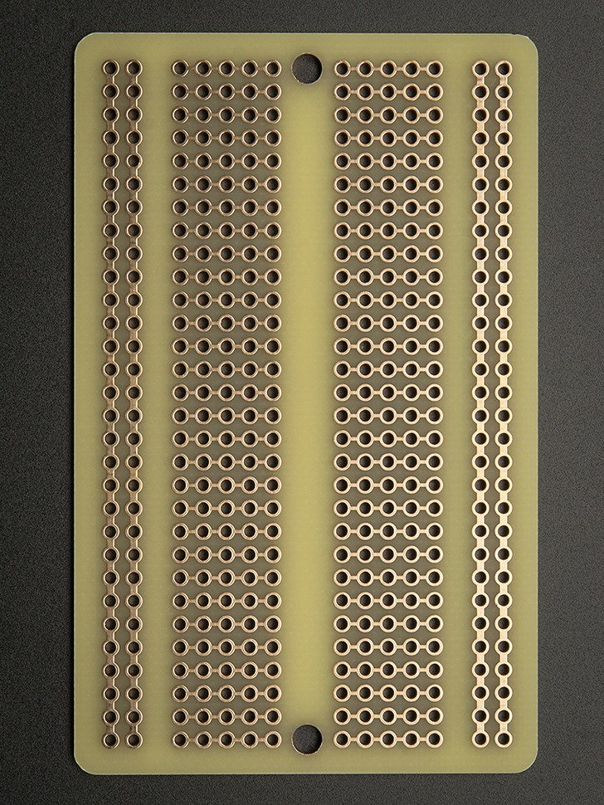
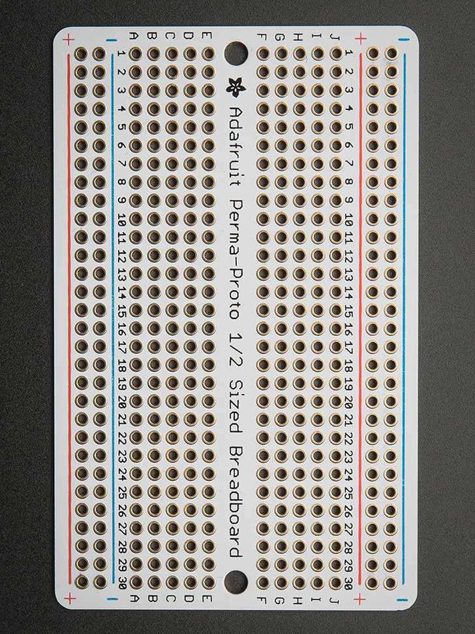
Building Techniques
To provide a mounting platform, I used a “perma” proto board from AdaFruit. It provides power and ground rails and makes multiple connections to the Teensy pins pretty easy. For the front panel, I laser printed plain paper which is then sandwiched between the aluminum panel and a sheet of clear ABS plastic.

Slide 14
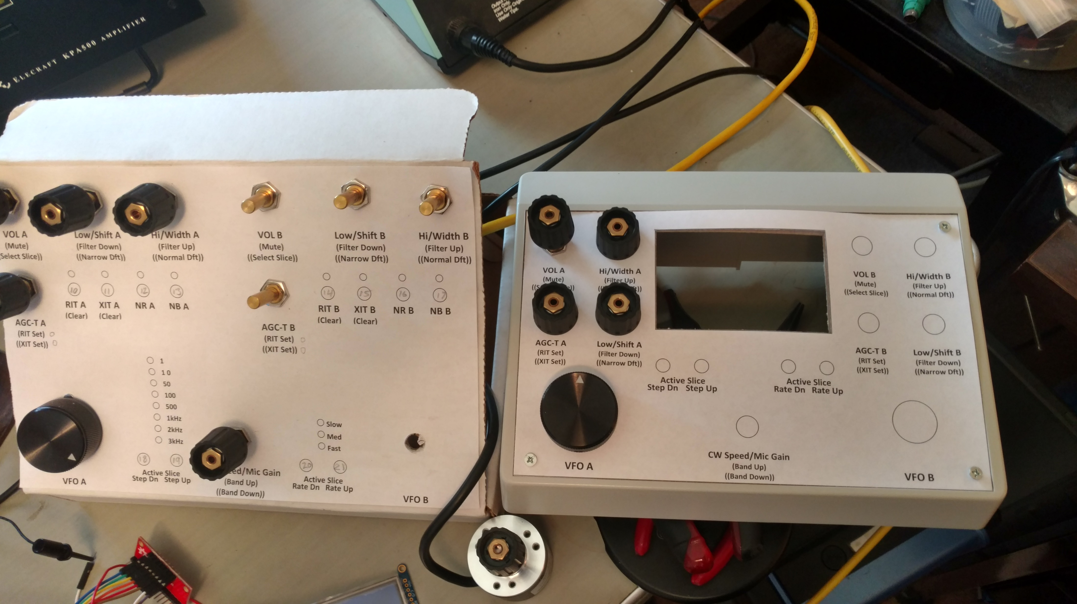
Moved to a Better Layout
The first layout was not too bad, but with the addition of the display, I didn’t need all of those LED indicators and I eliminated 8 buttons. The front panel design got a lot cleaner.

Slide 15
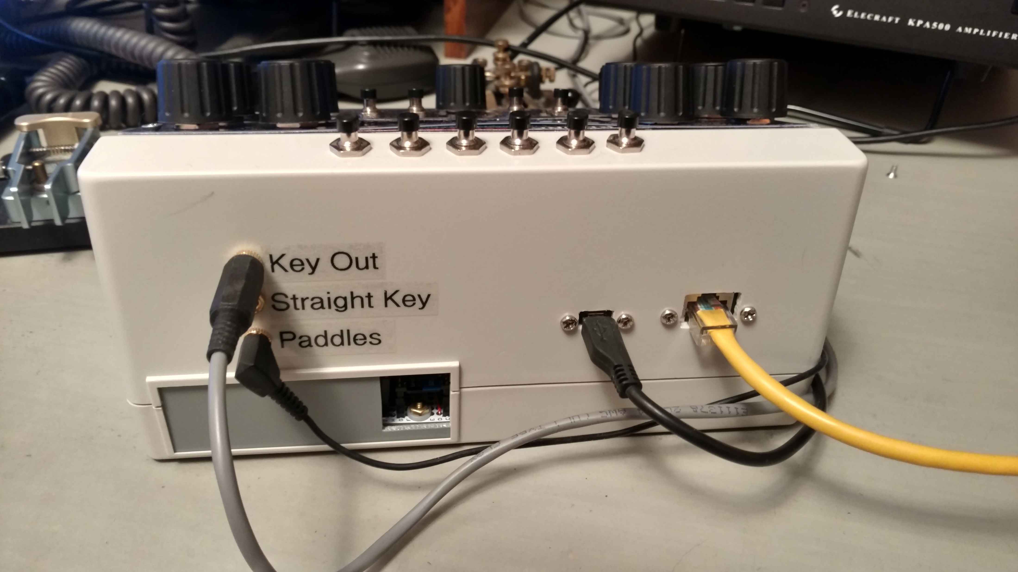
Final Layout
More scope-creep… I took most of the code from a keyer project (the same one I stole the display from) and ported it over to the TeensyMaestro. It can key the Flex, or operate as a standalone keyer to key any modern rig (sorry Frank and Carey, no 807/1625 cathode keying here…). The unlabeled buttons across the top activate the CW memories.

Slide 16
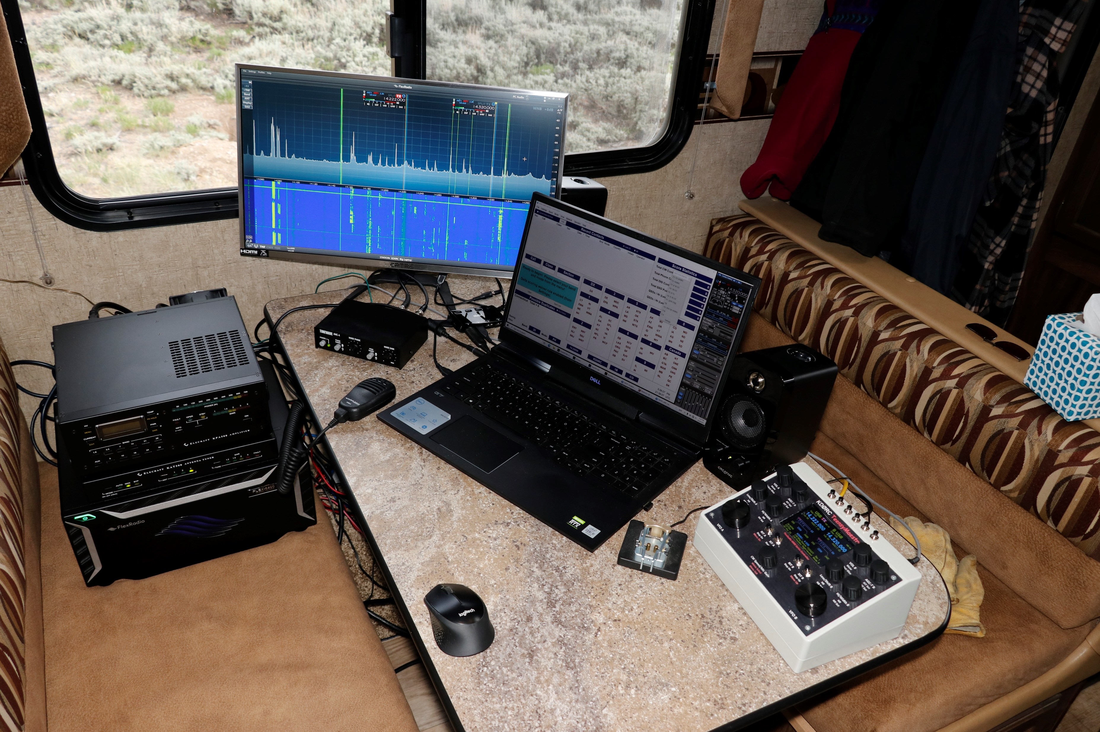
Field Day 2021
The TeensyMaestro worked great at Field Day. My whole station in my 5th wheel camper dinette. Had to run the generator to operate the KPA 500 amp, but otherwise ran off solar charged batteries.

Slide 17
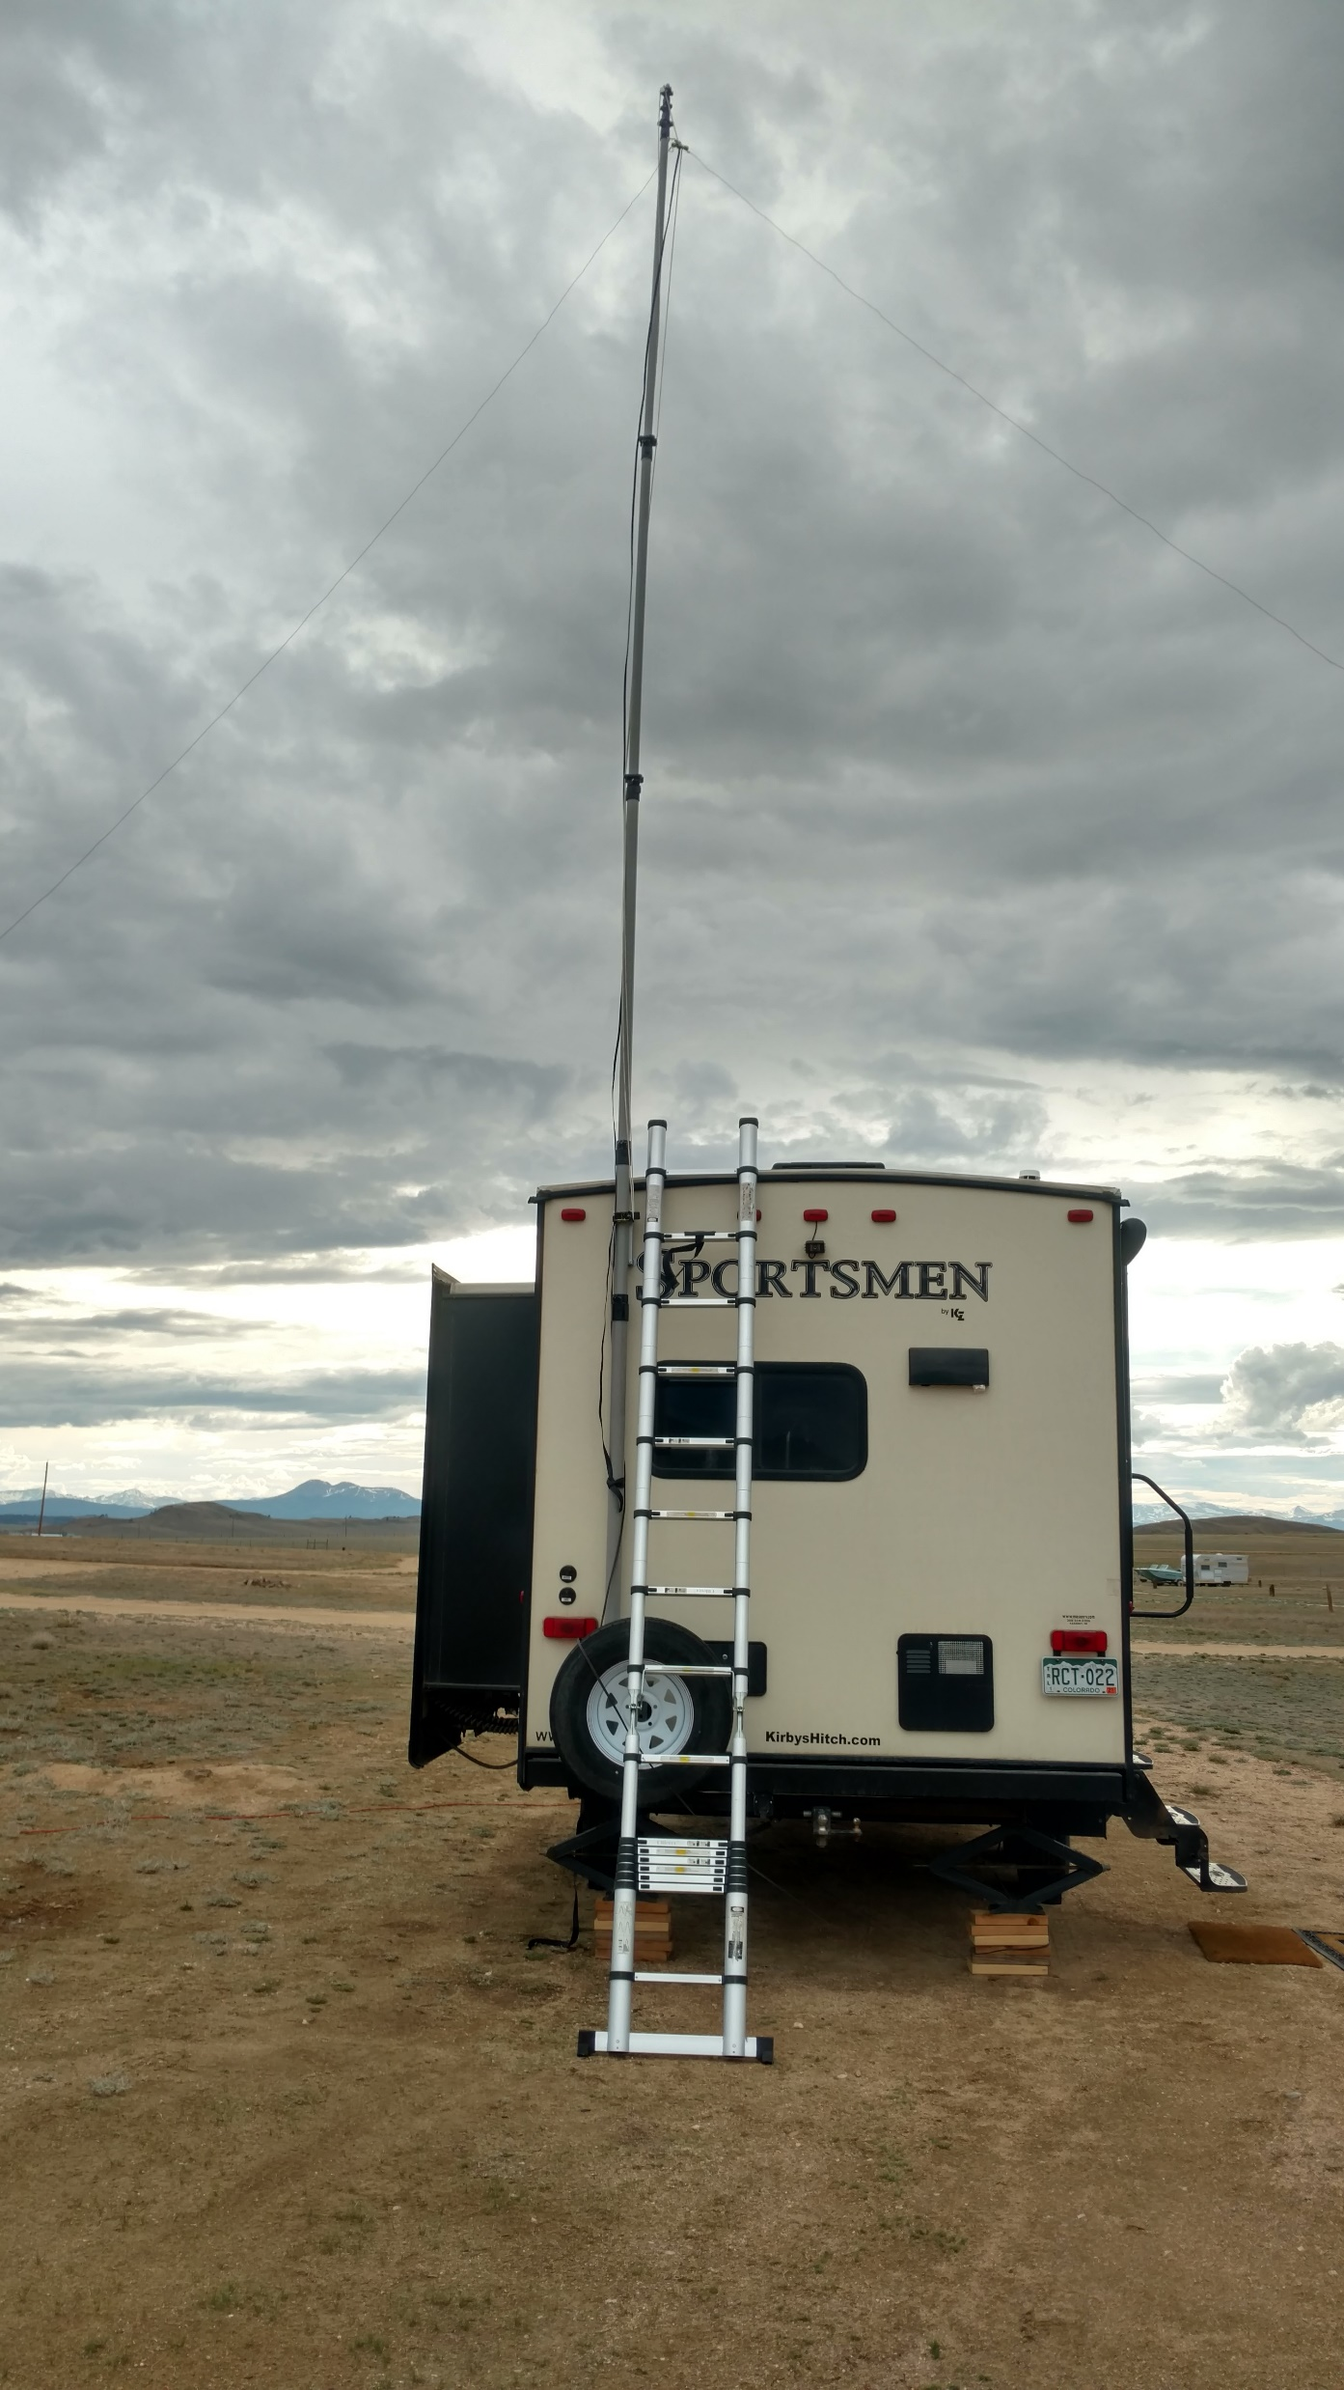
Fiberglass Mast
43 foot fiberglass mast raised to 30 (ish) feet. Antenna is an inverted V doublet fed with 300 ohm twinlead to a 4:1 balun.
I built aluminum brackets and mounted them to the back of my camper. A couple of ratchet straps hold the mast to the brackets.
If there are enough tall trees around, I can hang the antenna without the mast.

Slide 18
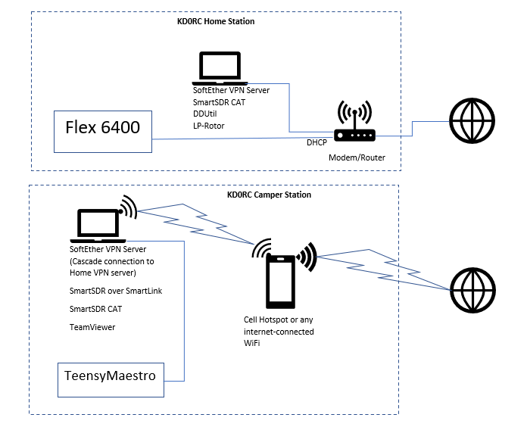
Remote Operation
T2X
KPA500
KAT500
Occasionally, I find a place to camp and fish that has actual cell service. I can then leave the station at home and just bring the laptop, cell phone and TeensyMaestro.

Slide 19
What’s Next?
PTT button and jack
Sidetone amplifier and low pass filter
Replace buttons made from Chinesium
Reprint front panel and get better corner panel screws
Add code to account for TX bandwidth when determining out of band
Software additions/tweaks as the mood strikes
If the jumpers and header pins cause problems, I will solder them to the proto board

Slide 20
Other Known TeensyMaestros in the Wild
Dave, W4WKU (formerly known as KG0EW)
Steve, AA3SS
Ben, VR2VIY (building a second one using a PCB)
Lasse, SM5GLC (in progress)
Stan, K3PW (in progress)
Mike, KF5DEY (in progress)
Mark, KD5RXT (in progress)
Jens, SM6AFV (in progress)

Slide 21
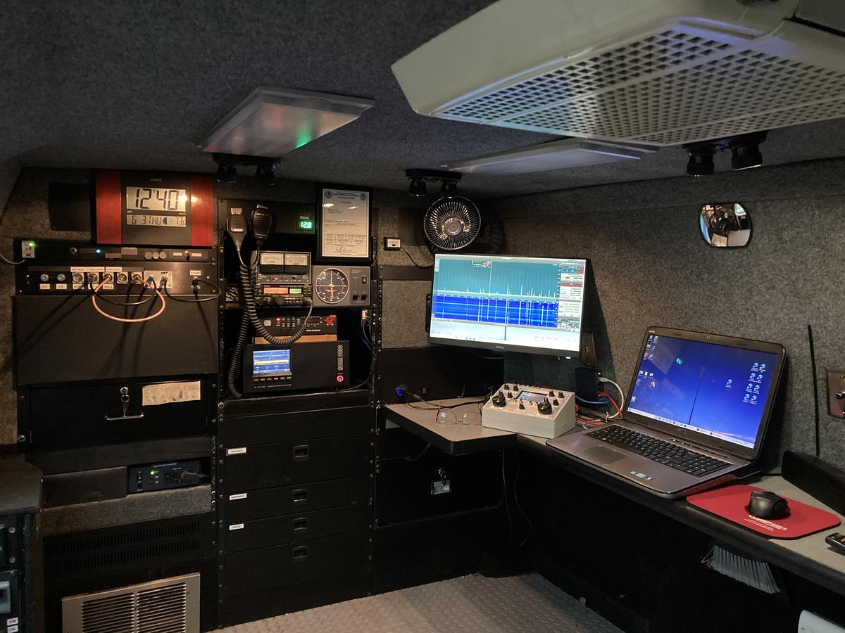
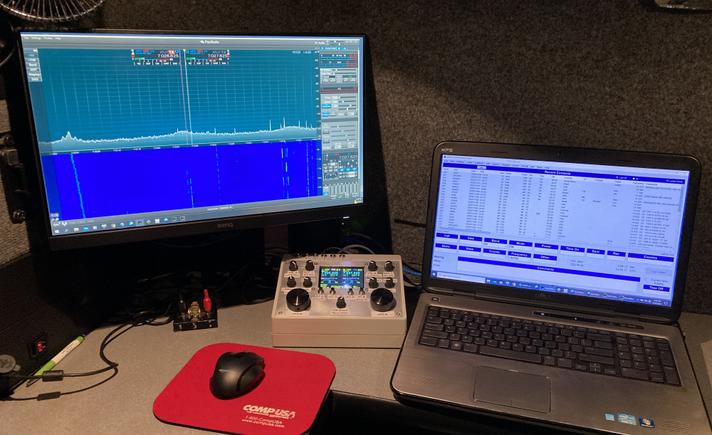
Dave, W4WKU

Slide 22
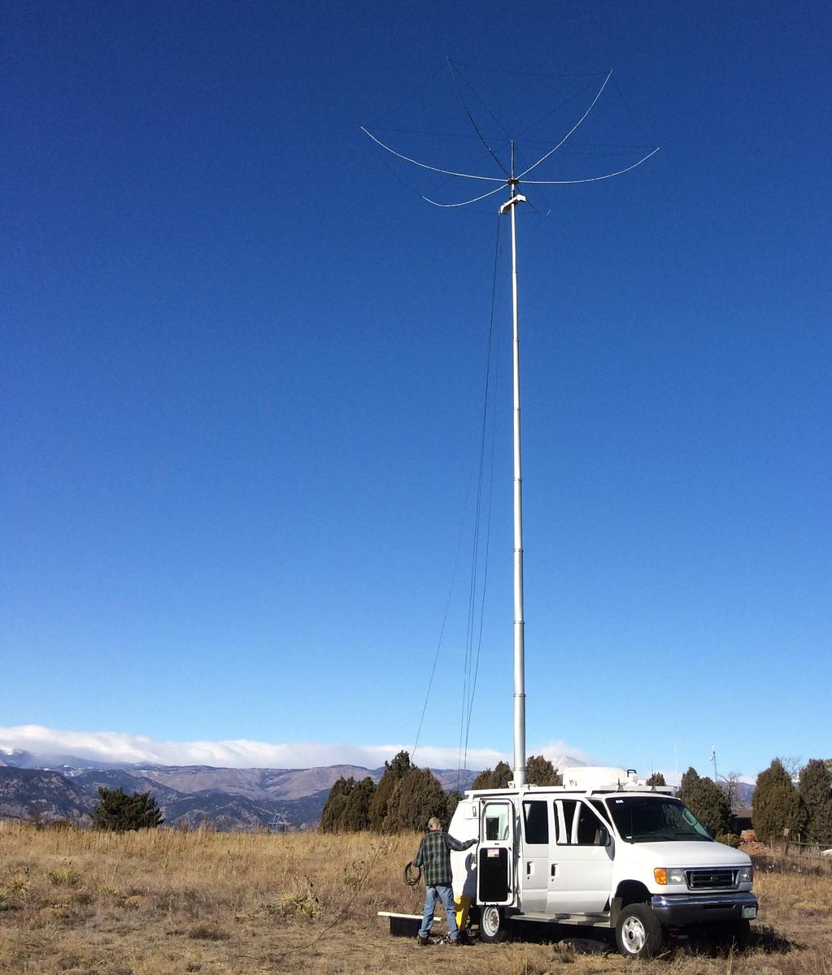
W4WKU Ham-Van

Slide 23
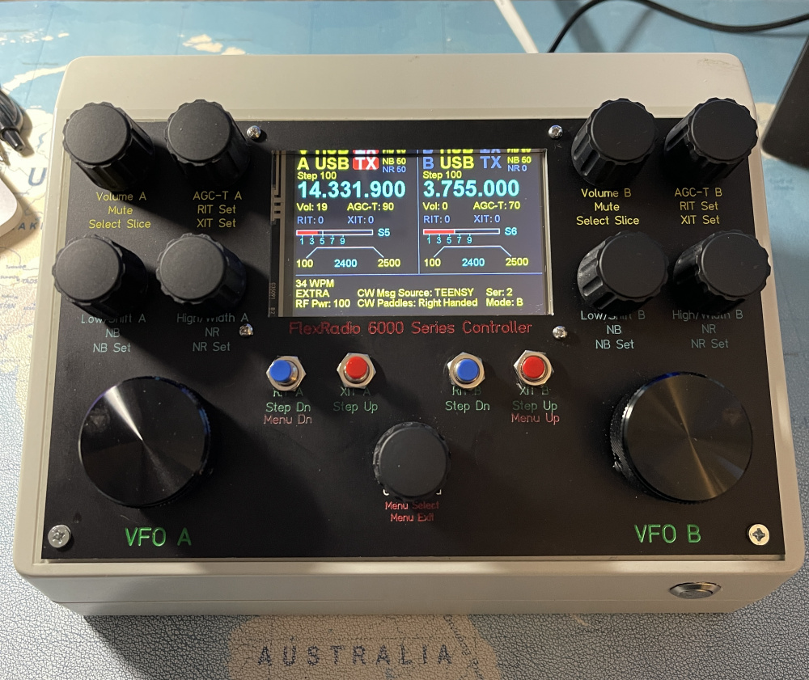
Steve, AA3SS

Slide 24
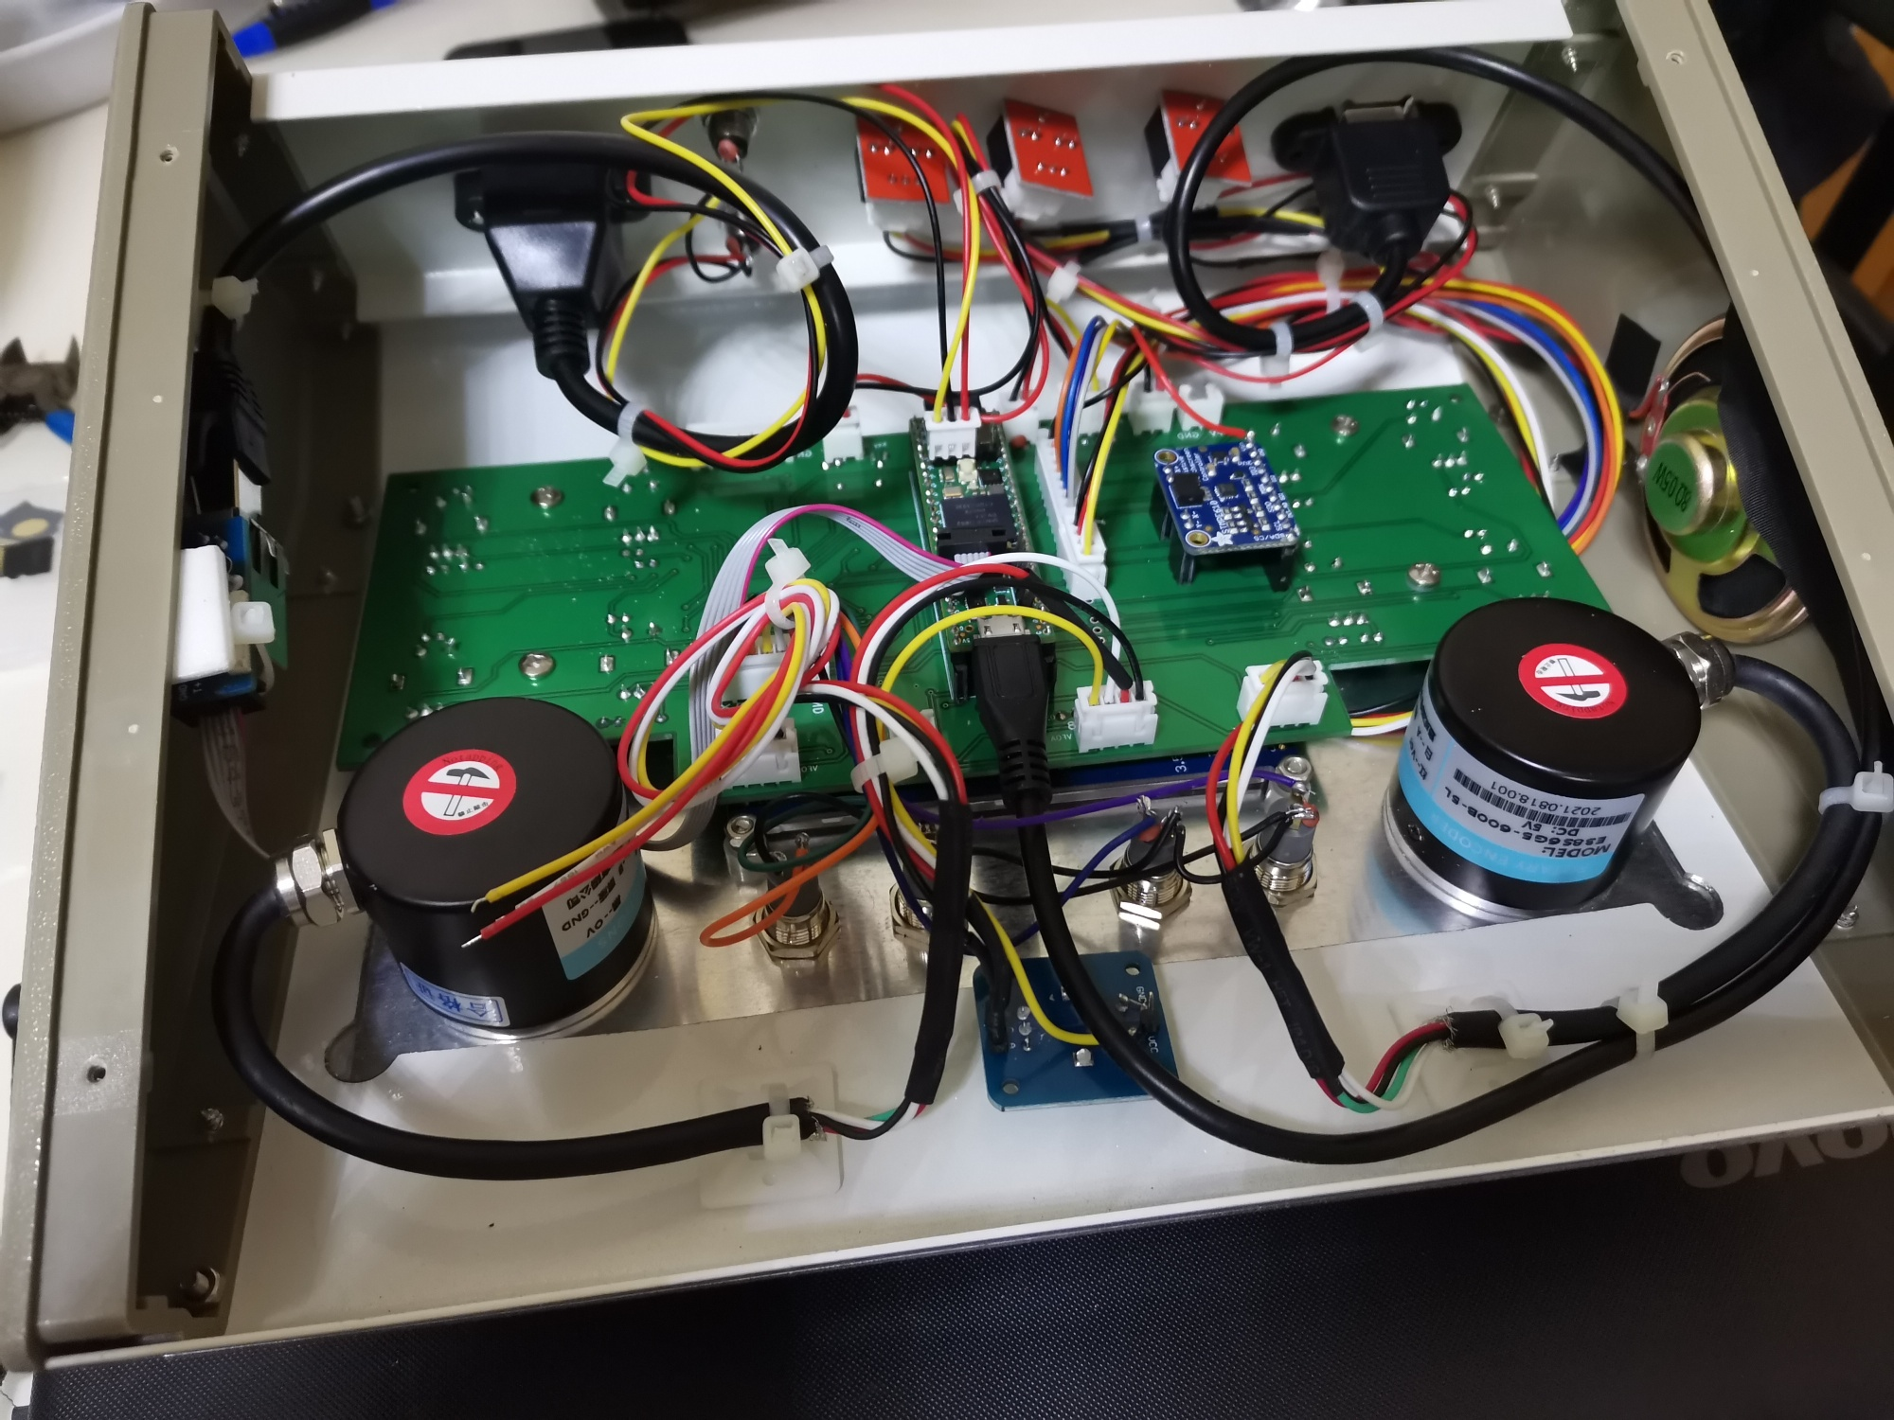
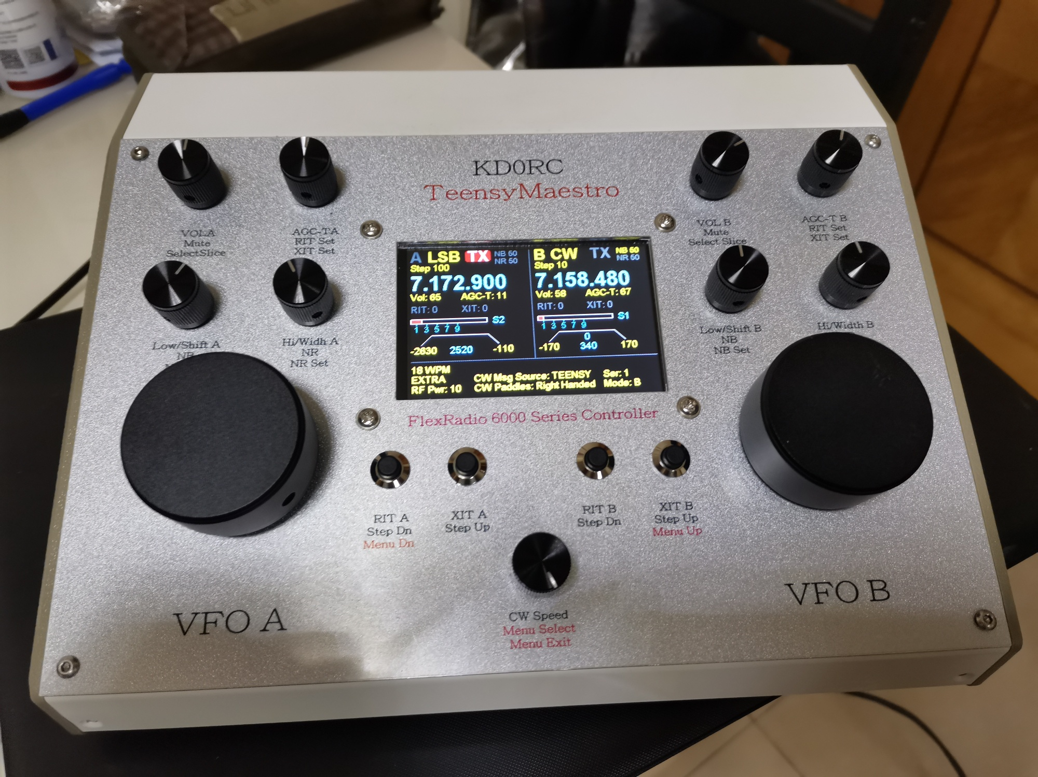
Ben, VR2VIY

Slide 25
Build Your Own!
User Manual
Bill of Materials
Schematic
Front Panel Layout
Everything is out on GitHub - KD0RC/Teensy-Maestro-for-Flex-6000-radios: TeensyMaestro - a Teensy-based set of controls for Flex 6000 series radios. (github.com)
There is a TeensyMaestro thread on the Flex Forum - TeensyMaestro - Page 6 — FlexRadio Community

Slide 26
Quick Demo

