Slide 1
Introduction to Santa Fe ARES (SFARES)
December 2020

Slide 2
SFARES
The SFARES Group is comprised of FCC licensed Amateur Radio Operators residing in the general Santa Fe, NM geographical area. Membership is open to any licensed operator interested in volunteer public service.
The SFARES mission is to augment and facilitate emergency communications and related services and activities for Santa Fe City and County Emergency Management.

Slide 3
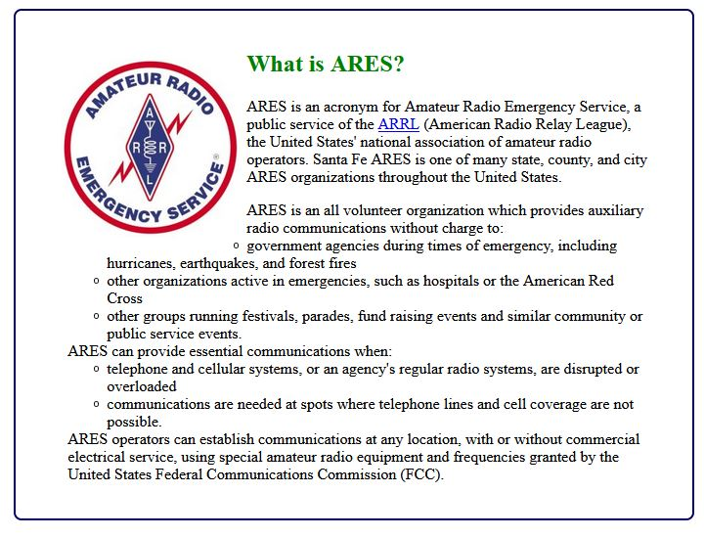

Slide 4
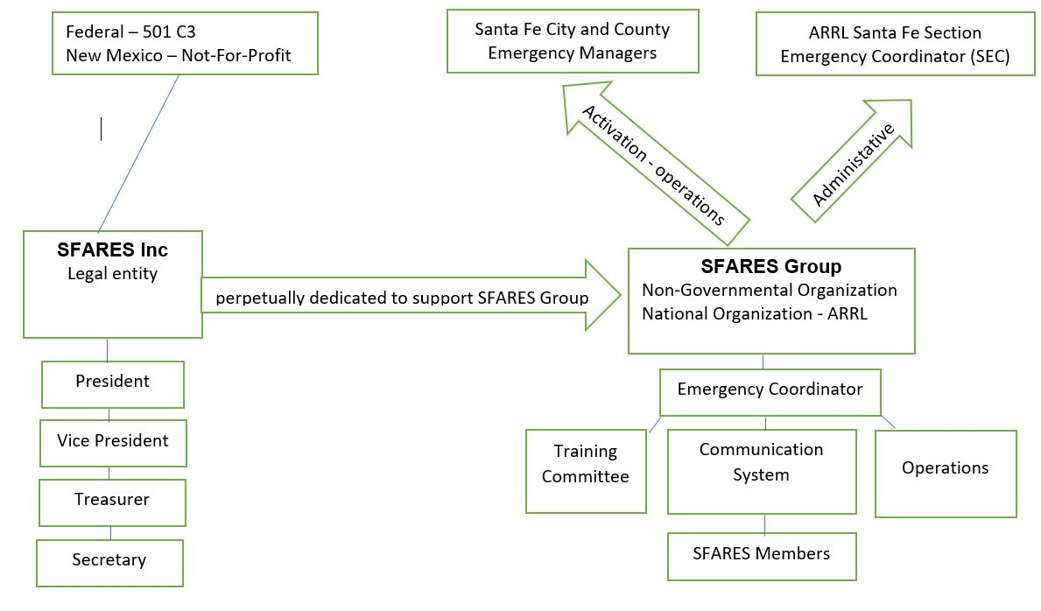
SFARES Organization

Slide 5
Who does SFARES Report to?
SFARES supports Santa Fe City and County Emergency Management, specifically the County Emergency Manager, Martin Vigil
ARES fits here

Slide 6
Possible Emergencies in Northern NM
Wildfire
Train wreck
Hazardous material spill (chemicals, nuclear material, etc.)
Dam breach
Cyber attack on communications, power and other utility infrastructure

Slide 7
Santa Fe Amateur Radio Emergency Services (SFARES)
When there is a need, the Santa Fe County Emergency Manager will contact Santa Fe ARES for communications support.
The Santa Fe County Emergency Manager will contact Evelyn Ward (KE5GLR). Evelyn is the SFARES Emergency Coordinator who is the point of contact for all activations. (If Evelyn is not available, then the County Emergency Manager will contact Alden Oyer (AG5S) or Don Hinsman (N4VIP) to coordinate activities).
The Emergency Coordinator will utilize the Call Multiplier phone messaging service to inform all members of an activation and how to proceed. Those members responding as available for activation will then be contacted by the Emergency Coordinator and given additional instructions.

Slide 8
Where to Start (Links on SFARES Web Site)
FEMA Emergency Management Institute – Independent Studies (ISP Courses)
Complete certification in the following courses:
IS 100.c – Introduction to the Incident Command System
IS 200.c – Basic Incident Command for Initial Response
IS 700.b – An Introduction to the National Incident Management System
IS 800.d – National Response Framework, An Introduction
Recommended for a better understanding of the role of Amateur Radio during an emergency :
IS 288.a – The Role of Voluntary Organizations in Emergency Management
American Radio Relay League (ARRL) Course:
Public Service and Emergency Communications Management for Radio Amateurs (EC-016) Course

Slide 9
Ongoing In-Service Training for SFARES Members
Organizational SOP’s
Aspects of Emergency Operational Plan
Introduction to Central and Remote SFARES Communication Sites and their capabilities
Operation of various radios
Understanding local and regional Audio VHF, UHF, Simplex, repeaters, and National and Global HF
Understanding local, regional ,national and global Digital D-Star, D-Rats, WL2K, VHF, UHF and HF
Learning situational awareness capabilities such as APRS and SARTrak
Becoming familiar with various software programs utilized in the communication sites.
An understanding of the SFARES Mesh and its components
Introduction to antennas and other technical communications equipment

Slide 10
SFARES participates in many Public Service Events
QSO Party
Field Day
Chimayo Pilgrimage
Santa Fe Century Bicycle Ride
Jemez Mountain Trail Run
Zozobra
Other requested Marathons and events as they are organized through out the year

Slide 11
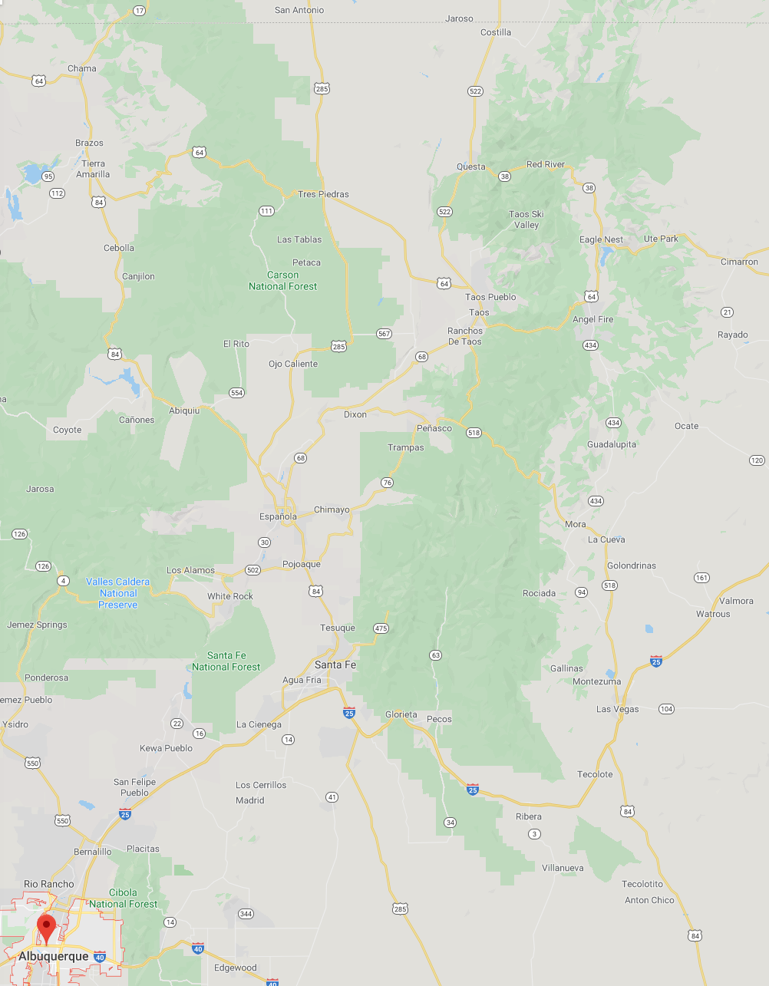
Santa Fe ARES TESuque LINKed Network (TESLINK)
St. Vincent’s Hospital
147.200 MHz (+600, 162.2)
Tesuque Peak
146.820 MHz (-600, 162.2)
442.825 MHz (+5, 131.8) UHF linking freq for TESLINK
Elk Mountain
147.300 MHz (+600, 162.2)
San Antonio Mountain
146.760 MHz (-600, 67.0)
ARES Simplex Frequency
147.555 MHz
DSTAR (Food Depot) (W5SF)
145.210 MHz (-600, )
When SF ARES is activated, TESLINK is the primary communications network
These repeaters are provided and maintained by the Santa Fe Amateur Radio Club (SFARC)

Slide 12
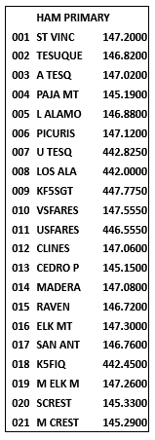
Other Communications Resources All Santa Fe ARES Radios are programmed with this list of repeaters
If TESLINK repeaters are not available or greater a greater coverage area is needed, then any of
the other repeaters listed may be used.
TESLINK Channels
Supports Digital Modes (DSTAR, Fusion)
Part of NM Mega-link network

Slide 13
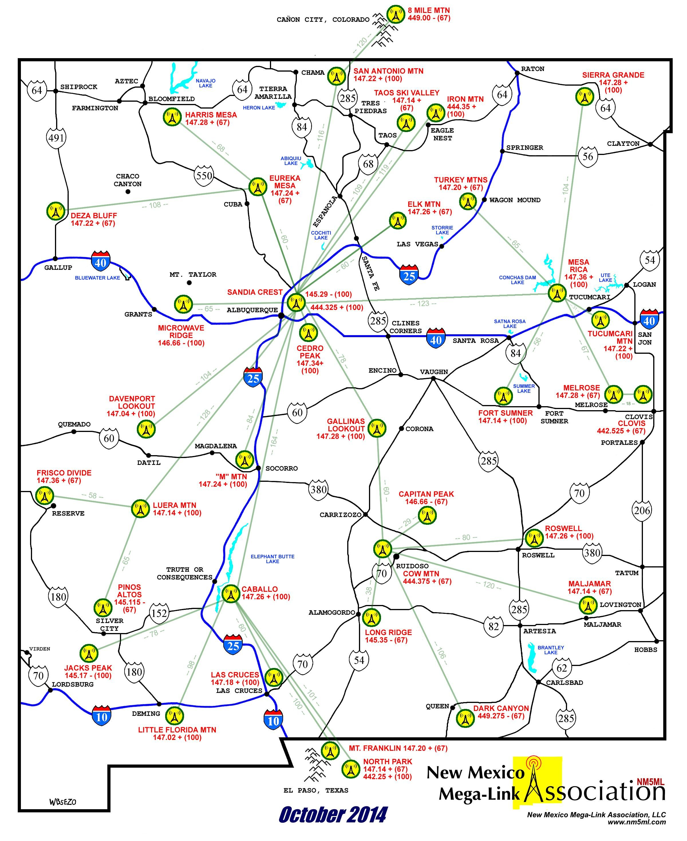
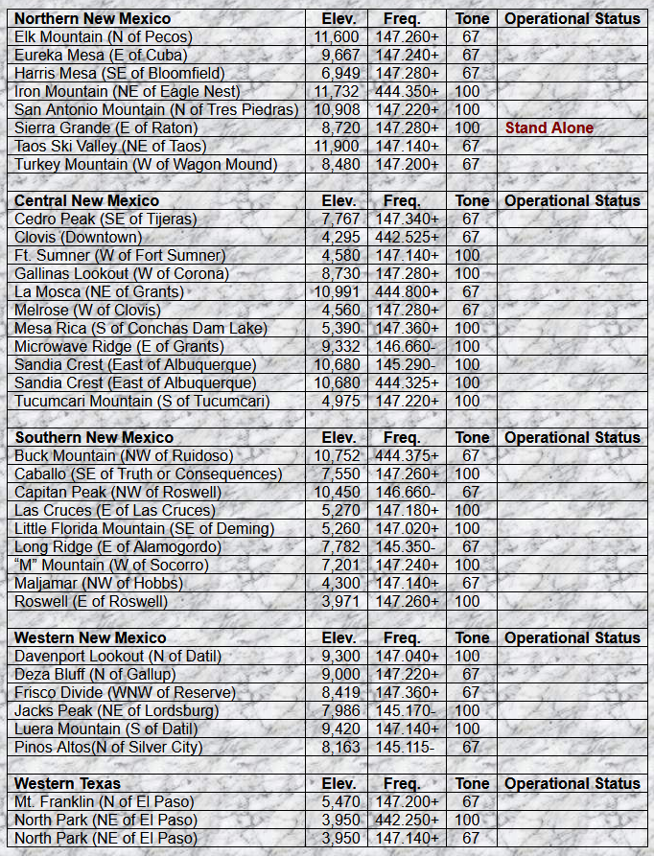
Other Communications Resources NM Megalink – 37 linked repeaters across NM and West Texas

Slide 15
Appendix
Regular meetings and radio nets
2nd Saturday of the month meetings (via Zoom during pandemic)
Tuesday before the 2nd Saturday D-RATS net, 7:30pm (via Internet)
Tuesday before the 2nd Saturday radio net, 8:00pm on Teslink
First Sunday State-wide emergency services net, 3.939 MHz, LSB
7:30pm Mountain Daylight Time, or
5:00pm Mountain Standard Time

