Slide 1
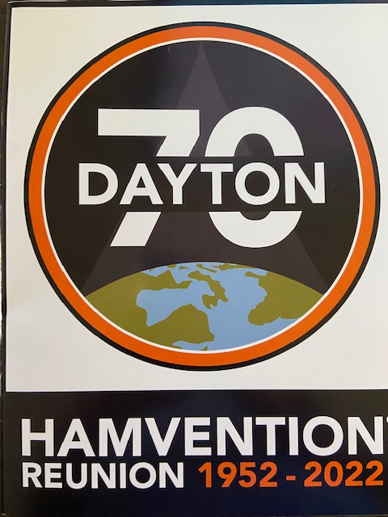
Total Attendance - 31367

Slide 2
We are not even there yet, and Bob is famous! (Atlanta Airport)

Slide 3
Cut in the hill. Cincinnati skyline straight ahead. The Cincinnati airport is actually located in Northern Kentucky. Go figure!

Slide 4
Dinner upon arrival at a Cincinnati staple – LaRosa’s Personal pizza and a garden salad. Followed by a little excitement. Next slide

Slide 5
Timber!!

Slide 6
Ohio State Flag welcomes you to the 2022 Hamvention.

Slide 7
CQ CQ CQ, Call me a HamBulance!!

Slide 8
Let the show begin, Maxim Building.

Slide 9
Maxim Building. Vendors everywhere.

Slide 10
Antenna up hairdo

Slide 11
Yaesu’s area took up half of one entire building.

Slide 12
Entry ticket to the Dayton Hamvention 2022. Notice the hole punch, this is how Yaesu tracked who received the annual Yaesu hat.

Slide 13
Just an example of Yaesu’s equipment on display. The new FT-110 Transceiver.

Slide 14
Building Two – Tesla Building, even more vendors. Everything from toys to towers.

Slide 15
Marconi Building

Slide 16
Volta Building

Slide 17
Overkill for a portable antenna

Slide 18
Need some coax???

Slide 19
Courtyard at the Hamvention

Slide 20
You must look but it is Wolfman with ears and a tail. Only in Xenia!

Slide 21
Quick tour of Cincinnati

Slide 22
A view of the 471 bridge (McDonald’s Bridge)

Slide 23
Home of the Flying Pigs – Porkopolis 1862

Slide 24
Fountain Square The Cincinnati Angel

Slide 25
Union Terminal – Now Cincinnati History Museum Amtrak still operates train service

Slide 26
Just some of the murals in the main terminal

Slide 27
Additional Mural in Union Terminal

Slide 28
The original information booth within the terminal

Slide 29
Rookwood Ice cream parlor - in Union Terminal

Slide 30
Original Ticket Counter inside Union Terminal

Slide 31
Old Bones inside the History Museum

Slide 32
Batter Up! The History of Baseball

Slide 33
In Cincinnati, it’s not a bridge, it’s a Viaduct

Slide 34
Lunch Time ----- White Castle Time

Slide 35
Even Amateur Radio Folks Love White Castle Where’s the Beef

Slide 36
The Battle of Cincinnati Chili #1 - Skyline

Slide 37
# 2 - Gold Star Chili - It’s a Cincy Thing as Bob says – Where’s the Hot Dog!!

Slide 38
Findlay Market Downtown

Slide 39
Inside Findlay Market Ohio’s oldest operating public market Since 1855

Slide 40
Modern day trolley outside Findlay Market

Slide 41
A view from Krone Conservatory

Slide 42
Mr. Cincinnati Reds or Farm Fresh Eggs – It’s your choice

Slide 43
University of Cincinnati In the heart of the city

Slide 44
Montgomery Inn Boathouse On the Ohio River

Slide 45
Montgomery Inn Cigar Pig that greets you

Slide 46
Montgomery Inn -,Founder Ted Gregory known for his Cigar and “Rib King” crown.

Slide 47
Pony Keg -A drive thru beer soda place Hummm, buy your beer while driving? Its a Cincy thing.

Slide 48
Frisch’s Big Boy – a Cincinnati institution Just another hamburger joint.

Slide 49
The Star Tower - 954 feet tall. Who do I see about permission to put my beam up top?

Slide 50
The John Roebling Suspension Bridge Opened December 1, 1866. Was the longest Suspension Bridge in the World, 1057 feet.

Slide 51
Another View and still standing

Slide 52
Inside Carew Tower All inlaid Rookwood Pottery Tile

Slide 53
Downtown Art Deco Clock What Time is it anyway? It’s a Cincinnati Thing

Slide 54
The Netherland Plaza Hotel – in the Carew Tower A 4-Star hotel

Slide 55
Jewish Temple In the Heart of Downtown

Slide 56
The Corner Stone for the Temple was laid on May 12, 1865.

