Slide 1
Technician Licensing Class
Electrical components, semiconductors, circuit diagrams, component functions
T6A - T6D
Valid
July 1, 2022 Through June 30, 2026
Originally developed by Bob Bytheway, K3DIO, and
updated to 2022 and 2018 Question Pool by NQ4K for Sterling Park Amateur Radio Club
Notes:
1

Slide 2
T 6 A Topics
Fixed and variable resistors;
Capacitors;
Inductors;
Fuses;
Switches;
Batteries
2

Slide 3
T 6 A
The electrical component which opposes the flow of current in a DC circuit is the resistor. T6A01
The component often used as an adjustable volume control is the potentiometer. T6A02
The electrical parameter controlled by a potentiometer is resistance. T6A03
3

Slide 4
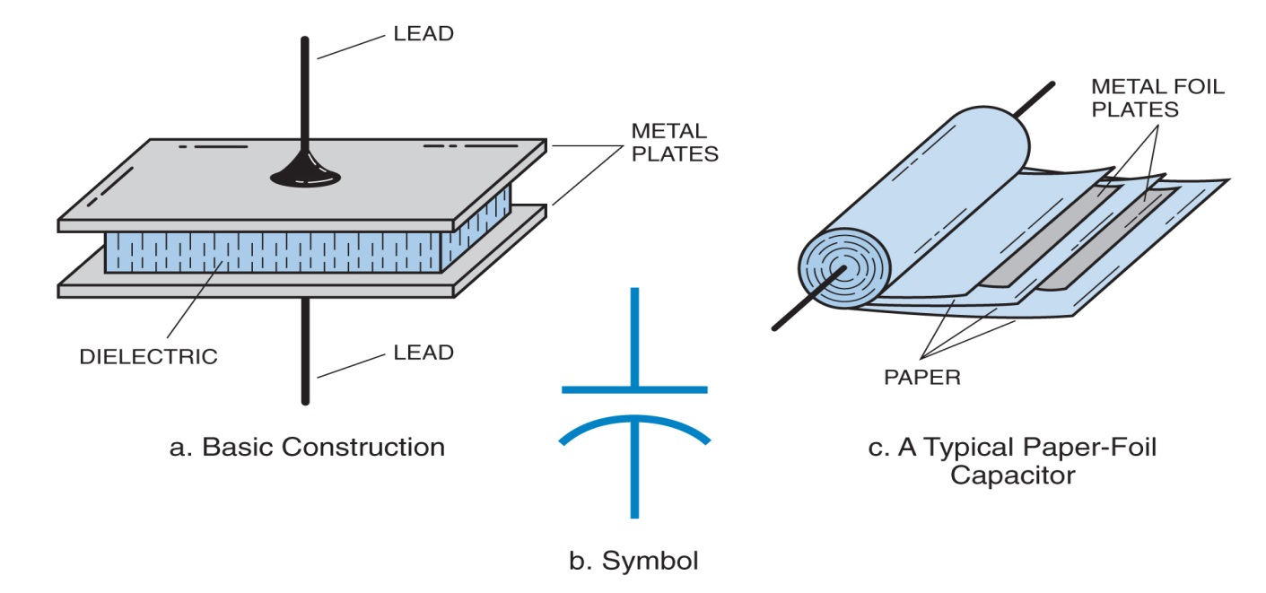
T 6 A
The electrical component that stores energy in an electric field is the capacitor. T6A04
The type of electrical component that consists of two or more conductive surfaces separated by an insulator is a capacitor. T6A05

Slide 5
T 6 A
The electrical component that stores energy in a magnetic field is an inductor. T6A06
The electrical component usually constructed as a coil of wire is an inductor. T6A07
5

Slide 6
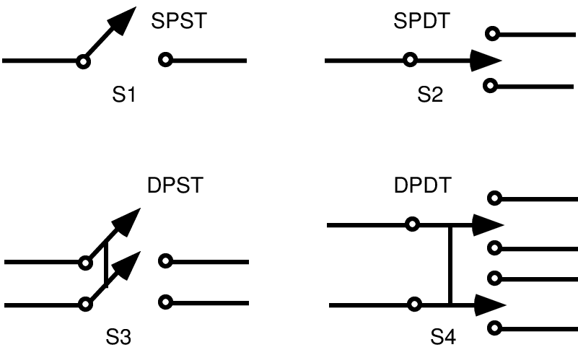
T 6 A
The function of a SPDT switch is to switch a single circuit between on of two other circuits. T6A08
The electrical component used to protect other circuit components from current overload is the fuse. T6A09
6

Slide 7
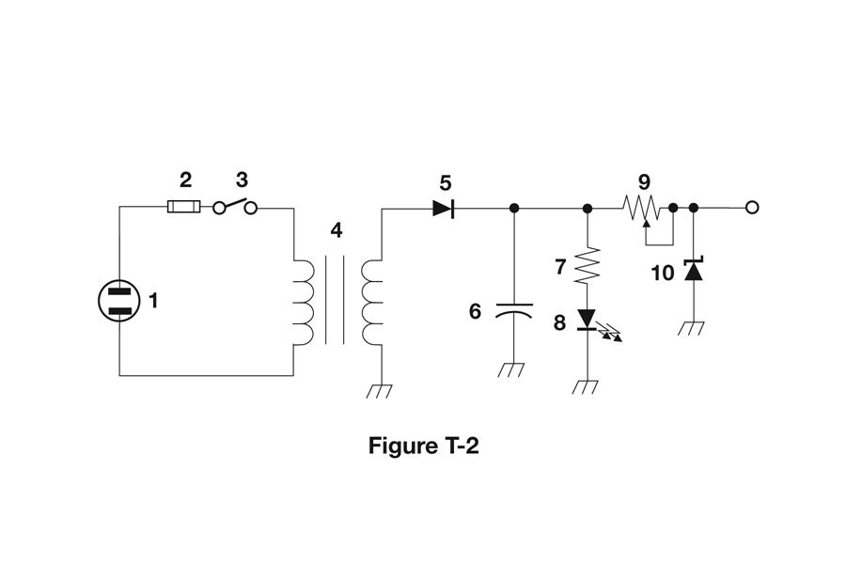
T 6 A
The type of switch represented by component 3 in figure T-2 is a Single-pole Single-throw (SPST). T6A12
7

Slide 8
T 6 A
The following battery chemistries are rechargeable:
Nickel-metal hydride;
Lithium-ion;
Lead-acid
All of these choices are correct. T6A10
This battery chemistry is not rechargeable:
Carbon-zinc. T6A11
8

Slide 9
T 6 B Topics
Semiconductors:
basic principles and applications of solid state devices;
diodes and transistors
9

Slide 10
T 6 B
The electronic component that allows current to flow in only one direction is the diode. T6B02
The forward voltage drop in a diode is lower in some diode types than in others. T6B01
The component that can be used as an electronic switch or amplifier is the transistor. T6B03
10

Slide 11
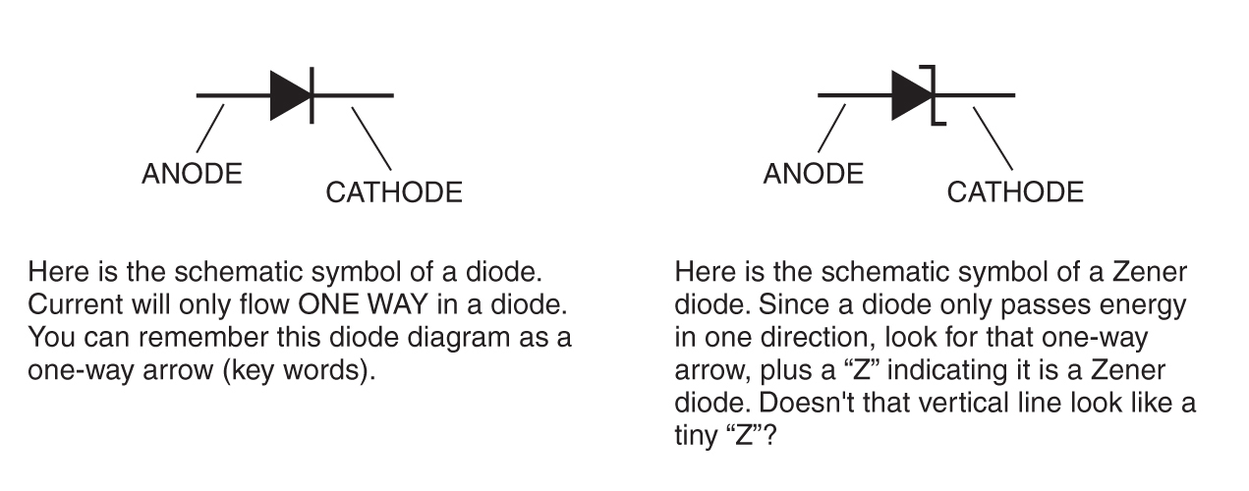
T 6 B
The component that consists of three layers of semiconductor material is the transistor. T6B04
The field effect transistor has a gate, drain, and source. T6B05
The cathode lead of a semiconductor diode is usually identified with a stripe. T6B06
11

Slide 12
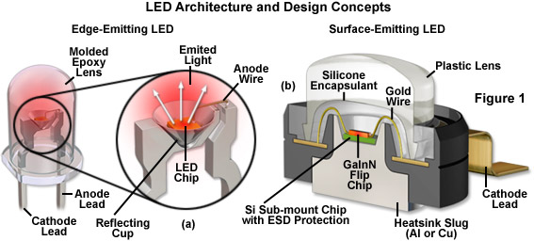
T 6 B
Forward current causes a light-emitting diode (LED) to emit light. T6B07
12

Slide 13
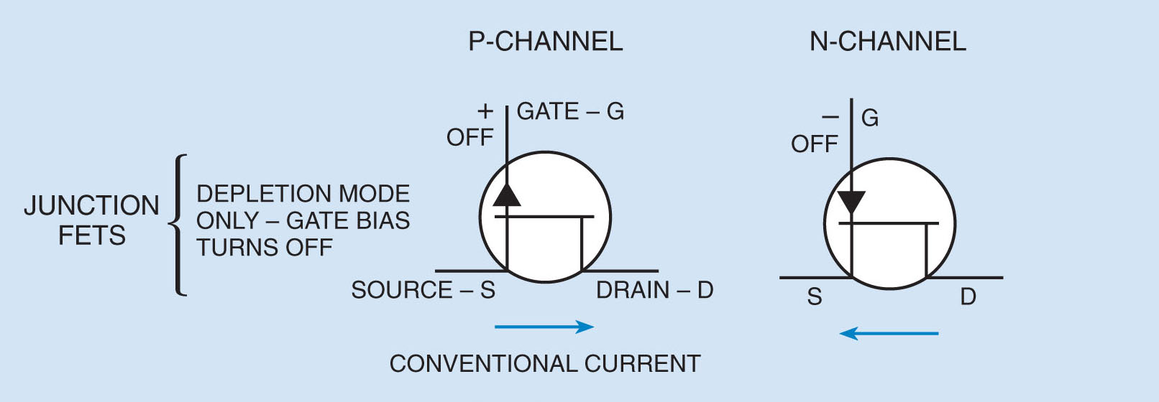
T 6 B
The abbreviation FET stands for Field Effect Transistor. T6B08

Slide 14
T 6 B
The names for the electrodes of a diode are the anode and cathode. T6B09
A transistor can provide power gain. T6B10
The term that describes a device’s ability to amplify a signal is gain. T6B11
14

Slide 15
T 6 B
The names for the electrodes of a bipolar junction transistor are emitter, base, and collector. T6B12
15

Slide 16
T 6 C Topics
Circuit diagrams;
Use of schematics
Basic structure
Schematic symbols of basic components
16

Slide 17
T 6 C
The name of an electrical wiring diagram that uses standard component symbols is a schematic. T6C01
17

Slide 18
T 6 C
Component #1 in Figure T1 is a Resistor T6C02
Component #2 in Figure T1 is a Transistor. T6C03
Figure T1
18

Slide 19
T 6 C
Component #3 in Figure T1 is a Lamp. T6C04
Component #4 in Figure T1 is a Battery. T6C05
Figure T1
19

Slide 20
T 6 C
Component #6 in Figure T2 is a capacitor. T6C06
Component #8 in Figure T2 is a light emitting diode. T6C07
Component #9 in Figure T2 is a variable resistor. T6C08
Figure T2
20

Slide 21
T 6 C
Component #4 in Figure T2 is a transformer. T6C09
Figure T2
21

Slide 22
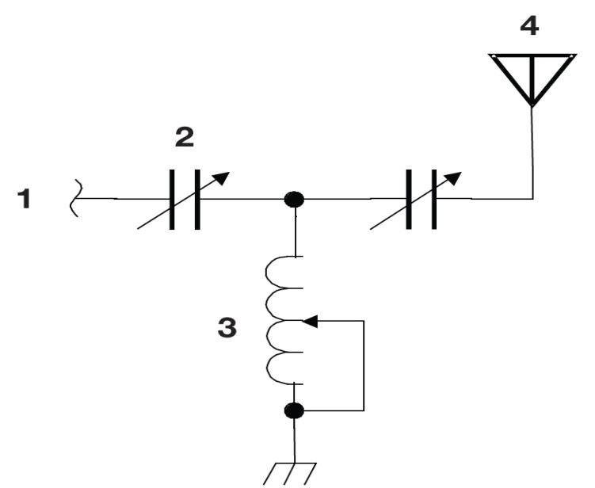
T 6 C
The component #3 in figure T3 is a variable inductor. T6C10
The component #4 in figure T3 is an antenna. T6C11
Figure T3
22

Slide 23
T 6 C
Component connections are accurately represented in electrical schematics. T6C12
23

Slide 24
T 6 D Topics
Component functions:
Rectifiers,
Relays,
Voltage regulators,
Meters,
Indicators,
Integrated circuits
Transformers;
Resonant circuit
Shielding
24

Slide 25
T 6 D
The device or circuit that changes an alternating current in to a varying direct current signal is the rectifier. T6D01
A relay is an electrically-controlled switch. T6D02
A reason to use shielded wire is to prevent coupling of unwanted signals to or from the wire. T6D03
25

Slide 26
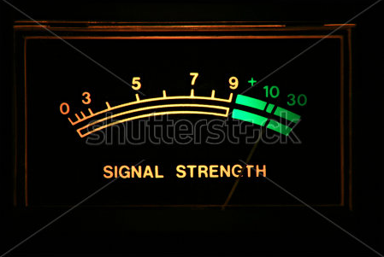
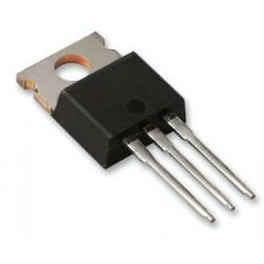
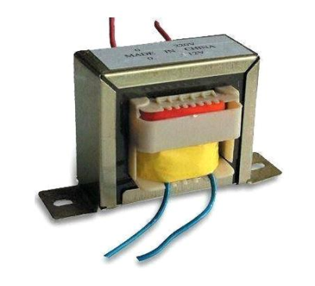
T 6 D
A meter can display an electrical quantity as a numeric value. T6D04
A regulator is a type of circuit that
controls the amount of voltage
from a power supply. T6D05
The component commonly used to
change 120V AC house current to
a lower AC voltage for other uses
is a transformer. T6D06
26

Slide 27
T 6 D
A device commonly used as a visual indicator is an LED. T6D07
A capacitor is used together with an inductor to make a tuned circuit. T6D08
27

Slide 28
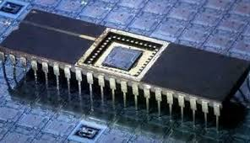
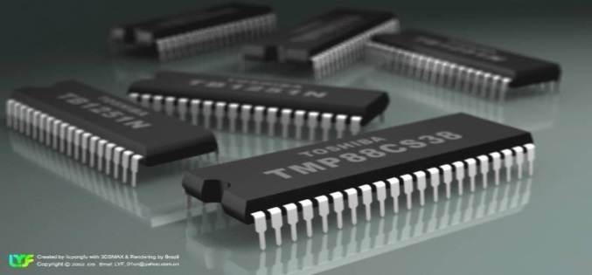
T 6 D
The device that combines
several semiconductors and other
components into one package is
an integrated circuit. T6D09
The function of component
#2 in Figure T1 is to control
the flow of current. T6D10
Figure T1
28

Slide 29
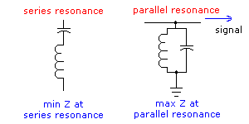
T 6 D
An inductor and a capacitor connected in series or parallel is a resonant or tuned circuit. T6D11
29

Slide 30
Element 2 Technician Class Question Pool
T 6 A – T 6 D
Notes:
30

Slide 31
T6A01 What electrical component opposes the flow of current in a DC circuit?
Inductor
Resistor
Voltmeter
Transformer
31

Slide 32
T6A01 What electrical component opposes the flow of current in a DC circuit?
Inductor
Resistor
Voltmeter
Transformer
32

Slide 33
T6A02 What type of component is often used as an adjustable volume control?
Fixed resistor
Power resistor
Potentiometer
Transformer
33

Slide 34
T6A02 What type of component is often used as an adjustable volume control?
Fixed resistor
Power resistor
Potentiometer
Transformer
34

Slide 35
T6A03 What electrical parameter is controlled by a potentiometer?
Inductance
Resistance
Capacitance
Field strength
35

Slide 36
T6A03 What electrical parameter is controlled by a potentiometer?
Inductance
Resistance
Capacitance
Field strength
36

Slide 37
T6A04 What electrical component stores energy in an electric field?
Resistor
Capacitor
Inductor
Diode
37

Slide 38
T6A04 What electrical component stores energy in an electric field?
Resistor
Capacitor
Inductor
Diode
38

Slide 39
T6A05 What type of electrical component consists of two conductive surfaces separated by an insulator?
Resistor
Potentiometer
Oscillator
Capacitor
39

Slide 40
T6A05 What type of electrical component consists of two conductive surfaces separated by an insulator?
Resistor
Potentiometer
Oscillator
Capacitor
40

Slide 41
T6A06 What type of electrical component stores energy in a magnetic field?
Resistor
Capacitor
Inductor
Diode
41

Slide 42
T6A06 What type of electrical component stores energy in a magnetic field?
Resistor
Capacitor
Inductor
Diode
42

Slide 43
T6A07 What electrical component is usually constructed as a coil of wire?
Switch
Capacitor
Diode
Inductor
43

Slide 44
T6A07 What electrical component is usually constructed as a coil of wire?
Switch
Capacitor
Diode
Inductor
44

Slide 45
T6A08 What is the function of a SPDT switch?
A single circuit is opened or closed
Two circuits are opened or closed
A single circuit is switched between one of two other circuits
Two circuits are each switched between one of two other circuits
45

Slide 46
T6A08 What is the function of an SPDT switch?
A single circuit is opened or closed
Two circuits are opened or closed
A single circuit is switched between one of two other circuits
Two circuits are each switched between one of two other circuits
46

Slide 47
T6A09 What electrical component is used to protect other circuit components from current overloads?
Fuse
Thyratron
Varactor
All of these choices are correct
47

Slide 48
T6A09 What electrical component is used to protect other circuit components from current overloads?
Fuse
Thyratron
Varactor
All of these choices are correct
48

Slide 49
T6A10 Which of the following battery types is rechargeable?
Nickel-metal hydride
Lithium-ion
Lead-acid
All of these choices are correct
49

Slide 50
T6A10 Which of the following battery types is rechargeable?
Nickel-metal hydride
Lithium-ion
Lead-acid
All of these choices are correct
50

Slide 51
T6A11 Which of the following battery chemistries is not rechargeable?
Nickel-cadmium
Carbon-zinc
Lead-acid
Lithium-ion
51

Slide 52
T6A11 Which of the following battery chemistries is not rechargeable?
Nickel-cadmium
Carbon-zinc
Lead-acid
Lithium-ion
52

Slide 53
T6A12 What type of switch is represented by component 3 in figure T-2?
Single-pole single-throw
Single-pole double-throw
Double-pole single-throw
Double-pole double-throw
53

Slide 54
T6A12 What type of switch is represented by component 3 in figure T-2?
Single-pole single-throw
Single-pole double-throw
Double-pole single-throw
Double-pole double-throw
54

Slide 55
T6B01 Which is true about forward voltage drop in a diode?
It is lower in some diode types than in others
It is proportional to peak inverse voltage
It indicates that the diode is defective
It has no impact on the voltage delivered to the load
55

Slide 56
T6B01 Which is true about forward voltage drop in a diode?
It is lower in some diode types than in others
It is proportional to peak inverse voltage
It indicates that the diode is defective
It has no impact on the voltage delivered to the load
56

Slide 57
T6B02 What electronic component allows current to flow in only one direction?
Resistor
Fuse
Diode
Driven element
57

Slide 58
T6B02 What electronic component allows current to flow in only one direction?
Resistor
Fuse
Diode
Driven element
58

Slide 59
T6B03 Which of these components can be used as an electronic switch?
Varistor
Potentiometer
Transistor
Thermistor
59

Slide 60
T6B03 Which of these components can be used as an electronic switch?
Varistor
Potentiometer
Transistor
Thermistor
60

Slide 61
T6B04 Which of the following components can consist of three layers of semiconductor material?
Alternator
Transistor
Triode
Pentagrid converter
61

Slide 62
T6B04 Which of the following components can consist of three layers of semiconductor material?
Alternator
Transistor
Triode
Pentagrid converter
62

Slide 63
T6B05 Which type of transistor has a gate, drain, and source?
Varistor
Field-effect
Tesla-effect
Bipolar junction
63

Slide 64
T6B05 Which type of transistor has a gate, drain, and source?
Varistor
Field-effect
Tesla-effect
Bipolar junction
64

Slide 65
T6B06 How is the cathode lead of a semiconductor diode often marked on the package?
With the word “cathode”
With a stripe
With the letter C
With the letter K
65

Slide 66
T6B06 How is the cathode lead of a semiconductor diode often marked on the package?
With the word “cathode”
With a stripe
With the letter C
With the letter K
66

Slide 67
T6B07 What causes a light-emitting diode (LED) to emit light?
Forward current
Reverse current
Capacitively-coupled RF signal
Inductively-coupled RF signal
67

Slide 68
T6B07 What causes a light-emitting diode (LED) to emit light?
Forward current
Reverse current
Capacitively-coupled RF signal
Inductively-coupled RF signal
68

Slide 69
T6B08 What does the abbreviation FET stand for?
Field Effect Transistor
Fast Electron Transistor
Free Electron Transition
Field Emission Thickness
69

Slide 70
T6B08 What does the abbreviation FET stand for?
Field Effect Transistor
Fast Electron Transistor
Free Electron Transition
Field Emission Thickness
70

Slide 71
T6B09 What are the names of the two electrodes of a diode?
Plus and minus
Source and drain
Anode and cathode
Gate and base
71

Slide 72
T6B09 What are the names of the two electrodes of a diode?
Plus and minus
Source and drain
Anode and cathode
Gate and base
72

Slide 73
T6B10 Which of the following can provide power gain?
Transformer
Transistor
Reactor
Resistor
73

Slide 74
T6B10 Which of the following can provide power gain?
Transformer
Transistor
Reactor
Resistor
74

Slide 75
T6B11 What is the term that describes a device’s ability to amplify a signal?
Gain
Forward resistance
Forward voltage drop
On resistance
75

Slide 76
T6B11 What is the term that describes a device’s ability to amplify a signal?
Gain
Forward resistance
Forward voltage drop
On resistance
76

Slide 77
T6B12 What are the names for the electrodes of a bipolar junction transistor?
Signal, bias, power
Emitter, base, collector
Input, output, supply
Pole one, pole two, output
77

Slide 78
T6B12 What are the names for the electrodes of a bipolar junction transistor?
Signal, bias, power
Emitter, base, collector
Input, output, supply
Pole one, pole two, output
78

Slide 79
T6C01 What is the name of an electrical wiring diagram that uses standard component symbols?
Bill of materials
Connector pinout
Schematic
Flow chart
79

Slide 80
T6C01 What is the name of an electrical wiring diagram that uses standard component symbols?
Bill of materials
Connector pinout
Schematic
Flow chart
80

Slide 81
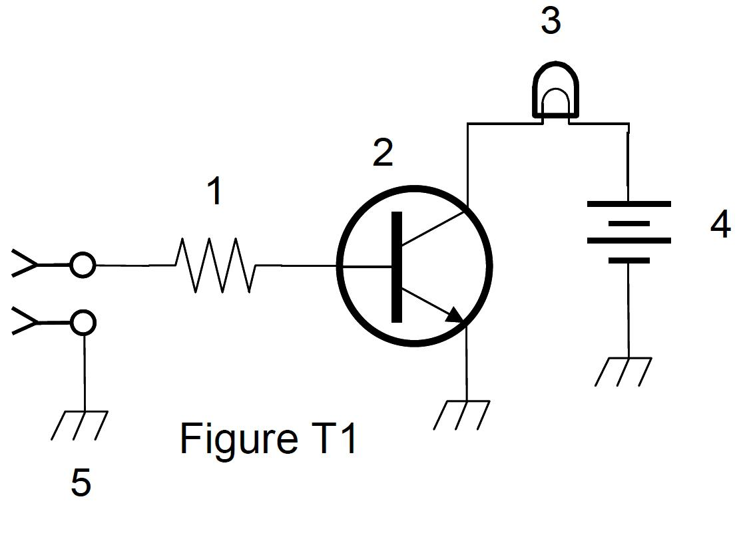
T6C02 What is component 1 in figure T1?
Resistor
Transistor
Battery
connector
81

Slide 82
T6C02 What is component 1 in figure T1?
Resistor
Transistor
Battery
connector
82

Slide 83
T6C03 What is component 2 in figure T1?
Resistor
Transistor
Indicator lamp
Connector
83

Slide 84
T6C03 What is component 2 in figure T1?
Resistor
Transistor
Indicator lamp
Connector
84

Slide 85
T6C04 What is component 3 in figure T1?
Resistor
Transistor
Lamp
Ground symbol
85

Slide 86
T6C04 What is component 3 in figure T1?
Resistor
Transistor
Lamp
Ground symbol
86

Slide 87
T6C05 What is component 4 in figure T1?
Resistor
Transistor
Battery
Ground symbol
87

Slide 88
T6C05 What is component 4 in figure T1?
Resistor
Transistor
Battery
Ground symbol
88

Slide 89
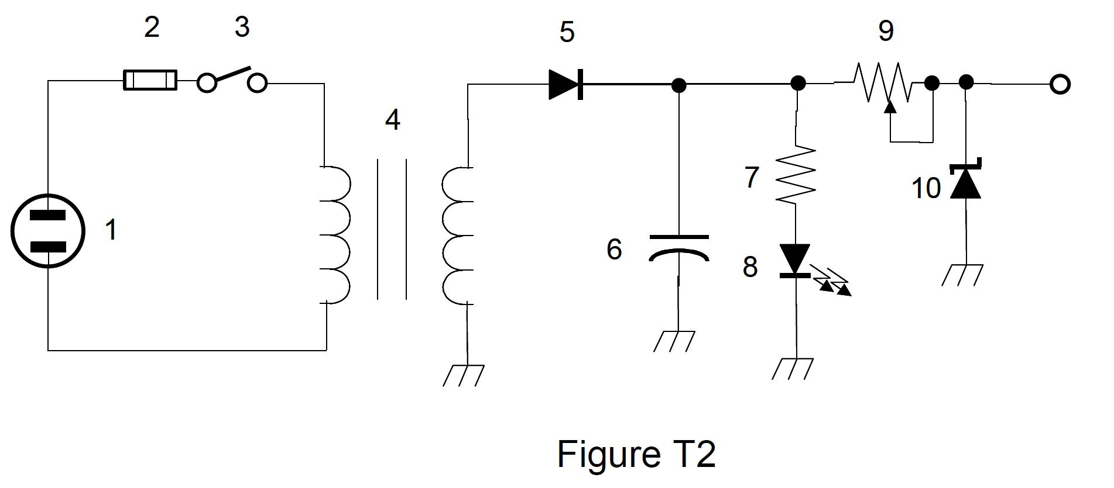
T6C06 What is component 6 in figure T2?
Resistor
Capacitor
Regulator IC
Transistor
89

Slide 90
T6C06 What is component 6 in figure T2?
Resistor
Capacitor
Regulator IC
Transistor
90

Slide 91
T6C07 What is component 8 in figure T2?
Resistor
Inductor
Regulator IC
Light emitting diode
91

Slide 92
T6C07 What is component 8 in figure T2?
Resistor
Inductor
Regulator IC
Light emitting diode
92

Slide 93
T6C08 What is component 9 in figure T2?
Variable capacitor
Variable inductor
Variable resistor
Variable transformer
93

Slide 94
T6C08 What is component 9 in figure T2?
Variable capacitor
Variable inductor
Variable resistor
Variable transformer
94

Slide 95
T6C09 What is component 4 in figure T2?
Variable inductor
Double-pole switch
Potentiometer
Transformer
95

Slide 96
T6C09 What is component 4 in figure T2?
Variable inductor
Double-pole switch
Potentiometer
Transformer
96

Slide 97
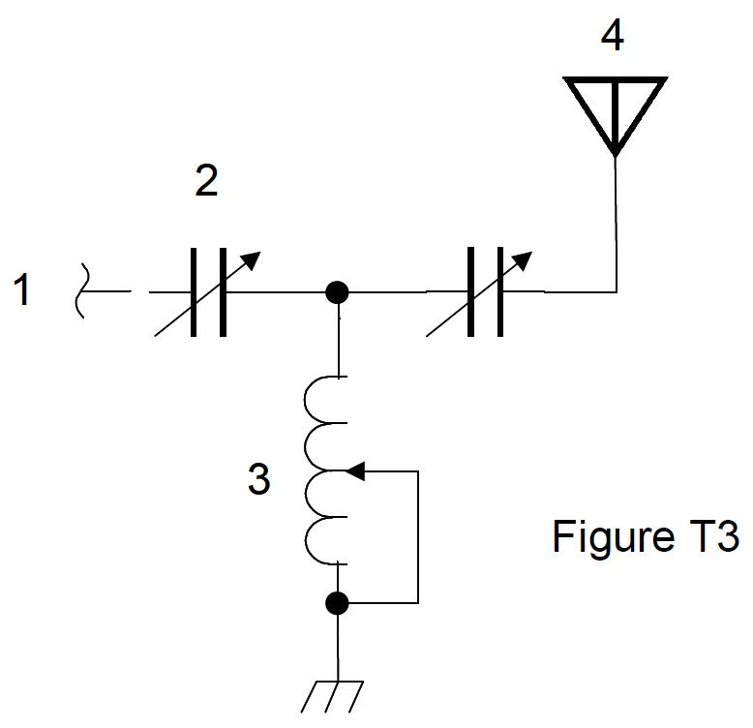
T6C10 What is component 3 in figure T3?
Connector
Meter
Variable capacitor
Variable inductor
97

Slide 98
T6C10 What is component 3 in figure T3?
Connector
Meter
Variable capacitor
Variable inductor
98

Slide 99
T6C11 What is component 4 in figure T3?
Antenna
Transmitter
Dummy load
Ground
99

Slide 100
T6C11 What is component 4 in figure T3?
Antenna
Transmitter
Dummy load
Ground
100

Slide 101
T6C12 Which of the following is accurately represented in electrical schematics?
Wire lengths
Physical appearance of components
Component connections
All these choices are correct
101

Slide 102
T6C12 Which of the following is accurately represented in electrical schematics?
Wire lengths
Physical appearance of components
Component connections
All these choices are correct
102

Slide 103
T6D01 Which of the following devices or circuits changes an alternating current into a varying direct current signal?
Transformer
Rectifier
Amplifier
Reflector
103

Slide 104
T6D01 Which of the following devices or circuits changes an alternating current into a varying direct current signal?
Transformer
Rectifier
Amplifier
Reflector
104

Slide 105
T6D02 What is a relay?
An electrically-controlled switch
A current controlled amplifier
An inverting amplifier
A pass transistor
105

Slide 106
T6D02 What is a relay?
An electrically-controlled switch
A current controlled amplifier
An inverting amplifier
A pass transistor
106

Slide 107
T6D03 Which of the following is a reason to use shielded wire?
To decrease the resistance of DC power connections
To increase the current carrying capability of the wire
To prevent coupling of unwanted signals to or from the wire
To couple the wire to other signals
107

Slide 108
T6D03 Which of the following is a reason to use shielded wire?
To decrease the resistance of DC power connections
To increase the current carrying capability of the wire
To prevent coupling of unwanted signals to or from the wire
To couple the wire to other signals
108

Slide 109
T6D04 Which of the following displays an electrical quantity as a numeric value?
Potentiometer
Transistor
Meter
Relay
109

Slide 110
T6D04 Which of the following displays an electrical quantity as a numeric value?
Potentiometer
Transistor
Meter
Relay
110

Slide 111
T6D05 What type of circuit controls the amount of voltage from a power supply?
Regulator
Oscillator
Filter
Phase inverter
111

Slide 112
T6D05 What type of circuit controls the amount of voltage from a power supply?
Regulator
Oscillator
Filter
Phase inverter
112

Slide 113
T6D06 What component changes 120V AC house power to a lower AC voltage for other uses?
Variable capacitor
Transformer
Transistor
Diode
113

Slide 114
T6D06 What component changes 120V AC house power to a lower AC voltage for other uses?
Variable capacitor
Transformer
Transistor
Diode
114

Slide 115
T6D07 Which of the following is commonly used as a visual indicator?
LED
FET
Zener diode
Bipolar transistor
115

Slide 116
T6D07 Which of the following is commonly used as a visual indicator?
LED
FET
Zener diode
Bipolar transistor
116

Slide 117
T6D08 Which of the following is combined with an inductor to make a tuned circuit?
Resistor
Zener diode
Potentiometer
Capacitor
117

Slide 118
T6D08 Which of the following is combined with an inductor to make a tuned circuit?
Resistor
Zener diode
Potentiometer
Capacitor
118

Slide 119
T6D09 What is the name of a device that combines several semiconductors and other components into one package?
Transducer
Multi-pole relay
Integrated circuit
Transformer
119

Slide 120
T6D09 What is the name of a device that combines several semiconductors and other components into one package?
Transducer
Multi-pole relay
Integrated circuit
Transformer
120

Slide 121
T6D10 What is the function of component 2 in Figure T1?
Give off light when current flows through it
Supply electrical energy
Control the flow of current
Convert electrical energy into radio waves
121

Slide 122
T6D10 What is the function of component 2 in Figure T1?
Give off light when current flows through it
Supply electrical energy
Control the flow of current
Convert electrical energy into radio waves
122

Slide 123
T6D11 What of the following is a resonant or tuned circuit?
An inductor and a capacitor in series or parallel
A linear voltage regulator
A resistor circuit used for reducing standing wave ratio
A circuit designed to provide high fidelity audio
123

Slide 124
T6D11 What of the following is a resonant or tuned circuit?
An inductor and a capacitor in series or parallel
A linear voltage regulator
A resistor circuit used for reducing standing wave ratio
A circuit designed to provide high fidelity audio
124

