Slide 1
Technician Licensing Class
AC power circuits,
antenna installation,
RF hazards
T0A - T0C
Valid
July 1, 2022 Through June 30, 2026
Updated: TBD
1
Developed by Bob Bytheway, K3DIO, and
updated to 2018 Question Pool by NQ4K for Sterling Park Amateur Radio Club
Notes:
1

Slide 2
T 0 A
Topics
  Power circuits and hazards:
    hazardous voltages;
    fuses and circuit breakers;
    grounding;
    electrical code compliance
  Lightning protection;
  Battery safety
2

Slide 3
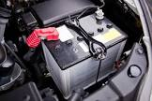
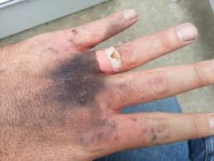
T 0 A
  A safety hazard of a 12-volt storage battery is that shorting the terminals can cause burns, fire, or explosion. T0A01
3

Slide 4
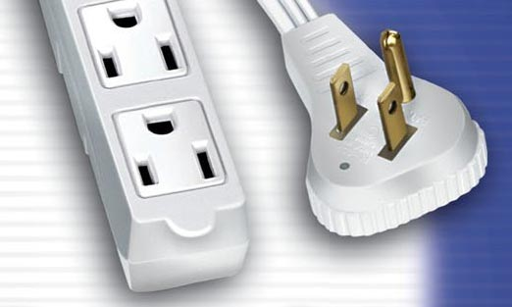
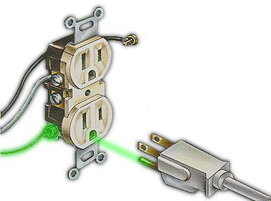
T 0 A
  Current flowing thru the body can cause a health hazard:
    Heating tissue;
    Disrupting the electrical functions of cells;
    Involuntary muscle contractions.
      All of these are correct. T0A02
  In the United States, the black wire in a three-wire 120 V cable indicates the hot wire. T0A03
4

Slide 5
T 0 A
  The purpose of a fuse in an electrical circuit is to remove power in case of overload. T0A04
  Never replace a 5-ampere fuse with of a 20-ampere fuse as excessive current could cause a fire. T0A05
5

Slide 6
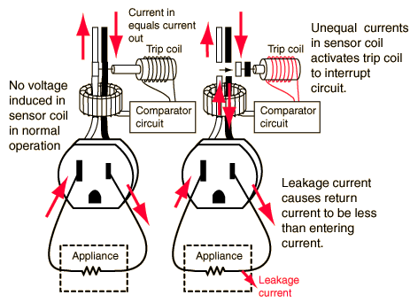
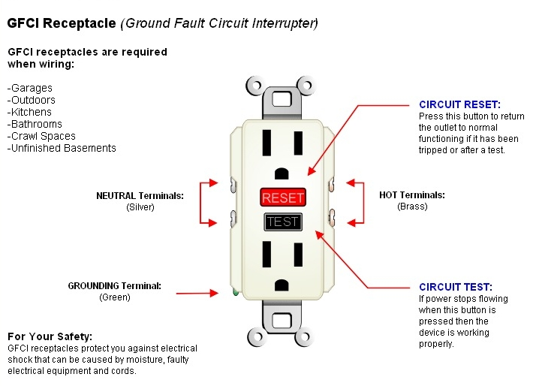
Safety First!
  Good ways to guard against electrical shock at your station:
    Use three-wire cords and plugs for all AC powered equipment.
    Connect AC powered station equipment to a common safety ground.
    Install mechanical interlocks in high-voltage circuits.
        All of these choices are correct. T0A06
6

Slide 7
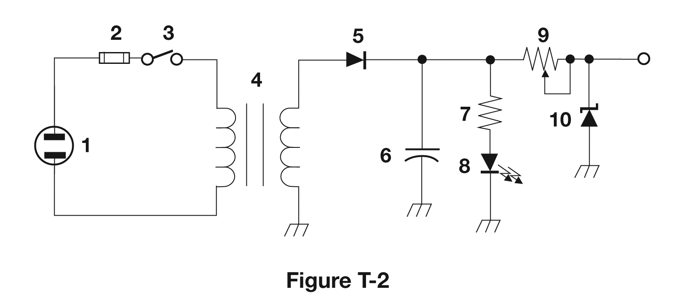
T 0 A
  Lightning arresters in a coaxial feed line should be installed on a grounded panel near where feed lines enter the building. T0A07
  A fuse or circuit breaker in a 120 AC power circuit should be installed in series with the hot conductor only. T0A08
7

Slide 8
T 0 A
  All external ground rods or earth connections should be bonded together with heavy wire or conductive strap. T0A09
  If a battery is charging or discharging too quickly, it could overheat or out-gas. T0A10
  A hazard might exist in a power supply immediately after turning it off from a charge stored in filter capacitors. T0A11
8

Slide 9
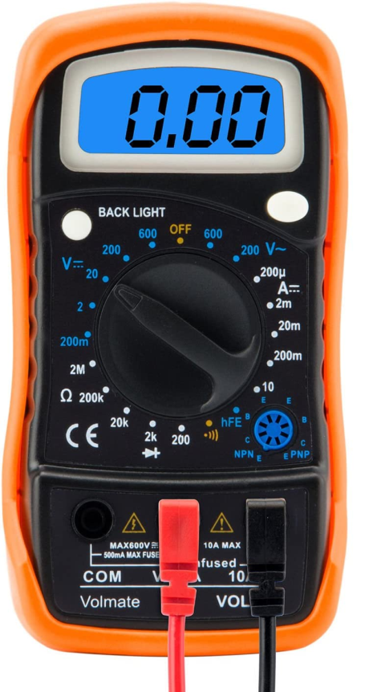
T 0 A
  When measuring high voltages with a voltmeter, ensure that the voltmeter and leads are rated for use at the voltages to be measured. T0A12
Only good for up to 600 V.
9

Slide 10
T0B
Topics
Antenna safety:
  tower safety and grounding;
  installing antennas;
  antenna supports
10

Slide 11
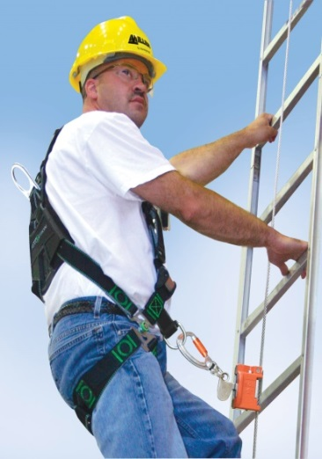
Safety First!
  When climbing an antenna tower:
    Have sufficient training on safe tower climbing techniques
    Use appropriate tie-off to the tower are all times
    Always wear an approved climbing harness T0B02
  It is never safe to climb a tower without a helper or observer. T0B03
Climbing Harness
11

Slide 12
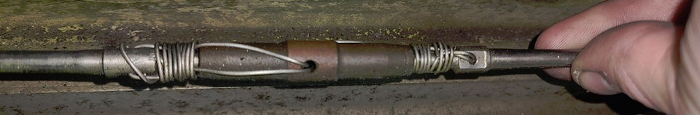
T 0 B
  An important safety precaution when putting up an antenna tower make sure to look for and stay clear of any overhead electrical wires. T0B04
  The safety wire through a turnbuckle used to tension guy wires is to prevent loosening of the turnbuckle from vibration. T0B05
12

Slide 13
T 0 B
  A minimum safe distance from a power line is enough distance so that if an antenna falls, no part can come closer than 10 feet to power wires. T0B06
  When using a crank-up tower, never climb the tower unless it is retracted, or mechanical safety locking devices have been installed. T0B07
13

Slide 14
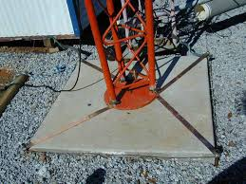
T 0 B
Update
    Proper grounding for a tower
  is accomplished by using
  separate eight-foot long
  ground rods for each tower
  leg, bonded to the tower
    and each other. T0B08
    You should avoid attaching an antenna to a utility pole because the antenna could contact high-voltage power lines. T0B09
14

Slide 15
T 0 B
  Avoid sharp bends when installing grounding conductors used for lightning protection. T0B10
  Local electrical codes establish grounding requirements for an amateur radio tower or antenna. T0B11
  A good practice when installing ground wires on a tower for lightning protection is to ensure that the connections are short and direct. T0B01
15

Slide 16
T 0 C
Topics
  RF hazards:
    radiation exposure,
    proximity to antennas,
    recognized safe power levels,
    radiation types,
    duty cycle
16

Slide 17
T 0 C
  Radio signals are non-ionizing radiation. T0C01
  50 MHz is the frequency that has the lowest value for maximum permissible exposure. T0C02
  The allowable power density for RF safety increases by a factor of 2 if the duty cycle changes from 100 percent to 50 percent. T0C03
17

Slide 18
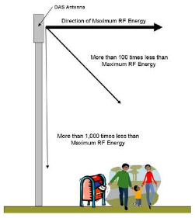
T 0 C
  Factors affecting RF exposure of people near an amateur station antenna:
    Frequency and power
    level of the RF field;
    Distance from antenna
    to a person;
    Radiation pattern
    of the antenna;
      All of these choices are correct.
      T0C04
18

Slide 19
T 0 C
  Exposure limits vary with frequency because the human body absorbs more RF energy at some frequencies than at others. T0C05
  Acceptable methods to determine that your station complies with FCC RF exposure regulations:
    By calculation based on FCC OET Bulletin 65;
    By calculation based on computer modeling;
    By measurement of field strength using calibrated
    equipment;
      All of these choices are correct. T0C06
19

Slide 20
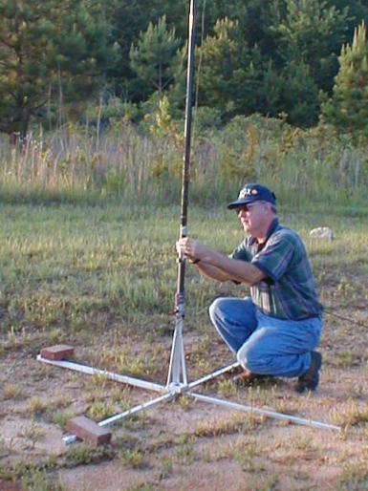
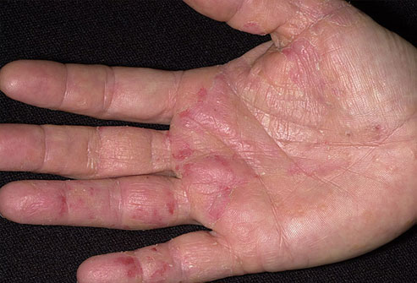
T 0 C
  One might receive a painful RF burn if they accidentally touch an antenna while transmitting. T0C07
  Relocate antennas to reduce exposure to RF radiation. T0C08
  Re-evaluate your station whenever an item in the transmitter or antenna system is changed, to make sure your station stays in compliance with RF safety regulations. T0C09
20

Slide 21
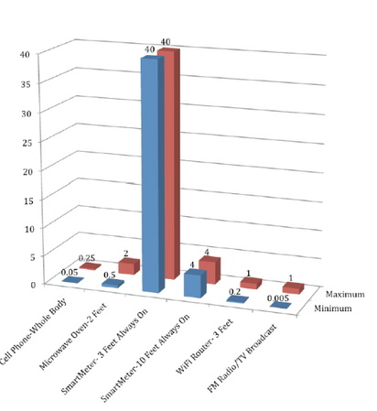
T 0 C
  Duty cycle is one factor used
  to determine safe RF radiation
  exposure levels because it
  affects the average exposure
  of people to radiation. T0C10
  Duty cycle during the averaging
  time for RF exposure is the
  percentage of the time that
  a transmitter is transmitting. T0C11
21

Slide 22
T 0 C
  RF radiation differs from ionizing radiation (radioactivity) in that RF radiation does not have sufficient energy to cause chemical changes in cells and damage DNA. T0C12
  The station licensee is responsible for ensuring that no person is exposed to RF energy above the FCC exposure limits. T0C13
22

Slide 23
Element 2 Technician Class Question Pool
T 0 A – T 0 C
Notes:
23

Slide 24
T0A01 Which of the following is a safety hazard of a 12 voltage storage battery?
  Touching both terminals with the hands can cause electrical shock
  Shorting the terminals can cause burns, fire, or an explosion
  RF emissions from a nearby transmitter can cause the electrolyte to emit poison
  All of these choices are correct
24

Slide 25
T0A01 Which of the following is a safety hazard of a 12 volt storage battery?
  Touching both terminals with the hands can cause electrical shock
  Shorting the terminals can cause burns, fire, or an explosion
  RF emissions from a nearby transmitter can cause the electrolyte to emit poison
  All of these choices are correct
25

Slide 26
T0A02 What health hazard is presented by current flowing through the body?
  It may cause injury by heating tissue
  It may disrupt the electrical functions of cells
  It may cause involuntary muscle contractions
  All of these choices are correct
26

Slide 27
T0A02 What health hazard is presented by current flowing through the body?
  It may cause injury by heating tissue
  It may disrupt the electrical functions of cells
  It may cause involuntary muscle contractions
  All of these choices are correct
27

Slide 28
T0A03 In the United States, what circuit does the black wire insulation indicate in a three-wire 120 V cable?
  Neutral
  Hot
  Equipment ground
  Black insulation is never used
28

Slide 29
T0A03 In the United States, what circuit does the black wire insulation indicate in a three-wire 120 V cable?
  Neutral
  Hot
  Equipment ground
  Black insulation is never used
29

Slide 30
T0A04 What is the purpose of a fuse in an electrical circuit?
  To prevent power supply ripple from damaging a circuit
  To interrupt power in case of overload
  To limit current to prevent shocks
  All of these choices are correct
30

Slide 31
T0A04 What is the purpose of a fuse in an electrical circuit?
  To prevent power supply ripple from damaging a circuit
  To interrupt power in case of overload
  To limit current to prevent shocks
  All of these choices are correct
31

Slide 32
T0A05 Why should a 5-ampere fuse never be replaced with a 20-ampere fuse?
  The larger fuse would be likely to blow because it is rated for higher current
  The power supply ripple would greatly increase
  Excessive current could cause a fire
  All of these choices are correct
32

Slide 33
T0A05 Why should a 5-ampere fuse never be replaced with a 20-ampere fuse?
  The larger fuse would be likely to blow because it is rated for higher current
  The power supply ripple would greatly increase
  Excessive current could cause a fire
  All of these choices are correct
33

Slide 34
T0A06 What is a good way to guard against electrical shock at your station?
  Use three-wire cords and plugs for all AC powered equipment
  Connect all AC powered station equipment to a common safety ground
  Install mechanical interlocks in high-voltage circuits
  All of these choices are correct
34

Slide 35
T0A06 What is a good way to guard against electrical shock at your station?
  Use three-wire cords and plugs for all AC powered equipment
  Connect all AC powered station equipment to a common safety ground
  Install mechanical interlocks in high-voltage circuits
  All of these choices are correct
35

Slide 36
T0A07 Where should a lightning arrester be installed in a coaxial feed line?
  At the output connector of a transceiver
  At the antenna feed point
  At the AC power service panel
  On a grounded panel near where the feed lines enter the building
36

Slide 37
T0A07 Where should a lightning arrester be installed in a coaxial feed line?
  At the output connector of a transceiver
  At the antenna feed point
  At the AC power service panel
  On a grounded panel near where the feed lines enter the building
37

Slide 38
T0A08 Where should a fuse or circuit breaker be installed in a 120 AC power circuit?
  In series with the hot conductor only
  In series with the hot and neutral conductors
  In parallel with the hot conductor only
  In parallel with the hot and neutral conductors
38

Slide 39
T0A08 Where should a fuse or circuit breaker be installed in a 120 AC power circuit?
  In series with the hot conductor only
  In series with the hot and neutral conductors
  In parallel with the hot conductor only
  In parallel with the hot and neutral conductors
39

Slide 40
T0A09 What should be done to all external ground rods or earth connections?
Waterproof them with silicone caulk or electrical tape
Keep them as far apart as possible
Bond them together with heavy wire or conductive strap
Tune them for resonance on the lowest frequency of operation
40

Slide 41
T0A09 What should be done to all external ground rods or earth connections?
Waterproof them with silicone caulk or electrical tape
Keep them as far apart as possible
Bond them together with heavy wire or conductive strap
Tune them for resonance on the lowest frequency of operation
41

Slide 42
T0A10 What hazard is caused by charging or discharging a battery too quickly?
  Overheating or out-gassing
  Excess output ripple
  Half-wave rectification
  Inverse memory effect
42

Slide 43
T0A10 What hazard is caused by charging or discharging a battery too quickly?
  Overheating or out-gassing
  Excess output ripple
  Half-wave rectification
  Inverse memory effect
43

Slide 44
T0A11 What hazard exists in a power supply immediately after turning it off ?
  Circulating currents in the dc filter
  Leakage flux in the power transformer
  Voltage transients from kickback diodes
  Charge stored in filter capacitors
44

Slide 45
T0A11 What hazard exists in a power supply immediately after turning it off ?
  Circulating currents in the dc filter
  Leakage flux in the power transformer
  Voltage transients from kickback diodes
  Charge stored in filter capacitors
45

Slide 46
T0A12 Which of the following precautions should be taken when measuring high voltages with a voltmeter?
  Ensure that the voltmeter has very low impedance
  Ensure that the voltmeter and leads are rated for use at the voltages to be measured
  Ensure that the circuit is grounded through the voltmeter
  Ensure that the voltmeter is set to the correct frequency
46

Slide 47
T0A12 Which of the following precautions should be taken when measuring high voltages with a voltmeter?
  Ensure that the voltmeter has very low impedance
  Ensure that the voltmeter and leads are rated for use at the voltages to be measured
  Ensure that the circuit is grounded through the voltmeter
  Ensure that the voltmeter is set to the correct frequency
47

Slide 48
T0B01 Which of the following is good practice when installing ground wires on a tower for lightning protection?
  Put a loop in the ground connection to prevent water damage to the ground system
  Make sure that all bends in the ground wires are clean, right-angle bends
  Ensure that connections are short and direct
  All of these choices are correct
48

Slide 49
T0B01 Which of the following is good practice when installing ground wires on a tower for lightning protection?
  Put a loop in the ground connection to prevent water damage to the ground system
  Make sure that all bends in the ground wires are clean, right-angle bends
  Ensure that connections are short and direct
  All of these choices are correct
49

Slide 50
T0B02 What is required when climbing an antenna tower?
  Have sufficient training on safe tower climbing techniques
  Use appropriate tie-off to the tower at all times
  Always wear an approved climbing harness
  All of these choices are correct
50

Slide 51
T0B02 What is required when climbing an antenna tower?
  Have sufficient training on safe tower climbing techniques
  Use appropriate tie-off to the tower at all times
  Always wear an approved climbing harness
  All of these choices are correct
51

Slide 52
T0B03 Under what circumstances is it safe to climb a tower without a helper or observer?
  When no electrical work is being performed
  When no mechanical work is being performed
  When the work being done is not more than 20 feet above the ground
  Never
52

Slide 53
T0B03 Under what circumstances is it safe to climb a tower without a helper or observer?
  When no electrical work is being performed
  When no mechanical work is being performed
  When the work being done is not more than 20 feet above the ground
  Never
53

Slide 54
T0B04 Which of the following is an important safety precaution to observe when putting up an antenna tower?
  Wear a ground strap connected to your wrist at all times
  Insulate the base of the tower to avoid lightning strikes
  Look for and stay clear of any overhead electrical wires
  All of these choices are correct
54

Slide 55
T0B04 Which of the following is an important safety precaution to observe when putting up an antenna tower?
  Wear a ground strap connected to your wrist at all times
  Insulate the base of the tower to avoid lightning strikes
  Look for and stay clear of any overhead electrical wires
  All of these choices are correct
55

Slide 56
T0B05 What is the purpose of a safety wire through a turnbuckle used to tension guy lines?
  Secure the guy line if the turnbuckle breaks
  Prevent loosening of the turnbuckle from vibration
  Provide a ground path for lightning strikes
  Provide an ability to measure for proper tensioning
56

Slide 57
T0B05 What is the purpose of a safety wire through a turnbuckle used to tension guy lines?
  Secure the guy line if the turnbuckle breaks
  Prevent loosening of the turnbuckle from vibration
  Provide a ground path for lightning strikes
  Provide an ability to measure for proper tensioning
57

Slide 58
T0B06 What is the minimum safe distance from a power line to allow when installing an antenna?
  Add the height of the antenna to the height of the power line and multiply by a factor of 1.5
  The height of the power line above ground
  1/2 wavelength at the operating frequency
  Enough so that if the antenna falls, no part of it can come closer than 10 feet to the power wires
58

Slide 59
T0B06 What is the minimum safe distance from a power line to allow when installing an antenna?
  Add the height of the antenna to the height of the power line and multiply by a factor of 1.5
  The height of the power line above ground
  1/2 wavelength at the operating frequency
  Enough so that if the antenna falls, no part of it can come closer than 10 feet to the power wires
59

Slide 60
T0B07 Which of the following is an important safety rule to remember when using a crank-up tower?
  This type of tower must never be painted
  This type of tower must never be grounded
  This type of tower must not be climbed unless it is retracted or mechanical safety locking devices have been installed
  All of these choices are correct
60

Slide 61
T0B07 Which of the following is an important safety rule to remember when using a crank-up tower?
  This type of tower must never be painted
  This type of tower must never be grounded
  This type of tower must not be climbed unless it is retracted or mechanical safety locking devices have been installed
  All of these choices are correct
61

Slide 62
T0B08 What is a proper grounding method for a tower?
  A single four-foot ground rod, driven into the ground no more than 12 inches from the base
  A ferrite-core RF choke connected between the tower and ground
  A connection between the tower base and a cold-water pipe
  Separate eight-foot ground rods for each tower leg, bonded to the tower and each other
62

Slide 63
T0B08 What is a proper grounding method for a tower?
  A single four-foot ground rod, driven into the ground no more than 12 inches from the base
  A ferrite-core RF choke connected between the tower and ground
  A connection between the tower base and a cold-water pipe
  Separate eight-foot ground rods for each tower leg, bonded to the tower and each other
63

Slide 64
T0B09 Why should you avoid attaching an antenna to a utility pole?
  The antenna will not work properly because of induced voltages
  The 60 Hz radiations from the feed line may increase the SWR
  The antenna could contact high-voltage power wires
  All of these choices are correct
64

Slide 65
T0B09 Why should you avoid attaching an antenna to a utility pole?
  The antenna will not work properly because of induced voltages
  The 60 Hz radiations from the feed line may increase the SWR
  The antenna could contact high-voltage power wires
  All of these choices are correct
65

Slide 66
T0B10 Which of the following is true when installing grounding conductors used for lightning protection?
  Only non-insulated wire must be used
  Wires must be carefully routed with precise right-angle bends
  Sharp bends must be avoided
  Common grounds must be avoided
66

Slide 67
T0B10 Which of the following is true when installing grounding conductors used for lightning protection?
  Only non-insulated wire must be used
  Wires must be carefully routed with precise right-angle bends
  Sharp bends must be avoided
  Common grounds must be avoided
67

Slide 68
T0B11 Which of the following establishes grounding requirements for an amateur radio tower or antenna?
  FCC Part 97 Rules
  Local electrical codes
  FAA tower lighting regulations
  UL recommended practices
68

Slide 69
T0B11 Which of the following establishes grounding requirements for an amateur radio tower or antenna?
  FCC Part 97 Rules
  Local electrical codes
  FAA tower lighting regulations
  UL recommended practices
69

Slide 70
T0C01 What type of radiation are radio signals?
  Gamma radiation
  Ionizing radiation
  Alpha radiation
  Non-ionizing radiation
70

Slide 71
T0C01 What type of radiation are radio signals?
  Gamma radiation
  Ionizing radiation
  Alpha radiation
  Non-ionizing radiation
71

Slide 72
T0C02 Which of the following frequencies does maximum permissible exposure have the lowest value?
  3.5 MHz
  50 MHz
  440 MHz
  1296 MHz
72

Slide 73
T0C02 Which of the following frequencies does maximum permissible exposure have the lowest value?
  3.5 MHz
  50 MHz
  440 MHz
  1296 MHz
73

Slide 74
T0C03 How does the allowable power density for RF safety change if duty cycle changes from 100 percent to 50 percent?
  It increased by a factor of 3
  It decreases by 50 percent
  It increases by a factor of 2
  There is no adjustment allowed for lower duty cycle
74

Slide 75
T0C03 How does the allowable power density for RF safety change if duty cycle changes from 100 percent to 50 percent?
  It increased by a factor of 3
  It decreases by 50 percent
  It increases by a factor of 2
  There is no adjustment allowed for lower duty cycle
75

Slide 76
T0C04 What factors affect the RF exposure of people near an amateur station antenna?
  Frequency and power level of the RF field
  Distance from the antenna to a person
  Radiation pattern of the antenna
  All of these choices are correct
76

Slide 77
T0C04 What factors affect the RF exposure of people near an amateur station antenna?
  Frequency and power level of the RF field
  Distance from the antenna to a person
  Radiation pattern of the antenna
  All of these choices are correct
77

Slide 78
T0C05 Why do exposure limits vary with frequency?
  Lower frequency RF fields have more energy than higher frequency fields
  Lower frequency RF fields do not penetrate the human body
  Higher frequency RF fields are transient in nature
  The human body absorbs more RF energy at some frequencies than at others
78

Slide 79
T0C05 Why do exposure limits vary with frequency?
  Lower frequency RF fields have more energy than higher frequency fields
  Lower frequency RF fields do not penetrate the human body
  Higher frequency RF fields are transient in nature
  The human body absorbs more RF energy at some frequencies than at others
79

Slide 80
T0C06 Which of the following is an acceptable method to determine whether your station complies with FCC RF exposure regulations?
  By calculations based on FCC OET Bulletin 65
  By calculation based on computer modeling
  By measurement of field strength using calibrated equipment
  All of these choices are correct
80

Slide 81
T0C06 Which of the following is an acceptable method to determine whether your station complies with FCC RF exposure regulations?
  By calculations based on FCC OET Bulletin 65
  By calculation based on computer modeling
  By measurement of field strength using calibrated equipment
  All of these choices are correct
81

Slide 82
T0C07 What hazard is created by touching an antenna during transmission?
  Electrocution
  RF burn to skin
  Radiation poisoning
  All of these choices are correct
82

Slide 83
T0C07 What hazard is created by touching an antenna during transmission?
  Electrocution
  RF burn to skin
  Radiation poisoning
  All of these choices are correct
83

Slide 84
T0C08 Which of the following actions can reduce exposure to RF radiation?
  Relocate antennas
  Relocate the transmitter
  Increase the duty cycle
  All of these choices are correct
84

Slide 85
T0C08 Which of the following actions can reduce exposure to RF radiation?
  Relocate antennas
  Relocate the transmitter
  Increase the duty cycle
  All of these choices are correct
85

Slide 86
T0C09 How can you make sure your station stays in compliance with RF safety regulations?
  By informing the FCC of any changes made in your station
  By re-evaluating the station whenever an item in the transmitter or antenna system is changed
  By making sure your antennas have low SWR
  All of these choices are correct
86

Slide 87
T0C09 How can you make sure your station stays in compliance with RF safety regulations?
  By informing the FCC of any changes made in your station
  By re-evaluating the station whenever an item in the transmitter or antenna system is changed
  By making sure your antennas have low SWR
  All of these choices are correct
87

Slide 88
T0C10 Why is duty cycle one of the factors used to determine safe RF radiation exposure levels?
  It affects the average exposure to radiation
  It affects the peak exposure to radiation
  It takes into account the antenna feedline loss
  It takes into account the thermal effects of the final amplifier
88

Slide 89
T0C10 Why is duty cycle one of the factors used to determine safe RF radiation exposure levels?
  It affects the average exposure to radiation
  It affects the peak exposure to radiation
  It takes into account the antenna feedline loss
  It takes into account the thermal effects of the final amplifier
89

Slide 90
T0C11 What is the definition of duty cycle during the averaging time for RF exposure?
  The difference between lowest power output and highest output power of a transmitter
  The difference between the PEP and average power output power of a transmitter
  The percentage of time that a transmitter transmits
  The percentage of time that a transmitter is not transmitting
90

Slide 91
T0C11 What is the definition of duty cycle during the averaging time for RF exposure?
  The difference between lowest power output and highest output power of a transmitter
  The difference between the PEP and average power output power of a transmitter
  The percentage of time that a transmitter transmits
  The percentage of time that a transmitter is not transmitting
91

Slide 92
T0C12 How does RF radiation differ from ionizing radiation (radioactivity)?
  RF radiation does not have sufficient energy to cause chemical changes in cells and damage DNA
  RF radiation can only be detected with an RF dosimeter
  RF radiation is limited in range to a few feet
  RF radiation is perfectly safe
92

Slide 93
T0C12 How does RF radiation differ from ionizing radiation (radioactivity)?
  RF radiation does not have sufficient energy to cause chemical changes in cells and damage DNA
  RF radiation can only be detected with an RF dosimeter
  RF radiation is limited in range to a few feet
  RF radiation is perfectly safe
93

Slide 94
T0C13 Who is responsible for ensuring that no person is exposed to RF energy above the FCC exposure limits?
  The FCC
  The station licensee
  Anyone who is near an antenna
  The local zoning board
94

Slide 95
T0C13 Who is responsible for ensuring that no person is exposed to RF energy above the FCC exposure limits?
  The FCC
  The station licensee
  Anyone who is near an antenna
  The local zoning board
95

