Slide 1
Technician License Course
Chapter 4
Lesson Plan Module 9 –
Antenna Fundamentals, Feed Lines & SWR
Notes:
Make sure you bring in samples of different kinds of feed lines as you are going through this lesson.

Slide 2
The Antenna System
Antenna: Transforms current into radio waves (transmit) and vice versa (receive).
Feed line: Connects your station to the antenna.
Test and matching equipment: Allows you to monitor and optimize antenna system performance.
Notes:
Talk about the whole antenna system, starting from the transmitter and working out to the antenna.

Slide 3
The Antenna (Some Vocabulary)
Element: The conducting part or parts of an antenna designed to radiate or receive radio waves.
Driven element: The element supplied directly with power from the transmitter.
Array: An antenna with more than one element.
Notes:
Use a small VHF Yagi to illustrate each word.

Slide 4
The Antenna (Some Vocabulary)
Parasitic element: Elements not connected directly to a feed line.
Resonant: An antenna is resonant when its feed point impedance has zero reactance.
Feed point: Where the transmitted energy enters the antenna.
Radiation: NOT radioactivity! An antenna emitting electromagnetic waves.
Notes:
Show the parasitic vs driven elements on the VHF Yagi.

Slide 5
Electromagnetic Waves
Radio waves are electromagnetic waves
  Electric and magnetic fields at right angles to each other, oscillating at the wave’s frequency
  Spread out into space from the antenna
  Created by ac current
  Wave and current have the same frequency
Notes:
Make the analogy to ripples on the surface of water. Stress that the current in the antenna determines the frequency of the radiated wave. Conversely, current in a receiving antenna has the same frequency as that of the received wave.

Slide 6
Wave Polarization
Orientation of the wave’s electric field component with respect to the surface of the Earth
  Vertical or horizontal – determined by elements
  Can be circular if the orientation twists as the wave spreads through space
  Combinations of polarization are called elliptical polarization

Slide 7
Cross-Polarization
Antenna and wave polarization must match for maximum reception.
  Cross-polarized: antenna elements and the wave’s electric field at right angles
  Can reduce reception by a factor of 100
For elliptically polarized waves (such as HF sky-wave) any antenna will respond at least partially.
Notes:
Use two pairs of Polaroid sunglasses to illustrate cross-polarization. Note that light is also an electromagnetic wave with a much shorter wavelength than radio waves.

Slide 8
The Decibel (dB)
A ratio expressed as an power of 10 to make large numbers easier to work with.
  dB = 10 log (power ratio)
  dB = 20 log (voltage ratio)
Positive values in dB indicate ratios > 1 and negative values of dB are for ratios < 1.
Antenna gain is discussed in terms of dB.
Notes:
Refer students to the decibel tutorial on the HRLM website.
The concept of decibels can be a difficult and scary concept for class members not comfortable with math. Don’t spend a lot of time on this, just get them used to the use of dB as a way of expressing the gain or comparisons between one antenna and another. Note that dB values always require a reference – “dB with respect to what?” is a good question.
An important specific gain value to remember is 3. For every 3 dB of gain, the apparent power advantage is doubled (5 watts seems like 10 with 3 dB of gain). You also could mention that -3 dB is halving the power…10 watts becomes 5 watts when there is a -3 dB of gain (this is significant when students are looking at the performance of the rubber duck antenna versus a ¼ wave whip). Make a worksheet of all exam questions about dB for them to work out.

Slide 9
The Antenna (Some Vocabulary)
Gain: Apparent increase in power in a particular direction by focusing radiation in that direction. Measured in decibels (dB).
Isotropic: Equal radiation in all directions.
Omnidirectional: No preferred horizontal direction.
Directional: Antenna that focuses radiation in specific directions.
Notes:
The concept of gain is an important concept to make sure the students understand. Gain does not increase the amount of power being transmitted, gain gives the appearance of increased power because the transmitted energy (and received energy) is focused in a specific direction by the antenna elements at the expense of energy that would have been send in other directions. A good way to illustrate this is to use the balloon demonstation.

Slide 10
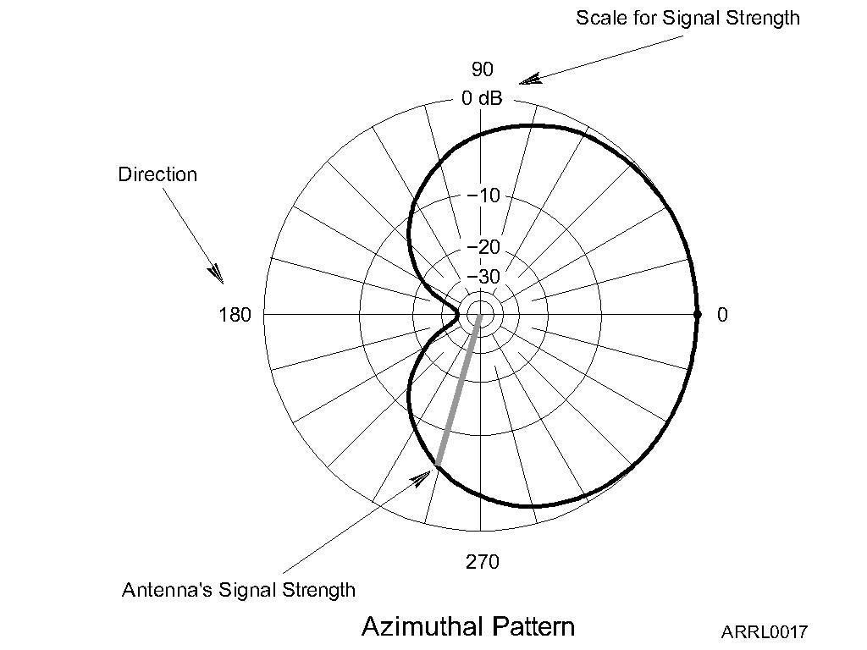
Antenna Radiation Patterns
Radiation patterns are a way of visualizing antenna performance.
The further the line is from the center of the graph, the stronger the signal at that point.
Graph calibrated in dB.
Notes:
This is an opportunity for you to expand on the concept of gain. Walk your students through how to interpret the antenna radio pattern plots by using the small VHF Yagi and a receiver to display signal strengths as the antenna is pointed in different directions. A good time to introduce fox-hunting, too!

Slide 11
Radiation Pattern Vocabulary
Nulls: Directions of minimum gain
Lobes: Regions between nulls
Main lobe: Lobe with highest gain
Side lobe: Any lobe other than the main lobe
Forward gain: Gain in the direction assigned as forward
Notes:
Illustrate each point on a radiation pattern in the HRLM or from an advertiser’s or magazine article’s antenna pattern.

Slide 12
Radiation Pattern Vocabulary
Azimuth pattern: Radiation pattern showing gain in all horizontal directions around the antenna.
Elevation pattern: Radiation pattern showing gain at all vertical angles from the antenna.
  Often restricted to angles above horizontal
Notes:
Reinforce that azimuth means direction on the surface of the Earth and elevation means angle above the surface of the Earth.

Slide 13
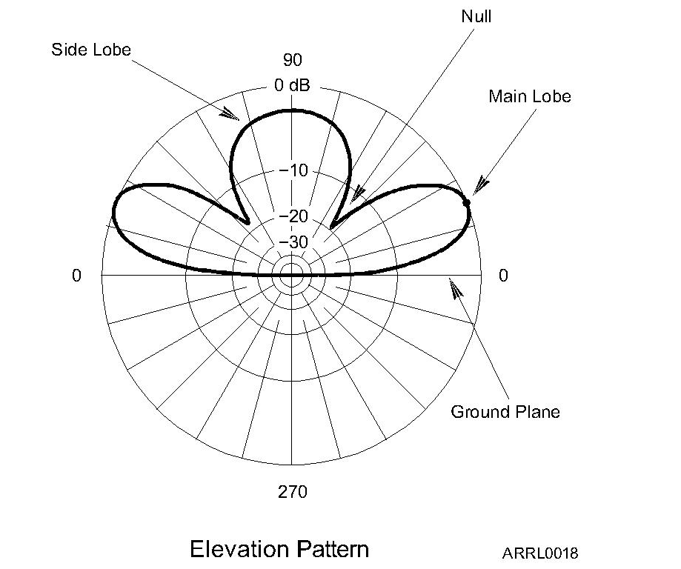
Azimuth
Pattern
Elevation
Pattern

Slide 14
Radiation Pattern Vocabulary
Front-to-back ratio: Ratio of forward gain to gain in the opposite direction.
Front-to-side ratio: Ratio of forward gain to gain at right angles to the forward direction.
Notes:
Show the ratios on a radiation pattern.

Slide 15
Feed Lines
The purpose of the feed line is to get RF power from your station to the antenna.
Basic feed line types
  Coaxial cable (coax)
  Open-wire line (OWL) also called ladder line or window line
Power lost as heat in the feed line is called loss and it increases with frequency.
Notes:
It would be very helpful to have physical examples of the two basic kinds of feed line.

Slide 16
Feed Line Vocabulary
Center conductor: Central wire
Dielectric: Insulation surrounding center conductor
Shield: Braid or foil surrounding dielectric
Jacket: Protective outer plastic coating
Forward (reflected) power: RF power traveling toward (away from) a load such as an antenna
Notes:
Show what each word refers to in a coaxial cable.

Slide 17
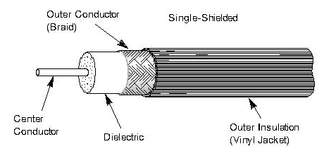
Coaxial Cable
Most common feed line
Easy to use
Not affected by nearby materials
Has higher loss than open-wire line at most frequencies
Air-insulated “hard line” has lowest loss
Notes:
Discuss why coax is so common and emphasize how it can be installed near metal and next to materials.

Slide 18
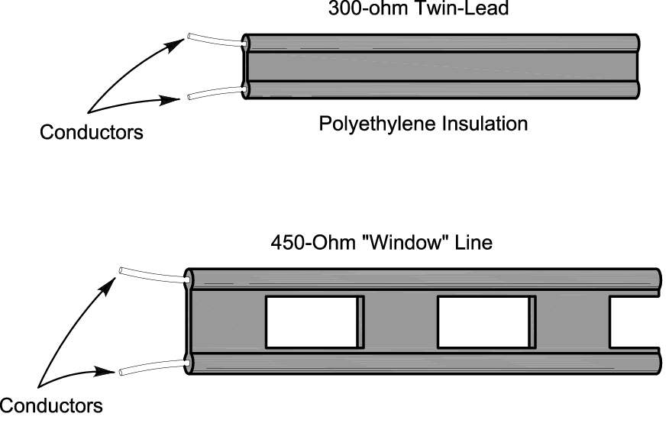
Open-Wire Line
Lighter and less expensive than coax
Has lower loss than coax at most frequencies
More difficult to use since it is affected by nearby materials
Requires impedance matching equipment to use with most transceivers
Notes:
Discuss some applications where ladder line is practical, such as a dipole used on multiple bands (really an HF thing). Note that an impedance matching unit is required to transform the feed line impedance to 50 ohms to match the transceiver’s required output impedance..

Slide 19
Characteristic Impedance
The impedance presented to a wave traveling through a feed line
Given in ohms (Ω), symbolized as Z₀
Depends on how the feed line is constructed and what materials are used
  Coax: 50 and 75 Ω
  OWL: 300, 450, and 600 Ω
Notes:
Use the demo of puffing air through a very thin straw (coffee stirrer) and through a fat straw (milk shake straw) to illustrate the difference in characteristic impedance.

Slide 20
Standing Wave Ratio (SWR)
If the antenna feed point and feed line impedances are not identical, some RF power is reflected back toward the transmitter.
  Called a mismatch
  Forward and reflected waves create a pattern of standing waves of voltage and current in the line
  SWR is the ratio of standing wave max to min
Measured with an SWR meter or SWR bridge.
Notes:
Recall the jump rope demonstration of frequency vs wavelength and the standing waves created when the rope was shaken.

Slide 21
Standing Wave Ratio (SWR)
Reflected power is re-reflected at the transmitter and bounces back and forth.
  Some RF power is lost as heat on each trip back and forth through the feed line
  All RF power is eventually lost as heat or transferred to the antenna or load
High SWR means more reflections and more loss of RF power (less transferred to the antenna or load).

Slide 22
Nothing Is Perfect
SWR equals the ratio of feed point (or load) and feed line impedance, whichever is greater than 1 (SWR always greater than 1:1).
What is an acceptable SWR?
  1:1 SWR is perfect – no power reflected
  Up to 2:1 SWR is normal
  Modern radios lower transmitter output power for protection when SWR is above 2:1

Slide 23
Nothing Is Perfect
SWR above 3:1 is considered high in most cases.
Erratic SWR readings may indicate a faulty feed line, faulty feed line connectors, or a faulty antenna.
High SWR can be corrected by
  Tuning or adjusting the antenna or
  With impedance matching equipment at the transmitter
    Called an antenna tuner or transmatch
    Does not change SWR in the feed line

Slide 24
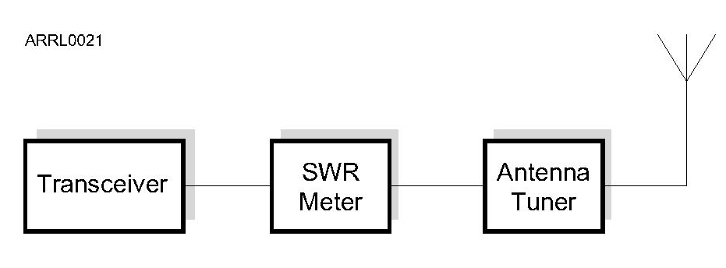
Adjusting SWR
An SWR meter is inserted in the feed line and indicates the mismatch at that point.
Either adjust the antenna to minimize the reflected power or adjust the antenna tuner for minimum SWR at the transceiver.
Notes:
Have an example of an SWR meter on hand to show the students. You can also discuss how SWR meters are now commonly included as a meter function of a transceiver.

Slide 25
Dummy Loads
A dummy load is a resistor and a heat sink
  Used to replace an antenna or other piece of equipment during testing.
Dummy loads dissipate signals in the feed line as heat
  Allows transmitter testing without sending a signal over the air
  Helpful in troubleshooting an antenna system
Notes:
Have an example of a dummy load to show the students. Note that it must be able to dissipate the entire power output of the transmitter or amplifier, although it can stand short overloads.

Slide 26
Practice Questions

Slide 27
What can happen if the antennas at opposite ends of a VHF or UHF line of sight radio link are not using the same polarization?
A. The modulation sidebands might become inverted
B. Signals could be significantly weaker
C. Signals have an echo effect on voices
D. Nothing significant will happen
  T3A04 HRLM (4-6)

Slide 28
What can happen if the antennas at opposite ends of a VHF or UHF line of sight radio link are not using the same polarization?
A. The modulation sidebands might become inverted
B. Signals could be significantly weaker
C. Signals have an echo effect on voices
D. Nothing significant will happen
  T3A04 HRLM (4-6)

Slide 29
What type of wave carries radio signals between transmitting and receiving stations?
A. Electromagnetic
B. Electrostatic
C. Surface acoustic
D. Magnetostrictive
  T3A07 HRLM (4-6)

Slide 30
What type of wave carries radio signals between transmitting and receiving stations?
A. Electromagnetic
B. Electrostatic
C. Surface acoustic
D. Magnetostrictive
  T3A07 HRLM (4-6)

Slide 31
Which of the following is a common effect of "skip" reflections between the Earth and the ionosphere?
A. The sidebands become reversed at each reflection
B. The polarization of the original signal is randomized
C. The apparent frequency of the received signal is shifted by a random amount
D. Signals at frequencies above 30 MHz become stronger with each reflection
  T3A09 HRLM (4-6)

Slide 32
Which of the following is a common effect of "skip" reflections between the Earth and the ionosphere?
A. The sidebands become reversed at each reflection
B. The polarization of the original signal is randomized
C. The apparent frequency of the received signal is shifted by a random amount
D. Signals at frequencies above 30 MHz become stronger with each reflection
  T3A09 HRLM (4-6)

Slide 33
What property of a radio wave is used to describe its polarization?
A. The orientation of the electric field
B. The orientation of the magnetic field
C. The ratio of the energy in magnetic field to the energy in the electric field
D. The ratio of the velocity to the wavelength
  T3B02 HRLM (4-6)

Slide 34
What property of a radio wave is used to describe its polarization?
A. The orientation of the electric field
B. The orientation of the magnetic field
C. The ratio of the energy in magnetic field to the energy in the electric field
D. The ratio of the velocity to the wavelength
  T3B02 HRLM (4-6)

Slide 35
What are the two components of a radio wave?
A. AC and DC
B. Voltage and current
C. Electric and magnetic fields
D. Ionizing and non-ionizing radiation
  T3B03 HRLM (4-6)

Slide 36
What are the two components of a radio wave?
A. AC and DC
B. Voltage and current
C. Electric and magnetic fields
D. Ionizing and non-ionizing radiation
  T3B03 HRLM (4-6)

Slide 37
What is the approximate amount of change, measured in decibels (dB), of a power increase from 5 watts to 10 watts?
A. 2 dB
B. 3 dB
C. 5 dB
D. 10 dB
  T5B09 HRLM (4-7)

Slide 38
What is the approximate amount of change, measured in decibels (dB), of a power increase from 5 watts to 10 watts?
A. 2 dB
B. 3 dB
C. 5 dB
D. 10 dB
  T5B09 HRLM (4-7)

Slide 39
What is the approximate amount of change, measured in decibels (dB), of a power decrease from 12 watts to 3 watts?
A. -1 dB
B. -3 dB
C. -6 dB
D. -9 dB
  T5B10 HRLM (4-7)

Slide 40
What is the approximate amount of change, measured in decibels (dB), of a power decrease from 12 watts to 3 watts?
A. -1 dB
B. -3 dB
C. -6 dB
D. -9 dB
  T5B10 HRLM (4-7)

Slide 41
What is the approximate amount of change, measured in decibels (dB), of a power increase from 20 watts to 200 watts?
A. 10 dB
B. 12 dB
C. 18 dB
D. 28 dB
  T5B11 HRLM (4-7)

Slide 42
What is the approximate amount of change, measured in decibels (dB), of a power increase from 20 watts to 200 watts?
A. 10 dB
B. 12 dB
C. 18 dB
D. 28 dB
  T5B11 HRLM (4-7)

Slide 43
What is a usual name for electromagnetic waves that travel through space?
A. Gravity waves
B. Sound waves
C. Radio waves
D. Pressure waves
  T5C07 HRLM (4-6)

Slide 44
What is a usual name for electromagnetic waves that travel through space?
A. Gravity waves
B. Sound waves
C. Radio waves
D. Pressure waves
  T5C07 HRLM (4-6)

Slide 45
What is the primary purpose of a dummy load?
A. To prevent the radiation of signals when making tests
B. To prevent over-modulation of your transmitter
C. To improve the radiation from your antenna
D. To improve the signal to noise ratio of your receiver
  T7C01 HRLM (5-4)

Slide 46
What is the primary purpose of a dummy load?
A. To prevent the radiation of signals when making tests
B. To prevent over-modulation of your transmitter
C. To improve the radiation from your antenna
D. To improve the signal to noise ratio of your receiver
  T7C01 HRLM (5-4)

Slide 47
What, in general terms, is standing wave ratio (SWR)?
A. A measure of how well a load is matched to a transmission line
B. The ratio of high to low impedance in a feed line
C. The transmitter efficiency ratio
D. An indication of the quality of your station’s ground connection
  T7C03 HRLM (4-10)

Slide 48
What, in general terms, is standing wave ratio (SWR)?
A. A measure of how well a load is matched to a transmission line
B. The ratio of high to low impedance in a feed line
C. The transmitter efficiency ratio
D. An indication of the quality of your station’s ground connection
  T7C03 HRLM (4-10)

Slide 49
What reading on an SWR meter indicates a perfect impedance match between the antenna and the feed line?
A. 2 to 1
B. 1 to 3
C. 1 to 1
D. 10 to 1
  T7C04 HRLM (4-10)

Slide 50
What reading on an SWR meter indicates a perfect impedance match between the antenna and the feed line?
A. 2 to 1
B. 1 to 3
C. 1 to 1
D. 10 to 1
  T7C04 HRLM (4-10)

Slide 51
What is the approximate SWR value above which the protection circuits in most solid-state transmitters begin to reduce transmitter power?
A. 2 to 1
B. 1 to 2
C. 6 to 1
D. 10 to 1
  T7C05 HRLM (4-10)

Slide 52
What is the approximate SWR value above which the protection circuits in most solid-state transmitters begin to reduce transmitter power?
A. 2 to 1
B. 1 to 2
C. 6 to 1
D. 10 to 1
  T7C05 HRLM (4-10)

Slide 53
What does an SWR reading of 4:1 indicate?
A. Loss of -4 dB
B. Good impedance match
C. Gain of +4 dB
D. Impedance mismatch
  T7C06 HRLM (4-10)

Slide 54
What does an SWR reading of 4:1 indicate?
A. Loss of -4 dB
B. Good impedance match
C. Gain of +4 dB
D. Impedance mismatch
  T7C06 HRLM (4-10)

Slide 55
What happens to power lost in a feed line?
A. It increases the SWR
B. It comes back into your transmitter and could cause damage
C. It is converted into heat
D. It can cause distortion of your signal
  T7C07 HRLM (4-8)

Slide 56
What happens to power lost in a feed line?
A. It increases the SWR
B. It comes back into your transmitter and could cause damage
C. It is converted into heat
D. It can cause distortion of your signal
  T7C07 HRLM (4-8)

Slide 57
Which of the following is a common use of coaxial cable?
A. Carrying dc power from a vehicle battery to a mobile radio
B. Carrying RF signals between a radio and antenna
C. Securing masts, tubing, and other cylindrical objects on towers
D. Connecting data signals from a TNC to a computer
  T7C12 HRLM (4-9)

Slide 58
Which of the following is a common use of coaxial cable?
A. Carrying dc power from a vehicle battery to a mobile radio
B. Carrying RF signals between a radio and antenna
C. Securing masts, tubing, and other cylindrical objects on towers
D. Connecting data signals from a TNC to a computer
  T7C12 HRLM (4-9)

Slide 59
What does a dummy load consist of?
A. A high-gain amplifier and a TR switch
B. A non-inductive resistor and a heat sink
C. A low voltage power supply and a DC relay
D. A 50 ohm reactance used to terminate transmission
  T7C13 HRLM (4-9)

Slide 60
What does a dummy load consist of?
A. A high-gain amplifier and a TR switch
B. A non-inductive resistor and a heat sink
C. A low voltage power supply and a DC relay
D. A 50 ohm reactance used to terminate transmission
  T7C13 HRLM (4-9)

Slide 61
Which of the following is true regarding vertical antennas?
A. The magnetic field is perpendicular to the Earth
B. The electric field is perpendicular to the Earth
C. The phase is inverted
D. The phase is reversed
  T9A02 HRLM (4-6)

Slide 62
Which of the following is true regarding vertical antennas?
A. The magnetic field is perpendicular to the Earth
B. The electric field is perpendicular to the Earth
C. The phase is inverted
D. The phase is reversed
  T9A02 HRLM (4-6)

Slide 63
What is meant by the gain of an antenna?
A. The additional power that is added to the transmitter power
B. The additional power that is lost in the antenna when transmitting on a higher frequency
C. The increase in signal strength in a specified direction when compared to a reference antenna
D. The increase in impedance on receive or transmit compared to a reference antenna
  T9A11 HRLM (4-6)

Slide 64
What is meant by the gain of an antenna?
A. The additional power that is added to the transmitter power
B. The additional power that is lost in the antenna when transmitting on a higher frequency
C. The increase in signal strength in a specified direction when compared to a reference antenna
D. The increase in impedance on receive or transmit compared to a reference antenna
  T9A11 HRLM (4-6)

Slide 65
Why is it important to have a low SWR in an antenna system that uses coaxial cable feed line?
A. To reduce television interference
B. To allow the efficient transfer of power and reduce losses
C. To prolong antenna life
D. All of these choices are correct
  T9B01 HRLM (4-10)

Slide 66
Why is it important to have a low SWR in an antenna system that uses coaxial cable feed line?
A. To reduce television interference
B. To allow the efficient transfer of power and reduce losses
C. To prolong antenna life
D. All of these choices are correct
  T9B01 HRLM (4-10)

Slide 67
What is the impedance of the most commonly used coaxial cable in typical amateur radio installations?
A. 8 ohms
B. 50 ohms
C. 600 ohms
D. 12 ohms
  T9B02 HRLM (4-9)

Slide 68
What is the impedance of the most commonly used coaxial cable in typical amateur radio installations?
A. 8 ohms
B. 50 ohms
C. 600 ohms
D. 12 ohms
  T9B02 HRLM (4-9)

Slide 69
Why is coaxial cable used more often than any other feed line for amateur radio antenna systems?
A. It is easy to use and requires few special installation considerations
B. It has less loss than any other type of feed line
C. It can handle more power than any other type of feed line
D. It is less expensive than any other types of feed line
  T9B03 HRLM (4-9)

Slide 70
Why is coaxial cable used more often than any other feed line for amateur radio antenna systems?
A. It is easy to use and requires few special installation considerations
B. It has less loss than any other type of feed line
C. It can handle more power than any other type of feed line
D. It is less expensive than any other types of feed line
  T9B03 HRLM (4-9)

Slide 71
What generally happens as the frequency of a signal passing through coaxial cable is increased?
The apparent SWR increases
The reflected power increases
The characteristic impedance increases
The loss increases
  T9B05 HRLM (4-8)

Slide 72
What generally happens as the frequency of a signal passing through coaxial cable is increased?
The apparent SWR increases
The reflected power increases
The characteristic impedance increases
The loss increases
  T9B05 HRLM (4-8)

Slide 73
What might cause erratic changes in SWR readings?
The transmitter is being modulated
A loose connection in an antenna or a feed line
The transmitter is being over-modulated
Interference from other stations is distorting your signal
  T9B09 HRLM (4-10)

Slide 74
What might cause erratic changes in SWR readings?
The transmitter is being modulated
A loose connection in an antenna or a feed line
The transmitter is being over-modulated
Interference from other stations is distorting your signal
  T9B09 HRLM (4-10)

Slide 75
Which of the following types of feed line has the lowest loss at VHF and UHF?
50-ohm flexible cable
Multi-conductor unbalanced cable
Air-insulated hard line
75-ohm flexible coax
  T9B11 HRLM (4-9)

Slide 76
Which of the following types of feed line has the lowest loss at VHF and UHF?
50-ohm flexible cable
Multi-conductor unbalanced cable
Air-insulated hard line
75-ohm flexible coax
  T9B11 HRLM (4-9)

