Slide 1
Technician License Course Chapter 3
Lesson Plan Module 7 –
Types of Radio Circuits

Slide 2
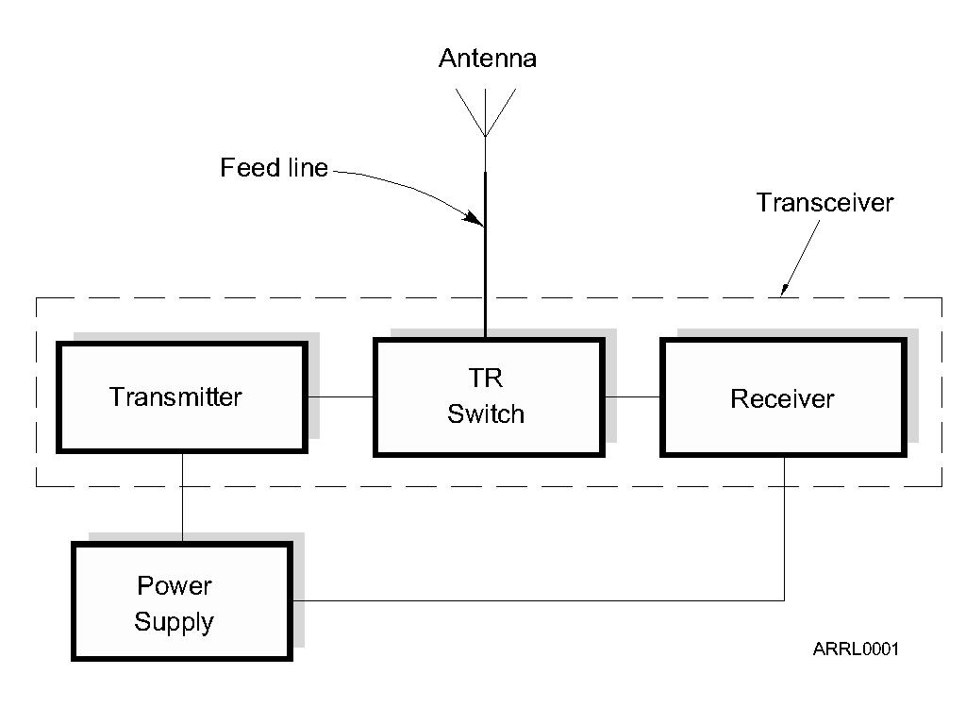
The Basic Transceiver
Combination of “transmitter” and “receiver”
Abbreviated “XCVR” (X = trans)
Antenna switched between transmitter and receiver by the TR switch
Notes:
Begin to work in bits of common jargon, like XCVR, so that students will have seen it. If you have pictures of older equipment, you can show them and compare to modern radios.

Slide 3
Transmit/Receive (TR) Switch
TR switch allows a single antenna to be switched to the transmitter when sending and to the receiver when receiving.
In a transceiver, the TR switch is inside the unit and operates automatically.
Transceivers cannot transmit and receive at the same time like a repeater.

Slide 4
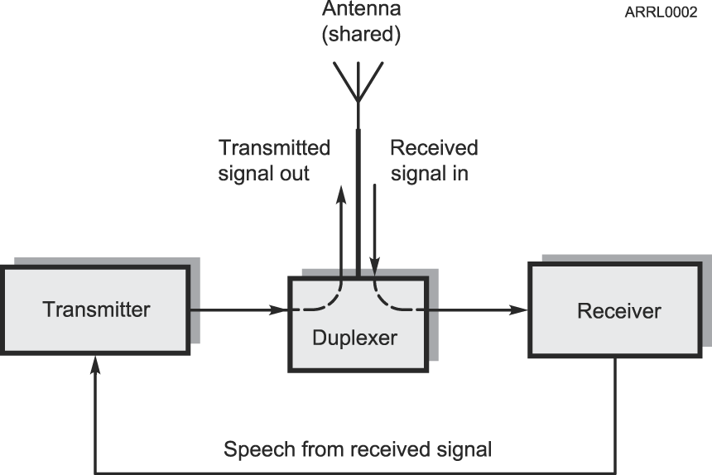
The Basic Repeater
Relays signals from low-power stations over a wide area
Simultaneously re-transmits received signal on the same band
TR switch replaced with duplexer which allows antenna to be shared without switching
Notes:
Contrast the duplexer with the TR switch in that the duplexer routes signals based on their frequency. The antenna is connected to both the transmitter and receiver at all times – there is no switching.

Slide 5
What Happens During Radio Communication? (Review)
Transmitting (sending a signal):
Information (voice, data, video, commands, etc.) is converted to electronic form.
The information in electronic form is added to a radio wave.
The radio wave carrying the information is sent from the station antenna into space.

Slide 6
What Happens During Radio Communication? (Review)
Receiving:
The radio wave carrying the information is intercepted by the receiving station’s antenna.
The receiver extracts the information from the received wave.
The information is then presented to the user in a format that can be understood (sound, picture, words on a computer screen, response to a command, etc.).

Slide 7
What Happens During Radio Communication? (Review)
Adding and extracting the information can be simple or complex.
This makes ham radio fun…learning all about how radios work.
Don’t be intimidated. You will be required to only know the basics, but you can learn as much about the “art and science” of radio as you want.
Notes:
Note that radios can be very simple – for AM or CW – or very complex such as for digital modes. Show examples of a minimal low-power CW transmitter and a simple AM receiver.

Slide 8
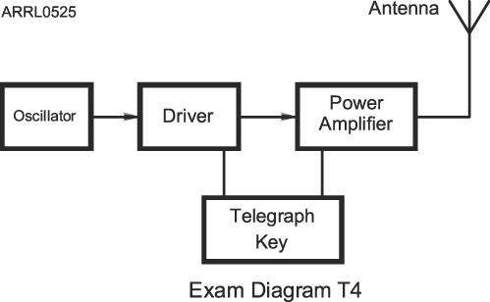
Simple Morse (CW) Transmitter Block Diagram
Notes:
Explain that each block is often called a “stage” and that signals generally progress from left to right.
Explain that a Driver is really just a low-power amplifier stage.

Slide 9
Filters
Circuits that act on signals differently according their frequency.
Filters can reject, enhance, or modify signals.
Notes:
Although there are no questions on filters, they are so fundamental and widely encountered that this is a good opportunity to spend some time explaining the basic types.

Slide 10
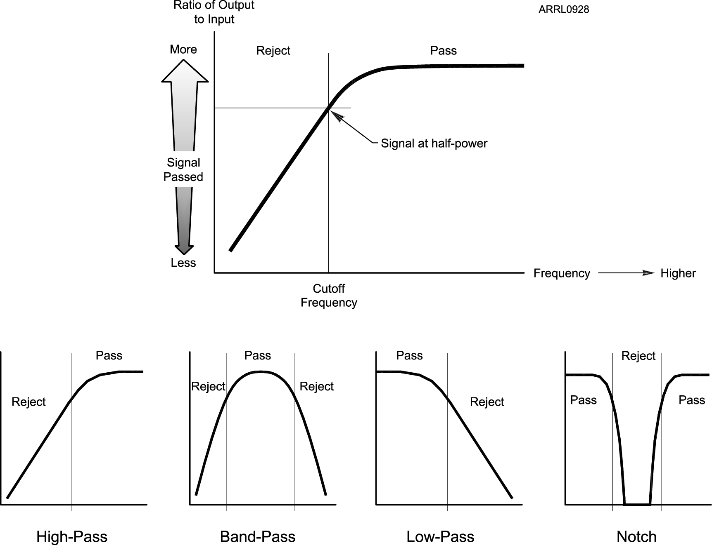
Types of Filters
Notes:
You can demonstrate the function of a filter by using an audio filter with a music source or spoken program. A radio with adjustable passband tuning or audio filters that is tuned to a clear, strong station will also work. Start with high-pass and low-pass. Change to band-pass and explain it as a combination of high- and low-pass. Then use the radio’s notch filter to remove a carrier or tone.

Slide 11
Adding Information - Modulation
When we add some information to the radio wave (the carrier), we modulate the wave.
Morse code (CW), speech, data
Different modulation techniques vary different properties of the wave to add the information:
Amplitude, frequency, or phase
Modulator and demodulator circuits
Modulators add information to an RF signal, demodulators recover the information
Notes:
Review the modulation coverage from Module 3. If you did not demonstrate modulation in Module 3, this would be a good time to do so.
Explain that modulation and demodulation are usually performed by specific circuits if modulation is performed electronically.
In a software-defined radio, modulation and demodulation are functions performed by a microprocessor on data but this is too advanced for the course. Be prepared to answer questions about SDR but do not spend significant class time explaining what it is.

Slide 12
Changing Frequency - Mixers
Signal frequencies can be changed by combining with another signal, called mixing
Also referred to as heterodyning
Two signals are combined in a mixer
Generates mixing product signals
Sum and difference of the input signals
Shifts frequency by adding or subtracting
Different than a multiplier which multiplies a signal’s frequency by some integer, usually 2 or 3
Notes:
You do not need to explain how a mixer works – only that it has two input signals and generates mixing products that are at the sum and difference of the input signal frequencies. Technically, there are an infinite number of output signals but again, this is not an appropriate topic for the course – keep it simple!

Slide 13
Sensitivity and Selectivity
Two essential tasks for a receiver:
Hear a signal and hear only one signal
Sensitivity is a measure of how well the receiver can detect weak signals
Selectivity is a measure of the receiver’s ability to discriminate between signals
Preamplifiers make a receiver more sensitive
Preamplifiers added between antenna and receiver
Notes:
Students will probably understand sensitivity already. Selectivity is best explained with a demonstration using wide and narrow filters or recording showing how filters can be used to eliminate or greatly reduce unwanted signals on nearby frequencies, leaving the desired signal clear and easy to understand.
Most preamps students will encounter are inside the radio. Explain that they are connected between the receiver’s antenna input and the rest of the receiver. If an external preamp is available, explain that it is installed as close to the antenna as possible and may have its own transmit-receive switch to allow use of the same antenna on receive and transmit, just like a TR switch in a transceiver.

Slide 14
Transverter
Short for “transceiving converter” (XVTR)
Converts a transceiver to operate on another band
Usually to a higher frequency
External mixers shift frequency
Typical examples
HF SSB/CW at 28 MHz converted to/from 222 MHz
VHF SSB/CW at 144 MHz converted to/from 10 GHz
Notes:
Download and show some product descriptions and photos for transverters. Note that transverters allow use of sophisticated transceiver features on bands for which it would be expensive to purchase a separate radio. A photo of a VHF/UHF rover station with several transverters would be interesting.

Slide 15
Practice Questions

Slide 16
What type of amateur station simultaneously retransmits the signal of another amateur station on a different channel or channels?
A. Beacon station
B. Earth station
C. Repeater station
D. Message forwarding station
FCC Rule: [97.3(a)(40)] T1F09 HRLM (2-12)

Slide 17
What type of amateur station simultaneously retransmits the signal of another amateur station on a different channel or channels?
A. Beacon station
B. Earth station
C. Repeater station
D. Message forwarding station
FCC Rule: [97.3(a)(40)] T1F09 HRLM (2-12)

Slide 18
Which term describes the ability of a receiver to detect the presence of a signal?
A. Linearity
B. Sensitivity
C. Selectivity
D. Total Harmonic Distortion
T7A01 HRLM (3-18)

Slide 19
Which term describes the ability of a receiver to detect the presence of a signal?
A. Linearity
B. Sensitivity
C. Selectivity
D. Total Harmonic Distortion
T7A01 HRLM (3-18)

Slide 20
What is a transceiver?
A. A type of antenna switch
B. A unit combining the functions of a transmitter and a receiver
C. A component in a repeater which filters out unwanted interference
D. A type of antenna matching network
T7A02 HRLM (2-12)

Slide 21
What is a transceiver?
A. A type of antenna switch
B. A unit combining the functions of a transmitter and a receiver
C. A component in a repeater which filters out unwanted interference
D. A type of antenna matching network
T7A02 HRLM (2-12)

Slide 22
Which of the following is used to convert a radio signal from one frequency to another?
A. Phase splitter
B. Mixer
C. Inverter
D. Amplifier
T7A03 HRLM (3-18)

Slide 23
Which of the following is used to convert a radio signal from one frequency to another?
A. Phase splitter
B. Mixer
C. Inverter
D. Amplifier
T7A03 HRLM (3-18)

Slide 24
Which term describes the ability of a receiver to discriminate between multiple signals?
A. Discrimination ratio
B. Sensitivity
C. Selectivity
D. Harmonic Distortion
T7A04 HRLM (3-18)

Slide 25
Which term describes the ability of a receiver to discriminate between multiple signals?
A. Discrimination ratio
B. Sensitivity
C. Selectivity
D. Harmonic Distortion
T7A04 HRLM (3-18)

Slide 26
What is the name of a circuit that generates a signal of a desired frequency?
A. Reactance modulator
B. Product detector
C. Low-pass filter
D. Oscillator
T7A05 HRLM (3-16)

Slide 27
What is the name of a circuit that generates a signal of a desired frequency?
A. Reactance modulator
B. Product detector
C. Low-pass filter
D. Oscillator
T7A05 HRLM (3-16)

Slide 28
What device takes the output of a low-powered 28 MHz SSB exciter and produces a 222 MHz output signal?
A. High-pass filter
B. Low-pass filter
C. Transverter
D. Phase converter
T7A06 HRLM (3-19)

Slide 29
What device takes the output of a low-powered 28 MHz SSB exciter and produces a 222 MHz output signal?
A. High-pass filter
B. Low-pass filter
C. Transverter
D. Phase converter
T7A06 HRLM (3-19)

Slide 30
Which of the following describes combining speech with an RF carrier signal?
A. Impedance matching
B. Oscillation
C. Modulation
D. Low-pass filtering
T7A08 HRLM (3-17)

Slide 31
Which of the following describes combining speech with an RF carrier signal?
A. Impedance matching
B. Oscillation
C. Modulation
D. Low-pass filtering
T7A08 HRLM (3-17)

Slide 32
What device increases the low-power output from a handheld transceiver?
A. A voltage divider
B. An RF power amplifier
C. An impedance network
D. All of these choices are correct
T7A10 HRLM (5-8)

Slide 33
What device increases the low-power output from a handheld transceiver?
A. A voltage divider
B. An RF power amplifier
C. An impedance network
D. All of these choices are correct
T7A10 HRLM (5-8)

Slide 34
Where is an RF preamplifier installed?
A. Between the antenna and receiver
B. At the output of the transmitter's power amplifier
C. Between a transmitter and antenna tuner
D. At the receiver's audio output
T7A11 HRLM (3-18)

Slide 35
Where is an RF preamplifier installed?
A. Between the antenna and receiver
B. At the output of the transmitter's power amplifier
C. Between a transmitter and antenna tuner
D. At the receiver's audio output
T7A11 HRLM (3-18)

