Slide 1
Technician License Course
Chapter 3
Lesson Plan Module 6 –
Electrical Components

Slide 2
Electronics – Controlling the Flow of Current
To make an electronic device (like a radio) do something useful (like a receiver), we need to control and manipulate the flow of current.
There are a number of different electronic components that are used to do this.
Notes:
You are now going to shift into some specifics of electronic components. Explain that there are several basic types of components that will be covered and the students will be expected to know the function of the components but not how electronic circuits work. Have several types of the basic components on hand for inspection.

Slide 3
Schematic Diagrams
We can draw pictures of electronic components forming circuits, such as for the parallel and series circuit examples. This is too cumbersome for most circuits.
Schematic diagrams use symbols with different components, each having a different symbol.
Notes:
Explain schematic diagrams as the way electronic circuits are described. Note that each type of component has a different symbol. Look at HRLM page 3-15 for an example. Let the students become accustomed to schematic symbols as the lesson progresses.

Slide 4
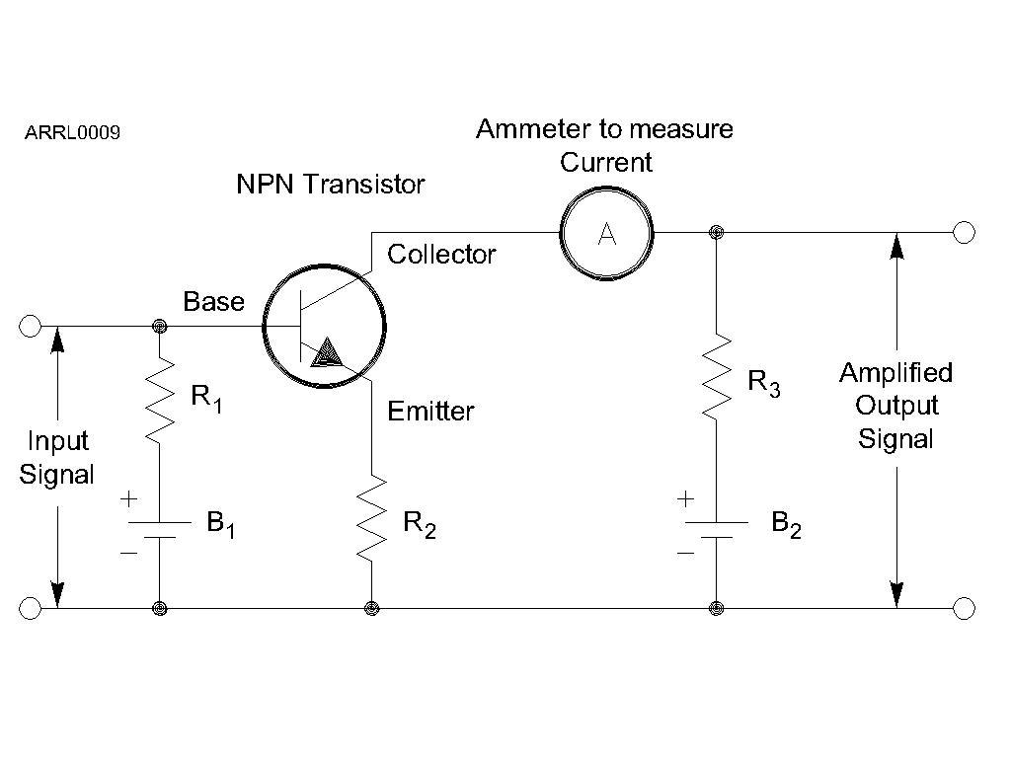
Schematic Diagrams
The lines and dots on schematics represent electrical connections between the components.
Notes:
It is also a good idea to have a simple circuit board with the associated circuit diagram so that students can see a practical application and the connection between the circuit diagram and an operative circuit. A code practice oscillator would be a good example -- simple but does something.

Slide 5
The Resistor
The function of a resistor is to restrict the flow of current.
Remember Ohm’s Law:
I = E / R
E = I × R
Schematic symbol
Potentiometer
or “Pot”
Arrow indicates adjustable value, such as for a volume control.
Notes:
Describe what causes a resistor to have resistance. Pass around different types of resistors, including a couple of types of variable resistors.

Slide 6
The Capacitor
The function of a capacitor is to store electrical energy – called capacitance.
  Acts like a battery
  Stores energy in an electric field created by voltage between the electrodes with insulating dielectric material between them
Schematic symbol
Electrodes
Notes:
Describe the basic structure of a capacitor.
Pass around different types of capacitor, including variable.

Slide 7
The Inductor
The function of an inductor is to store magnetic energy – called inductance.
  A coil of wire around a core of air or magnetic material like iron or ferrite
  Stores energy in a magnetic field created by current in the wire
Schematic symbol
Notes:
Describe the basic structure of a inductor.
Pass around different types of inductor, including variable.

Slide 8
The Transformer
A pair of inductors sharing a common core
  Also share their magnetic field
  Used to transfer energy from one circuit to another without a direct connection
  Changes the ratio of voltage and current
Schematic symbol
Core
Notes:
A small power transformer with both windings visible is a good example. Explain that electrical energy from current in the primary winding is transferred as magnetic energy through the core to the secondary where is converted back to electrical energy as current in the secondary.

Slide 9
Electrical Units
Each type of component has a value measured in specific units:
  Resistors > resistance > ohms (Ω)
  Capacitors > capacitance > farads (F)
  Inductors > inductance > henrys (H)

Slide 10
Component Designators
Each schematic symbol has a designator to denote which component it refers to. For example, the 10th resistor in a circuit is R10.
Resistors (R), capacitors (C), inductors (L).
Notes:
Show a schematic diagram with different component designators.

Slide 11
Indicators and Displays
Indicators communicate status
  ON/OFF, ready/stand-by, left/right
  LEDs, light bulbs, symbols, audio tones
Displays communicate values or text
  Numeric values, warnings, messages
  Digital and analog meters, LCD screens
Notes:
Pass around different types of LEDs, meters, indicator bulbs, etc.

Slide 12
Reactance
Capacitors and inductors store energy, rather than dissipating it like resistors.
Energy storage creates an effect called reactance (symbol X) that acts like a resistance in opposing the flow of ac current.
  Capacitors create capacitive reactance (X_{C} )
  Inductors create inductive reactance (X_{L} )
  The effects of each are complementary
Notes:
No need to get into phase differences. Explain that as energy is stored by the component, it becomes more difficult to add more energy. This increasing difficulty acts to oppose additional current flow in the component. Note that reactance only acts on ac currents or dc currents that change in value.

Slide 13
Impedance
The combination of resistance (R) and reactance (X) is called impedance, represented by the symbol Z.
Impedance represents a circuit’s opposition to both ac and dc currents.
Notes:
Don’t get into imaginary numbers – stick with the basics and note that impedance includes the component’s effects on both ac and dc current.

Slide 14
Resonance
A component’s reactance depends on frequency: X_{L} increases with frequency while X_{C} decreases.
At the frequency for which a circuit’s X_{L} and X_{C} are equal, their effects cancel. This is the circuit’s resonant frequency.
At resonance, a circuit has only resistance, which affects ac and dc current equally.
Notes:
Show a basic graph with reactances rising and falling with frequency. (See figure 2.55 in recent editions of the ARRL Handbook)

Slide 15
Resonant or Tuned Circuit
Capacitors and inductors connected together create a tuned circuit.
  When X_{L} and X_{C} are equal, the circuit is resonant.
  If C or L are adjustable the resonant frequency can be varied or tuned.
Notes:
Reinforce that the effects of capacitive and inductive reactance are complementary and when both are present cancel each other out. You can explain that the series circuit looks like a short at resonance and the parallel like an open, but don’t spend time explaining how the circuits work.

Slide 16
Semiconductor Components
Made of material like silicon that are “OK” conductors but not as good as metals.
Impurities added to semiconductors create material with more than usual electrons (N-type) and fewer than usual (P-type) electrons.
Structures of N and P material can control current flow through the semiconductor.

Slide 17
The Diode
Allows current to flow in only one direction.
  Two electrodes: anode and cathode
  AC current is changed to varying pulses of dc – called rectification
  Diodes used to change ac power to dc power are called rectifiers
Schematic symbol
Designator (D or CR)
Anode
Cathode
Arrows
indicate light (LED)
Notes:
Diodes are like check valves in a pipe that prevent backflow. Pass around different types of diodes and rectifiers.

Slide 18
The Transistor
The function of a transistor is to control large signals with small ones.
  An “electronically controlled current valve”
  When used as an amplifier a transistor produces gain
  Transistors can also be used as a switch
Schematic symbol
Designator (Q)
Bipolar Junction Transistor (BJT)
Field-Effect Transistor (FET)
Notes:
The water faucet analogy is a good one to explain the function of a transistor.

Slide 19
The Transistor
The Bipolar Junction Transistor (BJT) has three layers of N or P material connected to electrodes:
Depending on the arrangement of layers, a BJT is either an NPN or PNP transistor.
Collector
Collector
Base
Emitter
Notes:
Explain that small currents in the base control larger currents between the collector and emitter. Draw a simple layer example of NPN and PNP transistors. Pass around different types of BJTs for inspection.

Slide 20
The Transistor
The Field-Effect Transistor (FET) has a conducting path or channel of N and P material connected to the drain and source electrodes.
Voltage applied to the gate electrode controls current through the channel.
Drain
Gate
Source
Notes:
Explain that voltage on the gate controls currents between the source and drain. Show a simple cross-section of a channel with a gate on top of it. Pass around different types of FETs for inspection while explaining the only way to tell them apart is through part numbers on the device.

Slide 21
The Integrated Circuit
The integrated circuit is a collection of components contained in one device that accomplishes a specific task.
Schematic symbol
Designator (IC or U)
D
Q
CLK
Q
_
+
Notes:
Give some examples of the specific kind of task that might be performed by an IC.
Note that the code practice oscillator circuit shown earlier could easily be created in an IC. Show a 555 timer IC as an example of such a device.

Slide 22
Protective Components
Fuses and circuit breakers are designed to remove power in case of
a circuit overload.
  Fuses blow – one time protection
  Circuit breakers trip – can be reset and reused
  Always use proper rating
Schematic symbol
Designator (F or CB)
Fuses
Circuit
Breaker
Notes:
Spend some time on the safety aspects of dealing with fuses and circuit breakers. Pass around different types of fuses and non-household circuit breakers for inspection.

Slide 23
Switches
Switches are used to interrupt or allow current to flow.
  Each circuit controlled by the switch is a pole
  Each position is called a throw
Schematic symbol
Designator (S or SW)
SPST
SPDT
DPDT
Pushbutton
Notes:
Spend some time making sure the definitions of pole and throw are understood. These are old words from the early days of electricity that have been carried through to modern usage.
Pass around different types of switches for inspection.

Slide 24
Relays
Relays are switches activated by current in a coil (electromagnet)
  Relays use the same pole/throw names as switches
  The moving switch is called the armature
  Contacts are named by when they are connected
Schematic symbol
Designator (K or RLY)
NC - Normally Closed
COM - Common
NO - Normally Open
Coil
Notes:
Pass around different types of relays for inspection. If you have a small relay and power supply allow students to see it activate.

Slide 25
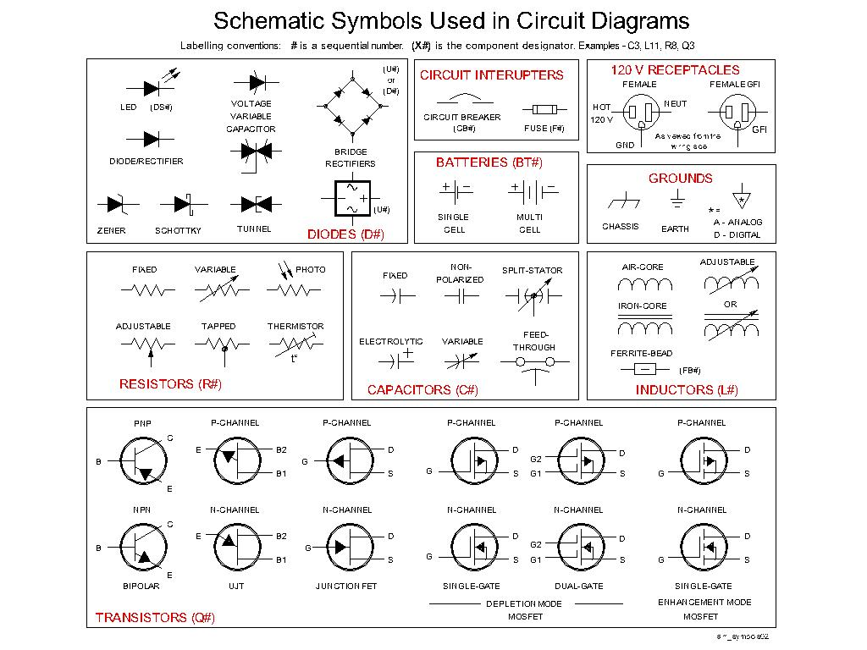
Other Circuit Symbols
Notes:
Draw other symbols not on this collection, such as an antenna, coax connector, some logic gates, etc.

Slide 26
Practice Questions

Slide 27
What is the ability to store energy in an electric field called?
A. Inductance
B. Resistance
C. Tolerance
D. Capacitance
  T5C01 HRLM (3-7)

Slide 28
What is the ability to store energy in an electric field called?
A. Inductance
B. Resistance
C. Tolerance
D. Capacitance
  T5C01 HRLM (3-7)

Slide 29
What is the basic unit of capacitance?
A. The farad
B. The ohm
C. The volt
D. The henry
  T5C02 HRLM (3-7)

Slide 30
What is the basic unit of capacitance?
A. The farad
B. The ohm
C. The volt
D. The henry
  T5C02 HRLM (3-7)

Slide 31
What is the ability to store energy in a magnetic field called?
A. Admittance
B. Capacitance
C. Resistance
D. Inductance
  T5C03 HRLM (3-7)

Slide 32
What is the ability to store energy in a magnetic field called?
A. Admittance
B. Capacitance
C. Resistance
D. Inductance
  T5C03 HRLM (3-7)

Slide 33
What is the basic unit of inductance?
A. The coulomb
B. The farad
C. The henry
D. The ohm
  T5C04 HRLM (3-7)

Slide 34
What is the basic unit of inductance?
A. The coulomb
B. The farad
C. The henry
D. The ohm
  T5C04 HRLM (3-7)

Slide 35
What is meant by the term impedance?
A. It is a measure of the opposition to AC current flow in a circuit
B. It is the inverse of resistance
C. It is a measure of the Q or Quality Factor of a component
D. It is a measure of the power handling capability of a component
  T5C12 HRLM (3-9)

Slide 36
What is meant by the term impedance?
A. It is a measure of the opposition to AC current flow in a circuit
B. It is the inverse of resistance
C. It is a measure of the Q or Quality Factor of a component
D. It is a measure of the power handling capability of a component
  T5C12 HRLM (3-9)

Slide 37
What are the units of impedance?
A. Volts
B. Amperes
C. Coulombs
D. Ohms
  T5C13 HRLM (3-9)

Slide 38
What are the units of impedance?
A. Volts
B. Amperes
C. Coulombs
D. Ohms
  T5C13 HRLM (3-9)

Slide 39
What electrical component is used to oppose the flow of current in a DC circuit?
A. Inductor
B. Resistor
C. Voltmeter
D. Transformer
  T6A01 HRLM (3-7)

Slide 40
What electrical component is used to oppose the flow of current in a DC circuit?
A. Inductor
B. Resistor
C. Voltmeter
D. Transformer
  T6A01 HRLM (3-7)

Slide 41
What type of component is often used as an adjustable volume control?
A. Fixed resistor
B. Power resistor
C. Potentiometer
D. Transformer
  T6A02 HRLM (3-9)

Slide 42
What type of component is often used as an adjustable volume control?
A. Fixed resistor
B. Power resistor
C. Potentiometer
D. Transformer
  T6A02 HRLM (3-9)

Slide 43
What electrical parameter is controlled by a potentiometer?
A. Inductance
B. Resistance
C. Capacitance
D. Field strength
  T6A03 HRLM (3-9)

Slide 44
What electrical parameter is controlled by a potentiometer?
A. Inductance
B. Resistance
C. Capacitance
D. Field strength
  T6A03 HRLM (3-9)

Slide 45
What electrical component stores energy in an electric field?
A. Resistor
B. Capacitor
C. Inductor
D. Diode
  T6A04 HRLM (3-7)

Slide 46
What electrical component stores energy in an electric field?
A. Resistor
B. Capacitor
C. Inductor
D. Diode
  T6A04 HRLM (3-7)

Slide 47
What type of electrical component consists of two or more conductive surfaces separated by an insulator?
A. Resistor
B. Potentiometer
C. Oscillator
D. Capacitor
  T6A05 HRLM (3-7)

Slide 48
What type of electrical component consists of two or more conductive surfaces separated by an insulator?
A. Resistor
B. Potentiometer
C. Oscillator
D. Capacitor
  T6A05 HRLM (3-7)

Slide 49
What type of electrical component stores energy in a magnetic field?
A. Resistor
B. Capacitor
C. Inductor
D. Diode
  T6A06 HRLM (3-7)

Slide 50
What type of electrical component stores energy in a magnetic field?
A. Resistor
B. Capacitor
C. Inductor
D. Diode
  T6A06 HRLM (3-7)

Slide 51
What electrical component is usually composed of a coil of wire?
A. Switch
B. Capacitor
C. Diode
D. Inductor
  T6A07 HRLM (3-7)

Slide 52
What electrical component is usually composed of a coil of wire?
A. Switch
B. Capacitor
C. Diode
D. Inductor
  T6A07 HRLM (3-7)

Slide 53
What electrical component is used to connect or disconnect electrical circuits?
A. Magnetron
B. Switch
C. Thermistor
D. All of these choices are correct
  T6A08 HRLM (3-12)

Slide 54
What electrical component is used to connect or disconnect electrical circuits?
A. Magnetron
B. Switch
C. Thermistor
D. All of these choices are correct
  T6A08 HRLM (3-12)

Slide 55
What electrical component is used to protect other circuit components from current overloads?
A. Fuse
B. Capacitor
C. Inductor
D. All of these choices are correct
  T6A09 HRLM (3-12)

Slide 56
What electrical component is used to protect other circuit components from current overloads?
A. Fuse
B. Capacitor
C. Inductor
D. All of these choices are correct
  T6A09 HRLM (3-12)

Slide 57
What class of electronic components is capable of using a voltage or current signal to control current flow?
A. Capacitors
B. Inductors
C. Resistors
D. Transistors
  T6B01 HRLM (3-11)

Slide 58
What class of electronic components is capable of using a voltage or current signal to control current flow?
A. Capacitors
B. Inductors
C. Resistors
D. Transistors
  T6B01 HRLM (3-11)

Slide 59
What electronic component allows current to flow in only one direction?
A. Resistor
B. Fuse
C. Diode
D. Driven Element
  T6B02 HRLM (3-10)

Slide 60
What electronic component allows current to flow in only one direction?
A. Resistor
B. Fuse
C. Diode
D. Driven Element
  T6B02 HRLM (3-10)

Slide 61
Which of these components can be used as an electronic switch or amplifier?
A. Oscillator
B. Potentiometer
C. Transistor
D. Voltmeter
  T6B03 HRLM (3-11)

Slide 62
Which of these components can be used as an electronic switch or amplifier?
A. Oscillator
B. Potentiometer
C. Transistor
D. Voltmeter
  T6B03 HRLM (3-11)

Slide 63
Which of the following components can be made of three layers of semiconductor material?
A. Alternator
B. Transistor
C. Triode
D. Pentagrid converter
  T6B04 HRLM (3-11)

Slide 64
Which of the following components can be made of three layers of semiconductor material?
A. Alternator
B. Transistor
C. Triode
D. Pentagrid converter
  T6B04 HRLM (3-11)

Slide 65
Which of the following electronic components can amplify signals?
A. Transistor
B. Variable resistor
C. Electrolytic capacitor
D. Multi-cell battery
  T6B05 HRLM (3-11)

Slide 66
Which of the following electronic components can amplify signals?
A. Transistor
B. Variable resistor
C. Electrolytic capacitor
D. Multi-cell battery
  T6B05 HRLM (3-11)

Slide 67
How is the cathode lead of a semiconductor diode usually identified?
A. With the word "cathode"
B. With a stripe
C. With the letter "C"
D. All of these choices are correct
  T6B06 HRLM (3-10)

Slide 68
How is the cathode lead of a semiconductor diode usually identified?
A. With the word "cathode"
B. With a stripe
C. With the letter "C"
D. All of these choices are correct
  T6B06 HRLM (3-10)

Slide 69
What does the abbreviation LED stand for?
A. Low Emission Diode
B. Light Emitting Diode
C. Liquid Emission Detector
D. Long Echo Delay
  T6B07 HRLM (3-10)

Slide 70
What does the abbreviation LED stand for?
A. Low Emission Diode
B. Light Emitting Diode
C. Liquid Emission Detector
D. Long Echo Delay
  T6B07 HRLM (3-10)

Slide 71
What does the abbreviation FET stand for?
A. Field Effect Transistor
B. Fast Electron Transistor
C. Free Electron Transition
D. Field Emission Thickness
  T6B08 HRLM (3-11)

Slide 72
What does the abbreviation FET stand for?
A. Field Effect Transistor
B. Fast Electron Transistor
C. Free Electron Transition
D. Field Emission Thickness
  T6B08 HRLM (3-11)

Slide 73
What are the names of the two electrodes of a diode?
A. Plus and minus
B. Source and drain
C. Anode and cathode
D. Gate and base
  T6B09 HRLM (3-10)

Slide 74
What are the names of the two electrodes of a diode?
A. Plus and minus
B. Source and drain
C. Anode and cathode
D. Gate and base
  T6B09 HRLM (3-10)

Slide 75
What are the three electrodes of a PNP or NPN transistor?
A. Emitter, base, and collector
B. Source, gate, and drain
C. Cathode, grid, and plate
D. Cathode, drift cavity, and collector
  T6B10 HRLM (3-11)

Slide 76
What are the three electrodes of a PNP or NPN transistor?
A. Emitter, base, and collector
B. Source, gate, and drain
C. Cathode, grid, and plate
D. Cathode, drift cavity, and collector
  T6B10 HRLM (3-11)

Slide 77
What are the three electrodes of a field effect transistor?
A. Emitter, base, and collector
B. Source, gate, and drain
C. Cathode, grid, and plate
D. Cathode, gate, and anode
  T6B11 HRLM (3-11)

Slide 78
What are the three electrodes of a field effect transistor?
A. Emitter, base, and collector
B. Source, gate, and drain
C. Cathode, grid, and plate
D. Cathode, gate, and anode
  T6B11 HRLM (3-11)

Slide 79
What is the term that describes a transistor's ability to amplify a signal?
A. Gain
B. Forward resistance
C. Forward voltage drop
D. On resistance
  T6B12 HRLM (3-11)

Slide 80
What is the term that describes a transistor's ability to amplify a signal?
A. Gain
B. Forward resistance
C. Forward voltage drop
D. On resistance
  T6B12 HRLM (3-11)

Slide 81
What is the name for standardized representations of components in an electrical wiring diagram?
A. Electrical depictions
B. Grey sketch
C. Schematic symbols
D. Component callouts
  T6C01 HRLM (3-13)

Slide 82
What is the name for standardized representations of components in an electrical wiring diagram?
A. Electrical depictions
B. Grey sketch
C. Schematic symbols
D. Component callouts
  T6C01 HRLM (3-13)

Slide 83
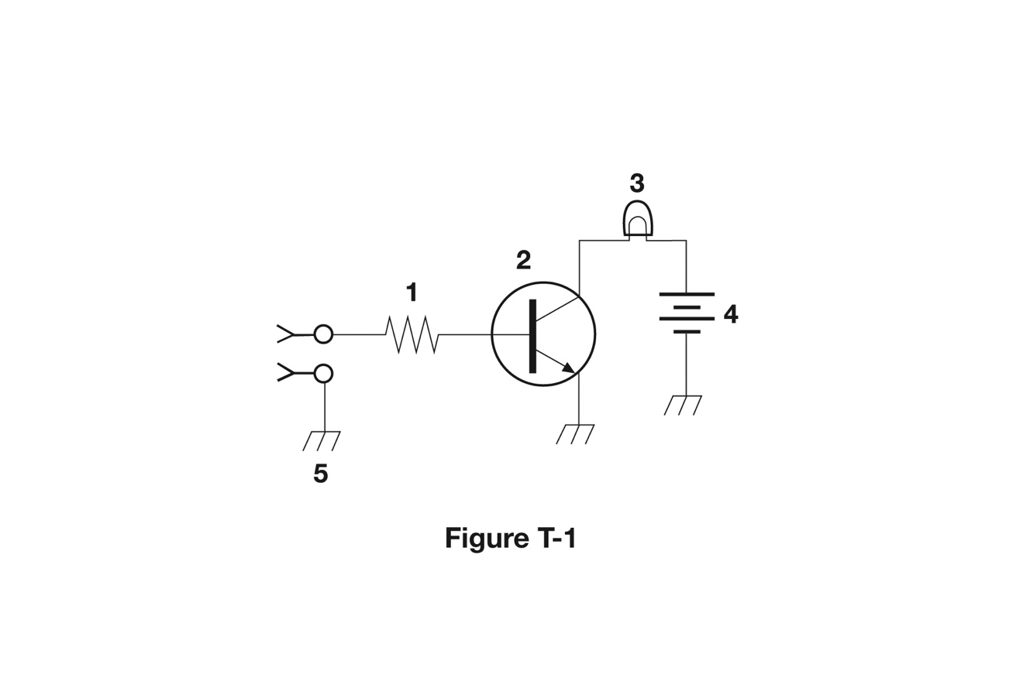
What is component 1 in figure T1?
A. Resistor
B. Transistor
C. Battery
D. Connector
  T6C02 HRLM (3-13)

Slide 84
What is component 1 in figure T1?
A. Resistor
B. Transistor
C. Battery
D. Connector
  T6C02 HRLM (3-13)

Slide 85
What is component 2 in figure T1?
A. Resistor
B. Transistor
C. Indicator lamp
D. Connector
  T6C03 HRLM (3-13)

Slide 86
What is component 2 in figure T1?
A. Resistor
B. Transistor
C. Indicator lamp
D. Connector
  T6C03 HRLM (3-13)

Slide 87
What is component 3 in figure T1?
A. Resistor
B. Transistor
C. Lamp
D. Ground symbol
  T6C04 HRLM (3-13)

Slide 88
What is component 3 in figure T1?
A. Resistor
B. Transistor
C. Lamp
D. Ground symbol
  T6C04 HRLM (3-13)

Slide 89
What is component 4 in figure T1?
A. Resistor
B. Transistor
C. Battery
D. Ground symbol
  T6C05 HRLM (3-13)

Slide 90
What is component 4 in figure T1?
A. Resistor
B. Transistor
C. Battery
D. Ground symbol
  T6C05 HRLM (3-13)

Slide 91
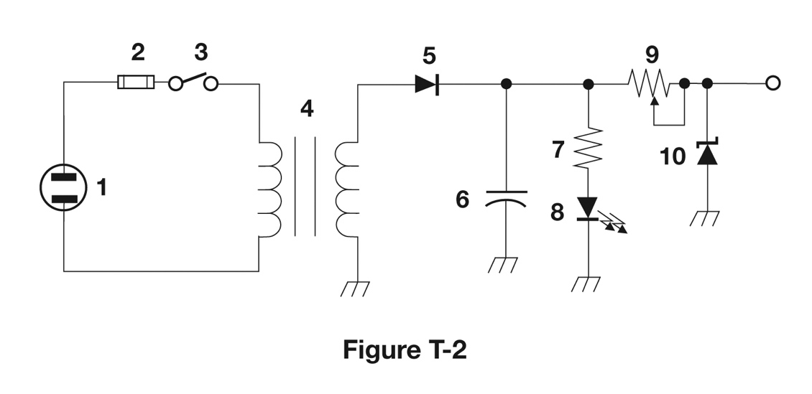
What is component 6 in figure T2?
A. Resistor
B. Capacitor
C. Regulator IC
D. Transistor
  T6C06 HRLM (3-13)

Slide 92
What is component 6 in figure T2?
A. Resistor
B. Capacitor
C. Regulator IC
D. Transistor
  T6C06 HRLM (3-13)

Slide 93
What is component 8 in figure T2?
A. Resistor
B. Inductor
C. Regulator IC
D. Light emitting diode
  T6C07 HRLM (3-13)

Slide 94
What is component 8 in figure T2?
A. Resistor
B. Inductor
C. Regulator IC
D. Light emitting diode
  T6C07 HRLM (3-13)

Slide 95
What is component 9 in figure T2?
A. Variable capacitor
B. Variable inductor
C. Variable resistor
D. Variable transformer
  T6C08 HRLM (3-13)

Slide 96
What is component 9 in figure T2?
A. Variable capacitor
B. Variable inductor
C. Variable resistor
D. Variable transformer
  T6C08 HRLM (3-13)

Slide 97
What is component 4 in figure T2?
A. Variable inductor
B. Double-pole switch
C. Potentiometer
D. Transformer
  T6C09 HRLM (3-13)

Slide 98
What is component 4 in figure T2?
A. Variable inductor
B. Double-pole switch
C. Potentiometer
D. Transformer
  T6C09 HRLM (3-13)

Slide 99
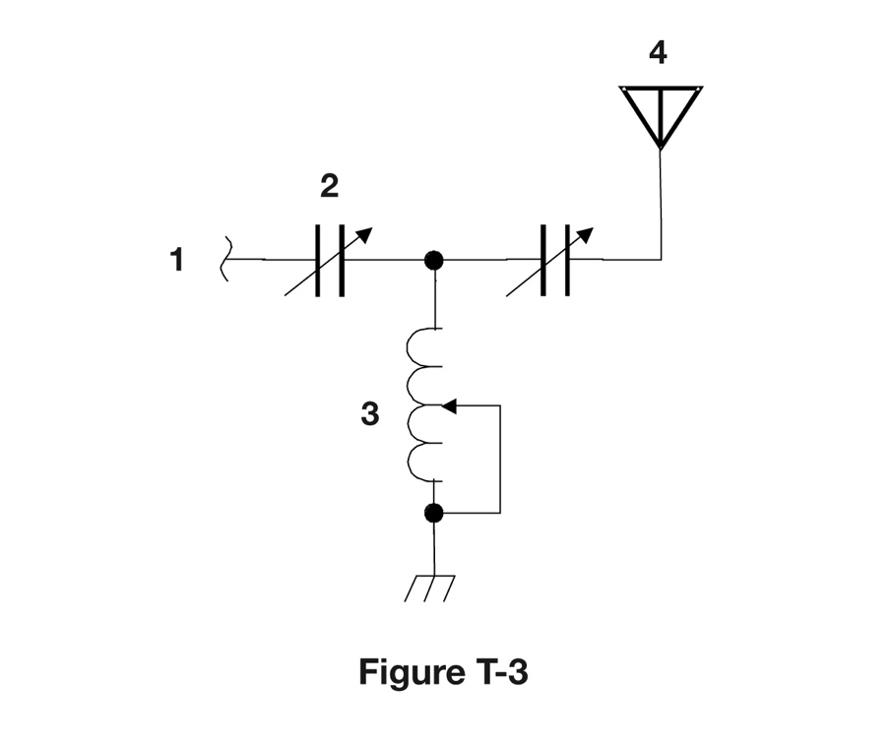
What is component 3 in figure T3?
A. Connector
B. Meter
C. Variable capacitor
D. Variable inductor
  T6C10 HRLM (3-13)

Slide 100
What is component 3 in figure T3?
A. Connector
B. Meter
C. Variable capacitor
D. Variable inductor
  T6C10 HRLM (3-13)

Slide 101
What is component 4 in figure T3?
A. Antenna
B. Transmitter
C. Dummy load
D. Ground
  T6C11 HRLM (3-13)

Slide 102
What is component 4 in figure T3?
A. Antenna
B. Transmitter
C. Dummy load
D. Ground
  T6C11 HRLM (3-13)

Slide 103
What do the symbols on an electrical circuit schematic diagram represent?
A. Electrical components
B. Logic states
C. Digital codes
D. Traffic nodes
  T6C12 HRLM (3-13)

Slide 104
What do the symbols on an electrical circuit schematic diagram represent?
A. Electrical components
B. Logic states
C. Digital codes
D. Traffic nodes
  T6C12 HRLM (3-13)

Slide 105
Which of the following is accurately represented in electrical circuit schematic diagrams?
A. Wire lengths
B. Physical appearance of components
C. The way components are interconnected
D. All of these choices are correct
  T6C13 HRLM (3-14)

Slide 106
Which of the following is accurately represented in electrical circuit schematic diagrams?
A. Wire lengths
B. Physical appearance of components
C. The way components are interconnected
D. All of these choices are correct
  T6C13 HRLM (3-14)

Slide 107
Which of the following devices or circuits changes an alternating current into a varying direct current signal?
A. Transformer
B. Rectifier
C. Amplifier
D. Reflector
  T6D01 HRLM (3-10)

Slide 108
Which of the following devices or circuits changes an alternating current into a varying direct current signal?
A. Transformer
B. Rectifier
C. Amplifier
D. Reflector
  T6D01 HRLM (3-10)

Slide 109
What best describes a relay?
A. A switch controlled by an electromagnet
B. A current controlled amplifier
C. An optical sensor
D. A pass transistor
  T6D02 HRLM (3-12)

Slide 110
What best describes a relay?
A. A switch controlled by an electromagnet
B. A current controlled amplifier
C. An optical sensor
D. A pass transistor
  T6D02 HRLM (3-12)

Slide 111
What type of switch is represented by component 3 in figure T2?
A. Single-pole single-throw
B. Single-pole double-throw
C. Double-pole single-throw
D. Double-pole double-throw
  T6D03 HRLM (3-13)

Slide 112
What type of switch is represented by component 3 in figure T2?
A. Single-pole single-throw
B. Single-pole double-throw
C. Double-pole single-throw
D. Double-pole double-throw
  T6D03 HRLM (3-13)

Slide 113
Which of the following can be used to display signal strength on a numeric scale?
A. Potentiometer
B. Transistor
C. Meter
D. Relay
  T6D04 HRLM (3-13)

Slide 114
Which of the following can be used to display signal strength on a numeric scale?
A. Potentiometer
B. Transistor
C. Meter
D. Relay
  T6D04 HRLM (3-13)

Slide 115
What component is commonly used to change 120V AC house current to a lower AC voltage for other uses?
A. Variable capacitor
B. Transformer
C. Transistor
D. Diode
  T6D06 HRLM (3-9)

Slide 116
What component is commonly used to change 120V AC house current to a lower AC voltage for other uses?
A. Variable capacitor
B. Transformer
C. Transistor
D. Diode
  T6D06 HRLM (3-9)

Slide 117
Which of the following is commonly used as a visual indicator?
A. LED
B. FET
C. Zener diode
D. Bipolar transistor
  T6D07 HRLM (3-11)

Slide 118
Which of the following is commonly used as a visual indicator?
A. LED
B. FET
C. Zener diode
D. Bipolar transistor
  T6D07 HRLM (3-11)

Slide 119
Which of the following is used together with an inductor to make a tuned circuit?
A. Resistor
B. Zener diode
C. Potentiometer
D. Capacitor
  T6D08 HRLM (3-9)

Slide 120
Which of the following is used together with an inductor to make a tuned circuit?
A. Resistor
B. Zener diode
C. Potentiometer
D. Capacitor
  T6D08 HRLM (3-9)

Slide 121
What is the name of a device that combines several semiconductors and other components into one package?
A. Transducer
B. Multi-pole relay
C. Integrated circuit
D. Transformer
  T6D09 HRLM (3-11)

Slide 122
What is the name of a device that combines several semiconductors and other components into one package?
A. Transducer
B. Multi-pole relay
C. Integrated circuit
D. Transformer
  T6D09 HRLM (3-11)

Slide 123
What is the function of component 2 in Figure T1?
A. Give off light when
current flows
through it
B. Supply electrical
energy
C. Control the flow of
current
D. Convert electrical
energy into radio
waves
  T6D10 HRLM (3-11)

Slide 124
What is the function of component 2 in Figure T1?
A. Give off light when
current flows
through it
B. Supply electrical
energy
C. Control the flow
of current
D. Convert electrical
energy into radio
waves
  T6D10 HRLM (3-11)

Slide 125
What is a simple resonant or tuned circuit?
A. An inductor and a capacitor connected in series or parallel to form a filter
B. A type of voltage regulator
C. A resistor circuit used for reducing standing wave ratio
D. A circuit designed to provide high fidelity audio
  T6D11 HRLM (3-9)

Slide 126
What is a simple resonant or tuned circuit?
A. An inductor and a capacitor connected in series or parallel to form a filter
B. A type of voltage regulator
C. A resistor circuit used for reducing standing wave ratio
D. A circuit designed to provide high fidelity audio
  T6D11 HRLM (3-9)

Slide 127
What is the purpose of a fuse in an electrical circuit?
A. To prevent power supply ripple from damaging a circuit
B. To interrupt power in case of overload
C. To limit current to prevent shocks
D. All of these choices are correct
  T0A04 HRLM (3-12)

Slide 128
What is the purpose of a fuse in an electrical circuit?
A. To prevent power supply ripple from damaging a circuit
B. To interrupt power in case of overload
C. To limit current to prevent shocks
D. All of these choices are correct
  T0A04 HRLM (3-12)

Slide 129
Why is it unwise to install a 20-ampere fuse in the place of a 5-ampere fuse?
A. The larger fuse would be likely to blow because it is rated for higher current
B. The power supply ripple would greatly increase
C. Excessive current could cause a fire
D. All of these choices are correct
  T0A05 HRLM (3-12)

Slide 130
Why is it unwise to install a 20-ampere fuse in the place of a 5-ampere fuse?
A. The larger fuse would be likely to blow because it is rated for higher current
B. The power supply ripple would greatly increase
C. Excessive current could cause a fire
D. All of these choices are correct
  T0A05 HRLM (3-12)

