Slide 1
Technician License Course
Chapter 3
Lesson Plan Module 5 –
Ohm’s Law, Power, and the Metric System

Slide 2
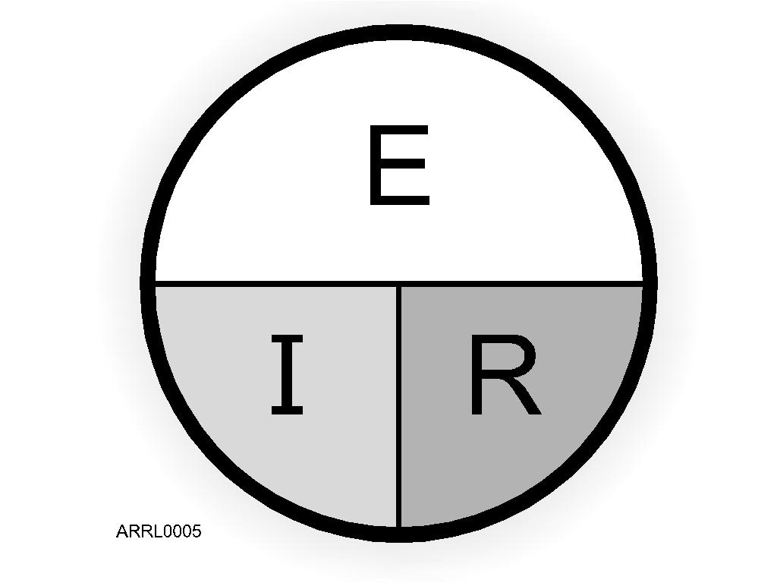
Ohm’s Law
E represents voltage
  Units – volts (V)
I represents current
  Units – amperes (A)
R represents resistance
  Units – ohms (Ω)
R = E / I
I = E / R
E = I x R
Notes:
Go over the simple Ohm’s Law math and provide a few examples of how to solve problems. Demonstrate how to use the graphic by placing a hand over the variable representing the unknown quantity.
Present some examples that are the same as test questions (without telling them that they are test questions).
Have the students solve these problems so they are confident that they can do the math.

Slide 3
Practice Questions

Slide 4
What formula is used to calculate current in a circuit?
A. Current (I) equals voltage (E) multiplied by resistance (R)
B. Current (I) equals voltage (E) divided by resistance (R)
C. Current (I) equals voltage (E) added to resistance (R)
D. Current (I) equals voltage (E) minus resistance (R)
  T5D01 HRLM (3-4)

Slide 5
What formula is used to calculate current in a circuit?
A. Current (I) equals voltage (E) multiplied by resistance (R)
B. Current (I) equals voltage (E) divided by resistance (R)
C. Current (I) equals voltage (E) added to resistance (R)
D. Current (I) equals voltage (E) minus resistance (R)
  T5D01 HRLM (3-4)

Slide 6
What formula is used to calculate voltage in a circuit?
A. Voltage (E) equals current (I) multiplied by resistance (R)
B. Voltage (E) equals current (I) divided by resistance (R)
C. Voltage (E) equals current (I) added to resistance (R)
D. Voltage (E) equals current (I) minus resistance (R)
  T5D02 HRLM (3-4)

Slide 7
What formula is used to calculate voltage in a circuit?
A. Voltage (E) equals current (I) multiplied by resistance (R)
B. Voltage (E) equals current (I) divided by resistance (R)
C. Voltage (E) equals current (I) added to resistance (R)
D. Voltage (E) equals current (I) minus resistance (R)
  T5D02 HRLM (3-4)

Slide 8
What formula is used to calculate resistance in a circuit?
A. Resistance (R) equals voltage (E) multiplied by current (I)
B. Resistance (R) equals voltage (E) divided by current (I)
C. Resistance (R) equals voltage (E) added to current (I)
D. Resistance (R) equals voltage (E) minus current (I)
  T5D03 HRLM (3-4)

Slide 9
What formula is used to calculate resistance in a circuit?
A. Resistance (R) equals voltage (E) multiplied by current (I)
B. Resistance (R) equals voltage (E) divided by current (I)
C. Resistance (R) equals voltage (E) added to current (I)
D. Resistance (R) equals voltage (E) minus current (I)
  T5D03 HRLM (3-4)

Slide 10
What is the resistance of a circuit in which a current of 3 amperes flows through a resistor connected to 90 volts?
A. 3 ohms
B. 30 ohms
C. 93 ohms
D. 270 ohms
  T5D04 HRLM (3-5)

Slide 11
What is the resistance of a circuit in which a current of 3 amperes flows through a resistor connected to 90 volts?
A. 3 ohms
B. 30 ohms
C. 93 ohms
D. 270 ohms
  T5D04 HRLM (3-5)

Slide 12
What is the resistance in a circuit for which the applied voltage is 12 volts and the current flow is 1.5 amperes?
A. 18 ohms
B. 0.125 ohms
C. 8 ohms
D. 13.5 ohms
  T5D05 HRLM (3-5)

Slide 13
What is the resistance in a circuit for which the applied voltage is 12 volts and the current flow is 1.5 amperes?
A. 18 ohms
B. 0.125 ohms
C. 8 ohms
D. 13.5 ohms
  T5D05 HRLM (3-5)

Slide 14
What is the resistance of a circuit that draws 4 amperes from a 12-volt source?
A. 3 ohms
B. 16 ohms
C. 48 ohms
D. 8 ohms
  T5D06 HRLM (3-5)

Slide 15
What is the resistance of a circuit that draws 4 amperes from a 12-volt source?
A. 3 ohms
B. 16 ohms
C. 48 ohms
D. 8 ohms
  T5D06 HRLM (3-5)

Slide 16
What is the current flow in a circuit with an applied voltage of 120 volts and a resistance of 80 ohms?
A. 9600 amperes
B. 200 amperes
C. 0.667 amperes
D. 1.5 amperes
  T5D07 HRLM (3-5)

Slide 17
What is the current flow in a circuit with an applied voltage of 120 volts and a resistance of 80 ohms?
A. 9600 amperes
B. 200 amperes
C. 0.667 amperes
D. 1.5 amperes
  T5D07 HRLM (3-5)

Slide 18
What is the current flowing through a 100-ohm resistor connected across 200 volts?
A. 20,000 amperes
B. 0.5 amperes
C. 2 amperes
D. 100 amperes
  T5D08 HRLM (3-5)

Slide 19
What is the current flowing through a 100-ohm resistor connected across 200 volts?
A. 20,000 amperes
B. 0.5 amperes
C. 2 amperes
D. 100 amperes
  T5D08 HRLM (3-5)

Slide 20
What is the current flowing through a 24-ohm resistor connected across 240 volts?
A. 24,000 amperes
B. 0.1 amperes
C. 10 amperes
D. 216 amperes
  T5D09 HRLM (3-5)

Slide 21
What is the current flowing through a 24-ohm resistor connected across 240 volts?
A. 24,000 amperes
B. 0.1 amperes
C. 10 amperes
D. 216 amperes
  T5D09 HRLM (3-5)

Slide 22
What is the voltage across a 2-ohm resistor if a current of 0.5 amperes flows through it?
A. 1 volt
B. 0.25 volts
C. 2.5 volts
D. 1.5 volts
  T5D10 HRLM (3-5)

Slide 23
What is the voltage across a 2-ohm resistor if a current of 0.5 amperes flows through it?
A. 1 volt
B. 0.25 volts
C. 2.5 volts
D. 1.5 volts
  T5D10 HRLM (3-5)

Slide 24
What is the voltage across a 10-ohm resistor if a current of 1 ampere flows through it?
A. 1 volt
B. 10 volts
C. 11 volts
D. 9 volts
  T5D11 HRLM (3-5)

Slide 25
What is the voltage across a 10-ohm resistor if a current of 1 ampere flows through it?
A. 1 volt
B. 10 volts
C. 11 volts
D. 9 volts
  T5D11 HRLM (3-5)

Slide 26
What is the voltage across a 10-ohm resistor if a current of 2 amperes flows through it?
A. 8 volts
B. 0.2 volts
C. 12 volts
D. 20 volts
  T5D12 HRLM (3-5)

Slide 27
What is the voltage across a 10-ohm resistor if a current of 2 amperes flows through it?
A. 8 volts
B. 0.2 volts
C. 12 volts
D. 20 volts
  T5D12 HRLM (3-5)

Slide 28
Power - Electrons Doing Work and Expending Energy
Any time energy is expended, power is consumed.
Electrons moving through resistance expend electrical energy and consume power.
Power is the rate at which energy is consumed.
Power is measured in units of watts (W).
Notes:
Discuss the concept of power in electronics. Be clear that power is a rate of energy consumption. Students will be familiar with their electric bill but point out that they are charged for energy (power x time is kilowatts x hours or kw-hr) no matter whether they use the energy quickly (high power) or slowly (low power).

Slide 29
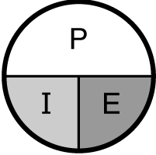
Power Equation
Power is calculated as the product of voltage and current
  P = E x I
  E = P / I
  I = P / E
Like Ohm’s Law, if you know two of the values, you can calculate the third.
Notes:
Go through some simple problems using the power formula. Again use test question examples.

Slide 30
Practice Questions

Slide 31
Electrical power is measured in which of the following units?
A. Volts
B. Watts
C. Ohms
D. Amperes
  T5A02 HRLM (3-5)

Slide 32
Electrical power is measured in which of the following units?
A. Volts
B. Watts
C. Ohms
D. Amperes
  T5A02 HRLM (3-5)

Slide 33
Which term describes the rate at which electrical energy is used?
A. Resistance
B. Current
C. Power
D. Voltage
  T5A10 HRLM (3-5)

Slide 34
Which term describes the rate at which electrical energy is used?
A. Resistance
B. Current
C. Power
D. Voltage
  T5A10 HRLM (3-5)

Slide 35
What is the formula used to calculate electrical power in a DC circuit?
A. Power (P) equals voltage (E) multiplied by current (I)
B. Power (P) equals voltage (E) divided by current (I)
C. Power (P) equals voltage (E) minus current (I)
D. Power (P) equals voltage (E) plus current (I)
  T5C08 HRLM (3-5)

Slide 36
What is the formula used to calculate electrical power in a DC circuit?
A. Power (P) equals voltage (E) multiplied by current (I)
B. Power (P) equals voltage (E) divided by current (I)
C. Power (P) equals voltage (E) minus current (I)
D. Power (P) equals voltage (E) plus current (I)
  T5C08 HRLM (3-5)

Slide 37
How much power is being used in a circuit when the applied voltage is 13.8 volts DC and the current is 10 amperes?
A. 138 watts
B. 0.7 watts
C. 23.8 watts
D. 3.8 watts
  T5C09 HRLM (3-5)

Slide 38
How much power is being used in a circuit when the applied voltage is 13.8 volts DC and the current is 10 amperes?
A. 138 watts
B. 0.7 watts
C. 23.8 watts
D. 3.8 watts
  T5C09 HRLM (3-5)

Slide 39
How much power is being used in a circuit when the applied voltage is 12 volts DC and the current is 2.5 amperes?
A. 4.8 watts
B. 30 watts
C. 14.5 watts
D. 0.208 watts
  T5C10 HRLM (3-5)

Slide 40
How much power is being used in a circuit when the applied voltage is 12 volts DC and the current is 2.5 amperes?
A. 4.8 watts
B. 30 watts
C. 14.5 watts
D. 0.208 watts
  T5C10 HRLM (3-5)

Slide 41
How many amperes are flowing in a circuit when the applied voltage is 12 volts DC and the load is 120 watts?
A. 0.1 amperes
B. 10 amperes
C. 12 amperes
D. 132 amperes
  T5C11 HRLM (3-5)

Slide 42
How many amperes are flowing in a circuit when the applied voltage is 12 volts DC and the load is 120 watts?
A. 0.1 amperes
B. 10 amperes
C. 12 amperes
D. 132 amperes
  T5C11 HRLM (3-5)

Slide 43
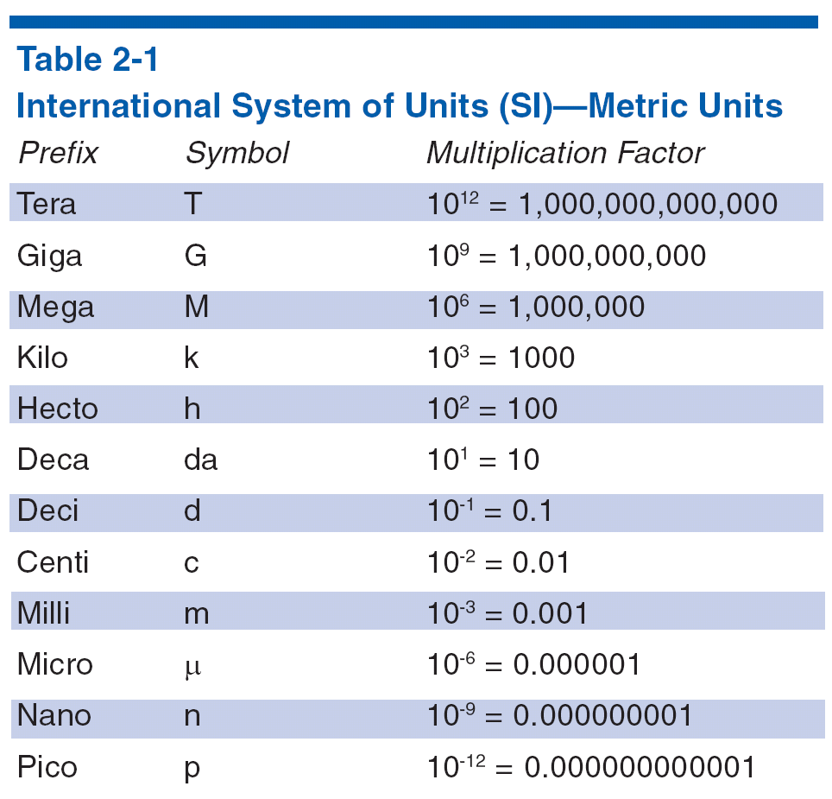
Metric Prefixes
Notes:
Point out the units students will have to deal with in ham radio: pico, nano, micro, milli, kilo, mega, giga, tera, etc. Using examples from test questions give the students some examples to convert between units.
Note that the prefixes apply to units – they are not units themselves.
Also point out that correct capitalization is important by showing the difference between mW and MW or mHz and MHz.

Slide 44
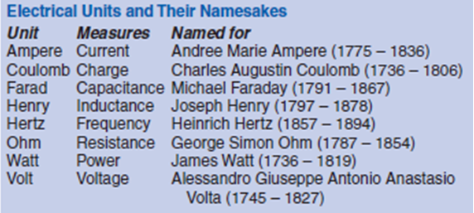
Electrical Units
Notes:
This topic acquaints the student with the various units of measurement. There are no historical questions on the exam but there may be some interest.

Slide 45
How many milliamperes is 1.5 amperes?
A. 15 milliamperes
B. 150 milliamperes
C. 1,500 milliamperes
D. 15,000 milliamperes
  T5B01 HRLM (2-2)

Slide 46
How many milliamperes is 1.5 amperes?
A. 15 milliamperes
B. 150 milliamperes
C. 1,500 milliamperes
D. 15,000 milliamperes
  T5B01 HRLM (2-2)

Slide 47
What is another way to specify a radio signal frequency of 1,500,000 hertz?
A. 1500 kHz
B. 1500 MHz
C. 15 GHz
D. 150 kHz
  T5B02 HRLM (2-2)

Slide 48
What is another way to specify a radio signal frequency of 1,500,000 hertz?
A. 1500 kHz
B. 1500 MHz
C. 15 GHz
D. 150 kHz
  T5B02 HRLM (2-2)

Slide 49
How many volts are equal to one kilovolt?
A. One one-thousandth of a volt
B. One hundred volts
C. One thousand volts
D. One million volts
  T5B03 HRLM (2-2)

Slide 50
How many volts are equal to one kilovolt?
A. One one-thousandth of a volt
B. One hundred volts
C. One thousand volts
D. One million volts
  T5B03 HRLM (2-2)

Slide 51
How many volts are equal to one microvolt?
A. One one-millionth of a volt
B. One million volts
C. One thousand kilovolts
D. One one-thousandth of a volt
  T5B04 HRLM (2-2)

Slide 52
How many volts are equal to one microvolt?
A. One one-millionth of a volt
B. One million volts
C. One thousand kilovolts
D. One one-thousandth of a volt
  T5B04 HRLM (2-2)

Slide 53
Which of the following is equivalent to 500 milliwatts?
A. 0.02 watts
B. 0.5 watts
C. 5 watts
D. 50 watts
  T5B05 HRLM (2-2)

Slide 54
Which of the following is equivalent to 500 milliwatts?
A. 0.02 watts
B. 0.5 watts
C. 5 watts
D. 50 watts
  T5B05 HRLM (2-2)

Slide 55
If an ammeter calibrated in amperes is used to measure a 3000-milliampere current, what reading would it show?
A. 0.003 amperes
B. 0.3 amperes
C. 3 amperes
D. 3,000,000 amperes
  T5B06 HRLM (2-2)

Slide 56
If an ammeter calibrated in amperes is used to measure a 3000-milliampere current, what reading would it show?
A. 0.003 amperes
B. 0.3 amperes
C. 3 amperes
D. 3,000,000 amperes
  T5B06 HRLM (2-2)

Slide 57
If a frequency readout calibrated in megahertz shows a reading of 3.525 MHz, what would it show if it were calibrated in kilohertz?
A. 0.003525 kHz
B. 35.25 kHz
C. 3525 kHz
D. 3,525,000 kHz
  T5B07 HRLM (2-2)

Slide 58
If a frequency readout calibrated in megahertz shows a reading of 3.525 MHz, what would it show if it were calibrated in kilohertz?
A. 0.003525 kHz
B. 35.25 kHz
C. 3525 kHz
D. 3,525,000 kHz
  T5B07 HRLM (2-2)

Slide 59
How many microfarads are 1,000,000 picofarads?
A. 0.001 microfarads
B. 1 microfarad
C. 1000 microfarads
D. 1,000,000,000 microfarads
  T5B08 HRLM (2-2)

Slide 60
How many microfarads are 1,000,000 picofarads?
A. 0.001 microfarads
B. 1 microfarad
C. 1000 microfarads
D. 1,000,000,000 microfarads
  T5B08 HRLM (2-2)

Slide 61
Which of the following frequencies is equal to 28,400 kHz?
A. 28.400 MHz
B. 2.800 MHz
C. 284.00 MHz
D. 28.400 kHz
  T5B12 HRLM (2-2)

Slide 62
Which of the following frequencies is equal to 28,400 kHz?
A. 28.400 MHz
B. 2.800 MHz
C. 284.00 MHz
D. 28.400 kHz
  T5B12 HRLM (2-2)

Slide 63
If a frequency readout shows a reading of 2425 MHz, what frequency is that in GHz?
A. 0.002425 GHz
B. 24.25 GHz
C. 2.425 GHz
D. 2425 GHz
  T5B13 HRLM (2-2)

Slide 64
If a frequency readout shows a reading of 2425 MHz, what frequency is that in GHz?
A. 0.002425 GHz
B. 24.25 GHz
C. 2.425 GHz
D. 2425 GHz
  T5B13 HRLM (2-2)

