Slide 1
Technician License Course
Chapter 3
Lesson Plan Module 4 –
Electricity

Slide 2
Fundamentals of Electricity
Radios are powered by electricity and radio signals are a form of electrical energy.
A basic understanding of how we control electricity allows you to better install and operate your radio.
Notes:
Use this time to provide some motivation of “why do I need to know this stuff.”
You need to take some time to make sure all the students are on the same page when dealing with basic electrical concepts. You will probably find a wide range of knowledge from those who have no clue what you’re talking about to those who know far more about the topic than you do. Acknowledge this right up front, but tell the students you are going to cover basic vocabulary in order to create a foundation for material that follows. For those with little knowledge, tell them to hang on because it will become clear as the lesson proceeds. For those more knowledgeable, tell them to be patient and allow the instructor to over-simplify so that all can understand.

Slide 3
Fundamentals of Electricity
Electrical charge can be positive or negative.
  Opposite charges attract each other
Electrical current is the flow of electrons.
  Electrons are negatively-charged atomic particles, usually surrounding an atom’s positively-charged nucleus of protons (positive) and neutrons (neutral – no charge)
  Electrons move in response to an electromotive force and can move independently of atoms
Notes:
Start very simple and make sure everybody knows about atoms and electrons. No need to spend a lot of time on the nucleus and protons.
Avoid getting into a discussion of conventional and electronic current at this point.

Slide 4
Basic Electrical Concepts
Current: the movement of electrons, measured in amperes (A) by an ammeter, and represented by I in formulas
Voltage: the amount of electromotive force (emf), also called electrical potential, measured in volts (V) by a voltmeter, represented by E or V in formulas
Notes:
Discuss the equivalence of electromotive force and voltage in circuits. Note that some formulas will use E and some will use V – for nearly all electronic and radio circuits, they are equivalent. (QST’s Hands-On Radio discusses this in Experiment #138 in the July 2014 issue.)
Note that emf is not the same thing as EMP ☺
Explain the difference between units of measurement and symbols in equations.
I is used to represent current instead of C because “intensity” in French was the original units for current, later changed to amperes.

Slide 5
Basic Electrical Concepts
Resistance: the opposition to the movement of electrons, measured in ohms (Ω) by an ohmmeter and represented by R in formulas.
Resistance is like friction and turns electrical energy into heat when current flows.
Conductors permit current flow (low resistance) and insulators block current flow (high resistance).
Notes:
Resistance comes from the electrons running into obstacles within the conductor (and other electrons) as they move.
Have the students rub their hands together and observe what happens (heat). When resistance impedes the flow of electrons, the change in their kinetic energy (energy of movement) must be turned into some form of energy. Remember energy is neither created or destroyed, it is just turned into something else, in this case heat.
Conductors have low resistance which offers little opposition to electron movement. Insulators have high resistance which makes it difficult for electrons to move through the material.

Slide 6
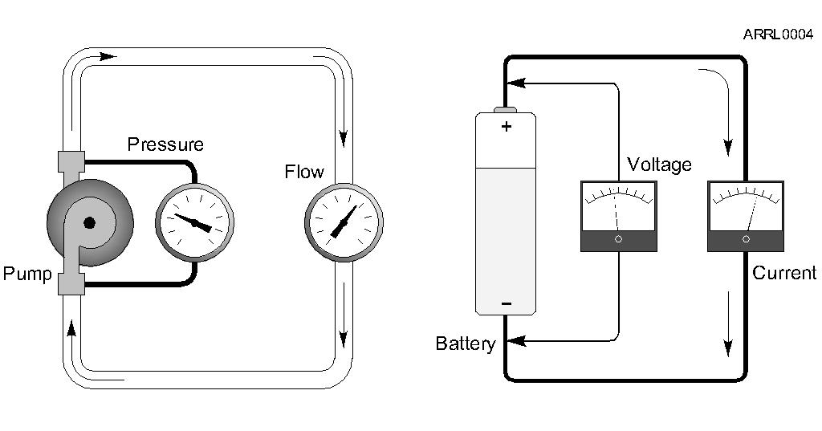
Basic Electrical Concepts
The flow of water through a pipe is a good analogy to understand the three characteristics of electricity and how they are related.
Notes:
Take some time to talk the students through the water analogy.
Pressure that pushes water through a pipe is analogous in electricity to voltage (or electromotive force).
The flow of water through the pipe in response to pressure is analogous in electricity to the movement of electrons (current).
Friction that prevents the water from just freely moving through the pipe is analogous in electricity to resistance.

Slide 7
Basic Electrical Concepts
Voltage from a source of electrical energy causes current to flow.
Resistance is a material’s opposition to the flow of current.
Voltage, current and resistance affect each other. For example, higher voltage (bigger push) causes more current (more flow).
Notes:
A source of electrical energy must be present to create a voltage. If there is no push (voltage) there is no current (flowing electrons).
The ratio of “push to flow” or of voltage to the resulting current is determined by the conducting material’s resistance.
Resistance is a characteristic of the material and is always present whether current is flowing or not. All materials except superconductors have some resistance.
The relationship between the three is called Ohm’s law and will be covered in the next module.

Slide 8
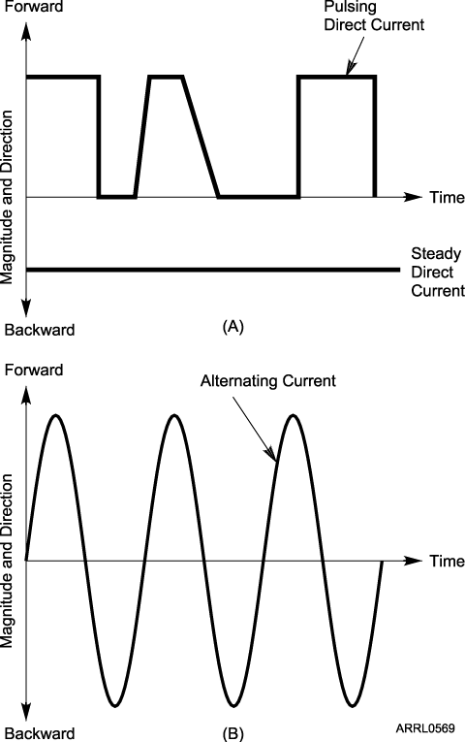
The Two Kinds of Current
Current that flows in only one direction, is called direct current (dc).
  Batteries are a common source of dc.
Current that flows in one direction then in the opposite direction is called alternating current (ac).
  Household current is ac
Notes:
Discuss the two different kinds of current and what they might be used for.
Point out to the students that their household ac current is frequently converted into dc to run many household appliances and electronics.
Show a “wall wart” style power source that plugs into an ac socket and outputs dc.
Show batteries and dc power supplies as sources of dc current

Slide 9
The Two Kinds of Current
AC current reverses direction on a regular basis
  Each process of reversing is a cycle.
  The number of cycles per second is frequency, measured in hertz (Hz).
1 Hz = 1 cycle per second
Notes:
Show one cycle and be sure everyone knows what the cycle is and that an ac frequency is the number of cycles per second.
Household ac electricity in North America has a frequency of 60 cycles per second or 60 hertz.

Slide 10
The Electric Circuit:
An Electronic Roadmap
For current to flow, there must be a path from one side of the energy source to the other side of the source – this path is called a circuit.
  There must be a pipe (conductive path) through which the water (current) can flow.
There are two types of electric circuits.
  Series and parallel
Notes:
Explain that all electrical energy sources have two connections – one is positive (+) and one is negative (-). The connections are called terminals. Current flows between the positive and negative terminals. Don’t get into conventional and electronic current at this point.

Slide 11
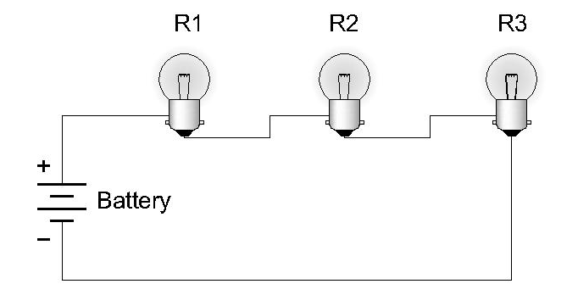
Series Circuits
Series circuits provide one and only one path for current flow.
Notes:
Trace the flow of current through the circuit and show there is only one path that current may take. This results in current being the same in each light bulb.
Note that the battery is not drawn as a pictorial but as an electronic component symbol.
Explain that R1/R2/R3 represent the resistances of the light bulbs. Note that incandescent light bulbs create light from the heat energy created by current flowing through the filament’s resistance.
Show how an ammeter is connected just like one of the bulbs.

Slide 12
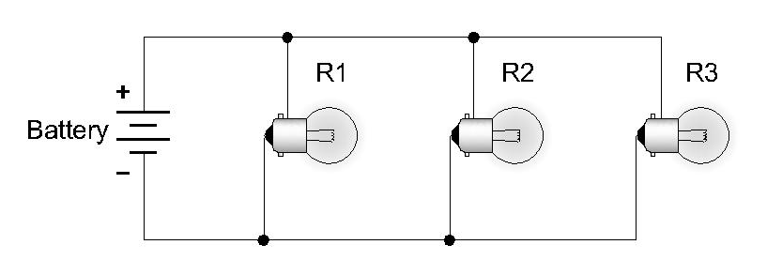
Parallel Circuits
Parallel circuits provide multiple paths for current flow.
Notes:
Trace the current flow through the circuit and show that there are multiple paths for current flow. Show how the voltage is the same across each bulb. Note this assumes “perfect” wires.
Show how a voltmeter is connected just like one of the bulbs.

Slide 13
Practice Questions

Slide 14
Electrical current is measured in which of the following units?
A. Volts
B. Watts
C. Ohms
D. Amperes
  T5A01 HRLM (3-1)

Slide 15
Electrical current is measured in which of the following units?
A. Volts
B. Watts
C. Ohms
D. Amperes
  T5A01 HRLM (3-1)

Slide 16
What is the name for the flow of electrons in an electric circuit?
A. Voltage
B. Resistance
C. Capacitance
D. Current
  T5A03 HRLM (3-1)

Slide 17
What is the name for the flow of electrons in an electric circuit?
A. Voltage
B. Resistance
C. Capacitance
D. Current
  T5A03 HRLM (3-1)

Slide 18
What is the name for a current that flows only in one direction?
A. Alternating current
B. Direct current
C. Normal current
D. Smooth current
  T5A04 HRLM (3-6)

Slide 19
What is the name for a current that flows only in one direction?
A. Alternating current
B. Direct current
C. Normal current
D. Smooth current
  T5A04 HRLM (3-6)

Slide 20
What is the electrical term for the electromotive force (EMF) that causes electron flow?
A. Voltage
B. Ampere-hours
C. Capacitance
D. Inductance
  T5A05 HRLM (3-1)

Slide 21
What is the electrical term for the electromotive force (EMF) that causes electron flow?
A. Voltage
B. Ampere-hours
C. Capacitance
D. Inductance
  T5A05 HRLM (3-1)

Slide 22
Which of the following is a good electrical conductor?
A. Glass
B. Wood
C. Copper
D. Rubber
  T5A07 HRLM (3-4)

Slide 23
Which of the following is a good electrical conductor?
A. Glass
B. Wood
C. Copper
D. Rubber
  T5A07 HRLM (3-4)

Slide 24
Which of the following is a good electrical insulator?
A. Copper
B. Glass
C. Aluminum
D. Mercury
  T5A08 HRLM (3-4)

Slide 25
Which of the following is a good electrical insulator?
A. Copper
B. Glass
C. Aluminum
D. Mercury
  T5A08 HRLM (3-4)

Slide 26
What is the name for a current that reverses direction on a regular basis?
A. Alternating current
B. Direct current
C. Circular current
D. Vertical current
  T5A09 HRLM (3-6)

Slide 27
What is the name for a current that reverses direction on a regular basis?
A. Alternating current
B. Direct current
C. Circular current
D. Vertical current
  T5A09 HRLM (3-6)

Slide 28
What is the basic unit of electromotive force?
A. The volt
B. The watt
C. The ampere
D. The ohm
  T5A11 HRLM (3-1)

Slide 29
What is the basic unit of electromotive force?
A. The volt
B. The watt
C. The ampere
D. The ohm
  T5A11 HRLM (3-1)

Slide 30
What term describes the number of times per second that an alternating current reverses direction?
A. Pulse rate
B. Speed
C. Wavelength
D. Frequency
  T5A12 HRLM (2-1)

Slide 31
What term describes the number of times per second that an alternating current reverses direction?
A. Pulse rate
B. Speed
C. Wavelength
D. Frequency
  T5A12 HRLM (2-1)

Slide 32
Which instrument would you use to measure electric potential or electromotive force?
A. An ammeter
B. A voltmeter
C. A wavemeter
D. An ohmmeter
  T7D01 HRLM (3-1)

Slide 33
Which instrument would you use to measure electric potential or electromotive force?
A. An ammeter
B. A voltmeter
C. A wavemeter
D. An ohmmeter
  T7D01 HRLM (3-1)

Slide 34
What is the correct way to connect a voltmeter to a circuit?
A. In series with the circuit
B. In parallel with the circuit
C. In quadrature with the circuit
D. In phase with the circuit
  T7D02 HRLM (3-3)

Slide 35
What is the correct way to connect a voltmeter to a circuit?
A. In series with the circuit
B. In parallel with the circuit
C. In quadrature with the circuit
D. In phase with the circuit
  T7D02 HRLM (3-3)

Slide 36
How is an ammeter usually connected to a circuit?
A. In series with the circuit
B. In parallel with the circuit
C. In quadrature with the circuit
D. In phase with the circuit
  T7D03 HRLM (3-3)

Slide 37
How is an ammeter usually connected to a circuit?
A. In series with the circuit
B. In parallel with the circuit
C. In quadrature with the circuit
D. In phase with the circuit
  T7D03 HRLM (3-3)

Slide 38
Which instrument is used to measure electric current?
A. An ohmmeter
B. A wavemeter
C. A voltmeter
D. An ammeter
  T7D04 HRLM (3-1)

Slide 39
Which instrument is used to measure electric current?
A. An ohmmeter
B. A wavemeter
C. A voltmeter
D. An ammeter
  T7D04 HRLM (3-1)

Slide 40
What instrument is used to measure resistance?
A. An oscilloscope
B. A spectrum analyzer
C. A noise bridge
D. An ohmmeter
  T7D05 HRLM (3-4)

Slide 41
What instrument is used to measure resistance?
A. An oscilloscope
B. A spectrum analyzer
C. A noise bridge
D. An ohmmeter
  T7D05 HRLM (3-4)

Slide 42
Which of the following might damage a multimeter?
A. Measuring a voltage too small for the chosen scale
B. Leaving the meter in the milliamps position overnight
C. Attempting to measure voltage when using the resistance setting
D. Not allowing it to warm up properly
  T7D06 HRLM (3-3)

Slide 43
Which of the following might damage a multimeter?
A. Measuring a voltage too small for the chosen scale
B. Leaving the meter in the milliamps position overnight
C. Attempting to measure voltage when using the resistance setting
D. Not allowing it to warm up properly
  T7D06 HRLM (3-3)

Slide 44
Which of the following measurements are commonly made using a multimeter?
A. SWR and RF power
B. Signal strength and noise
C. Impedance and reactance
D. Voltage and resistance
  T7D07 HRLM (3-3)

Slide 45
Which of the following measurements are commonly made using a multimeter?
A. SWR and RF power
B. Signal strength and noise
C. Impedance and reactance
D. Voltage and resistance
  T7D07 HRLM (3-3)

Slide 46
Which of the following precautions should be taken when measuring circuit resistance with an ohmmeter?
A. Ensure that the applied voltages are correct
B. Ensure that the circuit is not powered
C. Ensure that the circuit is grounded
D. Ensure that the circuit is operating at the correct frequency
  T7D11 HRLM (3-3)

Slide 47
Which of the following precautions should be taken when measuring circuit resistance with an ohmmeter?
A. Ensure that the applied voltages are correct
B. Ensure that the circuit is not powered
C. Ensure that the circuit is grounded
D. Ensure that the circuit is operating at the correct frequency
  T7D11 HRLM (3-3)

Slide 48
Which of the following precautions should be taken when measuring high voltages with a voltmeter?
A. Ensure that the voltmeter has very low impedance
B. Ensure that the voltmeter and leads are rated for use at the voltages to be measured
C. Ensure that the circuit is grounded through the voltmeter
D. Ensure that the voltmeter is set to the correct frequency
  T7D12 HRLM (3-3)

Slide 49
Which of the following precautions should be taken when measuring high voltages with a voltmeter?
A. Ensure that the voltmeter has very low impedance
B. Ensure that the voltmeter and leads are rated for use at the voltages to be measured
C. Ensure that the circuit is grounded through the voltmeter
D. Ensure that the voltmeter is set to the correct frequency
  T7D12 HRLM (3-3)

