Slide 1
Technician License Course Chapter 2
Lesson Plan Module 3 –
Modulation and Bandwidth

Slide 2
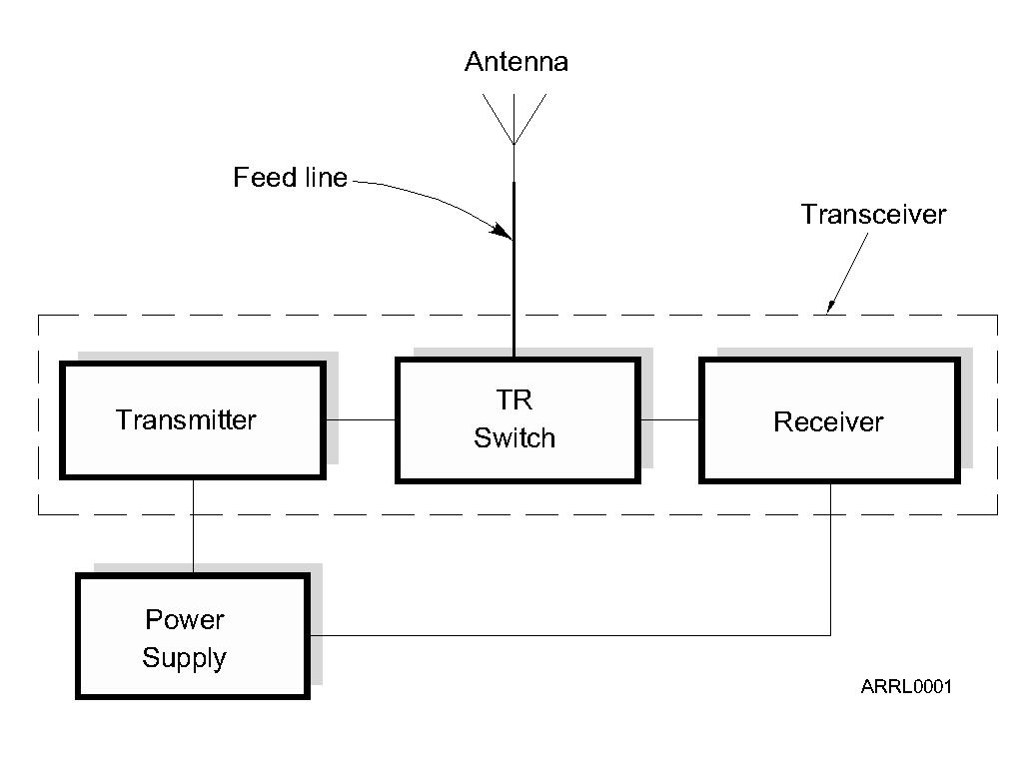
The Basic Radio Station
Notes:
Explain what a basic radio station consists of and show some examples of actual ham equipment.

Slide 3
What Happens During Radio Communication?
Transmitting (sending a signal):
Information (voice, data, video, commands, etc.) is converted to electronic form.
The information in electronic form is added to a radio wave.
The radio wave carrying the information is sent from the station antenna into space.

Slide 4
What Happens During Radio Communication?
Receiving:
The radio wave carrying the information is intercepted by the receiving station’s antenna.
The receiver extracts the information from the received wave.
The information is then presented to the user in a format that can be understood (sound, picture, words on a computer screen, response to a command, etc.).

Slide 5
What Happens During Radio Communication?
Adding and extracting the information can be simple or complex.
This makes ham radio fun…learning all about how radios work.
Don’t be intimidated. You will be required to only know the basics, but you can learn as much about the “art and science” of radio as you want.
Notes:
Note that radios can be very simple – for AM or CW – or very complex such as for digital modes. Show examples of a minimal low-power CW transmitter and a simple AM receiver.

Slide 6
Adding Information – Modulation
When we add some information to the radio wave, (the carrier) we modulate the wave.
Turn the wave on and off (Morse code)
Speech or music
Data
Different modulation techniques vary different properties of the wave to add the information:
Amplitude, frequency, or phase
Notes:
You now need to make the jump from the discussion of radio spectrum to the concept of modulation. The important concept is understanding that modulation adds information to the carrier radio wave. There are different ways to add information to the carrier by varying different properties of the wave.

Slide 7
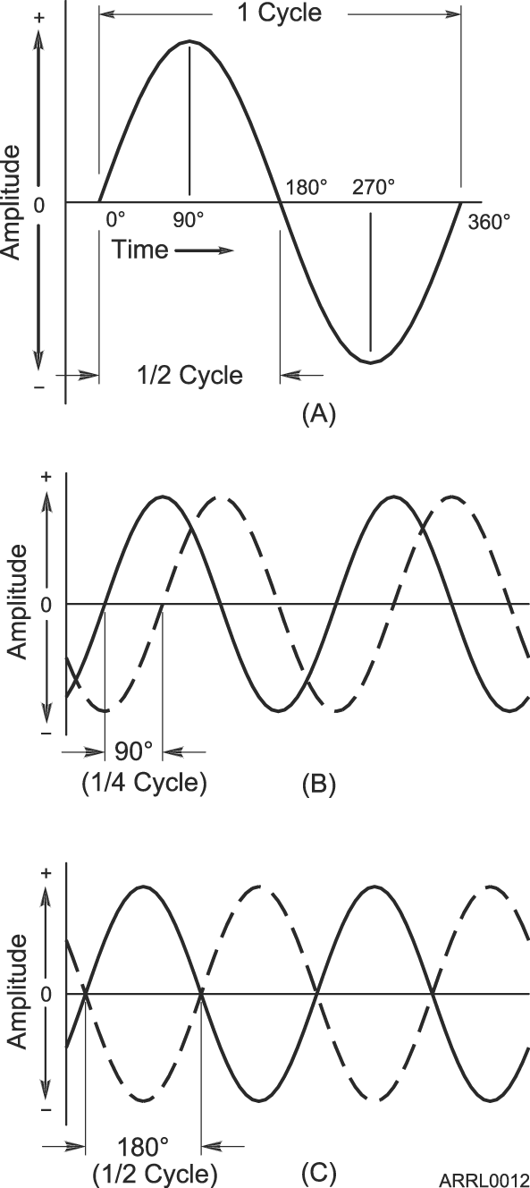
Phase
Along with frequency and period, another important property of waves is phase.
Phase is a position within a cycle.
Phase is also a relative position between two waves.
Notes:
Introduce the concept of phase as the position within a cycle or as a relative difference between two waves.
Note that phase is different from polarity, which is the convention that assigns positive and negative.

Slide 8
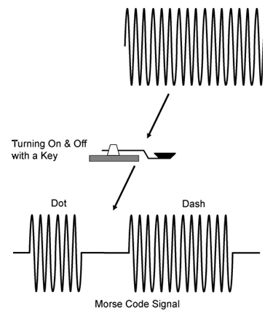
CW - Morse Code – On and Off

Slide 9
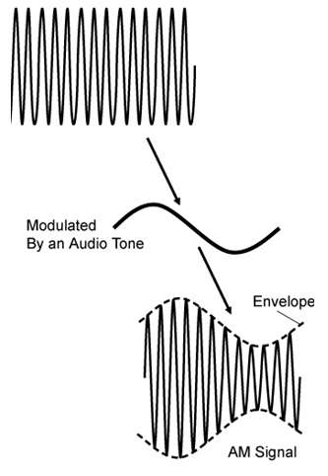
Amplitude Modulation (AM)
In AM, the amplitude of the carrier wave is modified in step with the waveform of the information (the tone shown here).
Notes:
The ARRL modulation board is an excellent resource that can be used to demonstrate the concept of modulation. This board uses amplitude modulation and demodulation circuits along with an oscilloscope to visually depict what happens during amplitude modulation.
If you have an oscilloscope, you can also use a regular ham transceiver to transmit into a dummy load. Connect the oscilloscope at the dummy load or to a wire wrapped several times around the coaxial cable to sample the output waveform.

Slide 10
Composite Signals
The process of adding information to an unmodulated radio wave creates additional signals called sidebands.
The sidebands and carrier work together to carry the information.
The combination of carrier and sidebands creates a composite signal.

Slide 11
Bandwidth
The carrier and sidebands have different frequencies, occupying a range of spectrum space.
The occupied range is the composite signal’s bandwidth.
Different types of modulation and information result in different signal bandwidths.
Notes:
Remind the students of the drawing in Module 2 that showed the signals arranged along the horizontal axis of the strength-versus-frequency graph. Ask them to recall how the receiver acted when being tuned across the signals, if that experiment was performed.

Slide 12
Characteristics of Voice AM
AM signals consist of three components:
Carrier
Lower sideband (LSB)
Upper sideband (USB)
AM bandwidth is twice the information bandwidth.
Carrier
LSB
USB
Amplitude
799.4 800 800.6
Frequency (kHz)
AM signal being modulated by a 600 Hz tone
Notes:
Show how each of the sidebands is spaced equally from the carrier by the frequency of the tone information modulating the carrier. (800 – 0.6 = 799.4 kHz and 800 + 0.6 = 800.6 kHz)
Note the convention of presenting a single-frequency signal as a vertical line with the height of the line representing amplitude and horizontal position indicating frequency.
Review the abbreviations USB and LSB.
If asked, explain that for AM signals, the carrier is more powerful than either sideband and that is why the carrier line is higher. This is discussed later when SSB is introduced.

Slide 13
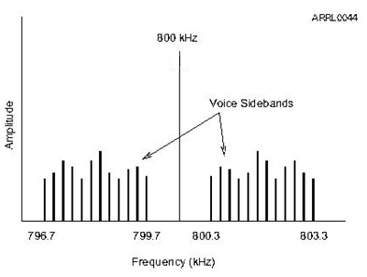
Characteristics of Voice Information
Sounds that make up voice are a complex mixture of multiple frequencies from 300–3000 Hz
Two mirror-image sets of sidebands are created, each up to 3000 Hz wide.
AM voice signal bandwidth 2 x 3000 Hz = 6000 Hz

Slide 14
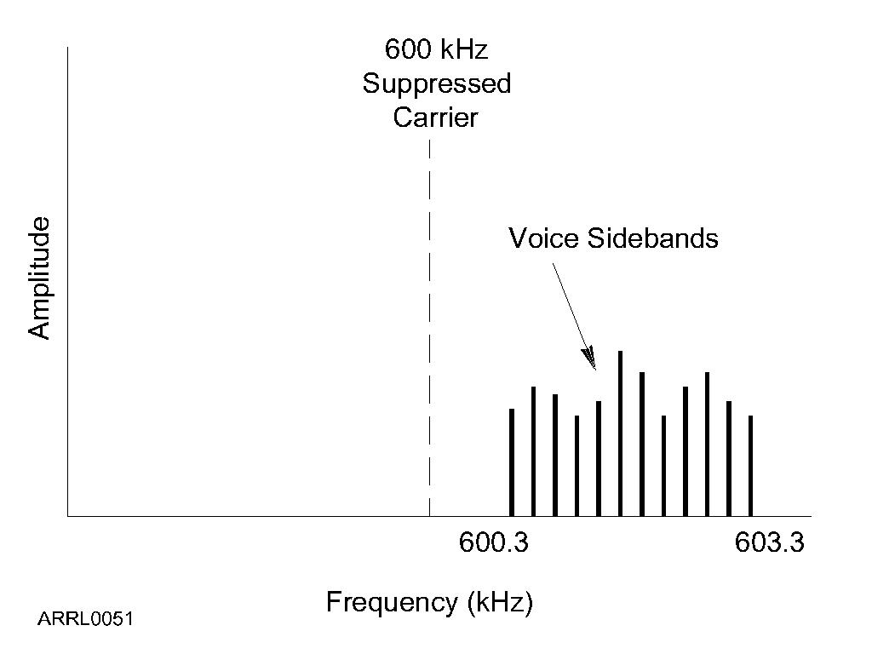
Single Sideband Modulation (SSB)
The two sets of voice sidebands carry duplicate information.
We can improve efficiency by transmitting only one sideband and reconstructing the missing carrier in the receiver.
SSB bandwidth is only 3000 Hz for voice signals.
Notes:
Note that above 10 MHz using USB is the standard, including on the VHF and UHF bands.
USB is also used on the 5 MHz band by rule.

Slide 15
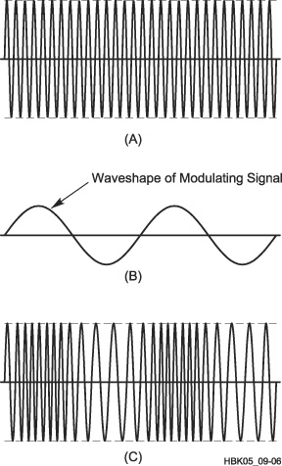
Frequency and Phase Modulation (FM and PM)
Instead of varying amplitude, if we use the information to vary the carrier’s frequency, frequency modulation (FM) is produced.
FM bandwidth (for voice) is between 5 and 15 kHz.
We can also shift the signal’s phase back and forth, creating phase modulation (PM) that is very similar to FM.
Notes:
Discuss the concept of deviation, the amount of frequency change from the carrier frequency determines the volume of the transmitted information. Discuss what happens if you over-deviate.
Also discuss that PM is produced by varying the phase of the carrier, creating a signal that is very similar to FM. Note that both FM and PM can be received by the same receiver although the effect on the extracted information is slightly different.
It is hard to distinguish between PM and FM. Don’t get into the dependence on amplitude and frequency of the modulating signal – it is not particularly important for the new ham.
This is a good opportunity to talk about the advantages and disadvantages of the different forms of modulation.

Slide 16
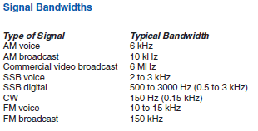
Typical Signal Bandwidths

Slide 17
Practice Questions

Slide 18
Why should you not set your transmit frequency to be exactly at the edge of an amateur band or sub-band?
A. To allow for calibration error in the transmitter frequency display
B. So that modulation sidebands do not extend beyond the band edge
C. To allow for transmitter frequency drift
D. All of these choices are correct
FCC Rule: [97.101(a), 97.301(a-e)] T1B09 HRLM (2-10)

Slide 19
Why should you not set your transmit frequency to be exactly at the edge of an amateur band or sub-band?
A. To allow for calibration error in the transmitter frequency display
B. So that modulation sidebands do not extend beyond the band edge
C. To allow for transmitter frequency drift
D. All of these choices are correct
FCC Rule: [97.101(a), 97.301(a-e)] T1B09 HRLM (2-10)

Slide 20
What determines the amount of deviation of an FM (as opposed to PM) signal?
A. Both the frequency and amplitude of the modulating signal
B. The frequency of the modulating signal
C. The amplitude of the modulating signal
D. The relative phase of the modulating signal
T2B05 HRLM (2-10)

Slide 21
What determines the amount of deviation of an FM (as opposed to PM) signal?
A. Both the frequency and amplitude of the modulating signal
B. The frequency of the modulating signal
C. The amplitude of the modulating signal
D. The relative phase of the modulating signal
T2B05 HRLM (2-10)

Slide 22
What happens when the deviation of an FM transmitter is increased?
A. Its signal occupies more bandwidth
B. Its output power increases
C. Its output power and bandwidth increases
D. Asymmetric modulation occurs
T2B06 HRLM (2-9)

Slide 23
What happens when the deviation of an FM transmitter is increased?
A. Its signal occupies more bandwidth
B. Its output power increases
C. Its output power and bandwidth increases
D. Asymmetric modulation occurs
T2B06 HRLM (2-9)

Slide 24
Which of the following is a form of amplitude modulation?
A. Spread spectrum
B. Packet radio
C. Single sideband
D. Phase shift keying
T8A01 HRLM (2-9)

Slide 25
Which of the following is a form of amplitude modulation?
A. Spread spectrum
B. Packet radio
C. Single sideband
D. Phase shift keying
T8A01 HRLM (2-9)

Slide 26
What type of modulation is most commonly used for VHF packet radio transmissions?
A. FM
B. SSB
C. AM
D. Spread spectrum
T8A02 HRLM (2-10)

Slide 27
What type of modulation is most commonly used for VHF packet radio transmissions?
A. FM
B. SSB
C. AM
D. Spread spectrum
T8A02 HRLM (2-10)

Slide 28
Which type of voice modulation is most often used for long-distance or weak signal contacts on the VHF and UHF bands?
A. FM
B. DRM
C. SSB
D. PM
T8A03 HRLM (2-11)

Slide 29
Which type of voice modulation is most often used for long-distance or weak signal contacts on the VHF and UHF bands?
A. FM
B. DRM
C. SSB
D. PM
T8A03 HRLM (2-11)

Slide 30
Which type of modulation is most commonly used for VHF and UHF voice repeaters?
A. AM
B. SSB
C. PSK
D. FM
T8A04 HRLM (2-10)

Slide 31
Which type of modulation is most commonly used for VHF and UHF voice repeaters?
A. AM
B. SSB
C. PSK
D. FM
T8A04 HRLM (2-10)

Slide 32
Which of the following types of emission has the narrowest bandwidth?
A. FM voice
B. SSB voice
C. CW
D. Slow-scan TV
T8A05 HRLM (2-10)

Slide 33
Which of the following types of emission has the narrowest bandwidth?
A. FM voice
B. SSB voice
C. CW
D. Slow-scan TV
T8A05 HRLM (2-10)

Slide 34
Which sideband is normally used for 10 meter HF, VHF and UHF single-sideband communications?
A. Upper sideband
B. Lower sideband
C. Suppressed sideband
D. Inverted sideband
T8A06 HRLM (2-11)

Slide 35
Which sideband is normally used for 10 meter HF, VHF and UHF single-sideband communications?
A. Upper sideband
B. Lower sideband
C. Suppressed sideband
D. Inverted sideband
T8A06 HRLM (2-11)

Slide 36
What is the primary advantage of single sideband over FM for voice transmissions?
A. SSB signals are easier to tune
B. SSB signals are less susceptible to interference
C. SSB signals have narrower bandwidth
D. All of these choices are correct
T8A07 HRLM (2-11)

Slide 37
What is the primary advantage of single sideband over FM for voice transmissions?
A. SSB signals are easier to tune
B. SSB signals are less susceptible to interference
C. SSB signals have narrower bandwidth
D. All of these choices are correct
T8A07 HRLM (2-11)

Slide 38
What is the approximate bandwidth of a single sideband voice signal?
A. 1 kHz
B. 3 kHz
C. 6 kHz
D. 15 kHz
T8A08 HRLM (2-5)

Slide 39
What is the approximate bandwidth of a single sideband voice signal?
A. 1 kHz
B. 3 kHz
C. 6 kHz
D. 15 kHz
T8A08 HRLM (2-5)

Slide 40
What is the approximate bandwidth of a VHF repeater FM phone signal?
A. Less than 500 Hz
B. About 150 kHz
C. Between 10 and 15 kHz
D. Between 50 and 125 kHz
T8A09 HRLM (2-5)

Slide 41
What is the approximate bandwidth of a VHF repeater FM phone signal?
A. Less than 500 Hz
B. About 150 kHz
C. Between 10 and 15 kHz
D. Between 50 and 125 kHz
T8A09 HRLM (2-5)

Slide 42
What is the typical bandwidth of analog fast-scan TV transmissions on the 70 cm band?
A. More than 10 MHz
B. About 6 MHz
C. About 3 MHz
D. About 1 MHz
T8A10 HRLM (2-5)

Slide 43
What is the typical bandwidth of analog fast-scan TV transmissions on the 70 cm band?
A. More than 10 MHz
B. About 6 MHz
C. About 3 MHz
D. About 1 MHz
T8A10 HRLM (2-5)

Slide 44
What is the approximate maximum bandwidth required to transmit a CW signal?
A. 2.4 kHz
B. 150 Hz
C. 1000 Hz
D. 15 kHz
T8A11 HRLM (2-5)

Slide 45
What is the approximate maximum bandwidth required to transmit a CW signal?
A. 2.4 kHz
B. 150 Hz
C. 1000 Hz
D. 15 kHz
T8A11 HRLM (2-5)

