Slide 1
Technician License Course Chapter 2
Lesson Plan Module 2 –
Radio Waves & Signals

Slide 2
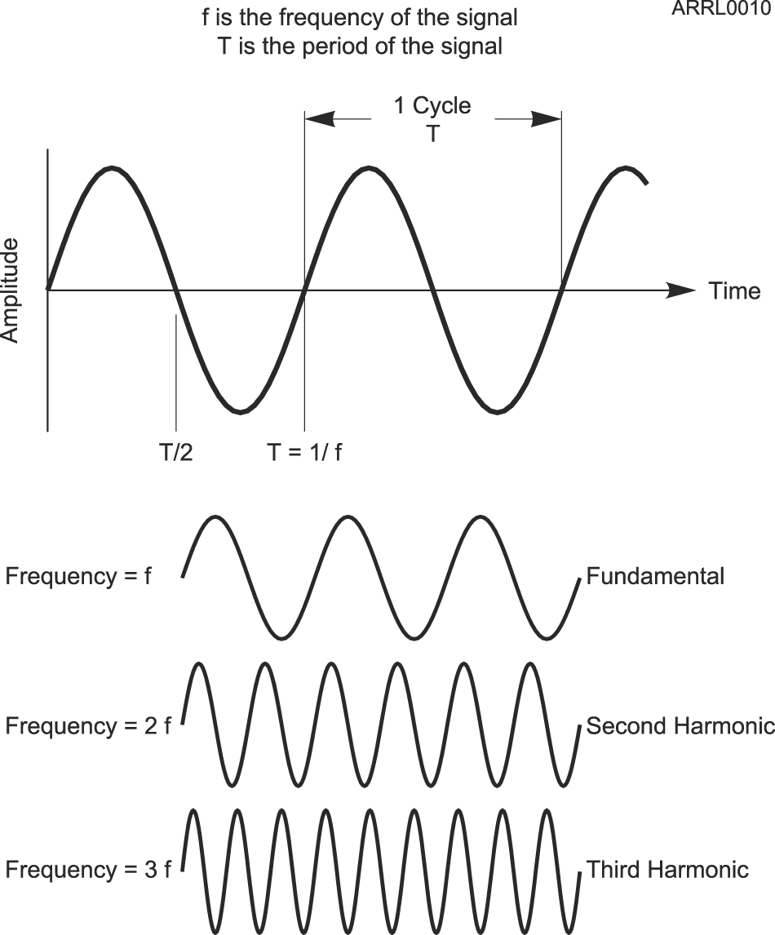
Wave Vocabulary
Before we study radio, we need to learn some wave vocabulary.
Amplitude
Frequency (hertz, Hz)
Period (seconds, s)
Fundamental
Harmonics
Notes:
Spend some time with live demonstration to make sure the students are really familiar with the concepts and vocabulary of waves. These demonstrations could include using an audio frequency generator connected to a speaker and oscilloscope to allow students to hear an audio sine wave and see the wave. This will allow you to point out the difference between amplitude and frequency, the relationship between frequency and wavelength, the relationship between frequency and period.
Explain the units of frequency (hertz, Hz) and period (seconds, s).

Slide 3
Electromagnetic Waves
Electromagnetic waves are made up of electric and magnetic energy (fields).
The electric and magnetic fields vary in the pattern of a sine wave.
Electromagnetic waves travel at the speed of light.
Notes:
This is an introduction only – the goal is to show that radio waves are a form of electromagnetic energy.

Slide 4
Electromagnetic Energy
A Demonstration
What happens when you drop a magnet through a pipe made of non-magnetic conductive material, such as copper?
Notes:
This is a powerful demonstration that will help your students understand that radio waves combine electric and magnetic fields. For this demonstration you will need a length of common copper pipe and PVC pipe and a very strong slug or ball magnet. Try www.gaussboys.com as a source of magnets. Their number 10 magnet, a cylinder about 5/8 inch in diameter is a good size. The pipes should be sufficient diameter to allow the magnet to pass through, ¾ inch pipe should work.
Talk with the students about the concept of magnetism and magnetic fields. Talk with the students about electric current. Demonstrate that the magnetic is in fact a magnet by having it stick to a ferrous metal. Demonstrate that the magnet does not stick to the copper or PVC pipe and explain why.
Pose the question. Have the students predict what will happen then have each drop the magnet through the pipe to test their hypothesis. (the magnet falls slowly through the copper pipe, falls right through the PVC) Discuss what the students observe.
What you are demonstrating is the two fundamental principles of electronics:
Any time a magnetic field moves, it causes electrons in the vicinity of the field to move.
Any time an electron moves, it creates a magnetic field.
So what is happening is that the moving magnet (field) causes electrons in the copper to move. Those moving electrons in the pipe in turn create an opposing magnetic field that prevents the magnet from falling right through. The magnet falls right through the PVC because the PVC is an insulator…no electrons allowed to move therefore no opposing magnetic field.

Slide 5
Electromagnetic Waves
You observed electromagnetic energy being exchanged between the magnet and electrons in the pipe:
The falling magnet creates a moving magnetic field, in turn causing electrons in the pipe to move.
The moving electrons create a magnetic field that opposes the magnet’s motion.
Notes:
Observe that the energy is transferred back and forth but that due to energy losses in the material of the pipe (resistance, if you want to introduce it at this stage) there is not quite enough energy re-generated by the moving electrons to keep the magnet from falling. As a result the magnet falls slowly until it is clear of the pipe, where it again falls at a normal rate.

Slide 6
Electromagnetic Waves
If the magnet was moved back and forth repeatedly, the varying electric and magnetic fields would create a sustained electromagnetic wave spreading into space like a water ripple.
Moving electrons in an antenna take the place of the moving magnet.
A signal from a transmitter can make the electrons in an antenna move, transferring energy from the signal to electromagnetic waves.

Slide 7
Electromagnetic Waves
The same process works “backward,” too!
Electromagnetic waves encountering an antenna make its electrons move in sync with the wave.
Electromagnetic energy is transferred from the wave to the electrons.
The moving electrons create a signal that can be detected by a receiver.

Slide 8
Electromagnetic Spectrum
The electromagnetic spectrum is divided into ranges of frequencies in which electromagnetic waves behave similarly.
Each range or segment has a different name.
Waves with a certain range of frequencies that can be used for communication are called radio waves.
Notes:
Waves with similar frequencies in each segment will act the about the same. For instance, they may have a long or short range, reflect off similar surfaces, interact with the atmosphere the same way, etc.

Slide 9
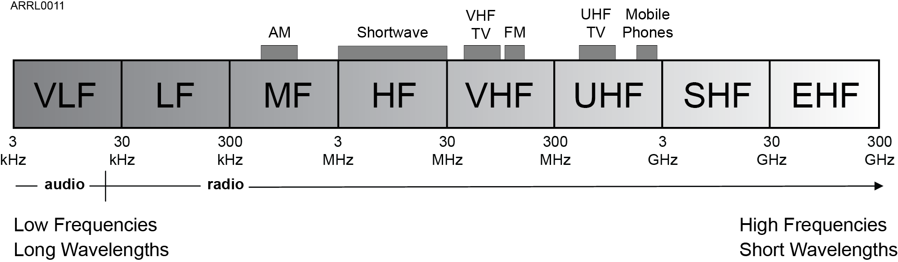
Radio Spectrum
The part of the electromagnetic spectrum composed of radio waves is called the radio frequency or RF spectrum.
Notes:
Point out on the diagram where familiar signals are located like AM/FM commercial radio, police and fire channels, TV, satellite TV. Show the location of a few amateur bands. Point out how each segment acts differently from adjacent segments. Don’t be afraid to tell them that it isn’t that simple, that the lines between segments sometimes are a little fuzzy, that is part of the fun of radio.

Slide 10
Radio Spectrum
Parts of the spectrum allocated for a common purpose are called a band, such as the “AM band” or “CB band.”
Signals in these bands are usually of the same type for commercial services
Hams share the band across many signals of different types
Notes:
Discuss the bands students are already familiar with – AM band, FM band, CB band
Show that the references are approximate and only for convenience, not an exact frequency or wavelength.

Slide 11
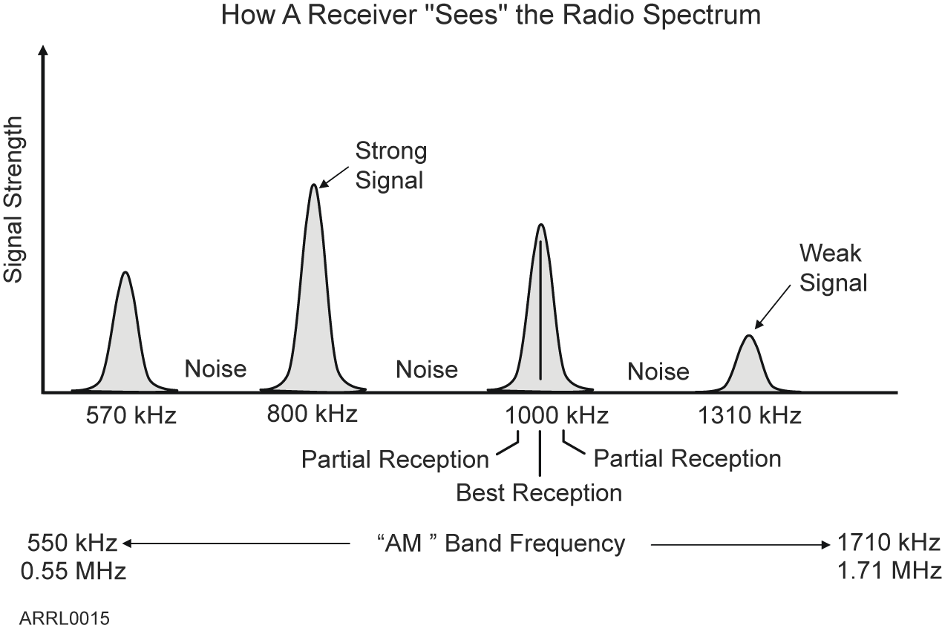
Radio Signals
A radio wave carrying information is a radio signal.
Each signal occupies a range of frequencies.
Receivers “tune in” a signal by listening at the signal’s frequency.
Notes:
If you have a radio that can tune continuously through the AM band, slowly tune past a few stations showing the signal strength meter and observing that the signal appears to have “width”.

Slide 12
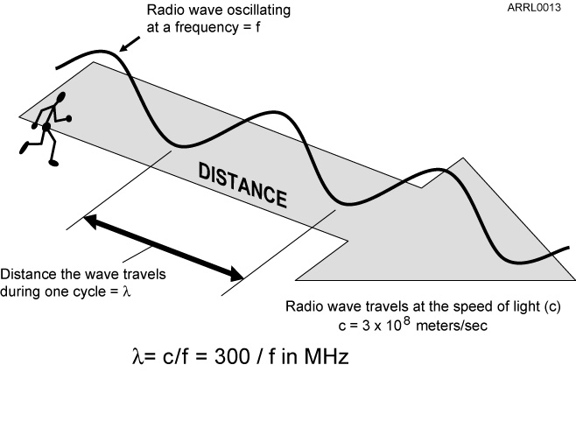
Wavelength
Wavelength is the distance a radio wave travels during one cycle of the wave’s electric and magnetic fields.
λ (lambda) is the symbol for wavelength
Waves travel at the speed of light, c.
Hams can refer to bands by frequency (50 MHz) or by wave-length (6 meters)
Notes:
Perform the rope demonstration.
Talk about the inverse relationship between frequency and wavelength. Use videos or other teaching aids to reinforce that the relationship exists because the speed of light is constant for all electromagnetic waves of any frequency or wavelength. Don’t confuse the students at this point discussing velocity factor or the speed of light in other media than air and free space.
Present and derive the 300/f formula.
Show how the same signal can be specified by frequency or by wavelength. Note that hams use this relationship to talk about bands by wavelength (“6 meters”) or frequency (“50 MHz”)
Go over a few practice problems. Give the test questions as homework.

Slide 13
Practice Questions

Slide 14
What is the name for the distance a radio wave travels during one complete cycle?
A. Wave speed
B. Waveform
C. Wavelength
D. Wave spread
T3B01 HRLM (2-5)

Slide 15
What is the name for the distance a radio wave travels during one complete cycle?
A. Wave speed
B. Waveform
C. Wavelength
D. Wave spread
T3B01 HRLM (2-5)

Slide 16
How fast does a radio wave travel through free space?
A. At the speed of light
B. At the speed of sound
C. Its speed is inversely proportional to its wavelength
D. Its speed increases as the frequency increases
T3B04 HRLM (2-5)

Slide 17
How fast does a radio wave travel through free space?
A. At the speed of light
B. At the speed of sound
C. Its speed is inversely proportional to its wavelength
D. Its speed increases as the frequency increases
T3B04 HRLM (2-5)

Slide 18
How does the wavelength of a radio wave relate to its frequency?
A. The wavelength gets longer as the frequency increases
B. The wavelength gets shorter as the frequency increases
C. There is no relationship between wavelength and frequency
D. The wavelength depends on the bandwidth of the signal
T3B05 HRLM (2-5)

Slide 19
How does the wavelength of a radio wave relate to its frequency?
A. The wavelength gets longer as the frequency increases
B. The wavelength gets shorter as the frequency increases
C. There is no relationship between wavelength and frequency
D. The wavelength depends on the bandwidth of the signal
T3B05 HRLM (2-5)

Slide 20
What is the formula for converting frequency to approximate wavelength in meters?
A. Wavelength in meters equals frequency in hertz multiplied by 300
B. Wavelength in meters equals frequency in hertz divided by 300
C. Wavelength in meters equals frequency in megahertz divided by 300
D. Wavelength in meters equals 300 divided by frequency in megahertz
T3B06 HRLM (2-6)

Slide 21
What is the formula for converting frequency to approximate wavelength in meters?
A. Wavelength in meters equals frequency in hertz multiplied by 300
B. Wavelength in meters equals frequency in hertz divided by 300
C. Wavelength in meters equals frequency in megahertz divided by 300
D. Wavelength in meters equals 300 divided by frequency in megahertz
T3B06 HRLM (2-6)

Slide 22
What property of radio waves is often used to identify the different frequency bands?
A. The approximate wavelength
B. The magnetic intensity of waves
C. The time it takes for waves to travel one mile
D. The voltage standing wave ratio of waves
T3B07 HRLM (2-5)

Slide 23
What property of radio waves is often used to identify the different frequency bands?
A. The approximate wavelength
B. The magnetic intensity of waves
C. The time it takes for waves to travel one mile
D. The voltage standing wave ratio of waves
T3B07 HRLM (2-5)

Slide 24
What are the frequency limits of the VHF spectrum?
A. 30 to 300 kHz
B. 30 to 300 MHz
C. 300 to 3000 kHz
D. 300 to 3000 MHz
T3B08 HRLM (2-3)

Slide 25
What are the frequency limits of the VHF spectrum?
A. 30 to 300 kHz
B. 30 to 300 MHz
C. 300 to 3000 kHz
D. 300 to 3000 MHz
T3B08 HRLM (2-3)

Slide 26
What are the frequency limits of the UHF spectrum?
A. 30 to 300 kHz
B. 30 to 300 MHz
C. 300 to 3000 kHz
D. 300 to 3000 MHz
T3B09 HRLM (2-3)

Slide 27
What are the frequency limits of the UHF spectrum?
A. 30 to 300 kHz
B. 30 to 300 MHz
C. 300 to 3000 kHz
D. 300 to 3000 MHz
T3B09 HRLM (2-3)

Slide 28
What frequency range is referred to as HF?
A. 300 to 3000 MHz
B. 30 to 300 MHz
C. 3 to 30 MHz
D. 300 to 3000 kHz
T3B10 HRLM (2-3)

Slide 29
What frequency range is referred to as HF?
A. 300 to 3000 MHz
B. 30 to 300 MHz
C. 3 to 30 MHz
D. 300 to 3000 kHz
T3B10 HRLM (2-3)

Slide 30
What is the approximate velocity of a radio wave as it travels through free space?
A. 3000 kilometers per second
B. 300,000,000 meters per second
C. 300,000 miles per hour
D. 186,000 miles per hour
T3B11 HRLM (2-5)

Slide 31
What is the approximate velocity of a radio wave as it travels through free space?
A. 3000 kilometers per second
B. 300,000,000 meters per second
C. 300,000 miles per hour
D. 186,000 miles per hour
T3B11 HRLM (2-5)

Slide 32
What is the unit of frequency?
A. Hertz
B. Henry
C. Farad
D. Tesla
T5C05 HRLM (2-3)

Slide 33
What is the unit of frequency?
A. Hertz
B. Henry
C. Farad
D. Tesla
T5C05 HRLM (2-3)

Slide 34
What does the abbreviation “RF” refer to?
A. Radio frequency signals of all types
B. The resonant frequency of a tuned circuit
C. The real frequency transmitted as opposed to the apparent frequency
D. Reflective force in antenna transmission lines
T5C06 HRLM (2-3)

Slide 35
What does the abbreviation “RF” refer to?
A. Radio frequency signals of all types
B. The resonant frequency of a tuned circuit
C. The real frequency transmitted as opposed to the apparent frequency
D. Reflective force in antenna transmission lines
T5C06 HRLM (2-3)

