Slide 1
Technician License Course
Chapter 9
Lesson Module 18 –
Safety and Amateur Radio

Slide 2
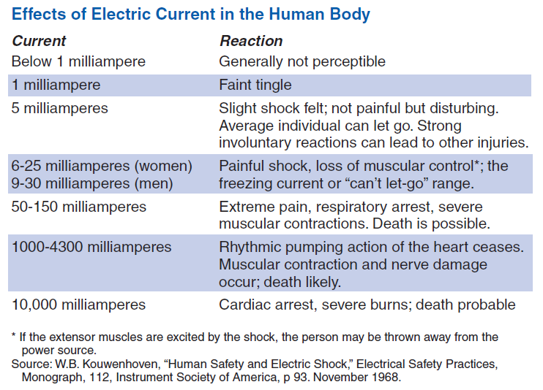
Electrical Injuries
Shocks and burns.
Low voltages can cause enough current to create problems.
Equipment today uses lower voltage than tube equipment but it can still cause burns.
Notes:
Even low voltages are sometimes enough to cause hazardous current. Never assume voltage is harmless! Even though most modern equipment runs off of 12 volts, there are still dangerous voltages to be wary of, particularly in power supplies that convert 120 volts AC to 12 volt DC. Be cautious and vigilant around electricity.
Remind students that current through the heart is the most dangerous: hand to hand, hand to foot
And electricity moves a LOT faster than a person!

Slide 3
Electrical Safety
Avoiding contact is the most effective way of practicing electrical safety
Unplug equipment before working on it
Keep one hand in your pocket
Make sure equipment is grounded
Use power from GFCI-protected circuits
Notes:
Don’t provide a path for current through you.
Don’t work on live equipment unless required to do so for adjustment or testing. Even then, don’t work alone!

Slide 4
Mitigating Electrical Hazards
If working on live equipment is required:
  Remove jewelry
  Avoid unintentional touching of circuitry
  Never bypass safety interlocks
  Discharge high-voltage points and components to ground
  Capacitors can store charge after power is off
  Storage batteries are dangerous when shorted
Notes:
Explain what an interlock is.
Show the students a grounding stick if one is available or a photo of one. Explain how to use it and when it is necessary.
Spend some time talking about battery safety. The energy capacities of today’s batteries makes even more important to avoid short-circuiting batteries.

Slide 5
Responding to Electrical Injury
REMOVE POWER!
  Have ON/OFF switches and circuit breakers clearly marked.
  Install an emergency master power switch and make sure your family knows how to use it.
Call for help.
Learn CPR and first aid.
Notes:
Online safety websites have instructions for what to do in case of electrical injury.
Remind students of the ARRL’s “Switch to Safety” program.

Slide 6
Electrical Grounding and Circuit Protection
Make sure your station wiring meets code
Most ham equipment does not require special wiring or circuits
  Use 3-wire power cords
  Use circuit breakers, circuit breaker outlets, or Ground Fault Circuit Interrupter (GFCI) circuit breakers or outlets
  Use proper fuse or circuit breaker size
  Don’t overload single outlets or circuits
Notes:
Show the students a properly wired 3-prong plug and ac socket using proper color-coded wiring.

Slide 7
Grounding & Bonding at RF
RF burns from “hot spots” at high RF voltage
  Do not cause serious injury at ham power level
  Prevent by bonding (connecting) equipment together with heavy wire or strap – braided strap not recommended at RF
  Prevent by keeping people away from antennas and radial or counterpoise wires
Ground equipment for AC safety
Notes:
Explain that connecting equipment to ground does little at RF since a ground path is often electrically long and acts more like an antenna. Discuss how bonding keeps all of the equipment at the same RF voltage so that hot spots do not form and RF current does not flow between pieces of equipment.

Slide 8
Lightning Protection
Ground antennas and towers to local code
  Use 8-ft ground rod for each tower leg
  Bond rods to tower leg and the other rods
Ground connections should be as short as possible
Use lightning arrestors on a single ground plate where cables enter the house
Unplug and disconnect equipment (including telephones and computers) and feed lines if lightning is expected
Notes:
Following local codes is important and may be required for insurance coverage.
Keep ground connections short and direct. Use a common ground connection as much as possible for lightning.
Mention the ARRL’s equipment insurance program as a benefit for members.

Slide 9
RF Exposure
Electromagnetic radiation (EMR) is not the same as radioactivity – much lower energy
RF energy heats body tissues
  Heating depends on the RF intensity and frequency.
  If precautions are taken, RF exposure is minimal and not dangerous.
Notes:
Point out to the students that RF exposure only causes very mild heating of body tissues (much like happens in a microwave oven but to a FAR lower extent). With simple precautions, the potential of harm is very low.
Repeat the simple rule of not standing near or touching an antenna when the transmitter is on.

Slide 10
RF Intensity
Power Density
  Watts per square centimeter (w/cm²)
Higher power density means higher RF exposure
RF absorption varies with frequency because of body part size
Safe exposure levels have been established by the FCC
Notes:
Here you will break down and discuss the two components of RF exposure, field intensity and frequency. Try to keep the discussion focused on the big picture, it is easy to get into details, charts and graphs, and vocabulary of units that can be very intimidating. Cover in general terms what influences RF exposure and how to limit the exposure.
It makes sense that the more power you transmit, the more potential there is for harmful RF exposure. Assure the students that if they operate commercial, off-the-shelf equipment (which they probably will early in their ham radio careers) that the power levels are such that there will be little exposure danger.
Beam antennas focus the RF energy in desired directions, therefore being close to the antenna in the favored direction of the beam will increase the hazard.

Slide 11
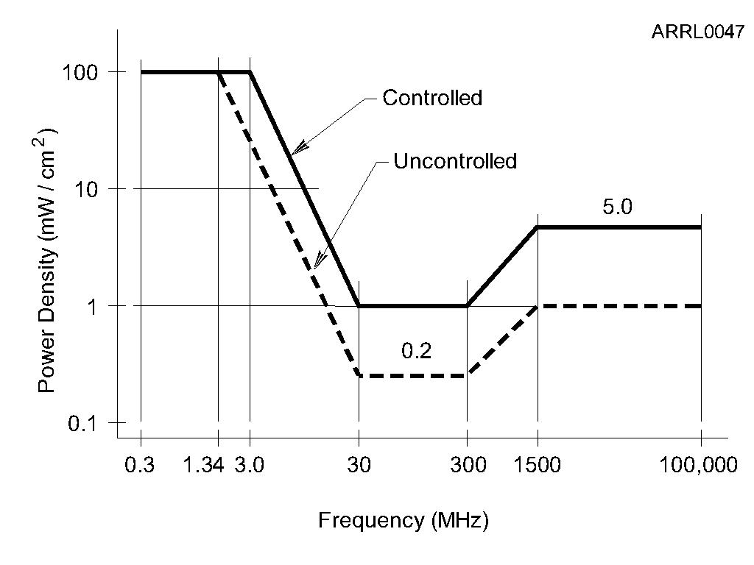
Maximum Permissible Exposure (MPE)
Notes:
Show how MPE varies with frequency. The points at which the graph is the lowest are the points at which the body absorbs RF the most. These are the frequency ranges at which the body and limbs are close to ½ or ¼ wavelength and begin acting like antennas.

Slide 12
RF Environment
Controlled Environment.
  You know where people are standing in relation to your antenna and you can do something about it.
  Higher power density is allowed because you can make adjustments if needed.
Uncontrolled Environment.
  You have no control of people near your antenna.
  Lower power density is allowed because you cannot control or adjust the exposure of people.
Notes:
If you have control of the environment around the antenna, you are allowed to use more power because you can take steps to limit exposure if required.
Discuss several examples of controlled and uncontrolled environments. (See the ARRL Technology web page on RF Exposure or the ARRL’s RF Exposure and You.

Slide 13
Duty Cycle and Duty Factor
Duty cycle is the percentage of time that a transmitter is on during the evaluation period, from 0 to 100%
  Duty cycle = 100 x (time on / total time)
Duty factor is the same as duty cycle, but given as a number from 0 to 1.0
Higher duty cycle or factor means higher average power density and exposure
Notes:
Note the relationship between the transmitter on/off duty cycle and that of the mode itself.
Give some simple examples of duty cycle and illustrate with a simulated contact.

Slide 14
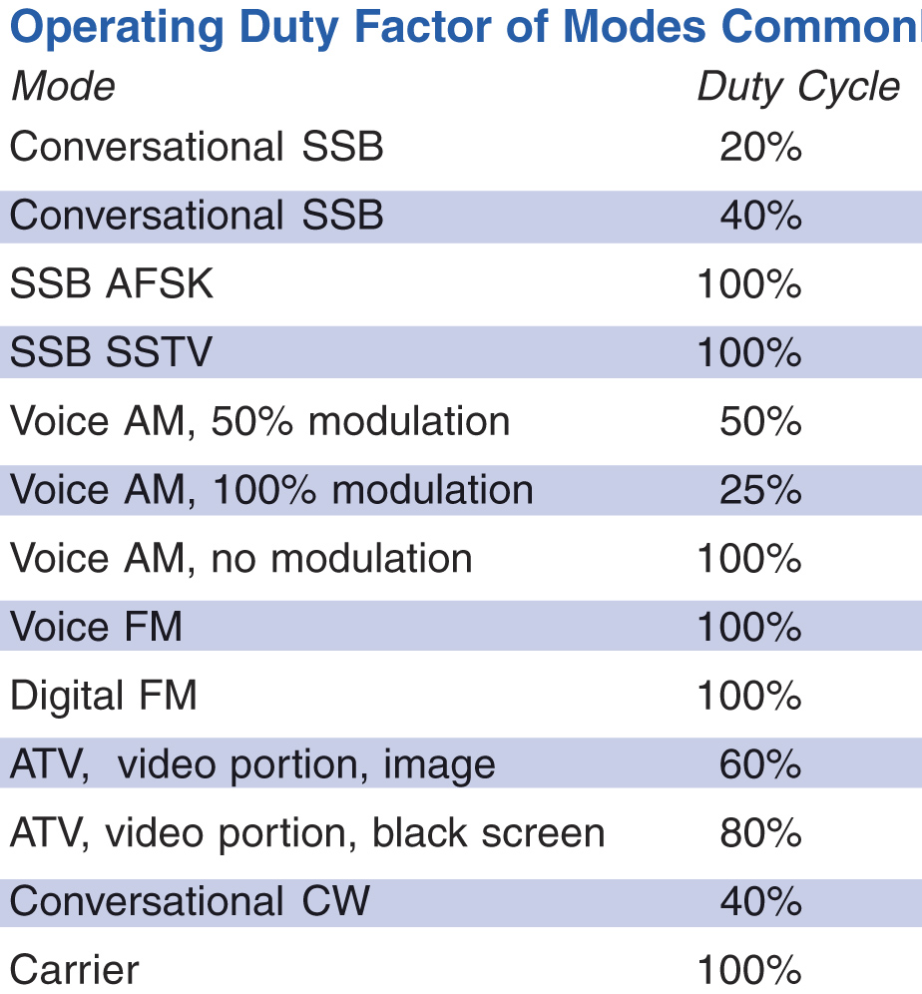
Mode Duty Cycle
Accounts for the different characteristics of the transmitted signal’s waveform
Notes:
Note here, that FM, the mode most used by new hams, has a 100% duty cycle when the transmitter is on.

Slide 15
RF Exposure Evaluation
All fixed stations must perform an exposure evaluation.
  Use online calculator (easiest)
  Model exposure with software (difficult)
  Measure RF power density (most difficult)
At lower power levels, no evaluation is required. Varies with frequency – example: below 50 W at VHF.
Re-evaluate exposure when station equipment or operating frequencies change.
Notes:
Stress that the online calculators are very easy to use and it’s actually quite rare for a ham to have to change the station or antenna configuration to comply with RF exposure rules.

Slide 16
Reducing RF Exposure
Relocate or reorient antennas
Raise the antenna
Reduce antenna gain
Reduce RF power output
Change to a lower duty cycle mode

Slide 17
Mobile Safety
Mobile Installations
  Secure all equipment
  Place equipment where you can operate it safely while driving
  Know local rules for use of communications equipment while driving
    May need hands-free microphone
Notes:
Make sure that equipment in cars is securely fastened so that it will not move around and create a hazard in an accident. Locate the controls of the equipment so that it does not present a hazard and distraction while driving.
Some states now require hands-free microphones. Regardless, drive safely and don’t use the radio when your attention is needed on the road.

Slide 18
Power Line Safety
Keep antennas well away from power lines
Check for power lines before installing antennas in trees
Provide a minimum of 10 feet of clearance if antenna falls
Never attach antennas or guy lines to utility poles or structures
Notes:
Antennas generally need to be clear of obstacles and as high as practical. However, some common sense needs to be exercised to prevent antennas from becoming a safety hazard. Particular attention needs to be given to power lines and structure attachment points.
Raising or lowering an antenna can be particularly risky if power lines are nearby. If the antenna and/or mast or tower falls, be sure that it can not fall into power lines. People are electrocuted every year in this way.

Slide 19
Tower Work
Basic tower safety
  Proper clothing, hard hat and eye protection
  Use a proper climbing harness, not a lineman’s belt or rock-climbing gear
  Don’t climb a crank-up tower supported only by its lift cable – block and secure it first
  Use a gin pole to lift heavy items
  Don’t work alone – use a ground crew
Notes:
Finally go over some precautions and safety considerations that must be taken if the students will be doing or assisting with tower work for a friend or club.
Most students will not be installing towers early in their ham careers, but they should be aware that special precautions should be taken and where they can review that information in the future. Suggest that they help out an experienced ham to learn how to do the work.

Slide 20
Practice Questions

Slide 21
Which of the following is a safety hazard of a 12 voltage storage battery?
A. Touching both terminals with the hands can cause electrical shock
B. Shorting the terminals can cause burns, fire, or an explosion
C. RF emissions from the battery
D. All of these choices are correct
  T0A01 HRLM (9-3)

Slide 22
Which of the following is a safety hazard of a 12 voltage storage battery?
A. Touching both terminals with the hands can cause electrical shock
B. Shorting the terminals can cause burns, fire, or an explosion
C. RF emissions from the battery
D. All of these choices are correct
  T0A01 HRLM (9-3)

Slide 23
How does current flowing through the body cause a health hazard?
A. By heating tissue
B. It disrupts the electrical functions of cells
C. It causes involuntary muscle contractions
D. All of these choices are correct
  T0A02 HRLM (9-2)

Slide 24
How does current flowing through the body cause a health hazard?
A. By heating tissue
B. It disrupts the electrical functions of cells
C. It causes involuntary muscle contractions
D. All of these choices are correct
  T0A02 HRLM (9-2)

Slide 25
What is connected to the green wire in a three-wire electrical AC plug?
A. Neutral
B. Hot
C. Safety ground
D. The white wire
  T0A03 HRLM (9-4)

Slide 26
What is connected to the green wire in a three-wire electrical AC plug?
A. Neutral
B. Hot
C. Safety ground
D. The white wire
  T0A03 HRLM (9-4)

Slide 27
What is a good way to guard against electrical shock at your station?
Use three-wire cords and plugs for all AC powered equipment
Connect all AC powered station equipment to a common safety ground
Use a circuit protected by a ground-fault interrupter
D. All of these choices are correct
  T0A06 HRLM (9-3)

Slide 28
What is a good way to guard against electrical shock at your station?
Use three-wire cords and plugs for all AC powered equipment
Connect all AC powered station equipment to a common safety ground
Use a circuit protected by a ground-fault interrupter
D. All of these choices are correct
  T0A06 HRLM (9-3)

Slide 29
Which of these precautions should be taken when installing devices for lightning protection in a coaxial cable feed line?
A. Include a parallel bypass switch for each protector so that it can be switched out of the circuit when running high power
B. Include a series switch in the ground line of each protector to prevent RF overload from inadvertently damaging the protector
C. Keep the ground wires from each protector separate and connected to station ground
D. Ground all of the protectors to a common plate which is in turn connected to an external ground
  T0A07 HRLM (9-5)

Slide 30
Which of these precautions should be taken when installing devices for lightning protection in a coaxial cable feed line?
A. Include a parallel bypass switch for each protector so that it can be switched out of the circuit when running high power
B. Include a series switch in the ground line of each protector to prevent RF overload from inadvertently damaging the protector
C. Keep the ground wires from each protector separate and connected to station ground
D. Ground all of the protectors to a common plate which is in turn connected to an external ground
  T0A07 HRLM (9-5)

Slide 31
What safety equipment should always be included in home-built equipment that is powered from 120V AC power circuits?
A. A fuse or circuit breaker in series with the AC "hot" conductor
B. An AC voltmeter across the incoming power source
C. An inductor in series with the AC power source
D. A capacitor across the AC power source
  T0A08 HRLM (9-4)

Slide 32
What safety equipment should always be included in home-built equipment that is powered from 120V AC power circuits?
A. A fuse or circuit breaker in series with the AC "hot" conductor
B. An AC voltmeter across the incoming power source
C. An inductor in series with the AC power source
D. A capacitor across the AC power source
  T0A08 HRLM (9-4)

Slide 33
What kind of hazard might exist in a power supply when it is turned off and disconnected?
A. Static electricity could damage the grounding system
B. Circulating currents inside the transformer might cause damage
C. The fuse might blow if you remove the cover
D. You might receive an electric shock from the charged stored in large capacitors
  T0A11 HRLM (9-3)

Slide 34
What kind of hazard might exist in a power supply when it is turned off and disconnected?
A. Static electricity could damage the grounding system
B. Circulating currents inside the transformer might cause damage
C. The fuse might blow if you remove the cover
D. You might receive an electric shock from the charged stored in large capacitors
  T0A11 HRLM (9-3)

Slide 35
When should members of a tower work team wear a hard hat and safety glasses?
A. At all times except when climbing the tower
B. At all times except when belted firmly to the tower
C. At all times when any work is being done on the tower
D. Only when the tower exceeds 30 feet in height
  T0B01 HRLM (9-13)

Slide 36
When should members of a tower work team wear a hard hat and safety glasses?
A. At all times except when climbing the tower
B. At all times except when belted firmly to the tower
C. At all times when any work is being done on the tower
D. Only when the tower exceeds 30 feet in height
  T0B01 HRLM (9-13)

Slide 37
What is a good precaution to observe before climbing an antenna tower?
A. Make sure that you wear a grounded wrist strap
B. Remove all tower grounding connections
C. Put on a climbing harness and safety glasses
D. All of the these choices are correct
  T0B02 HRLM (9-13)

Slide 38
What is a good precaution to observe before climbing an antenna tower?
A. Make sure that you wear a grounded wrist strap
B. Remove all tower grounding connections
C. Put on a climbing harness and safety glasses
D. All of the these choices are correct
  T0B02 HRLM (9-13)

Slide 39
Under what circumstances is it safe to climb a tower without a helper or observer?
A. When no electrical work is being performed
B. When no mechanical work is being performed
C. When the work being done is not more than 20 feet above the ground
D. Never
  T0B03 HRLM (9-14)

Slide 40
Under what circumstances is it safe to climb a tower without a helper or observer?
A. When no electrical work is being performed
B. When no mechanical work is being performed
C. When the work being done is not more than 20 feet above the ground
D. Never
  T0B03 HRLM (9-14)

Slide 41
Which of the following is an important safety precaution to observe when putting up an antenna tower?
A. Wear a ground strap connected to your wrist at all times
B. Insulate the base of the tower to avoid lightning strikes
C. Look for and stay clear of any overhead electrical wires
D. All of these choices are correct
  T0B04 HRLM (9-12)

Slide 42
Which of the following is an important safety precaution to observe when putting up an antenna tower?
A. Wear a ground strap connected to your wrist at all times
B. Insulate the base of the tower to avoid lightning strikes
C. Look for and stay clear of any overhead electrical wires
D. All of these choices are correct
  T0B04 HRLM (9-12)

Slide 43
What is the purpose of a gin pole?
A. To temporarily replace guy wires
B. To be used in place of a safety harness
C. To lift tower sections or antennas
D. To provide a temporary ground
  T0B05 HRLM (9-14)

Slide 44
What is the purpose of a gin pole?
A. To temporarily replace guy wires
B. To be used in place of a safety harness
C. To lift tower sections or antennas
D. To provide a temporary ground
  T0B05 HRLM (9-14)

Slide 45
What is the minimum safe distance from a power line to allow when installing an antenna?
A. Half the width of your property
B. The height of the power line above ground
C. 1/2 wavelength at the operating frequency
D. So that if the antenna falls unexpectedly, no part of it can come closer than 10 feet to the power wires
  T0B06 HRLM (9-12)

Slide 46
What is the minimum safe distance from a power line to allow when installing an antenna?
A. Half the width of your property
B. The height of the power line above ground
C. 1/2 wavelength at the operating frequency
D. So that if the antenna falls unexpectedly, no part of it can come closer than 10 feet to the power wires
  T0B06 HRLM (9-12)

Slide 47
Which of the following is an important safety rule to remember when using a crank-up tower?
A. This type of tower must never be painted
B. This type of tower must never be grounded
C. This type of tower must never be climbed unless it is in the fully retracted position
D. All of these choices are correct
  T0B07 HRLM (9-14)

Slide 48
Which of the following is an important safety rule to remember when using a crank-up tower?
A. This type of tower must never be painted
B. This type of tower must never be grounded
C. This type of tower must never be climbed unless it is in the fully retracted position
D. All of these choices are correct
  T0B07 HRLM (9-14)

Slide 49
What is considered to be a proper grounding method for a tower?
A. A single four-foot ground rod, driven into the ground no more than 12 inches from the base
B. A ferrite-core RF choke connected between the tower and ground
C. Separate eight-foot long ground rods for each tower leg, bonded to the tower and each other
D. A connection between the tower base and a cold water pipe
  T0B08 HRLM (9-13)

Slide 50
What is considered to be a proper grounding method for a tower?
A. A single four-foot ground rod, driven into the ground no more than 12 inches from the base
B. A ferrite-core RF choke connected between the tower and ground
C. Separate eight-foot long ground rods for each tower leg, bonded to the tower and each other
D. A connection between the tower base and a cold water pipe
  T0B08 HRLM (9-13)

Slide 51
Why should you avoid attaching an antenna to a utility pole?
A. The antenna will not work properly because of induced voltages
B. The utility company will charge you an extra monthly fee
C. The antenna could contact high-voltage power wires
D. All of these choices are correct
  T0B09 HRLM (9-12)

Slide 52
Why should you avoid attaching an antenna to a utility pole?
A. The antenna will not work properly because of induced voltages
B. The utility company will charge you an extra monthly fee
C. The antenna could contact high-voltage power wires
D. All of these choices are correct
  T0B09 HRLM (9-12)

Slide 53
Which of the following is true concerning grounding conductors used for lightning protection?
A. Only non-insulated wire must be used
B. Wires must be carefully routed with precise right-angle bends
C. Sharp bends must be avoided
D. Common grounds must be avoided
  T0B10 HRLM (9-4)

Slide 54
Which of the following is true concerning grounding conductors used for lightning protection?
A. Only non-insulated wire must be used
B. Wires must be carefully routed with precise right-angle bends
C. Sharp bends must be avoided
D. Common grounds must be avoided
  T0B10 HRLM (9-4)

Slide 55
Which of the following establishes grounding requirements for an amateur radio tower or antenna?
A. FCC Part 97 Rules
B. Local electrical codes
C. FAA tower lighting regulations
D. Underwriters Laboratories' recommended practices
  T0B11 HRLM (9-4)

Slide 56
Which of the following establishes grounding requirements for an amateur radio tower or antenna?
A. FCC Part 97 Rules
B. Local electrical codes
C. FAA tower lighting regulations
D. Underwriters Laboratories' recommended practices
  T0B11 HRLM (9-4)

Slide 57
Which of the following is good practice when installing ground wires on a tower for lightning protection?
A. Put a loop in the ground connection to prevent water damage to the ground system
B. Make sure that all bends in the ground wires are clean, right angle bends
C. Ensure that connections are short and direct
D. All of these choices are correct
  T0B12 HRLM (9-4)

Slide 58
Which of the following is good practice when installing ground wires on a tower for lightning protection?
A. Put a loop in the ground connection to prevent water damage to the ground system
B. Make sure that all bends in the ground wires are clean, right angle bends
C. Ensure that connections are short and direct
D. All of these choices are correct
  T0B12 HRLM (9-4)

Slide 59
What type of radiation are VHF and UHF radio signals?
A. Gamma radiation
B. Ionizing radiation
C. Alpha radiation
D. Non-ionizing radiation
  T0C01 HRLM (9-5)

Slide 60
What type of radiation are VHF and UHF radio signals?
A. Gamma radiation
B. Ionizing radiation
C. Alpha radiation
D. Non-ionizing radiation
  T0C01 HRLM (9-5)

Slide 61
Which of the following frequencies has the lowest Maximum Permissible Exposure limit?
A. 3.5 MHz
B. 50 MHz
C. 440 MHz
D. 1296 MHz
  T0C02 HRLM (9-7)

Slide 62
Which of the following frequencies has the lowest Maximum Permissible Exposure limit?
A. 3.5 MHz
B. 50 MHz
C. 440 MHz
D. 1296 MHz
  T0C02 HRLM (9-7)

Slide 63
What is the maximum power level that an amateur radio station may use at VHF frequencies before an RF exposure evaluation is required?
A. 1500 watts PEP transmitter output
B. 1 watt forward power
C. 50 watts PEP at the antenna
D. 50 watts PEP reflected power
  T0C03 HRLM (9-9)

Slide 64
What is the maximum power level that an amateur radio station may use at VHF frequencies before an RF exposure evaluation is required?
A. 1500 watts PEP transmitter output
B. 1 watt forward power
C. 50 watts PEP at the antenna
D. 50 watts PEP reflected power
  T0C03 HRLM (9-9)

Slide 65
What factors affect the RF exposure of people near an amateur station antenna?
A. Frequency and power level of the RF field
B. Distance from the antenna to a person
C. Radiation pattern of the antenna
D. All of these choices are correct
  T0C04 HRLM (9-9)

Slide 66
What factors affect the RF exposure of people near an amateur station antenna?
A. Frequency and power level of the RF field
B. Distance from the antenna to a person
C. Radiation pattern of the antenna
D. All of these choices are correct
  T0C04 HRLM (9-9)

Slide 67
Why do exposure limits vary with frequency?
A. Lower frequency RF fields have more energy than higher frequency fields
B. Lower frequency RF fields do not penetrate the human body
C. Higher frequency RF fields are transient in nature
D. The human body absorbs more RF energy at some frequencies than at others
  T0C05 HRLM (9-6)

Slide 68
Why do exposure limits vary with frequency?
A. Lower frequency RF fields have more energy than higher frequency fields
B. Lower frequency RF fields do not penetrate the human body
C. Higher frequency RF fields are transient in nature
D. The human body absorbs more RF energy at some frequencies than at others
  T0C05 HRLM (9-6)

Slide 69
Which of the following is an acceptable method to determine that your station complies with FCC RF exposure regulations?
A. By calculation based on FCC OET Bulletin 65
B. By calculation based on computer modeling
C. By measurement of field strength using calibrated equipment
D. All of these choices are correct
  T0C06 HRLM (9-9)

Slide 70
Which of the following is an acceptable method to determine that your station complies with FCC RF exposure regulations?
A. By calculation based on FCC OET Bulletin 65
B. By calculation based on computer modeling
C. By measurement of field strength using calibrated equipment
D. All of these choices are correct
  T0C06 HRLM (9-9)

Slide 71
What could happen if a person accidentally touched your antenna while you were transmitting?
A. Touching the antenna could cause television interference
B. They might receive a painful RF burn
C. They might develop radiation poisoning
D. All of these choices are correct
  T0C07 HRLM (9-6)

Slide 72
What could happen if a person accidentally touched your antenna while you were transmitting?
A. Touching the antenna could cause television interference
B. They might receive a painful RF burn
C. They might develop radiation poisoning
D. All of these choices are correct
  T0C07 HRLM (9-6)

Slide 73
Which of the following actions might amateur operators take to prevent exposure to RF radiation in excess of FCC-supplied limits?
A. Relocate antennas
B. Relocate the transmitter
C. Increase the duty cycle
D. All of these choices are correct
  T0C08 HRLM (9-10)

Slide 74
Which of the following actions might amateur operators take to prevent exposure to RF radiation in excess of FCC-supplied limits?
A. Relocate antennas
B. Relocate the transmitter
C. Increase the duty cycle
D. All of these choices are correct
  T0C08 HRLM (9-10)

Slide 75
How can you make sure your station stays in compliance with RF safety regulations?
A. By informing the FCC of any changes made in your station
B. By re-evaluating the station whenever an item of equipment is changed
C. By making sure your antennas have low SWR
D. All of these choices are correct
  T0C09 HRLM (9-9)

Slide 76
How can you make sure your station stays in compliance with RF safety regulations?
A. By informing the FCC of any changes made in your station
B. By re-evaluating the station whenever an item of equipment is changed
C. By making sure your antennas have low SWR
D. All of these choices are correct
  T0C09 HRLM (9-9)

Slide 77
Why is duty cycle one of the factors used to determine safe RF radiation exposure levels?
A. It affects the average exposure of people to radiation
B. It affects the peak exposure of people to radiation
C. It takes into account the antenna feed line loss
D. It takes into account the thermal effects of the final amplifier
  T0C10 HRLM (9-7)

Slide 78
Why is duty cycle one of the factors used to determine safe RF radiation exposure levels?
A. It affects the average exposure of people to radiation
B. It affects the peak exposure of people to radiation
C. It takes into account the antenna feed line loss
D. It takes into account the thermal effects of the final amplifier
  T0C10 HRLM (9-7)

Slide 79
What is the definition of duty cycle during the averaging time for RF exposure?
A. The difference between the lowest power output and the highest power output of a transmitter
B. The difference between the PEP and average power output of a transmitter
C. The percentage of time that a transmitter is transmitting
D. The percentage of time that a transmitter is not transmitting
  T0C11 HRLM (9-7)

Slide 80
What is the definition of duty cycle during the averaging time for RF exposure?
A. The difference between the lowest power output and the highest power output of a transmitter
B. The difference between the PEP and average power output of a transmitter
C. The percentage of time that a transmitter is transmitting
D. The percentage of time that a transmitter is not transmitting
  T0C11 HRLM (9-7)

Slide 81
How does RF radiation differ from ionizing radiation (radioactivity)?
A. RF radiation does not have sufficient energy to cause genetic damage
B. RF radiation can only be detected with an RF dosimeter
C. RF radiation is limited in range to a few feet
D. RF radiation is perfectly safe
  T0C12 HRLM (9-5)

Slide 82
How does RF radiation differ from ionizing radiation (radioactivity)?
A. RF radiation does not have sufficient energy to cause genetic damage
B. RF radiation can only be detected with an RF dosimeter
C. RF radiation is limited in range to a few feet
D. RF radiation is perfectly safe
  T0C12 HRLM (9-5)

Slide 83
If the averaging time for exposure is 6 minutes, how much power density is permitted if the signal is present for 3 minutes and absent for 3 minutes rather than being present for the entire 6 minutes?
A. 3 times as much
B. 1/2 as much
C. 2 times as much
D. There is no adjustment allowed for shorter exposure times
  T0C13 HRLM (9-7)

Slide 84
If the averaging time for exposure is 6 minutes, how much power density is permitted if the signal is present for 3 minutes and absent for 3 minutes rather than being present for the entire 6 minutes?
A. 3 times as much
B. 1/2 as much
C. 2 times as much
D. There is no adjustment allowed for shorter exposure times
  T0C13 HRLM (9-7)

