Slide 1
Technician License Course
Chapter 6
Lesson Plan Module 14 –
Communicating with Other Hams – Part 2
Nets, Emergency Communications, Special Modes and Techniques
Notes:
These lessons would benefit from demonstrations. It might be difficult to come up with demonstrations of all the latest and greatest things that ham radio has to offer.
Usually someone in the area is passionate about one of the operating modes and you can tap them as a demonstration resource. This will add substantially to class time.
The goal is not to make the students experts in each of the modes, it is to briefly introduce them to the wide variety of modes available to make them aware of the many opportunities available in ham radio.

Slide 2
Nets
Net is short for “Network”
  Evolved over the years to share and exchange information in an organized and efficient way
Social nets
Traffic nets
Emergency and public service nets
Notes:
Discuss with the students the purpose of nets and some of the nets that are in your area. Invite the students to listen to the nets during the course of the class. Play a recorded net check-in session.
Discuss here the purpose and theme of some of the social nets in your area.

Slide 3
Traffic Nets
Traffic refers to formal messages that are relayed via Amateur Radio
  Radiogram structured to ensure accuracy
National Traffic System (NTS)
  Procedures
  Accountability
Notes:
Give the students a copy of the radiogram form and go over the various sections of the form, but not in too much detail. The idea here is to give the students the sense that the NTS system and associate procedures are developed to ensure accuracy and accountability of the messages being handled within the system.

Slide 4
Emergency and Public Service Nets
Public service nets – training for emergency nets
  Training for ham operators as well as emergency groups and managers supported by Amateur Radio
Emergency nets
Notes:
Discuss some of the public service nets that are common in your area and how they are related to training for emergency communications while providing a valuable public service.
Discuss some of the emergency net operations that are involved in your area. More detail on emergency communications, of which emergency nets are a part, will be discussed a little later.

Slide 5
Net Structure
Net Control Station (NCS)
  Traffic cop who controls the flow of information
Check-in and check-out procedures
  Priority/Emergency access to Net Control
Communications discipline vital
  Learn and follow procedures
  Speak only when directed, and only to whom directed
  Follow through with your commitments
Notes:
Discuss with the students the structure and general operating procedures of a net. Emphasize the need for communication discipline, particularly for traffic and emergency nets. (Social nets are a different matter)
If you have time, role playing may help to demonstrate the point. You might even consider using HTs or FRS/GMRS radios on a simplex frequency to demonstrate net check-in/check-out procedures and even run through a short script of passing some traffic during a simulated emergency net.

Slide 6
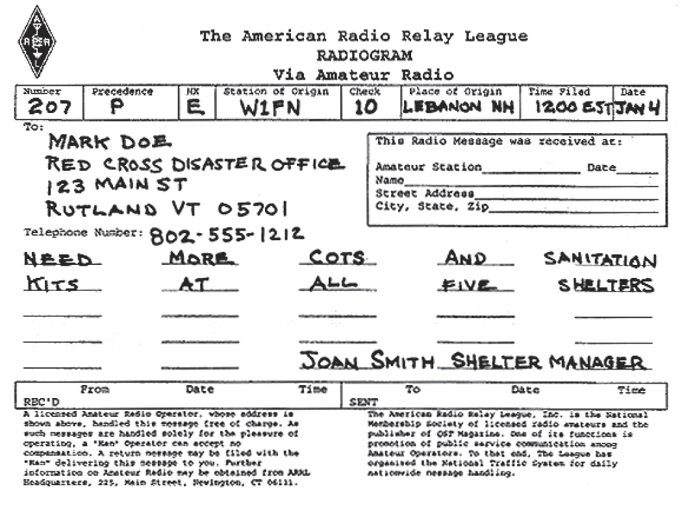
The Radiogram

Slide 7
Supporting Emergency Operations
One of the most important reasons for the existence of Amateur Radio.
Get involved and use what you have learned.
Know where you fit in the overall emergency management team.
Notes:
Here is where you can bring some of your own reasons for participating in emergency communications activities. However, stress the realistic role that ham radio plays in emergency management - don’t give false impressions that ham radio is the sole and primary communications method used by emergency managers. Don’t rely too heavily on “When All Else Fails…”
Note that the use of the term “emergency communications” is changing. Consult with ARRL HQ and review the instructor resources website for materials that help explain the various categories of assistance hams can render, such as public service, disaster relief, and emergency communications.
Ham radio frequently is used as a back-up system that is employed when the primary systems fail. In reality, if ham radio is never used during an emergency, that is a good thing, because that means the primary systems worked as planned.
One way to look at it is that ham radio provides some redundant capability – a “force multiplier” that will allow emergency managers to deploy and employ their professional resources in a more effective manner than if the redundant communications reserves provided by ham radio were not available.

Slide 8
Emergency Communications Organizations
Radio Amateur Civil Emergency Service (RACES).
  Supports civil emergencies
  National in scope
Amateur Radio Emergency Service ® (ARES®).
  Local and regional in scope
  Supports non-governmental agencies
Notes:
Discuss the two organizations and how they are similar and how they are dissimilar (this depends on your local organizations).

Slide 9
Emergency Communication Tips
Don’t become part of the problem.
You are a communicator, not a decision or policy maker.
Don’t give out unauthorized information.
Know your abilities and limitations — keep yourself safe.
Follow radio discipline and net procedures.
Protect personal information — Amateur Radio communications is public.
Notes:
De-emphasize the jargon “emcomm” and use “emergency communications” instead. See slide 7 about using a variety of terms to describe what we can do.
Then discuss these practical tips.

Slide 10
Emergency Declarations
FCC may declare a Temporary State of Communications Emergency.
  Includes details of conditions and rules to be followed.
  Specifics communicated through web sites and ARRL bulletins, the NTS, and on-the-air.
  Avoid operating on restricted frequencies unless engaged in relief efforts.
Notes:
Discuss with the students how this works. Hurricane relief operations are the most common communication emergency that they might encounter. Give them the frequencies used and encourage them to listen in on the relief efforts as a learning exercise. The Hurricane Watch Net website (www.hwn.org) is a good place for information.

Slide 11
Making and Answering Distress Calls
Rule number one – speak in plain language!
Mayday (voice); SOS (Morse code)
Identify
Give location
State the situation
Describe assistance required
Provide other important information
Notes:
Again, role playing will help to illustrate the major concepts in making and answering a distress call.

Slide 12
Tactical Communications
Tactical Identifiers
  Facilitate communications
  Location- or function-specific
  Transcends operator changes
FCC ID rules still apply
  Give your FCC call sign every 10 minutes and when changing operators
Notes:
The term “tactical call signs” is over-used. Strictly speaking, these aren’t call signs (which are only assigned by the FCC).
Because students will frequently hear tactical identifiers being used, it is a good idea to discuss their proper use and show how to stay in compliance with FCC station ID rules and regulations.
Role playing here is a good way to illustrate this point and an opportunity for you to model the correct way to use tactical identifiers.

Slide 13
Emergency Equipment
“Go-kits”
  Portable Amateur Radio equipment
  Emergency power sources
  Personal survival supplies and equipment
Notes:
Some examples of “go-kits” will help students see what type of equipment is appropriate in your area. Don’t forget to discuss personal survival gear, emphasize that personal survival considerations is part of “Not becoming part of the problem” that was mentioned earlier.

Slide 14
Emergency Communications Training
If you are going to participate, get training.
Actively participate in training and drill activities.
  Nets
  Public service activities
  Attend community meetings and get involved in your community.
Take emergency communication courses.
  ARRL courses
  FEMA courses on NIMS and other topics
    May be required for your participation
Notes:
Review training opportunities in your area.

Slide 15
Awards, DXing, Contests
On-the-air activities provide incentive to get on the radio.
Learn about propagation as you search for specific stations on various bands.
Improve operating skills.
Fun!

Slide 16
Awards
WAC
  Contacting all six inhabited continents
WAS
  Contacting 50 states
VUCC
  Contacting 100 grid squares on VHF/UHF
Notes:
Bring in awards for show and tell. These are just a few of the major operating awards that are available. Discuss with the students that awards usually require QSL card confirmation of the contact. Also introduce the students to the Logbook of the World as an alternative to QSL cards. Bring in a stack of QSL cards to show the students. Hand out your own QSL card for the students to keep start their collection.
One post class activity that you can do related to QSLing is to make first contacts with the students after they get their licenses. Make it a big deal. Have the class reassemble as a group and pass around an HT for their first contacts. At the end of the class, present QSL cards and First Contact Certificates to each participant as a memento.

Slide 17
DXing
Contacting stations far away – a tradition since the first days of radio.
On HF, usually means contacting stations in other countries.
On VHF/UHF, means contacting stations outside your normal coverage area.

Slide 18
Contests
ARRL Rookie Roundup
North American QSO Parties (ncjweb.com)
State QSO Parties
VHF/UHF Contests
CQ World Wide DX Contest (a big one!)
Contest Calendars
Notes:
The object of a radio contest is to contact as many different stations in a defined period of time, using specific frequencies and modes, and exchange some information. Results are published for the major contests. Contests test operator radio operating skills as well as technical skills.
Point out that there are usually at least one contest opportunity each weekend and how to find out about upcoming contests. ARRL Web contest results would be helpful to illustrate the popularity of contesting in the hobby.
This list of contests is suitable for beginners.

Slide 19
Field Day
Emergency communications training with a competitive spirit.
Set up portable station and antenna (in the field, mobile, anywhere!) and make as many contacts as possible.
Get started with your local club or group – great way to get involved.
Notes:
Field Day is not technically a contest, but it is treated as such by most ham operators. It is an easy way to get a look at HF operating and many different types of ham radio.
GOTA (Get On The Air) stations are set up with a mentor to help new hams make contacts and get a little experience.

Slide 20
Special Events
Special Event stations are set up to commemorate some significant local event.
Usually stations are demonstration stations set up for public display.
Commemorative certificates are awarded for contacting the stations.
Notes:
Bring in some of the special event certificates that you have on hand for show and tell. Bring in the latest QST listing or show the ARRL special event search web page to illustrate the variety of special event themes and the number of special events and call signs.

Slide 21
Radio Direction Finding
Useful for locating interference or noise sources.
Works best with a directional antenna.
“Fox hunting” competitions offer a fun opportunity to learn and practice.
Good training for search and rescue.
Notes:
Good combination of outdoor activities and radio training. DF-ing can be local and informal or large competitions that are popular around the world.
IARU Region II ARDF - www.ardf-r2.org
Homing In - www.homingin.com

Slide 22
Amateur Satellites
OSCAR
  Orbiting Satellites Carrying Amateur Radio
Modes
  FM
  Analog (SSB and CW)
  Digital
International Space Station
Notes:
Satellite operating might interest some hams of the hams. Briefly describe the station equipment required to effectively operate through a satellite and the type of satellite modes available. Discuss some of the technical challenges that have to be considered to operate satellites; finding and tracking the satellite, Doppler compensation, working with transponder equipment, etc.
If you are lucky, an ISS “pass” will be visible during one of your classes. Use heavens-above.com to find visible passes in your area.

Slide 23
Satellite Terms
Uplink – Earth stations transmit to satellite
Downlink – Satellite transmits to stations on Earth
Beacon – Signal from satellite with information about satellite operating conditions
Doppler Shift – Shift in frequency due to relative motion between satellite and Earth station
LEO – Low Earth Orbit

Slide 24
Satellite Terms
Spin fading – caused by rotation of satellite
Pacsat – packet radio satellite
Tracking software – gives beam heading and times when satellite is in view
Mode – bands satellite is using for uplink and downlink (eg Mode U/V = 70 cm uplink, 2 meters downlink)

Slide 25
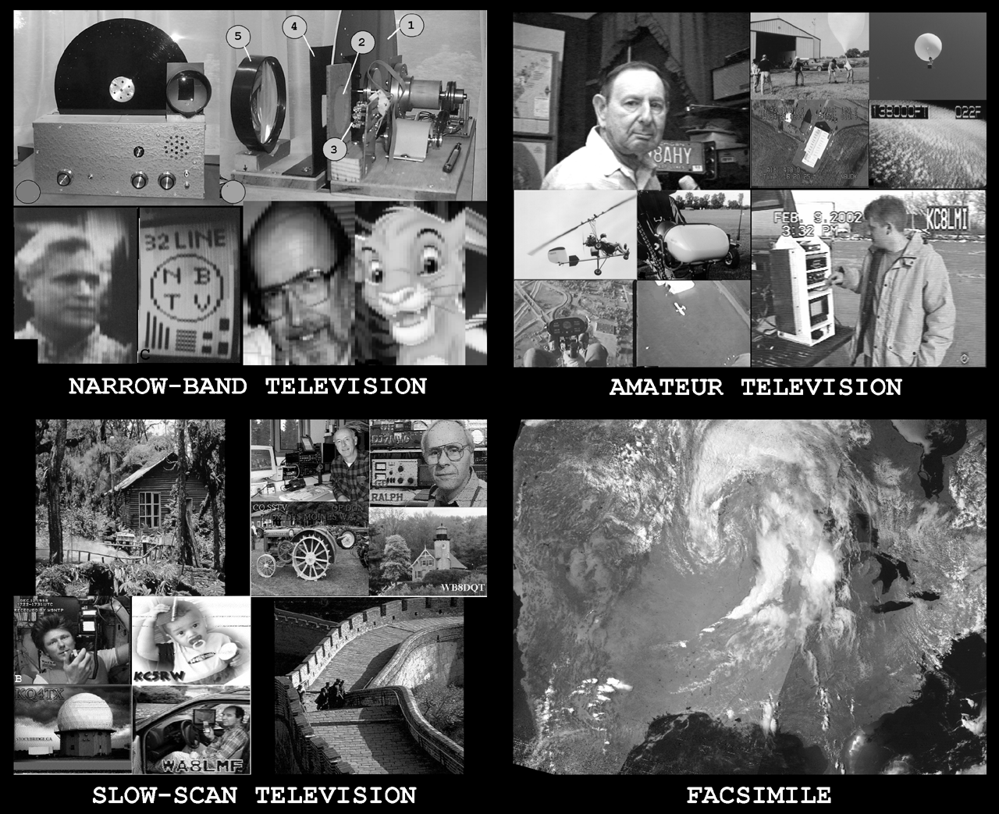
Other Special Modes
Slow Scan TV (SSTV)
  Sending snap-shot pictures
  One frame every few seconds
Amateur TV (ATV)
  Similar to commercial TV imagery
  Uses analog TV format (NTSC)

Slide 26
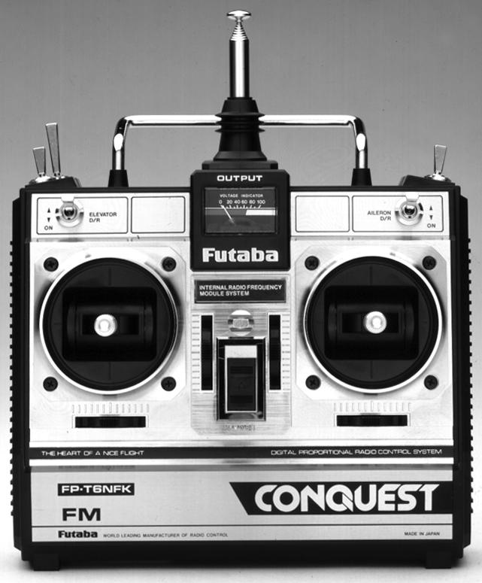
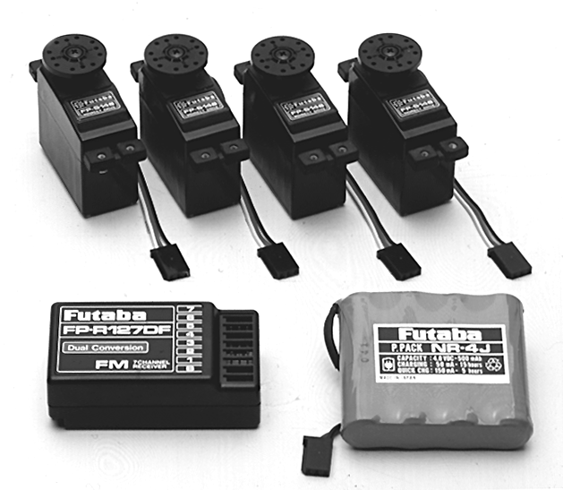
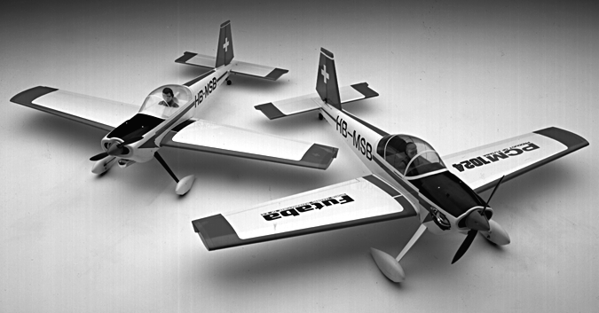
Other Special Modes
Radio Control (RC)
  Telecommand
  50 MHz band
Notes:
Note that amateurs have a special set of frequencies for RC that are unavailable to unlicensed modelers.

Slide 27
Practice Questions

Slide 28
What is the FCC Part 97 definition of telemetry?
A. An information bulletin issued by the FCC
B. A one-way transmission to initiate, modify or terminate functions of a device at a distance
C. A one-way transmission of measurements at a distance from the measuring instrument
D. An information bulletin from a VEC
  FCC Rule: [97.3(a)(46)] T1A07 HRLM (6-33)

Slide 29
What is the FCC Part 97 definition of telemetry?
A. An information bulletin issued by the FCC
B. A one-way transmission to initiate, modify or terminate functions of a device at a distance
C. A one-way transmission of measurements at a distance from the measuring instrument
D. An information bulletin from a VEC
  FCC Rule: [97.3(a)(46)] T1A07 HRLM (6-33)

Slide 30
What is the FCC Part 97 definition of telecommand?
A. An instruction bulletin issued by the FCC
B. A one-way radio transmission of measurements at a distance from the measuring instrument
C. A one-way transmission to initiate, modify or terminate functions of a device at a distance
D. An instruction from a VEC
  FCC Rule: [97.3(a)(45)] T1A13 HRLM (6-33)

Slide 31
What is the FCC Part 97 definition of telecommand?
A. An instruction bulletin issued by the FCC
B. A one-way radio transmission of measurements at a distance from the measuring instrument
C. A one-way transmission to initiate, modify or terminate functions of a device at a distance
D. An instruction from a VEC
  FCC Rule: [97.3(a)(45)] T1A13 HRLM (6-33)

Slide 32
When do the FCC rules NOT apply to the operation of an amateur station?
A. When operating a RACES station
B. When operating under special FEMA rules
C. When operating under special ARES rules
D. Never, FCC rules always apply
  FCC Rule: [97.103(a)] T2C01 HRLM (6-25)

Slide 33
When do the FCC rules NOT apply to the operation of an amateur station?
A. When operating a RACES station
B. When operating under special FEMA rules
C. When operating under special ARES rules
D. Never, FCC rules always apply
  FCC Rule: [97.103(a)] T2C01 HRLM (6-25)

Slide 34
What do RACES and ARES have in common?
A. They represent the two largest ham clubs in the United States
B. Both organizations broadcast road and weather traffic information
C. Neither may handle emergency traffic supporting public service agencies
D. Both organizations may provide communications during emergencies
  T2C04 HRLM (6-24)

Slide 35
What do RACES and ARES have in common?
A. They represent the two largest ham clubs in the United States
B. Both organizations broadcast road and weather traffic information
C. Neither may handle emergency traffic supporting public service agencies
D. Both organizations may provide communications during emergencies
  T2C04 HRLM (6-24)

Slide 36
Which of the following describes the Radio Amateur Civil Emergency Service (RACES)?
A. A radio service using amateur frequencies for emergency management or civil defense communications
B. A radio service using amateur stations for emergency management or civil defense communications
C. An emergency service using amateur operators certified by a civil defense organization as being enrolled in that organization
D. All of these choices are correct
  FCC Rule: [97.3(a)(38), 97.407 ] T2C05 HRLM (6-24)

Slide 37
Which of the following describes the Radio Amateur Civil Emergency Service (RACES)?
A. A radio service using amateur frequencies for emergency management or civil defense communications
B. A radio service using amateur stations for emergency management or civil defense communications
C. An emergency service using amateur operators certified by a civil defense organization as being enrolled in that organization
D. All of these choices are correct
  FCC Rule: [97.3(a)(38), 97.407 ] T2C05 HRLM (6-24)

Slide 38
Which of the following is an accepted practice to get the immediate attention of a net control station when reporting an emergency?
A. Repeat the words SOS three times followed by the call sign of the reporting station
B. Press the push-to-talk button three times
C. Begin your transmission with “Priority” or “Emergency” followed by your call sign
D. Play a pre-recorded emergency alert tone followed by your call sign
  T2C06 HRLM (6-21)

Slide 39
Which of the following is an accepted practice to get the immediate attention of a net control station when reporting an emergency?
A. Repeat the words SOS three times followed by the call sign of the reporting station
B. Press the push-to-talk button three times
C. Begin your transmission with “Priority” or “Emergency” followed by your call sign
D. Play a pre-recorded emergency alert tone followed by your call sign
  T2C06 HRLM (6-21)

Slide 40
Which of the following is an accepted practice for an amateur operator who has checked into an emergency traffic net?
A. Whenever the net frequency is quiet, announce your call sign and location
B. Move 5 kHz away from the net's frequency and use high power to ask other hams to keep clear of the net frequency
C. Remain on frequency without transmitting until asked to do so by the net control station
D. All of the choices are correct
  T2C07 HRLM (6-21)

Slide 41
Which of the following is an accepted practice for an amateur operator who has checked into an emergency traffic net?
A. Whenever the net frequency is quiet, announce your call sign and location
B. Move 5 kHz away from the net's frequency and use high power to ask other hams to keep clear of the net frequency
C. Remain on frequency without transmitting until asked to do so by the net control station
D. All of the choices are correct
  T2C07 HRLM (6-21)

Slide 42
Which of the following is a characteristic of good emergency traffic handling?
A. Passing messages exactly as received
B. Making decisions as to whether or not messages should be relayed or delivered
C. Communicating messages to the news media for broadcast outside the disaster area
D. All of these choices are correct
  T2C08 HRLM (6-22)

Slide 43
Which of the following is a characteristic of good emergency traffic handling?
A. Passing messages exactly as received
B. Making decisions as to whether or not messages should be relayed or delivered
C. Communicating messages to the news media for broadcast outside the disaster area
D. All of these choices are correct
  T2C08 HRLM (6-22)

Slide 44
Are amateur station control operators ever permitted to operate outside the frequency privileges of their license class?
A. No
B. Yes, but only when part of a FEMA emergency plan
C. Yes, but only when part of a RACES emergency plan
D. Yes, but only if necessary in situations involving the immediate safety of human life or protection of property
  FCC Rule: [97.403(b)] T2C09 HRLM (6-25)

Slide 45
Are amateur station control operators ever permitted to operate outside the frequency privileges of their license class?
A. No
B. Yes, but only when part of a FEMA emergency plan
C. Yes, but only when part of a RACES emergency plan
D. Yes, but only if necessary in situations involving the immediate safety of human life or protection of property
  FCC Rule: [97.403(b)] T2C09 HRLM (6-25)

Slide 46
What is the preamble in a formal traffic message?
A. The first paragraph of the message text
B. The message number
C. The priority handling indicator for the message
D. The information needed to track the message as it passes through the amateur radio traffic handling system
  T2C10 HRLM (6-22)

Slide 47
What is the preamble in a formal traffic message?
A. The first paragraph of the message text
B. The message number
C. The priority handling indicator for the message
D. The information needed to track the message as it passes through the amateur radio traffic handling system
  T2C10 HRLM (6-22)

Slide 48
What is meant by the term "check" in reference to a formal traffic message?
A. The check is a count of the number of words or word equivalents in the text portion of the message
B. The check is the value of a money order attached to the message
C. The check is a list of stations that have relayed the message
D. The check is a box on the message form that tells you the message was received
  T2C11 HRLM (6-22)

Slide 49
What is meant by the term "check" in reference to a formal traffic message?
A. The check is a count of the number of words or word equivalents in the text portion of the message
B. The check is the value of a money order attached to the message
C. The check is a list of stations that have relayed the message
D. The check is a box on the message form that tells you the message was received
  T2C11 HRLM (6-22)

Slide 50
What is the Amateur Radio Emergency Service (ARES)?
A. Licensed amateurs who have voluntarily registered their qualifications and equipment for communications duty in the public service
B. Licensed amateurs who are members of the military and who voluntarily agreed to provide message handling services in the case of an emergency
C. A training program that provides licensing courses for those interested in obtaining an amateur license to use during emergencies
D. A training program that certifies amateur operators for membership in the Radio Amateur Civil Emergency Service
  T2C12 HRLM (6-24)

Slide 51
What is the Amateur Radio Emergency Service (ARES)?
A. Licensed amateurs who have voluntarily registered their qualifications and equipment for communications duty in the public service
B. Licensed amateurs who are members of the military and who voluntarily agreed to provide message handling services in the case of an emergency
C. A training program that provides licensing courses for those interested in obtaining an amateur license to use during emergencies
D. A training program that certifies amateur operators for membership in the Radio Amateur Civil Emergency Service
  T2C12 HRLM (6-24)

Slide 52
Who may be the control operator of a station communicating through an amateur satellite or space station?
A. Only an Amateur Extra Class operator
B. A General Class licensee or higher licensee who has a satellite operator certification
C. Only an Amateur Extra Class operator who is also an AMSAT member
D. Any amateur whose license privileges allow them to transmit on the satellite uplink frequency
  FCC Rule: [97.301, 97.207(c)] T8B01 HRLM (6-30)

Slide 53
Who may be the control operator of a station communicating through an amateur satellite or space station?
A. Only an Amateur Extra Class operator
B. A General Class licensee or higher licensee who has a satellite operator certification
C. Only an Amateur Extra Class operator who is also an AMSAT member
D. Any amateur whose license privileges allow them to transmit on the satellite uplink frequency
  FCC Rule: [97.301, 97.207(c)] T8B01 HRLM (6-30)

Slide 54
How much transmitter power should be used on the uplink frequency of an amateur satellite or space station?
A. The maximum power of your transmitter
B. The minimum amount of power needed to complete the contact
C. No more than half the rating of your linear amplifier
D. Never more than 1 watt
  FCC Rule: [97.313] T8B02 HRLM (6-31)

Slide 55
How much transmitter power should be used on the uplink frequency of an amateur satellite or space station?
A. The maximum power of your transmitter
B. The minimum amount of power needed to complete the contact
C. No more than half the rating of your linear amplifier
D. Never more than 1 watt
  FCC Rule: [97.313] T8B02 HRLM (6-31)

Slide 56
Which of the following are provided by satellite tracking programs?
A. Maps showing the real-time position of the satellite track over the earth
B. The time, azimuth, and elevation of the start, maximum altitude, and end of a pass
C. The apparent frequency of the satellite transmission, including effects of Doppler shift
D. All of these answers are correct
  T8B03 HRLM (6-31)

Slide 57
Which of the following are provided by satellite tracking programs?
A. Maps showing the real-time position of the satellite track over the earth
B. The time, azimuth, and elevation of the start, maximum altitude, and end of a pass
C. The apparent frequency of the satellite transmission, including effects of Doppler shift
D. All of these answers are correct
  T8B03 HRLM (6-31)

Slide 58
Which amateur stations may make contact with an amateur station on the International Space Station using 2 meter and 70 cm band amateur radio frequencies?
A. Only members of amateur radio clubs at NASA facilities
B. Any amateur holding a Technician or higher class license
C. Only the astronaut's family members who are hams
D. You cannot talk to the ISS on amateur radio frequencies
  FCC Rule: [97.301, 97.207(c)] T8B04 HRLM (6-30)

Slide 59
Which amateur stations may make contact with an amateur station on the International Space Station using 2 meter and 70 cm band amateur radio frequencies?
A. Only members of amateur radio clubs at NASA facilities
B. Any amateur holding a Technician or higher class license
C. Only the astronaut's family members who are hams
D. You cannot talk to the ISS on amateur radio frequencies
  FCC Rule: [97.301, 97.207(c)] T8B04 HRLM (6-30)

Slide 60
What is a satellite beacon?
A. The primary transmit antenna on the satellite
B. An indicator light that shows where to point your antenna
C. A reflective surface on the satellite
D. A transmission from a space station that contains information about a satellite
  T8B05 HRLM (6-30)

Slide 61
What is a satellite beacon?
A. The primary transmit antenna on the satellite
B. An indicator light that shows where to point your antenna
C. A reflective surface on the satellite
D. A transmission from a space station that contains information about a satellite
  T8B05 HRLM (6-30)

Slide 62
Which of the following are inputs to a satellite tracking program?
A. The weight of the satellite
B. The Keplerian elements
C. The last observed time of zero Doppler shift
D. All of these answers are correct
  T8B06 HRLM (6-31)

Slide 63
Which of the following are inputs to a satellite tracking program?
A. The weight of the satellite
B. The Keplerian elements
C. The last observed time of zero Doppler shift
D. All of these answers are correct
  T8B06 HRLM (6-31)

Slide 64
With regard to satellite communications, what is Doppler shift?
A. A change in the satellite orbit
B. A mode where the satellite receives signals on one band and transmits on another
C. An observed change in signal frequency caused by relative motion between the satellite and the earth station
D. A special digital communications mode for some satellites
  T8B07 HRLM (6-30)

Slide 65
With regard to satellite communications, what is Doppler shift?
A. A change in the satellite orbit
B. A mode where the satellite receives signals on one band and transmits on another
C. An observed change in signal frequency caused by relative motion between the satellite and the earth station
D. A special digital communications mode for some satellites
  T8B07 HRLM (6-30)

Slide 66
What is meant by the statement that a satellite is operating in mode U/V?
A. The satellite uplink is in the 15 meter band and the downlink is in the 10 meter band
B. The satellite uplink is in the 70 cm band and the downlink is in the 2 meter band
C. The satellite operates using ultraviolet frequencies
D. The satellite frequencies are usually variable
  T8B08 HRLM (6-31)

Slide 67
What is meant by the statement that a satellite is operating in mode U/V?
A. The satellite uplink is in the 15 meter band and the downlink is in the 10 meter band
B. The satellite uplink is in the 70 cm band and the downlink is in the 2 meter band
C. The satellite operates using ultraviolet frequencies
D. The satellite frequencies are usually variable
  T8B08 HRLM (6-31)

Slide 68
What causes spin fading when referring to satellite signals?
A. Circular polarized noise interference radiated from the sun
B. Rotation of the satellite and its antennas
C. Doppler shift of the received signal
D. Interfering signals within the satellite uplink band
  T8B09 HRLM (6-31)

Slide 69
What causes spin fading when referring to satellite signals?
A. Circular polarized noise interference radiated from the sun
B. Rotation of the satellite and its antennas
C. Doppler shift of the received signal
D. Interfering signals within the satellite uplink band
  T8B09 HRLM (6-31)

Slide 70
What do the initials LEO tell you about an amateur satellite?
A. The satellite battery is in Low Energy Operation mode
B. The satellite is performing a Lunar Ejection Orbit maneuver
C. The satellite is in a Low Earth Orbit
D. The satellite uses Light Emitting Optics
  T8B10 HRLM (6-30)

Slide 71
What do the initials LEO tell you about an amateur satellite?
A. The satellite battery is in Low Energy Operation mode
B. The satellite is performing a Lunar Ejection Orbit maneuver
C. The satellite is in a Low Earth Orbit
D. The satellite uses Light Emitting Optics
  T8B10 HRLM (6-30)

Slide 72
What is a commonly used method of sending signals to and from a digital satellite?
A. USB AFSK
B. PSK31
C. FM Packet
D. WSJT
  T8B11 HRLM (6-31)

Slide 73
What is a commonly used method of sending signals to and from a digital satellite?
A. USB AFSK
B. PSK31
C. FM Packet
D. WSJT
  T8B11 HRLM (6-31)

Slide 74
Which of the following methods is used to locate sources of noise interference or jamming?
A. Echolocation
B. Doppler radar
C. Radio direction finding
D. Phase locking
  T8C01 HRLM (6-29)

Slide 75
Which of the following methods is used to locate sources of noise interference or jamming?
A. Echolocation
B. Doppler radar
C. Radio direction finding
D. Phase locking
  T8C01 HRLM (6-29)

Slide 76
Which of these items would be useful for a hidden transmitter hunt?
A. Calibrated SWR meter
B. A directional antenna
C. A calibrated noise bridge
D. All of these choices are correct
  T8C02 HRLM (6-29)

Slide 77
Which of these items would be useful for a hidden transmitter hunt?
A. Calibrated SWR meter
B. A directional antenna
C. A calibrated noise bridge
D. All of these choices are correct
  T8C02 HRLM (6-29)

Slide 78
What popular operating activity involves contacting as many stations as possible during a specified period of time?
A. Contesting
B. Net operations
C. Public service events
D. Simulated emergency exercises
  T8C03 HRLM (6-28)

Slide 79
What popular operating activity involves contacting as many stations as possible during a specified period of time?
A. Contesting
B. Net operations
C. Public service events
D. Simulated emergency exercises
  T8C03 HRLM (6-28)

Slide 80
Which of the following is good procedure when contacting another station in a radio contest?
A. Be sure to sign only the last two letters of your call if there is a pileup calling the station
B. Work the station twice to be sure that you are in his log
C. Send only the minimum information needed for proper identification and the contest exchange
D. All of these choices are correct
  T8C04 HRLM (6-28)

Slide 81
Which of the following is good procedure when contacting another station in a radio contest?
A. Be sure to sign only the last two letters of your call if there is a pileup calling the station
B. Work the station twice to be sure that you are in his log
C. Send only the minimum information needed for proper identification and the contest exchange
D. All of these choices are correct
  T8C04 HRLM (6-28)

Slide 82
What is the maximum power allowed when transmitting telecommand signals to radio controlled models?
A. 500 milliwatts
B. 1 watt
C. 25 watts
D. 1500 watts
  FCC Rule: [97.215(c)] T8C07 HRLM (6-33)

Slide 83
What is the maximum power allowed when transmitting telecommand signals to radio controlled models?
A. 500 milliwatts
B. 1 watt
C. 25 watts
D. 1500 watts
  FCC Rule: [97.215(c)] T8C07 HRLM (6-33)

Slide 84
What is required in place of on-air station identification when sending signals to a radio control model using amateur frequencies?
A. Voice identification must be transmitted every 10 minutes
B. Morse code ID must be sent once per hour
C. A label indicating the licensee’s name, call sign and address must be affixed to the transmitter
D. A flag must be affixed to the transmitter antenna with the station call sign in 1 inch high letters or larger
  FCC Rule: [97.215(a)] T8C08 HRLM (6-33)

Slide 85
What is required in place of on-air station identification when sending signals to a radio control model using amateur frequencies?
A. Voice identification must be transmitted every 10 minutes
B. Morse code ID must be sent once per hour
C. A label indicating the licensee’s name, call sign and address must be affixed to the transmitter
D. A flag must be affixed to the transmitter antenna with the station call sign in 1 inch high letters or larger
  FCC Rule: [97.215(a)] T8C08 HRLM (6-33)

Slide 86
What type of transmission is indicated by the term NTSC?
A. A Normal Transmission mode in Static Circuit
B. A special mode for earth satellite uplink
C. An analog fast scan color TV signal
D. A frame compression scheme for TV signals
  T8D04 HRLM (6-32)

Slide 87
What type of transmission is indicated by the term NTSC?
A. A Normal Transmission mode in Static Circuit
B. A special mode for earth satellite uplink
C. An analog fast scan color TV signal
D. A frame compression scheme for TV signals
  T8D04 HRLM (6-32)

