Slide 1
Technician License Course Chapter 6
Lesson Plan Module 13 –
Contacting Other Hams – Part 1
Contact Basics, Band Plans, Making Contacts and Using Repeaters

Slide 2
The Typical Telephone Conversation
Greeting
Identify who is participating
Exchange information, generally taking turns
Salutations
End the conversation
Notes:
Communication is something that we do every day, but rarely to we think about communication in detail. Simply go through a short telephone conversation that the students might have and point out the parts.
Greeting: Hello
Identify: Mom? This is Ron.
Exchange information: I am having a really great time on my vacation….we have done….
Salutations: Well I better get going, I’ll call you tomorrow.
End the conversation: Bye

Slide 3
The Typical Ham Contact (QSO)
Greeting
Identify who is participating
Exchange information, generally taking turns
Salutations
End the conversation
Notes:
Take a moment to mention “Q” signals and what QSO means.
Now go over a fictitious ham contact and point out that it is the same as a telephone conversation except that there are a few procedural differences and some special vocabulary.
Greeting: CQ CQ CQ this is WA8SME.
Identify who is participating: WA8SME this is W6WBT Phil in Coleville calling.
Exchange information: Hi Phil, you have a good signal today from Coleville, you’re running 59 here in Bridgeport….
Salutations: Well Phil, I better get to some chores before it rains. Thanks for the contact and I hope to hear you again. 73 for now.
End the conversation: W6WBT this is WA8SME, clear.

Slide 4
Radio Manners
Speak clearly and distinctly
Remember – you can’t see the other person talking!
Use phonetics when needed
Assume all communications are public –choose topics accordingly
Notes:
Just like using the phone, when you talk on the radio you are communicating only with verbal information, there is no non-verbal feedback or communication. (The majority of communication while face-to-face is in non-verbal form) Therefore you need to make sure you speak clearly and distinctly (you won’t see the raised eyebrows that indicate that you are not being understood). Additionally there may be static and interfering signals or possibly language barriers and accents.
Other stations can hear your conversation and the person you are talking to could be in another country with different values. Therefore, choose your conversation topics wisely even on local contacts. Avoid controversial and or offensive topics. Avoid talking about religion, politics, off color content, dirty jokes and swearing.

Slide 5
Radio Manners
Before transmitting, be sure the frequency is clear and you are authorized to use it!
Station identification (10-minute rule)
Frequencies are shared
No one has a prior claim to a frequency
Schedules, nets, pre-planned events
Be flexible, always have a “Plan B”
Notes:
You will share the frequencies with other hams, and because of propagation, you may not hear both sides of a conversation going on. It is a good habit to get into to ask if the frequency is in use before you use it. Simply say, “Is this frequency in use?” and wait a few seconds for a reply. Sometimes, you will hear the questions asked twice – which is fine if there is time to wait. If no reply then go ahead.

Slide 6
Radio Manners
Signal reports
Power level
Avoid excess power
Location (QTH)
Grid locators
RST
Readability (1–5)
Strength (1–9)
Tone (CW only 1–9)
“Your signal is 58”
Notes:
Go over the meaning of RST. Talk with your students about adjusting the content and pace of the QSO according to the RST. If signals are strong and perfectly readable, “armchair copy” (explain this term), then carry on at a normal pace. If signals a weak and barely readable, give lost of repeats of important information, keep transmissions short and the content light. If the other station can’t hear you well, then there is no need to talk about the meaning of life.
Give the location of your station is one of the fundamental components of a QSO. Your location is usually referred to as your QTH. You can give your QTH as city and state, simply your state, major geographic landmarks and street intersections, or by grid square…depending of the context of the conversation. Note the various grid-locator programs online, including on the ARRL website.

Slide 7
Radio Manners
Advice and assistance
Radio and antenna tests or checks
Ham radio is self-regulated
ARRL Official Observers
Logging contacts – on paper or computer
QSLs and award programs
Notes:
Spend some time discussing with the students about how hams deal with unacceptable on-the-air behavior. Stress the importance of not confronting the violator on-the-air. One of the best strategies is to note the violation, but do not indicate to the offender that their behavior is being noticed…that gives them the audience that they are seeking and actually reinforces the bad behavior. Discuss the role of the OO program.
Though logging is no longer required, it is a good idea to keep records of your on-the-air activity even if just as an archive of those you have talked to or perhaps as a record of when your station was in use in case of an interference concern. Logging is a good habit. Logs can be submitted for contest operation.
Bring in some QSL cards and show them to the class. Also bring in some of the operating awards that you have and explain some of the award programs.

Slide 8
Band Plans
A band plan is a formal plan for organizing types of operation on a band
Informal agreement – not a regulation
Intended for normal circumstances
Be flexible in times of heavy band use (contests, special events, DXpeditions)
Always have a “Plan B”
Notes:
Discuss with the students the need for band plans, to bring organization and prevent potential chaos, but also a band plan allows us to find other hams to contact.
Pass out the band plan chart and explain how to extract information from the chart.
There are band allocations and band plans.
An allocation is the formal or legal plan is the regulated authorization and regulated use of specific frequency ranges (bands) for licensed use. These plans are established by governmental regulatory agencies (like the FCC). Violating the allocation could result in legal sanctions. Give examples of allocation rules.
A band plan is an informal organization of operating activities based on accepted practice. These plans are not legally binding but good operator practice and radio manners encourage hams to follow the informal band plans. These informal band plans are established by precedence and accepted practice.
Informal band plans are voluntary, but the FCC expects that good amateur practice means we follow those band plans under normal circumstances. When band loading is very heavy due to a big contest, DXpedition, or other special event, operation probably won’t follow the band plan for a while. Be flexible and normal operation will resume soon – have a Plan B so you have alternatives.

Slide 9
Making Contacts
Repeater operation
Listen to see how the regulars operate
To announce your presence, just say your call
Respond to a call with the station’s call followed by your own call
Often used by a club or group as a regional intercom
Notes:
Note that the “group intercom” use means that stations won’t always respond to a call from a non-member. Just be patient and an opportunity (a net, a multi-station contact, a station making an unanswered call, etc) will present itself.

Slide 10
Making Contacts
Repeater signal reports (examples)
Full-quieting: signal is strong enough that no noise is heard
Scratchy: occasional noise with your signal
Flutter: multi-path from a mobile station
In and out: occasionally copyable but mostly inaudible

Slide 11
Making Contacts
HF on CW or SSB
“CQ” means “I am calling anyone”
To answer give the station’s call followed by your call once or twice
Use of phonetics is common
Notes:
Explain the difference between channelized repeater operation and continuous tuning on HF.

Slide 12
Making Contacts
Taking turns
Nets
Roundtables
Shared contacts
Breaking in
Wait for a pause
Give your call

Slide 13
Making Contacts
Simplex FM
Each user takes turns to transmit
Works for stations close to each other
If you can hear the other station on the repeater input frequency, try simplex
2 meters: 146.52 MHz
70 cm: 446.00 MHz

Slide 14
Repeater Review
Specialized transmitter/receiver interconnected by a controller.
Generally located at a high place.
Receives and simultaneously retransmits your signal on a different frequency.
Dramatically extends line-of-sight range.

Slide 15
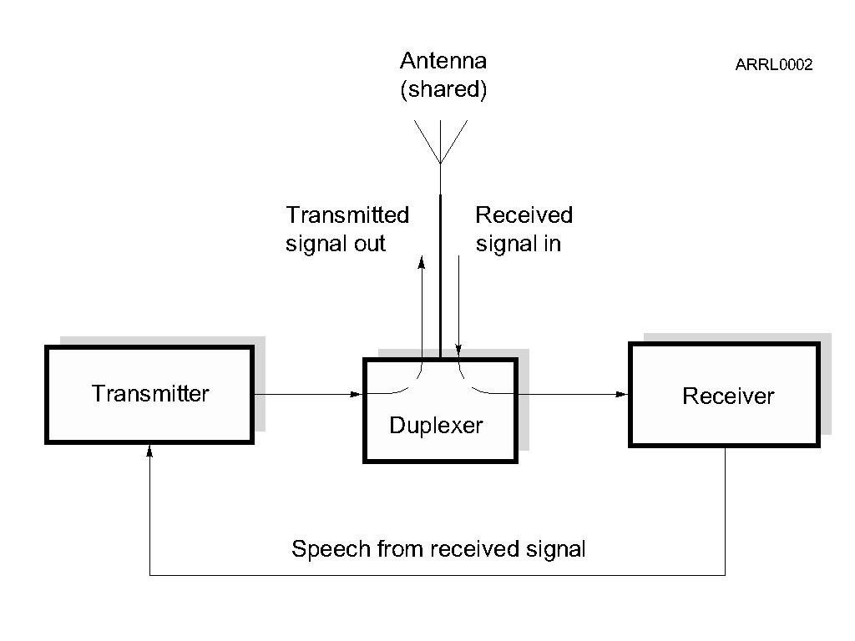
Repeater Review – How They Work

Slide 16
Duplex Communication
Transmitting on one frequency while simultaneously listening on a different frequency.
Repeaters use duplex communications.
Output frequency – the frequency the repeater transmits on and you listen to.
Input frequency – the frequency the repeater listens to and you transmit on.

Slide 17
Things to Know to Use a Repeater
Output frequency
Frequency offset
And therefore the input frequency
Repeater access tones (if any)

Slide 18
Repeater Output Frequency
Repeaters are frequently identified by their output frequency.
“Meet you on the 443.50 machine.”
Here the specific frequency is used.
“Let’s go to 94.”
Here an abbreviation for a standard repeater channel is used, meaning 146.94 MHz.
“How about the NARL repeater?”
Here the repeater is referenced by the sponsoring club name.
Notes:
Inform the students of various repeater directory source materials that are available either online or in print.

Slide 19
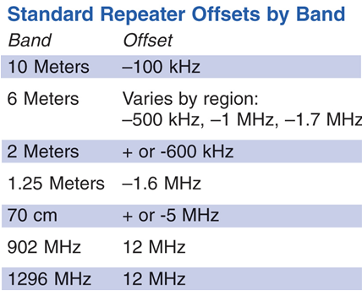
Repeater Frequency Offset
The offset frequencies (shifts or splits) are standardized to help facilitate repeater use.
There are + and – offsets depending on the plan.
Different bands have different standardized amounts of offset.
Notes:
The use of different terms for frequency offset might confuse students, let them know that all the terms refer to the same thing. Use the standard term – offset – consistently.
Discuss with the students that most modern radios will automatically set the standardized offset frequency when programmed, that they must specifically program in a non-standard split for those repeaters requiring it. Finally, let them know that the offset plan is not law, just a plan that is used by convention. There are some repeaters that use non standardized splits in order to limit or control use.

Slide 20
Repeater Access Tones
Prevents accessing multiple repeaters at once.
Subaudible low-frequency tone must be present before the repeater transmitter will turn on.
Tones have various names (depending on equipment manufacturer).
CTCSS (continuous tone coded squelch system)
PL (a Motorola trade name for CTCSS)
Privacy codes or tones
DCS (digital coded squelch)
Notes:
You will have to define what sub-audible means and give some examples of tone frequencies.

Slide 21
Repeater Access Tones
Access tones are usually published along with repeater frequencies.
Could also be announced when the repeater identifies.
“PL is 123.0” meaning 123.0 Hz
Tones are generally programmed into the radio along with frequency and offset.

Slide 22
Repeater Control
Repeater identification (Morse code or synthesized voice)
Same ID requirements as you have
Time-out protection
Protects against continuous transmission in the event of a stuck PTT or long-winded speaker
Usually three minutes
Courtesy beep or tone signals time-out timer reset
May have an autopatch system for phone calls
Notes:
Here you should cover some of the characteristics of the local repeaters that the students will encounter. Include in the discussion the different IDs used, what a courtesy tone is and what it means, the length of the time-out timers on some machines, and locally accepted uses of repeaters.

Slide 23
Common Problems
Off frequency: causes audio distortion
Low batteries: weak signal, audio distortion
Poor location: hear repeater OK, can’t make or maintain contact
Access tone off or wrong: repeater is strong but can’t access it
Repeater drops in and out of your receiver: squelch setting too high
Notes:
Go over some common problems, anything specific to your area, things you have encountered.

Slide 24
Digital Repeater Systems
Repeaters linked by the Internet
Use digital audio – Voice Over Internet Protocol (VOIP)
Similar to Skype
Allows communication world-wide
Internet Linking Relay Project (IRLP)
Echolink
Access codes on system websites
Notes:
Note there are many tutorials and explanations online for the digital repeater systems.

Slide 25
D-STAR
Both a repeater linking system and a digital voice protocol
DV: Digital Voice mode (voice + 1200 baud data)
DD: Digital Data mode (128 kbps data)
Repeaters linked together worldwide
Call user-to-user based on call sign
Currently an ICOM system
Yaesu and Kenwood also building digital systems

Slide 26
Practice Questions

Slide 27
What is the most common repeater frequency offset in the 2 meter band?
A. Plus 500 kHz
B. Plus or minus 600 kHz
C. Minus 500 kHz
D. Only plus 600 kHz
T2A01 HRLM (6-16)

Slide 28
What is the most common repeater frequency offset in the 2 meter band?
A. Plus 500 kHz
B. Plus or minus 600 kHz
C. Minus 500 kHz
D. Only plus 600 kHz
T2A01 HRLM (6-16)

Slide 29
What is the national calling frequency for FM simplex operations in the 70 cm band?
A. 146.520 MHz
B. 145.000 MHz
C. 432.100 MHz
D. 446.000 MHz
T2A02 HRLM (6-14)

Slide 30
What is the national calling frequency for FM simplex operations in the 70 cm band?
A. 146.520 MHz
B. 145.000 MHz
C. 432.100 MHz
D. 446.000 MHz
T2A02 HRLM (6-14)

Slide 31
What is a common repeater frequency offset in the 70 cm band?
A. Plus or minus 5 MHz
B. Plus or minus 600 kHz
C. Minus 600 kHz
D. Plus 600 kHz
T2A03 HRLM (6-16)

Slide 32
What is a common repeater frequency offset in the 70 cm band?
A. Plus or minus 5 MHz
B. Plus or minus 600 kHz
C. Minus 600 kHz
D. Plus 600 kHz
T2A03 HRLM (6-16)

Slide 33
What is an appropriate way to call another station on a repeater if you know the other station's call sign?
A. Say "break, break" then say the station's call sign
B. Say the station's call sign then identify with your call sign
C. Say "CQ" three times then the other station's call sign
D. Wait for the station to call "CQ" then answer it
T2A04 HRLM (6-12)

Slide 34
What is an appropriate way to call another station on a repeater if you know the other station's call sign?
A. Say "break, break" then say the station's call sign
B. Say the station's call sign then identify with your call sign
C. Say "CQ" three times then the other station's call sign
D. Wait for the station to call "CQ" then answer it
T2A04 HRLM (6-12)

Slide 35
How should you respond to a station calling CQ?
A. Transmit CQ followed by the other station’s call sign
B. Transmit our call sign followed by the other station’s call sign
C. Transmit the other station’s call sign followed by your call sign
D. Transmit a signal report followed by your call sign
T2A05 HRLM (6-13)

Slide 36
How should you respond to a station calling CQ?
A. Transmit CQ followed by the other station’s call sign
B. Transmit our call sign followed by the other station’s call sign
C. Transmit the other station’s call sign followed by your call sign
D. Transmit a signal report followed by your call sign
T2A05 HRLM (6-13)

Slide 37
What is the meaning of the procedural signal "CQ"?
A. Call on the quarter hour
B. A new antenna is being tested (no station should answer)
C. Only the called station should transmit
D. Calling any station
T2A08 HRLM (6-13)

Slide 38
What is the meaning of the procedural signal "CQ"?
A. Call on the quarter hour
B. A new antenna is being tested (no station should answer)
C. Only the called station should transmit
D. Calling any station
T2A08 HRLM (6-13)

Slide 39
What brief statement is often used in place of "CQ" to indicate that you are listening on a repeater?
A. The words "Hello test" followed by your call sign
B. Your call sign
C. The repeater call sign followed by your call sign
D. The letters "QSY" followed by your call sign
T2A09 HRLM (6-9)

Slide 40
What brief statement is often used in place of "CQ" to indicate that you are listening on a repeater?
A. The words "Hello test" followed by your call sign
B. Your call sign
C. The repeater call sign followed by your call sign
D. The letters "QSY" followed by your call sign
T2A09 HRLM (6-9)

Slide 41
Which of the following is a guideline to use when choosing an operating frequency for calling CQ?
A. Listen first to be sure that no one else is using the frequency
B. Ask if the frequency is in use
C. Make sure you are in your assigned band
D. All of these choices are correct
T2A12 HRLM (6-13)

Slide 42
Which of the following is a guideline to use when choosing an operating frequency for calling CQ?
A. Listen first to be sure that no one else is using the frequency
B. Ask if the frequency is in use
C. Make sure you are in your assigned band
D. All of these choices are correct
T2A12 HRLM (6-13)

Slide 43
What is the term used to describe an amateur station that is transmitting and receiving on the same frequency?
A. Full duplex communication
B. Diplex communication
C. Simplex communication
D. Multiplex
T2B01 HRLM (6-9)

Slide 44
What is the term used to describe an amateur station that is transmitting and receiving on the same frequency?
A. Full duplex communication
B. Diplex communication
C. Simplex communication
D. Multiplex
T2B01 HRLM (6-9)

Slide 45
What is the term used to describe the use of a sub-audible tone transmitted with normal voice audio to open the squelch of a receiver?
A. Carrier squelch
B. Tone burst
C. DTMF
D. CTCSS
T2B02 HRLM (6-16)

Slide 46
What is the term used to describe the use of a sub-audible tone transmitted with normal voice audio to open the squelch of a receiver?
A. Carrier squelch
B. Tone burst
C. DTMF
D. CTCSS
T2B02 HRLM (6-16)

Slide 47
Which of the following common problems might cause you to be able to hear but not access a repeater even when transmitting with the proper offset?
A. The repeater receiver may require an audio tone burst for access
B. The repeater receiver may require a CTCSS tone for access
C. The repeater receiver may require a DCS tone sequence for access
D. All of these choices are correct
T2B04 HRLM (6-17)

Slide 48
Which of the following common problems might cause you to be able to hear but not access a repeater even when transmitting with the proper offset?
A. The repeater receiver may require an audio tone burst for access
B. The repeater receiver may require a CTCSS tone for access
C. The repeater receiver may require a DCS tone sequence for access
D. All of these choices are correct
T2B04 HRLM (6-17)

Slide 49
Which "Q" signal indicates that you are receiving interference from other stations?
A. QRM
B. QRN
C. QTH
D. QSB
T2B10 HRLM (6-5)

Slide 50
Which "Q" signal indicates that you are receiving interference from other stations?
A. QRM
B. QRN
C. QTH
D. QSB
T2B10 HRLM (6-5)

Slide 51
Which "Q" signal indicates that you are changing frequency?
A. QRU
B. QSY
C. QSL
D. QRZ
T2B11 HRLM (6-5)

Slide 52
Which "Q" signal indicates that you are changing frequency?
A. QRU
B. QSY
C. QSL
D. QRZ
T2B11 HRLM (6-5)

Slide 53
Under what circumstances should you consider communicating via simplex rather than a repeater?
A. When the stations can communicate directly without using a repeater
B. Only when you have an endorsement for simplex operation on your license
C. Only when third party traffic is not being passed
D. Only if you have simplex modulation capability
T2B12 HRLM (6-14)

Slide 54
Under what circumstances should you consider communicating via simplex rather than a repeater?
A. When the stations can communicate directly without using a repeater
B. Only when you have an endorsement for simplex operation on your license
C. Only when third party traffic is not being passed
D. Only if you have simplex modulation capability
T2B12 HRLM (6-14)

Slide 55
What should be done to insure that voice message traffic containing proper names and unusual words are copied correctly by the receiving station?
A. The entire message should be repeated at least four times
B. Such messages must be limited to no more than 10 words
C. Such words and terms should be spelled out using a standard phonetic alphabet
D. All of these choices are correct
T2C03 HRLM (6-22)

Slide 56
What should be done to insure that voice message traffic containing proper names and unusual words are copied correctly by the receiving station?
A. The entire message should be repeated at least four times
B. Such messages must be limited to no more than 10 words
C. Such words and terms should be spelled out using a standard phonetic alphabet
D. All of these choices are correct
T2C03 HRLM (6-22)

Slide 57
Which of the following describes the common meaning of the term “repeater offset”?
A. The distance between the repeater’s transmit and receive antennas
B. The time delay before the repeater timer resets
C. The difference between the repeater’s transmit and receive frequencies
D. Matching the antenna impedance to the feed line impedance
T4B11 HRLM (6-16)

Slide 58
Which of the following describes the common meaning of the term “repeater offset”?
A. The distance between the repeater’s transmit and receive antennas
B. The time delay before the repeater timer resets
C. The difference between the repeater’s transmit and receive frequencies
D. Matching the antenna impedance to the feed line impedance
T4B11 HRLM (6-16)

Slide 59
What might be the problem if you receive a report that your audio signal through the repeater is distorted or unintelligible?
A. Your transmitter may be slightly off frequency
B. Your batteries may be running low
C. You could be in a bad location
D. All of these choices are correct
T7B10 HRLM (6-12)

Slide 60
What might be the problem if you receive a report that your audio signal through the repeater is distorted or unintelligible?
A. Your transmitter may be slightly off frequency
B. Your batteries may be running low
C. You could be in a bad location
D. All of these choices are correct
T7B10 HRLM (6-12)

Slide 61
What is a grid locator?
A. A letter-number designator assigned to a geographic location
B. A letter-number designator assigned to an azimuth and elevation
C. An instrument for neutralizing a final amplifier
D. An instrument for radio direction finding
T8C05 HRLM (6-4)

Slide 62
What is a grid locator?
A. A letter-number designator assigned to a geographic location
B. A letter-number designator assigned to an azimuth and elevation
C. An instrument for neutralizing a final amplifier
D. An instrument for radio direction finding
T8C05 HRLM (6-4)

Slide 63
How is access to an IRLP node accomplished?
A. By obtaining a password which is sent via voice to the node
B. By using DTMF signals
C. By entering the proper Internet password
D. By using CTCSS tone codes
T8C06 HRLM (6-19)

Slide 64
How is access to an IRLP node accomplished?
A. By obtaining a password which is sent via voice to the node
B. By using DTMF signals
C. By entering the proper Internet password
D. By using CTCSS tone codes
T8C06 HRLM (6-19)

Slide 65
How might you obtain a list of active nodes that use VoIP?
A. From the FCC Rulebook
B. From your local emergency coordinator
C. From a repeater directory
D. From the local repeater frequency coordinator
T8C09 HRLM (6-19)

Slide 66
How might you obtain a list of active nodes that use VoIP?
A. From the FCC Rulebook
B. From your local emergency coordinator
C. From a repeater directory
D. From the local repeater frequency coordinator
T8C09 HRLM (6-19)

Slide 67
How do you select a specific IRLP node when using a portable transceiver?
A. Choose a specific CTCSS tone
B. Choose the correct DSC tone
C. Access the repeater autopatch
D. Use the keypad to transmit the IRLP node ID
T8C10 HRLM (6-19)

Slide 68
How do you select a specific IRLP node when using a portable transceiver?
A. Choose a specific CTCSS tone
B. Choose the correct DSC tone
C. Access the repeater autopatch
D. Use the keypad to transmit the IRLP node ID
T8C10 HRLM (6-19)

Slide 69
What is meant by Voice Over Internet Protocol (VoIP) as used in amateur radio?
A. A set of rules specifying how to identify your station when linked over the Internet to another station
B. A set of guidelines for working DX during contests using Internet access
C. A technique for measuring the modulation quality of a transmitter using remote sites monitored via the Internet
D. A method of delivering voice communications over the Internet using digital techniques
T8C12 HRLM (6-19)

Slide 70
What is meant by Voice Over Internet Protocol (VoIP) as used in amateur radio?
A. A set of rules specifying how to identify your station when linked over the Internet to another station
B. A set of guidelines for working DX during contests using Internet access
C. A technique for measuring the modulation quality of a transmitter using remote sites monitored via the Internet
D. A method of delivering voice communications over the Internet using digital techniques
T8C12 HRLM (6-19)

Slide 71
What is the Internet Radio Linking Project (IRLP)?
A. A technique to connect amateur radio systems, such as repeaters, via the Internet using a Voice Over Internet Protocol
B. A system for providing access to websites via amateur radio
C. A system for informing amateurs real time of the frequency of active DX stations
D. A technique for measuring signal strength of an amateur transmitter via the Internet
T8C13 HRLM (6-18)

Slide 72
What is the Internet Radio Linking Project (IRLP)?
A. A technique to connect amateur radio systems, such as repeaters, via the Internet using a Voice Over Internet Protocol
B. A system for providing access to websites via amateur radio
C. A system for informing amateurs real time of the frequency of active DX stations
D. A technique for measuring signal strength of an amateur transmitter via the Internet
T8C13 HRLM (6-18)

