Slide 1
Technician License Course Chapter 5
Lesson Plan Module 11 –
Transmitters, Receivers and Transceivers

Slide 2
Generalized Transceiver Categories
Mobile VHF/UHF FM
Single Band VHF or UHF FM
Dual Band VHF/UHF FM
All Band HF and VHF/UHF
Multimode VHF/UHF CW/SSB/FM
Handheld (HT)
Notes:
In this lesson you will be comparing and contrasting the different kinds of equipment available. You can adjust these categories to meet your personal preferences and experiences. It would be a good idea to have examples of the different kinds of equipment. Catalogs from the major equipment retailers would be helpful to give an idea of cost. (The larger stores might send a box of catalogs for your students.)
Students will have a lot of questions about equipment. To keep from eating up class time, defer those questions not specifically related to a test question and have a followup session just about equipment with individual mentors.

Slide 3
Single-Band Mobile
Single-band, 2 meter is a good starter radio.
Operates from 13.8 volts dc, requires external power supply or car battery.
Requires an external antenna.
Can be operated mobile or as a base station.
Limited to frequency modulation (FM) and usually either 2 meters or 70 cm bands.
Up to approximately 50 watts output.
Notes:
Let students know that the term rig refers to the radio. The specific piece of equipment referenced comes from the context in which the word is used.
Good time to note that rigs requiring “12 volts” are usually designed to run at 13.8 volts. This is the voltage of a 12-volt vehicle electrical system with the engine running to charge the battery. Most of them begin to work poorly at or below 12 volts. If a “12 volt” power supply is purchased, be sure it will supply 13.8 volts under full load.

Slide 4
Dual-Band Mobile
Same as the single-band transceiver but includes additional band(s).
Most common are 2 meter and 70 cm bands.
Could add 6 meters, 222 MHz or 1.2 GHz.
Might have separate antenna connections for each band or a single connection for a dual-band antenna.
Notes:
Without getting into the complexities of duplexers, explain that some rigs are designed to have a completely separate antenna on each band. To use a multi-band antenna with these rigs requires an accessory called a duplexer to share a single multi-band antenna.

Slide 5
Multimode Transceiver
Nearly all HF rigs are multimode.
VHF multimode operates on FM plus AM/SSB/CW modes.
Required for “weak-signal” operation on VHF/UHF
More features add complexity and cost.
More flexibility will allow you to explore new modes as you gain experience.
Notes:
Explain what “weak-signal” operation is and that CW and SSB are used which provide better reception and intelligibility (copy) at lower levels than FM which is used for local operation. Signals are of all signal strengths and not necessarily weak.

Slide 6
Multiband Transceiver
Covers many bands – usually refers to coverage of HF + VHF/UHF.
Also covers all modes.
Frequently 100 watts on HF, some power limitations on high bands (25–50 watts).
Larger units have internal power supplies, smaller units need external power supply.

Slide 7
Handheld (HT) Transceiver
Small handheld FM units.
Can be single band or dual band.
Limited power (usually 5 watts or less).
Includes power (battery) and antenna in one package.
Often purchased as a starter rig but low power limits range.
Notes:
The HT is often viewed as the starter rig by new hams. Spend some time discussing the advantages and limitations of the HT, particularly for your area of operation.
Downplay the HT as a starter rig because of the often disappointing performance in remote or sparsely populated areas due to the low power and limited range.
Encourage new hams to consider the HT as the secondary radio and steer them toward the single-band or dual-band mobile transceiver as their first rig. If they decide on the HT, a mobile or external antenna is a must. Show them how to use a mobile antenna at home.

Slide 8
Handheld (HT) Transceiver
Single, dual and multiband versions (with increasing cost and complexity).
Some can receive outside the ham bands, such as aircraft, commercial FM broadcast, etc.
Very portable and self-contained.
Internal microphone and speaker.
Rubber duck antenna.
Battery powered.
Notes:
Spend some time discussing how to get the most performance out of the HT (hold the HT vertical, speak across the mic, not into the mic, etc.)
Also make sure that you cover that the trade-off between the convenience of a small, flexible antenna against reduced performance.

Slide 9
Handheld (HT) Accessories
Extra battery packs
AA cell pack useful in emergencies
Drop-in, fast charger
Extended antenna
External microphone and speaker
Headset

Slide 10
Side-by-Side
 | Single Band | Dual Band | Multimode | Multiband | Handheld
Freq Agility | Limited | Medium | Medium | Full | Limited
Functionality | Limited | Limited | Full | Full | Limited
Ease of Use | Easy | Medium | Medium | Difficult | Easy
Programming | Easy | Easy | Medium | Challenging | Easy/Medium
Power | Low | Low | Medium | High | Low
Cost | Low | Modest | High | High | Low
Notes:
Assess the various rigs side-by-side, you may want to adjust or rearrange this slide based on your assessment, audience, and local circumstances. Power levels are all green because it all depends on the area and what the ham wants to accomplish. This slide could generate a lot of good discussion questions, so let it.

Slide 11
Rig Vocabulary
We will now go through some jargon and vocabulary specific to the receive and transmit functions and controls of a transceiver.
Notes:
The following presentation serves a dual purpose. It will allow you to focus on vocabulary that might show up in the examination and also allow you to discuss with the students how you operate a transmitter and a receiver.

Slide 12
Band and Frequency Selection
Fundamental to all amateur transceivers
Can set by VFO (continuously variable) or by keypad “direct” entry
Memories can generally store:
Frequency
Mode
Filter and similar settings
Alphanumeric labels

Slide 13
Transmitter Controls and Functions
Main tuning display (both TX and RX):
Controls the frequency selection via the variable frequency oscillator (VFO).
Frequency can be set with a knob or keypad or programmed channels.
Variable frequency step size (tuning rate, resolution).
Rigs can usually store the information for two operating frequencies (VFO A and VFO B).

Slide 14
Transmitter Controls and Functions
Mode selector (both TX and RX for multimode rigs).
AM/FM/SSB (LSB or USB)
CW
Data (RTTY or PSK)
Could be automatic based on recognized band plan.

Slide 15
Transmitter Controls and Functions
Microphone controls
Gain
Controls transmitter sensitivity to your voice
Speech Compressor or Speech Processor
Increases microphone gain at lower sound levels to increase overall signal strength or “punch”
Too much gain or compression can cause problems
Splatter
Over-deviation
Over-modulation

Slide 16
Transmitter Controls and Functions
Automatic Level Control (ALC)
Automatically limits speech modulation, reducing transmitter over-drive
Causes some speech distortion
Do NOT use for data modes like PSK
Also prevents overdrive to external power amplifier

Slide 17
Microphones and Keys
Microphones (mic)
Hand mics
Desk mics
Preamplified desk mics
Speaker-mics
Headsets or boom-sets
Internal mics
Speak across the mic, not into the mic
Notes:
As you talk about microphones, give the students some techniques on how close to hold the mic to their mouth, how to speak into the mic (clearly and distinctly), and speak across the mic not directly into the mic (to prevent breath causing popping sounds). If another ham is available, demonstrate the effects on the air.

Slide 18
Microphones and Keys
Transmitter ON/OFF or “keying”
Push-to-Talk (PTT)
Voice-Operated Transmission (VOX)
VOX Gain
VOX Delay
Anti-VOX
Key jack
Manually-Operating Transmission (MOX or SEND - varies with manufacturer)
Notes:
Spend some time here explaining the various VOX controls and how they affect the control of the transceiver. Note that VOX can be used in a mobile environment to satisfy “hands-free” regulations.

Slide 19
Microphones and Keys
Morse code
Straight key
Electronic keyer and paddle
Semi-automatic (Bug)

Slide 20
Receiver Controls and Functions
AF Gain or Volume
Controls the audio level to the speaker or headphones
RF Gain
Controls the gain of the receiver’s input amplifiers
Attenuator
Reduces signal at the receiver input
Notes:
Show a basic block diagram of a receiver and show where each control takes effect. Point out that on HF, receivers have more than enough gain and don’t need to have all gain settings set to maximum. In fact, this makes the receiver too sensitive, leading to overload and distortion that sounds like interference. If a radio is available, show how reducing RF Gain quiets the receiver.

Slide 21
Receiver Controls and Functions
Receive Incremental Tuning (RIT)
“Fine tuning”
Adjusts receive frequency independent of main VFO
Doesn’t vary the transmitted frequency
Transmitters have a similar function (XIT)
Notes:
Show a basic block diagram of a receiver and show where each control takes effect. Point out that on HF, receivers have more than enough gain and don’t need to have all gain settings set to maximum. In fact, this makes the receiver too sensitive, leading to overload and distortion that sounds like interference. If a radio is available, show how reducing RF Gain quiets the receiver.

Slide 22
Receiver Controls and Functions
Automatic Gain Control (AGC)
Automatically limits the incoming signals during signal (voice) peaks to maintain even volume
Keeps strong signals from blasting the listener
Different time response settings:
Fast setting for CW
Slow settings for SSB and AM
Not used in FM because amplitude is constant

Slide 23
Receiver Controls and Functions
Squelch
Mutes audio to speaker when signal is not present
Used in FM primarily
Open – allows very weak signals to pass through (along with noise)
Tight – allows only the strongest signals to pass
Advance the squelch control until the noise just disappears
Also opened by MON (Monitor) control on handhelds

Slide 24
Receiver Controls and Functions
Filters (can be electronic modules or DSP)
IF filter
Used to narrow the width of signal that is passed.
Can attenuate adjacent signals.
Notch filter
Very narrow filter that can be moved over an interfering signal to attenuate it.

Slide 25
Receiver Controls and Functions
Noise blanker (NB)
Removes signal pulses that are frequently associated with random naturally generated noise
Can cause problems if strong signals are present
Noise reduction (NR)
DSP function to remove noise from signal
Noise limiter (NL)
Simply limits maximum volume of a noise pulse

Slide 26
Receiver Controls and Functions
Preamplifier
Increases sensitivity but can cause overload
Reception and Transmission Meter
In transmit, indicates output power or ALC or other functions as selected by switch setting
In receive, indicates signal strength
In “S” units S1 through S9 – S9 is strongest
Above S9, meter is calibrated in dB (i.e S9+10 dB)

Slide 27
Receiver Controls and Functions
Receivers can be limited to ham bands or can cover other parts of the spectrum.
General coverage receivers cover a wide area of the spectrum and can be used for shortwave listening (SWL).

Slide 28
Data Modes
Computer-to-computer communication
Specialized modems
Terminal Node Controller (TNC)
Multiple Protocol Controller (MPC)
Computer sound card software
Requires radio interface

Slide 29
Popular Digital Modes & Systems
Radioteletype (RTTY)
PSK31
MFSK
Packet Radio and PACTOR
CW (International Morse)
Automatic Packet Reporting System (APRS)
Winlink System

Slide 30
Popular Digital Modes
Error detection
Yes: Packet radio, MFSK
No: RTTY, PSK31
Error correction
MFSK (forward error correction or FEC)
Packet radio
Checksums and call signs
Retransmission or ARQ
Notes:
Explain the difference between error detection (the ability to determine that the data has an error) and error correction (the ability to correct the error from the received data (forward error correction – FEC) or by requesting a re-transmission (automatic repeat request – ARQ)

Slide 31
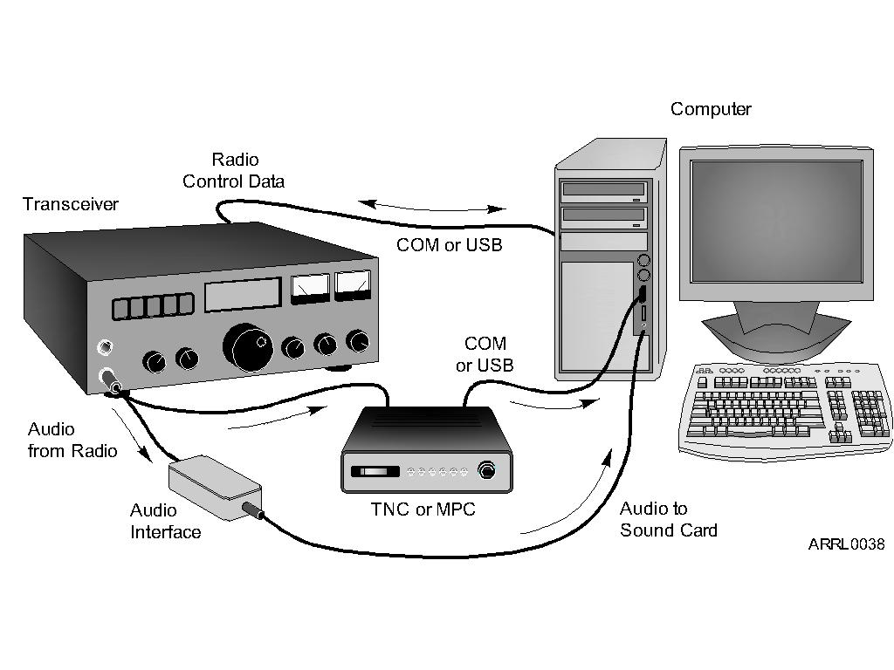
Data Station Setup
Notes:
Point out that a computer is an integral part of the amateur station and can be used for recordkeeping (logging, award tracking), sending and receiving CW, encoding and decoding digital modes, acting as a test instrument, controlling accessories, and more. (T4A02)

Slide 32
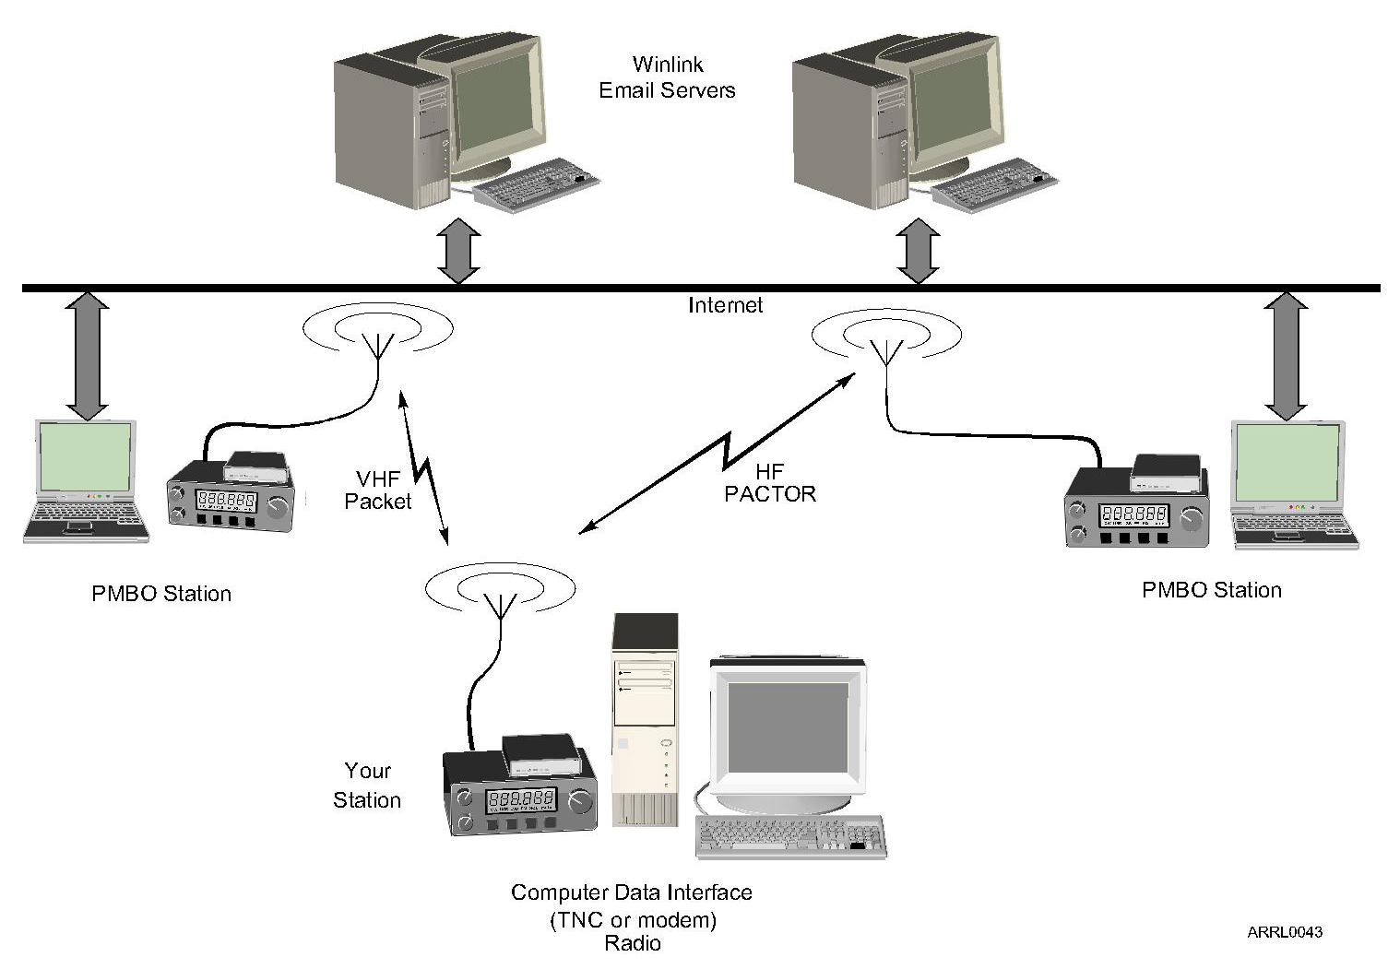
Internet Gateway
Notes:
Remind students that while the Internet and email can be accessed via ham radio, the rules prohibiting commercial traffic and content still apply. Ham radio is not for browsing the Internet! Email transferred via ham radio should never include commercial information, advertisements, etc.

Slide 33
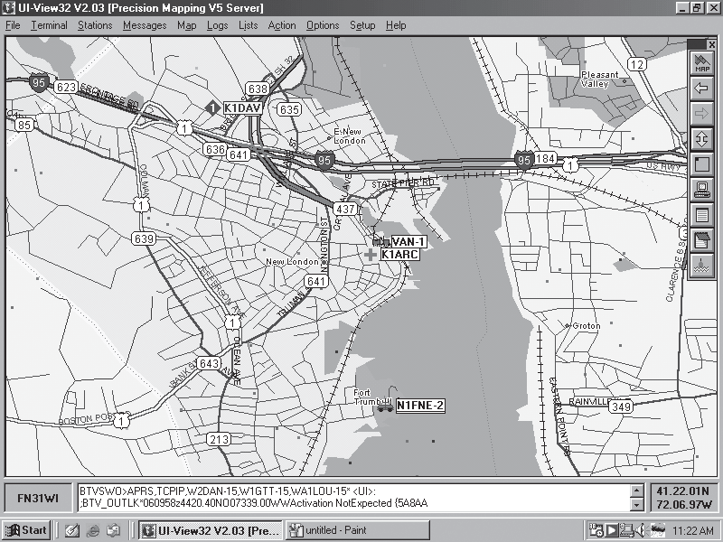
Automatic Position Reporting System (APRS)
Notes:
Explain the APRS system and how it sends data from a GPS receiver (sometimes built into the radio) via packet radio to Internet gateways. The data sent by a station can then be viewed on maps like the one on the slide. APRS is used in support of public service activities as well as for individual tracking. APRS can also be used to send text messages.

Slide 34
Practice Questions

Slide 35
Which of the following describes the muting of receiver audio controlled solely by the presence or absence of an RF signal?
A. Tone squelch
B. Carrier squelch
C. CTCSS
D. Modulated carrier
T2B03 HRLM (5-7)

Slide 36
Which of the following describes the muting of receiver audio controlled solely by the presence or absence of an RF signal?
A. Tone squelch
B. Carrier squelch
C. CTCSS
D. Modulated carrier
T2B03 HRLM (5-7)

Slide 37
Which of the following is true concerning the microphone connectors on amateur transceivers?
A. All transceivers use the same microphone connector type
B. Some connectors include push-to-talk and voltages for powering the microphone
C. All transceivers using the same connector type are wired identically
D. Un-keyed connectors allow any microphone to be connected
T4A01 HRLM (5-6)

Slide 38
Which of the following is true concerning the microphone connectors on amateur transceivers?
A. All transceivers use the same microphone connector type
B. Some connectors include push-to-talk and voltages for powering the microphone
C. All transceivers using the same connector type are wired identically
D. Un-keyed connectors allow any microphone to be connected
T4A01 HRLM (5-6)

Slide 39
How might a computer be used as part of an amateur radio station?
A. For logging contacts and contact information
B. For sending and/or receiving CW
C. For generating and decoding digital signals
D. All of these choices are correct
T4A02 HRLM (5-1)

Slide 40
How might a computer be used as part of an amateur radio station?
A. For logging contacts and contact information
B. For sending and/or receiving CW
C. For generating and decoding digital signals
D. All of these choices are correct
T4A02 HRLM (5-1)

Slide 41
Which of the following would be connected between a transceiver and computer in a packet radio station?
A. Transmatch
B. Mixer
C. Terminal node controller
D. Antenna
T4A06 HRLM (5-13)

Slide 42
Which of the following would be connected between a transceiver and computer in a packet radio station?
A. Transmatch
B. Mixer
C. Terminal node controller
D. Antenna
T4A06 HRLM (5-13)

Slide 43
How is a computer’s sound card used when conducting digital communications using a computer?
A. The sound card communicates between the computer CPU and the video display
B. The sound card records the audio frequency for video display
C. The sound card provides audio to the microphone input and converts received audio to digital form
D. All of these choices are correct
T4A07 HRLM (5-13)

Slide 44
How is a computer’s sound card used when conducting digital communications using a computer?
A. The sound card communicates between the computer CPU and the video display
B. The sound card records the audio frequency for video display
C. The sound card provides audio to the microphone input and converts received audio to digital form
D. All of these choices are correct
T4A07 HRLM (5-13)

Slide 45
What may happen if a transmitter is operated with the microphone gain set too high?
A. The output power might be too high
B. The output signal might become distorted
C. The frequency might vary
D. The SWR might increase
T4B01 HRLM (5-4)

Slide 46
What may happen if a transmitter is operated with the microphone gain set too high?
A. The output power might be too high
B. The output signal might become distorted
C. The frequency might vary
D. The SWR might increase
T4B01 HRLM (5-4)

Slide 47
Which of the following can be used to enter the operating frequency on a modern transceiver?
A. The keypad or VFO knob
B. The CTCSS or DTMF encoder
C. The Automatic Frequency Control
D. All of these choices are correct
T4B02 HRLM (5-2)

Slide 48
Which of the following can be used to enter the operating frequency on a modern transceiver?
A. The keypad or VFO knob
B. The CTCSS or DTMF encoder
C. The Automatic Frequency Control
D. All of these choices are correct
T4B02 HRLM (5-2)

Slide 49
What is the purpose of the squelch control on a transceiver?
A. To set the highest level of volume desired
B. To set the transmitter power level
C. To adjust the Automatic Gain Control
D. To mute receiver output noise when no signal is being received
T4B03 HRLM (5-7)

Slide 50
What is the purpose of the squelch control on a transceiver?
A. To set the highest level of volume desired
B. To set the transmitter power level
C. To adjust the Automatic Gain Control
D. To mute receiver output noise when no signal is being received
T4B03 HRLM (5-7)

Slide 51
What is a way to enable quick access to a favorite frequency on your transceiver?
A. Enable the CTCSS tones
B. Store the frequency in a memory channel
C. Disable the CTCSS tones
D. Use the scan mode to select the desired frequency
T4B04 HRLM (5-2)

Slide 52
What is a way to enable quick access to a favorite frequency on your transceiver?
A. Enable the CTCSS tones
B. Store the frequency in a memory channel
C. Disable the CTCSS tones
D. Use the scan mode to select the desired frequency
T4B04 HRLM (5-2)

Slide 53
Which of the following would reduce ignition interference to a receiver?
A. Change frequency slightly
B. Decrease the squelch setting
C. Turn on the noise blanker
D. Use the RIT control
T4B05 HRLM (5-7)

Slide 54
Which of the following would reduce ignition interference to a receiver?
A. Change frequency slightly
B. Decrease the squelch setting
C. Turn on the noise blanker
D. Use the RIT control
T4B05 HRLM (5-7)

Slide 55
Which of the following controls could be used if the voice pitch of a single-sideband signal seems too high or low?
A. The AGC or limiter
B. The bandwidth selection
C. The tone squelch
D. The receiver RIT or clarifier
T4B06 HRLM (5-7)

Slide 56
Which of the following controls could be used if the voice pitch of a single-sideband signal seems too high or low?
A. The AGC or limiter
B. The bandwidth selection
C. The tone squelch
D. The receiver RIT or clarifier
T4B06 HRLM (5-7)

Slide 57
What does the term "RIT" mean?
A. Receiver Input Tone
B. Receiver Incremental Tuning
C. Rectifier Inverter Test
D. Remote Input Transmitter
T4B07 HRLM (5-7)

Slide 58
What does the term "RIT" mean?
A. Receiver Input Tone
B. Receiver Incremental Tuning
C. Rectifier Inverter Test
D. Remote Input Transmitter
T4B07 HRLM (5-7)

Slide 59
What is the advantage of having multiple receive bandwidth choices on a multimode transceiver?
A. Permits monitoring several modes at once
B. Permits noise or interference reduction by selecting a bandwidth matching the mode
C. Increases the number of frequencies that can be stored in memory
D. Increases the amount of offset between receive and transmit frequencies
T4B08 HRLM (5-7)

Slide 60
What is the advantage of having multiple receive bandwidth choices on a multimode transceiver?
A. Permits monitoring several modes at once
B. Permits noise or interference reduction by selecting a bandwidth matching the mode
C. Increases the number of frequencies that can be stored in memory
D. Increases the amount of offset between receive and transmit frequencies
T4B08 HRLM (5-7)

Slide 61
Which of the following is an appropriate receive filter bandwidth to select in order to minimize noise and interference for SSB reception?
A. 500 Hz
B. 1000 Hz
C. 2400 Hz
D. 5000 Hz
T4B09 HRLM (5-7)

Slide 62
Which of the following is an appropriate receive filter bandwidth to select in order to minimize noise and interference for SSB reception?
A. 500 Hz
B. 1000 Hz
C. 2400 Hz
D. 5000 Hz
T4B09 HRLM (5-7)

Slide 63
Which of the following is an appropriate receive filter bandwidth to select in order to minimize noise and interference for CW reception?
A. 500 Hz
B. 1000 Hz
C. 2400 Hz
D. 5000 Hz
T4B10 HRLM (5-7)

Slide 64
Which of the following is an appropriate receive filter bandwidth to select in order to minimize noise and interference for CW reception?
A. 500 Hz
B. 1000 Hz
C. 2400 Hz
D. 5000 Hz
T4B10 HRLM (5-7)

Slide 65
What is the function of automatic gain control or AGC?
A. To keep received audio relatively constant
B. To protect an antenna from lightning
C. To eliminate RF on the station cabling
D. an asymmetric goniometer control used for antenna matching
T4B12 HRLM (5-7)

Slide 66
What is the function of automatic gain control or AGC?
A. To keep received audio relatively constant
B. To protect an antenna from lightning
C. To eliminate RF on the station cabling
D. an asymmetric goniometer control used for antenna matching
T4B12 HRLM (5-7)

Slide 67
What is meant by the term "PTT"?
A. Pre-transmission tuning to reduce transmitter harmonic emission
B. Precise tone transmissions used to limit repeater access to only certain signals
C. A primary transformer tuner use to match antennas
D. The push to talk function which switches between receive and transmit
T7A07 HRLM (5-6)

Slide 68
What is meant by the term "PTT"?
A. Pre-transmission tuning to reduce transmitter harmonic emission
B. Precise tone transmissions used to limit repeater access to only certain signals
C. A primary transformer tuner use to match antennas
D. The push to talk function which switches between receive and transmit
T7A07 HRLM (5-6)

Slide 69
Which of the following devices is most useful for VHF weak-signal communication?
A. A quarter-wave vertical antenna
B. A multi-mode VHF transceiver
C. An omni-directional antenna
D. A mobile VHF FM transceiver
T7A09 HRLM (6-28)

Slide 70
Which of the following devices is most useful for VHF weak-signal communication?
A. A quarter-wave vertical antenna
B. A multi-mode VHF transceiver
C. An omni-directional antenna
D. A mobile VHF FM transceiver
T7A09 HRLM (6-28)

Slide 71
What device increases the low-power output from a handheld transceiver?
A. A voltage divider
B. An RF power amplifier
C. An impedance network
D. All of these choices are correct
T7A10 HRLM (5-8)

Slide 72
What device increases the low-power output from a handheld transceiver?
A. A voltage divider
B. An RF power amplifier
C. An impedance network
D. All of these choices are correct
T7A10 HRLM (5-8)

Slide 73
What can you do if you are told your FM handheld or mobile transceiver is over-deviating?
A. Talk louder into the microphone
B. Let the transceiver cool off
C. Change to a higher power level
D. Talk farther away from the microphone
T7B01 HRLM (5-4)

Slide 74
What can you do if you are told your FM handheld or mobile transceiver is over-deviating?
A. Talk louder into the microphone
B. Let the transceiver cool off
C. Change to a higher power level
D. Talk farther away from the microphone
T7B01 HRLM (5-4)

Slide 75
What name is given to an amateur radio station that is used to connect other amateur stations to the Internet?
A. A gateway
B. A repeater
C. A digipeater
D. A beacon
T8C11 HRLM (5-14)

Slide 76
What name is given to an amateur radio station that is used to connect other amateur stations to the Internet?
A. A gateway
B. A repeater
C. A digipeater
D. A beacon
T8C11 HRLM (5-14)

Slide 77
Which of the following is an example of a digital communications method?
A. Packet
B. PSK31
C. MFSK
D. All of these choices are correct
T8D01 HRLM (5-9)

Slide 78
Which of the following is an example of a digital communications method?
A. Packet
B. PSK31
C. MFSK
D. All of these choices are correct
T8D01 HRLM (5-9)

Slide 79
What does the term APRS mean?
A. Automatic Packet Reporting System
B. Associated Public Radio Station
C. Auto Planning Radio Set-up
D. Advanced Polar Radio System
T8D02 HRLM (5-11)

Slide 80
What does the term APRS mean?
A. Automatic Packet Reporting System
B. Associated Public Radio Station
C. Auto Planning Radio Set-up
D. Advanced Polar Radio System
T8D02 HRLM (5-11)

Slide 81
Which of the following devices provides data to the transmitter when sending automatic position reports from a mobile amateur radio station?
A. The vehicle speedometer
B. A WWV receiver
C. A connection to a broadcast FM sub-carrier receiver
D. A Global Positioning System receiver
T8D03 HRLM (5-11)

Slide 82
Which of the following devices provides data to the transmitter when sending automatic position reports from a mobile amateur radio station?
A. The vehicle speedometer
B. A WWV receiver
C. A connection to a broadcast FM sub-carrier receiver
D. A Global Positioning System receiver
T8D03 HRLM (5-11)

Slide 83
Which of the following is an application of APRS (Automatic Packet Reporting System)?
A. Providing real time tactical digital communications in conjunction with a map showing the locations of stations
B. Showing automatically the number of packets transmitted via PACTOR during a specific time interval
C. Providing voice over Internet connection between repeaters
D. Providing information on the number of stations signed into a repeater
T8D05 HRLM (5-11)

Slide 84
Which of the following is an application of APRS (Automatic Packet Reporting System)?
A. Providing real time tactical digital communications in conjunction with a map showing the locations of stations
B. Showing automatically the number of packets transmitted via PACTOR during a specific time interval
C. Providing voice over Internet connection between repeaters
D. Providing information on the number of stations signed into a repeater
T8D05 HRLM (5-11)

Slide 85
What does the abbreviation PSK mean?
A. Pulse Shift Keying
B. Phase Shift Keying
C. Packet Short Keying
D. Phased Slide Keying
T8D06 HRLM (5-11)

Slide 86
What does the abbreviation PSK mean?
A. Pulse Shift Keying
B. Phase Shift Keying
C. Packet Short Keying
D. Phased Slide Keying
T8D06 HRLM (5-11)

Slide 87
What is PSK31?
A. A high-rate data transmission mode
B. A method of reducing noise interference to FM signals
C. A method of compressing digital television signals
D. A low-rate data transmission mode
T8D07 HRLM (5-11)

Slide 88
What is PSK31?
A. A high-rate data transmission mode
B. A method of reducing noise interference to FM signals
C. A method of compressing digital television signals
D. A low-rate data transmission mode
T8D07 HRLM (5-11)

Slide 89
Which of the following may be included in packet transmissions?
A. A check sum which permits error detection
B. A header which contains the call sign of the station to which the information is being sent
C. Automatic repeat request in case of error
D. All of these choices are correct
T8D08 HRLM (5-10)

Slide 90
Which of the following may be included in packet transmissions?
A. A check sum which permits error detection
B. A header which contains the call sign of the station to which the information is being sent
C. Automatic repeat request in case of error
D. All of these choices are correct
T8D08 HRLM (5-10)

Slide 91
What code is used when sending CW in the amateur bands?
A. Baudot
B. Hamming
C. International Morse
D. Gray
T8D09 HRLM (5-9)

Slide 92
What code is used when sending CW in the amateur bands?
A. Baudot
B. Hamming
C. International Morse
D. Gray
T8D09 HRLM (5-9)

Slide 93
Which of the following can be used to transmit CW in the amateur bands?
A. Straight Key
B. Electronic Keyer
C. Computer Keyboard
D. All of these choices are correct
T8D10 HRLM (5-6)

Slide 94
Which of the following can be used to transmit CW in the amateur bands?
A. Straight Key
B. Electronic Keyer
C. Computer Keyboard
D. All of these choices are correct
T8D10 HRLM (5-6)

Slide 95
What is an ARQ transmission system?
A. A special transmission format limited to video signals
B. A system used to encrypt command signals to an amateur radio satellite
C. A digital scheme whereby the receiving station detects errors and sends a request to the sending station to retransmit the information
D. A method of compressing the data in a message so more information can be sent in a shorter time
T8D11 HRLM (5-10)

Slide 96
What is an ARQ transmission system?
A. A special transmission format limited to video signals
B. A system used to encrypt command signals to an amateur radio satellite
C. A digital scheme whereby the receiving station detects errors and sends a request to the sending station to retransmit the information
D. A method of compressing the data in a message so more information can be sent in a shorter time
T8D11 HRLM (5-10)

