Slide 1
Technician License Course Chapter 4
Lesson Plan Module 10 –
Practical Antennas

Slide 2
The Dipole
Most basic antenna
Total length is ½ wavelength (½ λ)
Usual construction:
Two equal halves of wire, rod, or tubing
Feed line connected in the middle
Length (in feet) usually estimated
468 / frequency (in MHz) – often too short
Notes:
Note that the 468/f formula is rarely right – start long (use 490/f, for example) and learn to adjust length to suit the specific installation.

Slide 3
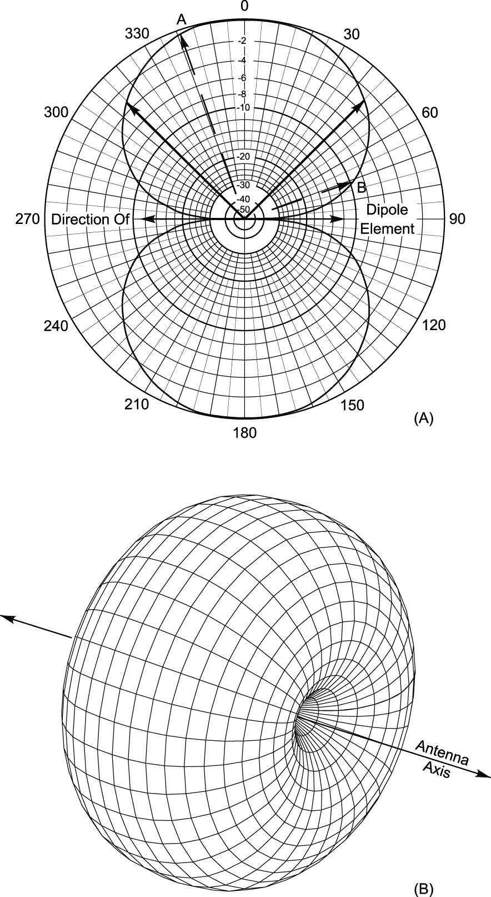
The Dipole
Radiates strongest broadside to the dipole, weakest off the ends
If oriented horizontally, the radiated waves are horizontally polarized
3D radiation pattern looks like a donut or bagel
This is a free-space picture
Notes:
Review radiation pattern if necessary. Discuss free-space as “absence of ground”.

Slide 4
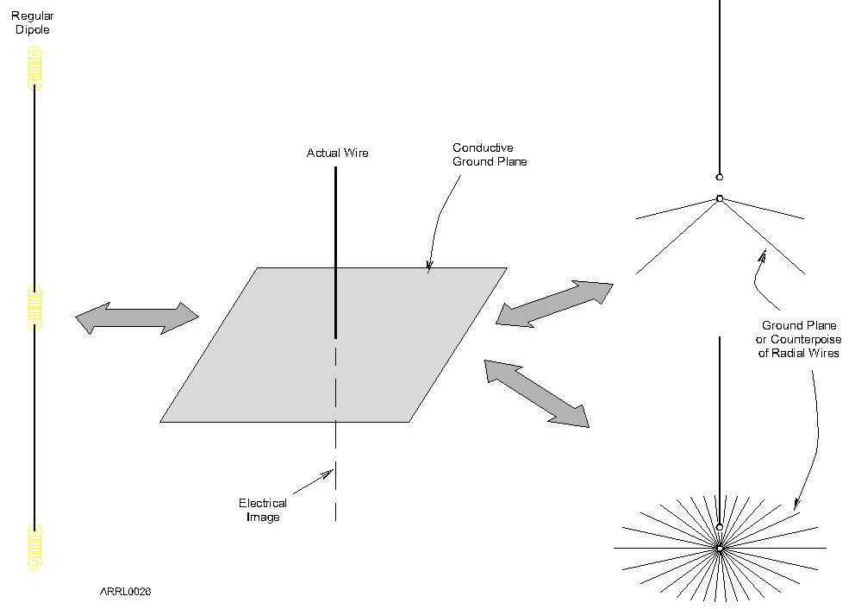
The Ground-Plane

Slide 5
The Ground-Plane
One-half of a dipole (1/4-wavelength long) oriented perpendicularly to a ground plane that acts as an “electrical mirror”
Replaces the dipole’s missing half
Any conducting surface can act as the ground-plane, including the ground!
Car roof or trunk, or other metal surface
Radial wires
Notes:
Show examples of ground-plane mag-mount antenna and maybe a homebrew ¼-wave whip for VHF/UHF.

Slide 6
The Rubber Duck
Coiled wire coated in tough plastic
Convenient size, rugged enough for handheld use
The radio and operator make up the ground plane
Small size equals compromise performance
Hold vertically to maximize range
Doesn’t work well inside vehicles due to metal body shielding signal
For mobile use, replace rubber duck with an external magnet-mount or permanent antenna
Notes:
Explain why the students will get better results from replacing a handheld’s rubber duck with a mag-mount or other external antenna whenever it is practical to do so.

Slide 7
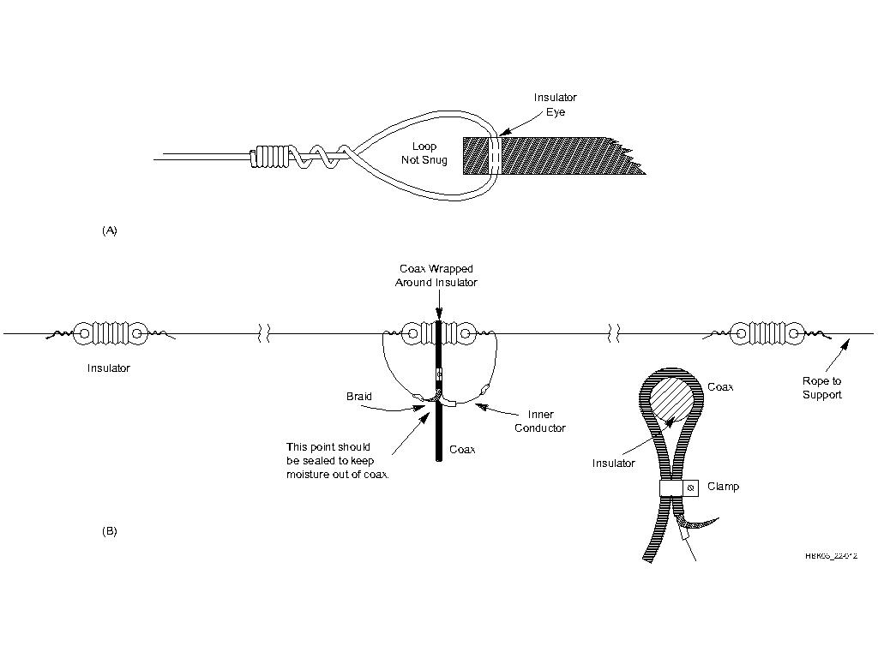
Dipole Construction
Start with excess length (490 / f) and adjust
To raise resonant frequency, shorten each half equally
Notes:
Mention that there are variations of the dipole antenna (inverted V, folded, off-center fed) and that there are advantages and disadvantages of each. Have a pre-made dipole and examples of insulators to show as examples.

Slide 8
Ground-Plane Construction
Length (in feet) usually estimated
234 / frequency (in MHz) – often short, start long and trim to length
Thickness of whip or rod also affects calculated length
Vertical ground-plane antennas are omni-directional
Mount mobile whips in center of roof or trunk for best coverage

Slide 9
Ground-Plane Construction
Lengthening a ¼-wavelength VHF/UHF ground-plane to ⁵/8 wavelengths focuses more signal toward the horizon which usually improves range.
At HF, vertical antenna size is quite large.
40 meter ¼-wavelength whip is about 32 feet
Inserting an inductor makes the antenna longer electrically
Reduces physical length required

Slide 10
Directional (Beam) Antennas
Beam antennas focus or direct RF energy in a desired direction.
Gain improves range
Reduces reception in unwanted directions
Reduces interference to and from other stations
Directional characteristics are the same for receiving as they are for transmitting.
Notes:
Go over the concept of gain again with the students and emphasize that there is no increase in power from the transmitter, only an apparent increase in power because the available power is focused or directed in the desired direction at the expense of that power that would have been transmitted in the un-desired directions.
Also note that the same is true when receiving signals. Noise and signals from unwanted directions are rejected.

Slide 11
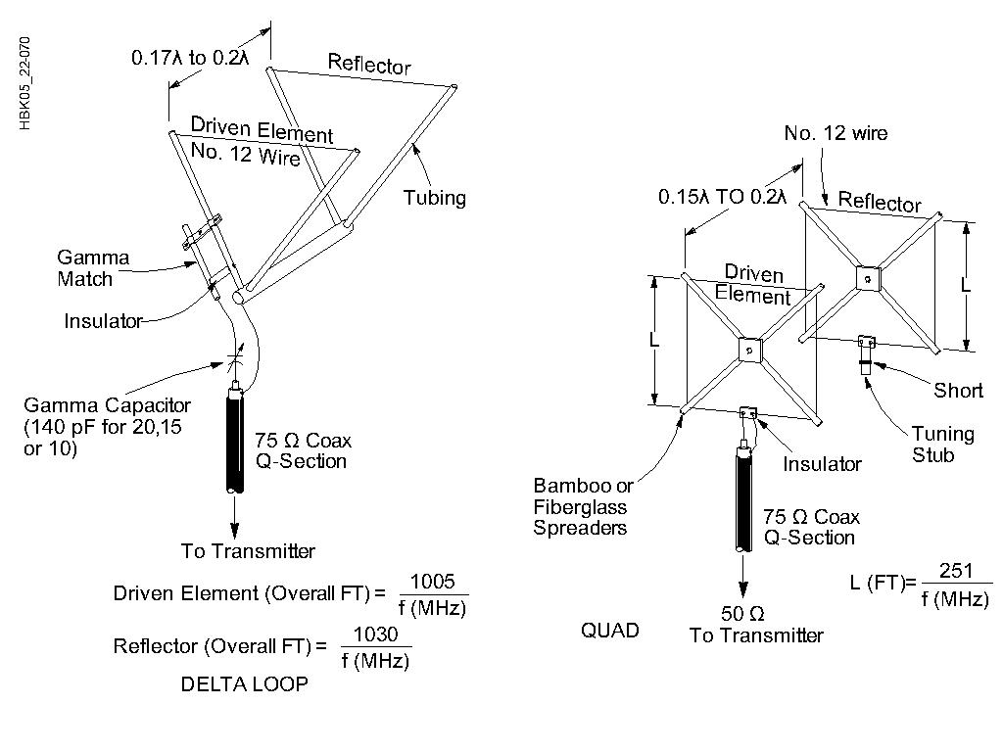
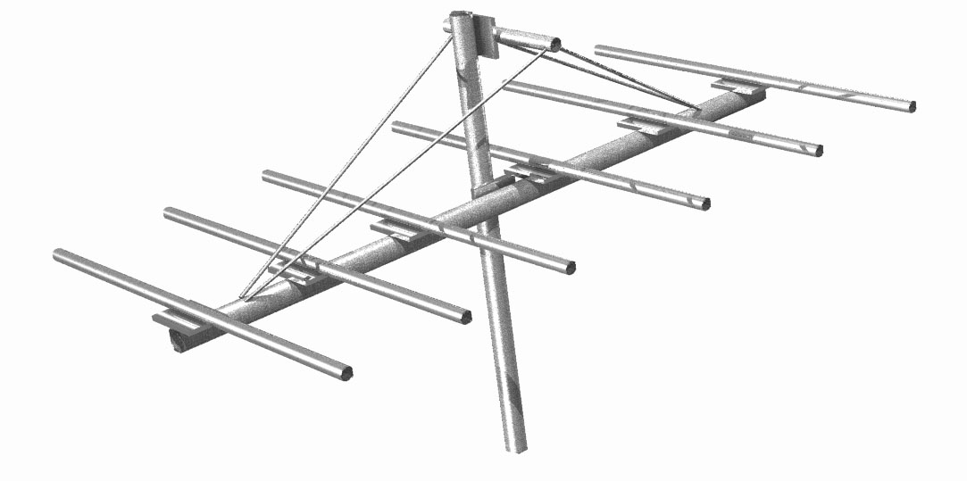
Directional (Beam) Antennas
Yagi
Quads
Notes:
Have on hand photos or examples of the two common beam antennas, Yagi and Quad to illustrate examples. A couple of QST or other ham magazines will have plenty of examples. Show the boom, driven element, and the parasitic elements (directors and reflectors).

Slide 12
Directional (Beam) Antennas
Used for “DXing” to obtain maximum range for contacts
Can be used at VHF/UHF to avoid multi-path and bypass obstructions
Use vertical elements for repeaters and FM simplex contacts
Use horizontal elements for CW and SSB contacts to reduce ground losses

Slide 13
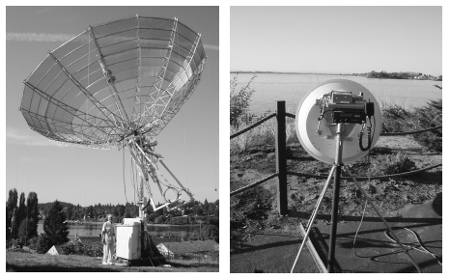
Directional (Beam) Antennas
At microwave frequencies (above 1 GHz) it becomes practical to use a dish antenna
Short wavelength
High gain
Small size
Notes:
Point out the big dish’s feed point above the surface of the dish. Explain that the dish uses a small feed antenna and a very large reflector – like a flashlight – to achieve focusing power and gain. The surface of the dish must be many wavelengths in diameter, making them impractical for amateurs below about 1 GHz.

Slide 14
Practical Feed Lines
Coaxial cables
Larger diameter cables have lower loss
Loss is measured in dB/foot
Loss increases with frequency
Keep water out! Protect the jacket from cuts and cracks and ultraviolet exposure.
Some cable is UV-rated
Notes:
Briefly discuss the purpose and application of each kind of feed line device that the students may encounter or read about in the literature. Physical examples of each type of feed line would be helpful during the presentation.

Slide 15
Common Coaxial Cables
RG-174: miniature, short connections only
RG-58: 0.2" OD, lossy at VHF/UHF
RG-8X: 0.25" OD, good through low VHF
RG-8/RG-213; 0.4" OD, used through UHF
Hard line: ½" to multiple inch OD, used through microwave
Most coax is 50 Ω or 75 Ω
Notes:
Go over the different types and grades of coax; examples to show would be helpful. Talk with the students about relative losses and power handling capabilities of each type of coax along with the price.

Slide 16
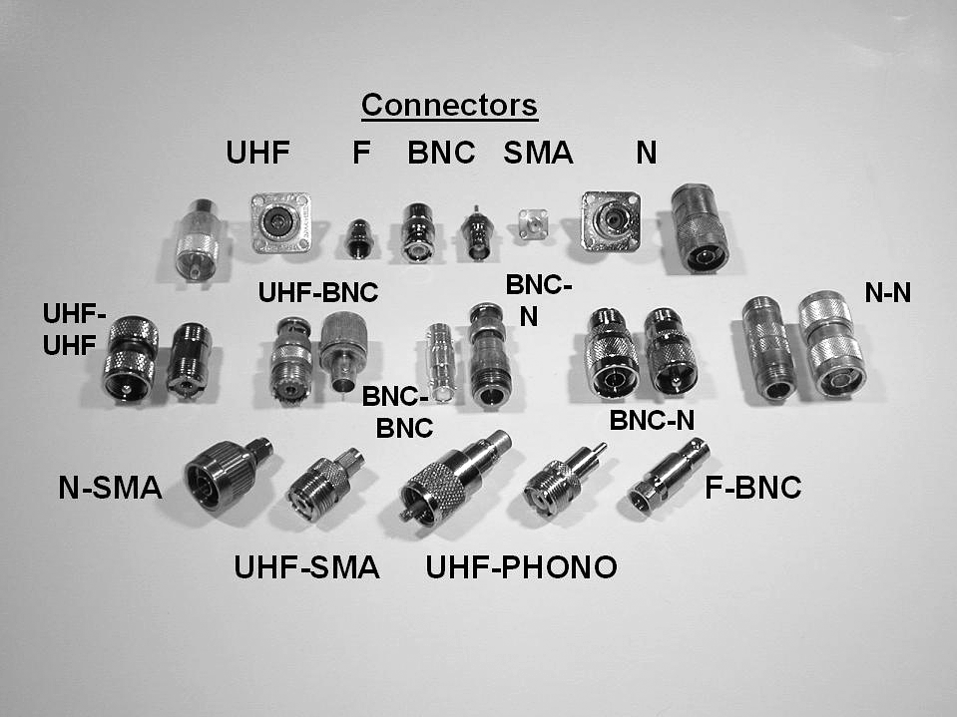
Coaxial Connectors
UHF
SO-239/PL-259
BNC
N
SMA
F (cable TV)
Notes:
Explain that there are connector “families” that all connect to each other, similarly to plumbing fittings. Explain what adapters are – also similar to plumbing.

Slide 17
Installing Coaxial Connectors
Soldering is the traditional way
Use rosin-core solder and avoid “cold” solder joints
See The Art of Soldering on the ARRL website
Crimp connectors are becoming widely used by hams
Obtain and learn to use proper crimping tools
Notes:
Show a soldered and a crimped PL-259.

Slide 18
Waterproofing Connectors
MUST be waterproofed for use outdoors
Type N are waterproof but still usually protected anyway
Use good-quality electrical tape first, then a layer of self-vulcanizing tape, then another covering of electrical tape
Air-core coaxial cable requires special connectors and techniques to waterproof
Notes:
Show a waterproofed PL-259/SO-239 connector or demonstrate the basic process.

Slide 19
Practical Feed Lines
Open-wire feed lines
Flexing will eventually break conductors
Vulnerable to abrasion and twisting
Rain, snow, and ice do affect the line
Lower loss than coax, generally
Higher impedance may complicate use
Notes:
Show examples of twinlead, window line, and plastic-covered ladder line.

Slide 20
Feed Line Equipment
Wattmeters
SWR Meters
Antenna Tuners
Antenna Analyzers
Notes:
Show physical examples of each device and give a short overview of the function of each.
Suggest that the SWR meter or antenna analyzer is probably one of the first pieces of test equipment they would want to add to their station. SWR meters are usually built in to HF transceivers and antenna tuners.

Slide 21
Wattmeters
Most wattmeters are directional
Sensitive to direction of power flow
Read forward and reflected power
Use a sensing element
SWR is computed from power values
Table or formula
Notes:
Relate SWR and forward/reflection power without getting into the equation. Note that higher reflected power means higher SWR. Wattmeters are generally more accurate (and more expensive) than SWR meters.

Slide 22
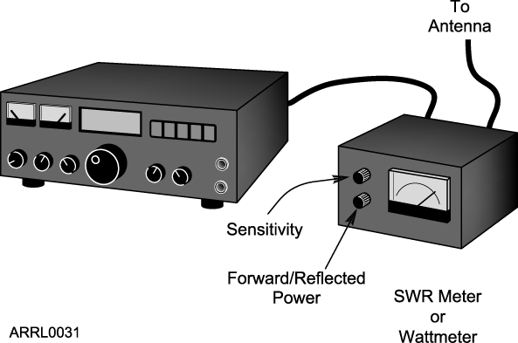
SWR Meters
Measure SWR directly by sensing power flow in the line
Usually installed at the transmitter
Notes:
SWR meters are really wattmeters in disguise but perform the calculation of SWR internally. The “calculation” can also be done as a meter’s calibrated scale.

Slide 23
Antenna Tuners
Don’t really “tune the antenna”
Transform impedances at the end of the feed line to 50 Ω which reduces SWR to 1:1
Antenna feed point impedance unchanged
Feed line SWR unchanged
Also called impedance matchers, transmatches, matchboxes, other trade names
Notes:
Talk about the “tune the antenna” misnomer so that students understand that the device is really an impedance converter not a “tuner.” Use the HRLM’s analogy of the gearbox as an impedance converter that changes one combination of torque and speed that make the engine happy to another combination to torque and speed that suit the wheels and road conditions.

Slide 24
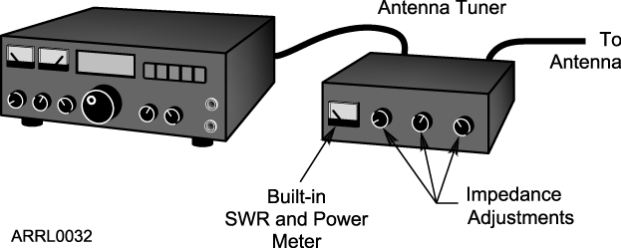
How to Use an Antenna Tuner
Transmit a low-power signal
Monitor the SWR meter
Adjust the tuner until minimum SWR is achieved

Slide 25
Antenna Analyzers
Low-power signal source, frequency counter, and SWR meter in one package
Makes antenna and cable measurements without transmitting a full-power signal
Available for HF through UHF and microwave
Very handy for adjusting and troubleshooting antennas and feed lines
Notes:
An antenna analyzer combines the SWR meter with the low-power signal source and frequency counter. This makes adjusting and troubleshooting far easier and more convenient than when using separate equipment at higher power.

Slide 26
Practice Questions

Slide 27
What antenna polarization is normally used for long-distance weak-signal CW and SSB contacts using the VHF and UHF bands?
A. Right-hand circular
B. Left-hand circular
C. Horizontal
D. Vertical
T3A03 HRLM (4-15)

Slide 28
What antenna polarization is normally used for long-distance weak-signal CW and SSB contacts using the VHF and UHF bands?
A. Right-hand circular
B. Left-hand circular
C. Horizontal
D. Vertical
T3A03 HRLM (4-15)

Slide 29
When using a directional antenna, how might your station be able to access a distant repeater if buildings or obstructions are blocking the direct line of sight path?
A. Change from vertical to horizontal polarization
B. Try to find a path that reflects signals to the repeater
C. Try the long path
D. Increase the antenna SWR
T3A05 HRLM (4-14)

Slide 30
When using a directional antenna, how might your station be able to access a distant repeater if buildings or obstructions are blocking the direct line of sight path?
A. Change from vertical to horizontal polarization
B. Try to find a path that reflects signals to the repeater
C. Try the long path
D. Increase the antenna SWR
T3A05 HRLM (4-14)

Slide 31
Where should an in-line SWR meter be connected to monitor the standing wave ratio of the station antenna system?
A. In series with the feed line, between the transmitter and antenna
B. In series with the stations ground
C. In parallel with the push-to-talk line and the antenna
D. In series with the power cable, as close as possible to the radio
T4A05 HRLM (4-18)

Slide 32
Where should an in-line SWR meter be connected to monitor the standing wave ratio of the station antenna system?
A. In series with the feed line, between the transmitter and antenna
B. In series with the stations ground
C. In parallel with the push-to-talk line and the antenna
D. In series with the power cable, as close as possible to the radio
T4A05 HRLM (4-18)

Slide 33
Which of the following instruments can be used to determine if an antenna is resonant at the desired operating frequency?
A. A VTVM
B. An antenna analyzer
C. A Q meter
D. A frequency counter
T7C02 HRLM (4-19)

Slide 34
Which of the following instruments can be used to determine if an antenna is resonant at the desired operating frequency?
A. A VTVM
B. An antenna analyzer
C. A Q meter
D. A frequency counter
T7C02 HRLM (4-19)

Slide 35
What instrument other than an SWR meter could you use to determine if a feed line and antenna are properly matched?
A. Voltmeter
B. Ohmmeter
C. Iambic pentameter
D. Directional wattmeter
T7C08 HRLM (4-18)

Slide 36
What instrument other than an SWR meter could you use to determine if a feed line and antenna are properly matched?
A. Voltmeter
B. Ohmmeter
C. Iambic pentameter
D. Directional wattmeter
T7C08 HRLM (4-18)

Slide 37
Which of the following is the most common cause for failure of coaxial cables?
A. Moisture contamination
B. Gamma rays
C. The velocity factor exceeds 1.0
D. Overloading
T7C09 HRLM (4-16)

Slide 38
Which of the following is the most common cause for failure of coaxial cables?
A. Moisture contamination
B. Gamma rays
C. The velocity factor exceeds 1.0
D. Overloading
T7C09 HRLM (4-16)

Slide 39
Why should the outer jacket of coaxial cable be resistant to ultraviolet light?
A. Ultraviolet resistant jackets prevent harmonic radiation
B. Ultraviolet light can increase losses in the cable’s jacket
C. Ultraviolet and RF signals can mix together, causing interference
D. Ultraviolet light can damage the jacket and allow water to enter the cable
T7C10 HRLM (4-16)

Slide 40
Why should the outer jacket of coaxial cable be resistant to ultraviolet light?
A. Ultraviolet resistant jackets prevent harmonic radiation
B. Ultraviolet light can increase losses in the cable’s jacket
C. Ultraviolet and RF signals can mix together, causing interference
D. Ultraviolet light can damage the jacket and allow water to enter the cable
T7C10 HRLM (4-16)

Slide 41
What is a disadvantage of air core coaxial cable when compared to foam or solid dielectric types?
A. It has more loss per foot
B. It cannot be used for VHF or UHF antennas
C. It requires special techniques to prevent water absorption
D. It cannot be used at below freezing temperatures
T7C11 HRLM (4-17)

Slide 42
What is a disadvantage of air core coaxial cable when compared to foam or solid dielectric types?
A. It has more loss per foot
B. It cannot be used for VHF or UHF antennas
C. It requires special techniques to prevent water absorption
D. It cannot be used at below freezing temperatures
T7C11 HRLM (4-17)

Slide 43
Which of the following is a common use of coaxial cable?
Carrying dc power from a vehicle battery to a mobile radio
Carrying RF signals between a radio and antenna
C. Securing masts, tubing, and other cylindrical objects on towers
D. Connecting data signals from a TNC to a computer
T7C12 HRLM (4-9)

Slide 44
Which of the following is a common use of coaxial cable?
Carrying dc power from a vehicle battery to a mobile radio
Carrying RF signals between a radio and antenna
C. Securing masts, tubing, and other cylindrical objects on towers
D. Connecting data signals from a TNC to a computer
T7C12 HRLM (4-9)

Slide 45
Which of the following types of solder is best for radio and electronic use?
A. Acid-core solder
B. Silver solder
C. Rosin-core solder
D. Aluminum solder
T7D08 HRLM (4-17)

Slide 46
Which of the following types of solder is best for radio and electronic use?
A. Acid-core solder
B. Silver solder
C. Rosin-core solder
D. Aluminum solder
T7D08 HRLM (4-17)

Slide 47
What is the characteristic appearance of a cold solder joint?
A. Dark black spots
B. A bright or shiny surface
C. A grainy or dull surface
D. A greenish tint
T7D09 HRLM (4-17)

Slide 48
What is the characteristic appearance of a cold solder joint?
A. Dark black spots
B. A bright or shiny surface
C. A grainy or dull surface
D. A greenish tint
T7D09 HRLM (4-17)

Slide 49
What is a beam antenna?
A. An antenna built from aluminum I-beams
B. An omnidirectional antenna invented by Clarence Beam
C. An antenna that concentrates signals in one direction
D. An antenna that reverses the phase of received signals
T9A01 HRLM (4-14)

Slide 50
What is a beam antenna?
A. An antenna built from aluminum I-beams
B. An omnidirectional antenna invented by Clarence Beam
C. An antenna that concentrates signals in one direction
D. An antenna that reverses the phase of received signals
T9A01 HRLM (4-14)

Slide 51
Which of the following describes a simple dipole mounted so the conductor is parallel to the Earth’s surface?
A. A ground wave antenna
B. A horizontally polarized antenna
C. A rhombic antenna
D. A vertically polarized antenna
T9A03 HRLM (4-11)

Slide 52
Which of the following describes a simple dipole mounted so the conductor is parallel to the Earth’s surface?
A. A ground wave antenna
B. A horizontally polarized antenna
C. A rhombic antenna
D. A vertically polarized antenna
T9A03 HRLM (4-11)

Slide 53
What is a disadvantage of the “rubber duck” antenna supplied with most handheld radio transceivers?
A. It does not transmit or receive as effectively as a full-sized antenna
B. It transmits a circularly polarized signal
C. If the rubber end cap is lost it will unravel very quickly
D. All of these choices are correct
T9A04 HRLM (4-13)

Slide 54
What is a disadvantage of the “rubber duck” antenna supplied with most handheld radio transceivers?
A. It does not transmit or receive as effectively as a full-sized antenna
B. It transmits a circularly polarized signal
C. If the rubber end cap is lost it will unravel very quickly
D. All of these choices are correct
T9A04 HRLM (4-13)

Slide 55
How would you change a dipole antenna to make it resonant on a higher frequency?
A. Lengthen it
B. Insert coils in series with radiating wires
C. Shorten it
D. Add capacitive loading to the ends of the radiating wires
T9A05 HRLM (4-12)

Slide 56
How would you change a dipole antenna to make it resonant on a higher frequency?
A. Lengthen it
B. Insert coils in series with radiating wires
C. Shorten it
D. Add capacitive loading to the ends of the radiating wires
T9A05 HRLM (4-12)

Slide 57
What type of antennas are the quad, Yagi, and dish?
A. Non-resonant antennas
B. Loop antennas
C. Directional antennas
D. Isotropic antennas
T9A06 HRLM (4-15)

Slide 58
What type of antennas are the quad, Yagi, and dish?
A. Non-resonant antennas
B. Loop antennas
C. Directional antennas
D. Isotropic antennas
T9A06 HRLM (4-15)

Slide 59
What is a good reason not to use a “rubber duck” antenna inside your car?
A. Signals can be significantly weaker than when it is outside of the vehicle
B. It might cause your radio to overheat
C. The SWR might decrease, decreasing the signal strength
D. All of these choices are correct
T9A07 HRLM (4-13)

Slide 60
What is a good reason not to use a “rubber duck” antenna inside your car?
A. Signals can be significantly weaker than when it is outside of the vehicle
B. It might cause your radio to overheat
C. The SWR might decrease, decreasing the signal strength
D. All of these choices are correct
T9A07 HRLM (4-13)

Slide 61
What is the approximate length, in inches, of a quarter-wavelength vertical antenna for 146 MHz?
A. 112
B. 50
C. 19
D. 12
T9A08 HRLM (4-11)

Slide 62
What is the approximate length, in inches, of a quarter-wavelength vertical antenna for 146 MHz?
A. 112
B. 50
C. 19
D. 12
T9A08 HRLM (4-11)

Slide 63
What is the approximate length, in inches, of a 6 meter 1/2-wavelength wire dipole antenna?
A. 6
B. 50
C. 112
D. 236
T9A09 HRLM (4-11)

Slide 64
What is the approximate length, in inches, of a 6 meter 1/2-wavelength wire dipole antenna?
A. 6
B. 50
C. 112
D. 236
T9A09 HRLM (4-11)

Slide 65
In which direction is the radiation strongest from a half-wave dipole antenna in free space?
A. Equally in all directions
B. Off the ends of the antenna
C. Broadside to the antenna
D. In the direction of the feed line
T9A10 HRLM (4-11)

Slide 66
In which direction is the radiation strongest from a half-wave dipole antenna in free space?
A. Equally in all directions
B. Off the ends of the antenna
C. Broadside to the antenna
D. In the direction of the feed line
T9A10 HRLM (4-11)

Slide 67
What is a reason to use a properly mounted 5/8 wavelength antenna for VHF or UHF mobile service?
A. It offers a lower angle of radiation than a 1/4 wavelength antenna and usually provides improved coverage
B. It features a very high angle of radiation and is better for communicating via a repeater
C. The 5/8 wavelength antenna completely eliminates distortion caused by reflected signals
D. The 5/8 wavelength antenna offers a 10-times power gain over a 1/4 wavelength design
T9A12 HRLM (4-13)

Slide 68
What is a reason to use a properly mounted 5/8 wavelength antenna for VHF or UHF mobile service?
A. It offers a lower angle of radiation than a 1/4 wavelength antenna and usually provides improved coverage
B. It features a very high angle of radiation and is better for communicating via a repeater
C. The 5/8 wavelength antenna completely eliminates distortion caused by reflected signals
D. The 5/8 wavelength antenna offers a 10-times power gain over a 1/4 wavelength design
T9A12 HRLM (4-13)

Slide 69
Why are VHF or UHF mobile antennas often mounted in the center of the vehicle roof?
A. Roof mounts have the lowest possible SWR of any mounting configuration
B. Only roof mounting can guarantee a vertically polarized signal
C. A roof mounted antenna normally provides the most uniform radiation pattern
D. Roof mounted antennas are always the easiest to install
T9A13 HRLM (4-13)

Slide 70
Why are VHF or UHF mobile antennas often mounted in the center of the vehicle roof?
A. Roof mounts have the lowest possible SWR of any mounting configuration
B. Only roof mounting can guarantee a vertically polarized signal
C. A roof mounted antenna normally provides the most uniform radiation pattern
D. Roof mounted antennas are always the easiest to install
T9A13 HRLM (4-13)

Slide 71
Which of the following terms describes a type of “loading” when referring to an antenna?
A. Inserting an inductor in the radiating portion of the antenna to make it electrically longer
B. Inserting a resistor in the radiating portion of the antenna to make it resonant
C. Installing a spring at the base of the antenna to absorb the effects of collisions with other objects
D. Making the antenna heavier so it will resist wind effects when in motion
T9A14 HRLM (4-13)

Slide 72
Which of the following terms describes a type of “loading” when referring to an antenna?
A. Inserting an inductor in the radiating portion of the antenna to make it electrically longer
B. Inserting a resistor in the radiating portion of the antenna to make it resonant
C. Installing a spring at the base of the antenna to absorb the effects of collisions with other objects
D. Making the antenna heavier so it will resist wind effects when in motion
T9A14 HRLM (4-13)

Slide 73
What does an antenna tuner do?
A. It matches the antenna system impedance to the transceiver's output impedance
B. It helps a receiver automatically tune in weak stations
C. It allows an antenna to be used on both transmit and receive
D. It automatically selects the proper antenna for the frequency band being used
T9B04 HRLM (4-18)

Slide 74
What does an antenna tuner do?
A. It matches the antenna system impedance to the transceiver's output impedance
B. It helps a receiver automatically tune in weak stations
C. It allows an antenna to be used on both transmit and receive
D. It automatically selects the proper antenna for the frequency band being used
T9B04 HRLM (4-18)

Slide 75
Which of the following connectors is most suitable for frequencies above 400 MHz?
A. A UHF (PL-259/SO-239) connector
B. A Type N connector
C. An RS-213 connector
D. A DB-25 connector
T9B06 HRLM (4-17)

Slide 76
Which of the following connectors is most suitable for frequencies above 400 MHz?
A. A UHF (PL-259/SO-239) connector
B. A Type N connector
C. An RS-213 connector
D. A DB-25 connector
T9B06 HRLM (4-17)

Slide 77
Which of the following is true of PL-259 type coax connectors?
A. They are preferred for microwave operation
B. They are water tight
C. The are commonly used at HF frequencies
D. They are a bayonet type connector
T9B07 HRLM (4-17)

Slide 78
Which of the following is true of PL-259 type coax connectors?
A. They are preferred for microwave operation
B. They are water tight
C. The are commonly used at HF frequencies
D. They are a bayonet type connector
T9B07 HRLM (4-17)

Slide 79
Why should coax connectors exposed to the weather be sealed against water intrusion?
A. To prevent an increase in feed line loss
B. To prevent interference to telephones
C. To keep the jacket from becoming loose
D. All of these choices are correct
T9B08 HRLM (4-17)

Slide 80
Why should coax connectors exposed to the weather be sealed against water intrusion?
A. To prevent an increase in feed line loss
B. To prevent interference to telephones
C. To keep the jacket from becoming loose
D. All of these choices are correct
T9B08 HRLM (4-17)

Slide 81
What electrical difference exists between the smaller RG-58 and larger RG-8 coaxial cables?
A. There is no significant difference between the two types
B. RG-58 cable has less loss at a given frequency
C. RG-8 cable has less loss at a given frequency
D. RG-58 cable can handle higher power levels
T9B10 HRLM (4-16)

Slide 82
What electrical difference exists between the smaller RG-58 and larger RG-8 coaxial cables?
A. There is no significant difference between the two types
B. RG-58 cable has less loss at a given frequency
C. RG-8 cable has less loss at a given frequency
D. RG-58 cable can handle higher power levels
T9B10 HRLM (4-16)

