Slide 1
RULES AND REGUALTIONS
Licensing Regulations

Slide 2
Background and concepts

Slide 3
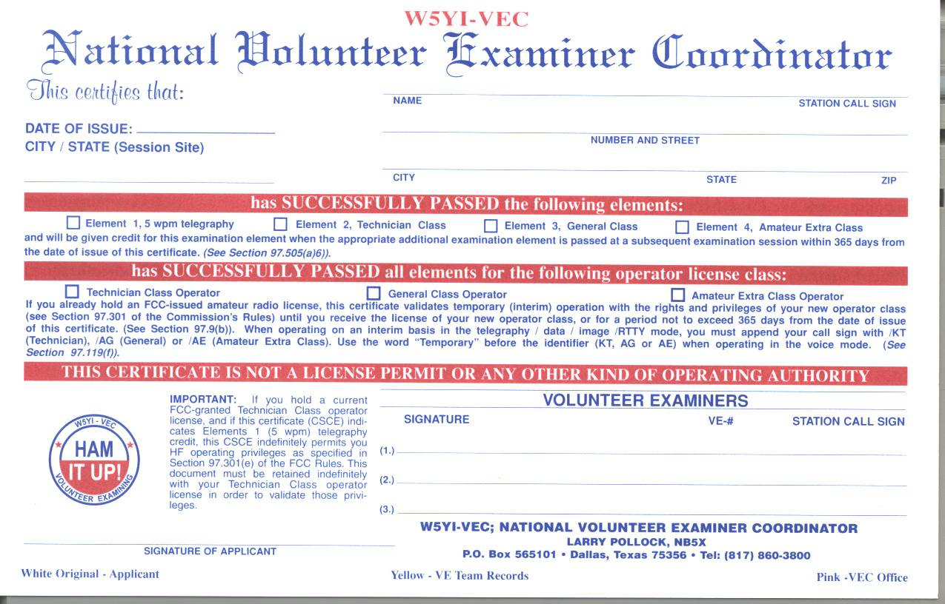
Certificate of Successful Completion (CSCE)
Valid for 365 Days
Notes:
The three current license classes that can be earned are visible in the middle. If you pass element 1, this is upgrade credit for 365 days but offers operating privileges forever. The three VE signature lines are visible on the bottom as is the issuing VEC organization (W5YI) across the top.

Slide 4
Wavelength vs Frequency
The distance a radio wave travels in one cycle is called wavelength
The number of cycles per second is frequency
The maximum displacement of wave from reference value is amplitude
V+
One Cycle
Amplitude
0V
Time
V-
One Wavelength

Slide 5
Frequency to Wavelength Conversion
To convert from frequency to wavelength in meters:
300
Freq (MHz)
Wavelength =
Frequency and wavelength are inversely proportional – as one increases, the other decreases
Longer (wavelength) – Lower (frequency)

Slide 6
Technician HF Privileges
28 28.100 28.300 28.500 29.0 29.7
 | CW & Data | CW & SSB
10m
21 21.100 21.200 21.450
 | CW Only
15m
7 7.100 7.150 7.300
 | CW Only
40m
3.5 3.675 3.725 4.0
 | CW Only
80m
Legend | Technician + HF CW
 | Technician + HF Voice (SSB)
Notes
This information does not appear in the Technician exam
Technician Licensees may use up to 1500 watts PEP above 50 MHz.
Technician Licensees may use up to 1500 watts PEP and 200 watts PEP on the HF bands
Notes:
This information is not on the Technician exam

Slide 7
2300 2310 2390 2450
13cm
1240 1300
23cm
902 928
33cm
420 430 435 438 450
Not Available North of Line A |  | Satellite
70cm
70cm - 5 MHz repeater frequency separation (Split)
219 220 222 225
Point to Point Digital Links
1.25m
144 144.1 148
CW
2m
2m - 600 kHz repeater frequency separation (Split)
50 50.1 54
CW
6m
 Technicians Have All Privileges On The Above Bands 
Notes:
The FCC has mandated the areas colored (other than blue) to specific purposes. The remaining areas are divided by the amateur community into a band plan to insure most effective use of the spectrum and minimize interference. This band plan is not law but voluntary. If the FCC does get involved in a dispute, they will use the local band plan as a means to resolve the dispute.

Slide 8
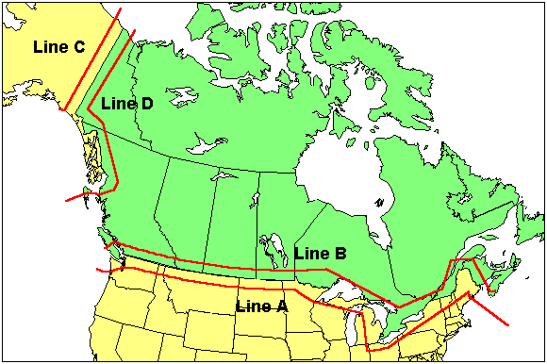
FCC Line A
Notes:
This information is not on the test. It is only provided because it’s relevant to Seattle amateurs

Slide 9
FCC Part 97
  Title 47 governs all Telecommunicatons in the US
    There are 301 parts (Part 0-300)
  Part 97 applies to Amateur Radio
  Copies available at: http://www.arrl.org/FandES/field/regulations/rules-reg.html
  http://www.fcc.gov

Slide 10
FCC Universal License System
  Online License Service http://wireless.fcc.gov/uls/
  Tracks all FCC License Applications and Licensees
  When your license shows up here, you’re legal

Slide 11
Callsign Groups
All valid US Callsigns start with A, K, N or W
and contain a digit 0-9
Group A | 1x2, 2x1 W1AW, KU7M
Group B | 2x2 KK7LK
Group C | 1x3 N7WSU
Group D | 2x3 KB7PJM
Notes:
There are no more Group A or B callsigns issued automatically in any call district. All new licenses are either class C or D. In the 7 call district, the new callsigns will be class D.

Slide 12
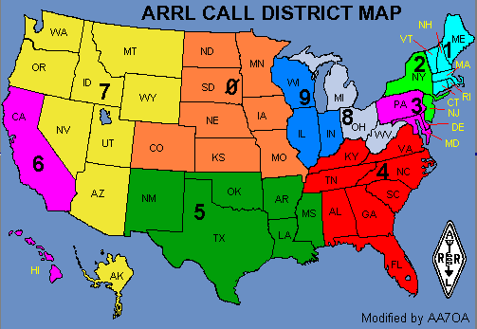
US Call Districts

Slide 13
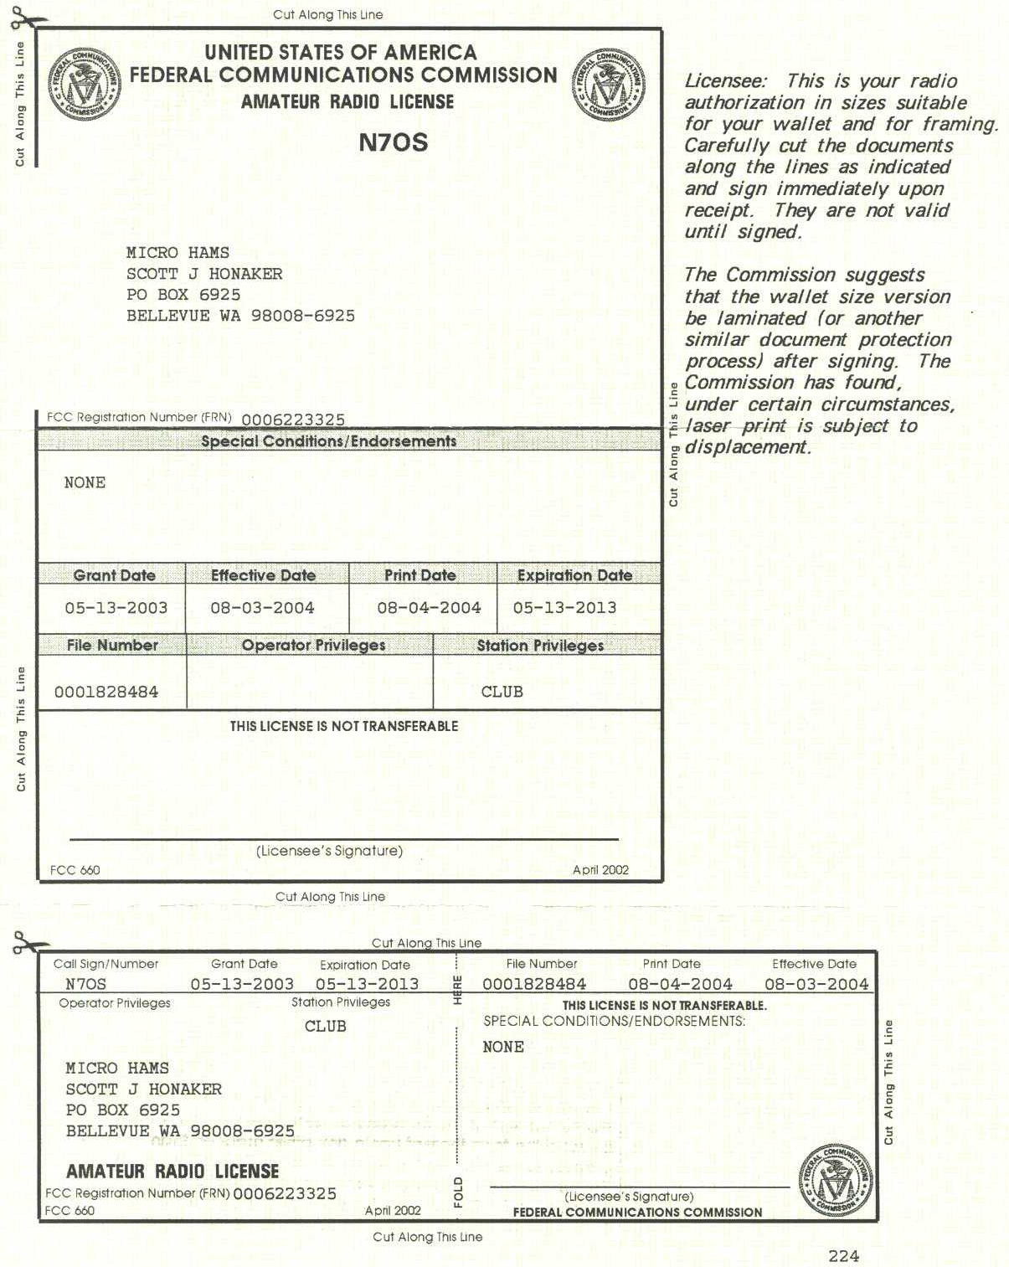
FCC Amateur License
N7OS is a Club Vanity License

Slide 14
Definitions
Regulatory Body – FCC rules are defined in Part 97
Amateur Service – A radio communication service, carried out by authorized individuals without pecuniary interest
Amateur Operator – A person granted a license for amateur service
Amateur Station – A station licensed for Amateur Service
Amateur Space Station – An amateur station over 50KM high
Unidentified Communications – Communications from an unidentified source
Interference – Unwanted signals that disrupt other communications
Notes:
An Amateur License is two licenses: Operator license and a Station license

Slide 15
Five Fundamental Purposes of Ham Radio
  1. Recognition and enhancement of the value of the amateur service to the public as a voluntary noncommercial communication service, particularly with respect to providing emergency communications.
  2. Continuation and extension of the amateur’s proven ability to contribute to the advancement of the radio art.
  3. Encouragement and improvement of the amateur service through rules which provide for advancing skills in both the communications and technical phases of the art.
  4. Expansion of the existing reservoir within the amateur radio service of trained operators, technicians, and electronics experts.
  5. Continuation and extension of the amateur’s unique ability to enhance international goodwill.

Slide 16
T1A01 Which of the following is a purpose of the Amateur Radio Service as stated in the FCC rules and regulations?
A. Providing personal radio communications for as many citizens as possible
B. Providing communications for international non-profit organizations
C. Advancing skills in the technical and communication phases of the radio art
D. All of these choices are correct

Slide 17
T1A01 Which of the following is a purpose of the Amateur Radio Service as stated in the FCC rules and regulations?
A. Providing personal radio communications for as many citizens as possible
B. Providing communications for international non-profit organizations
C. Advancing skills in the technical and communication phases of the radio art
D. All of these choices are correct

Slide 18
T1A02 Which agency regulates and enforces the rules for the Amateur Radio Service in the United States?
A. FEMA
B. The ITU
C. The FCC
D. Homeland Security

Slide 19
T1A02 Which agency regulates and enforces the rules for the Amateur Radio Service in the United States?
A. FEMA
B. The ITU
C. The FCC
D. Homeland Security

Slide 20
T1A03 Which part of the FCC regulations contains the rules governing the Amateur Radio Service?
A. Part 73
B. Part 95
C. Part 90
D. Part 97

Slide 21
T1A03 Which part of the FCC regulations contains the rules governing the Amateur Radio Service?
A. Part 73
B. Part 95
C. Part 90
D. Part 97

Slide 22
T1A05 Which of the following is a purpose of the Amateur Radio Service rules and regulations as defined by the FCC?
A. Enhancing international goodwill
B. Providing inexpensive communication for local emergency organizations
C. Training of operators in military radio operating procedures
D. All of these choices are correct

Slide 23
T1A05 Which of the following is a purpose of the Amateur Radio Service rules and regulations as defined by the FCC?
A. Enhancing international goodwill
B. Providing inexpensive communication for local emergency organizations
C. Training of operators in military radio operating procedures
D. All of these choices are correct

Slide 24
T1A10 What is the FCC Part 97 definition of an amateur station?
A. A station in the Amateur Radio Service consisting of the apparatus necessary for carrying on radio communications
B. A building where Amateur Radio receivers, transmitters, and RF power amplifiers are installed
C. Any radio station operated by a non-professional
D. Any radio station for hobby use

Slide 25
T1A10 What is the FCC Part 97 definition of an amateur station?
A. A station in the Amateur Radio Service consisting of the apparatus necessary for carrying on radio communications
B. A building where Amateur Radio receivers, transmitters, and RF power amplifiers are installed
C. Any radio station operated by a non-professional
D. Any radio station for hobby use

Slide 26
T1A12 Which of the following is a permissible use of the Amateur Radio Service?
A. Broadcasting music and videos to friends
B. Providing a way for amateur radio operators to earn additional income by using their stations to pass messages
C. Providing low-cost communications for start-up businesses
D. Allowing a person to conduct radio experiments and to communicate with other licensed hams around the world

Slide 27
T1A12 Which of the following is a permissible use of the Amateur Radio Service?
A. Broadcasting music and videos to friends
B. Providing a way for amateur radio operators to earn additional income by using their stations to pass messages
C. Providing low-cost communications for start-up businesses
D. Allowing a person to conduct radio experiments and to communicate with other licensed hams around the world

Slide 28
T1C08 What is the normal term for an FCC-issued primary station/operator amateur radio license grant?
A. Five years
B. Life
C. Ten years
D. Twenty years

Slide 29
T1C08 What is the normal term for an FCC-issued primary station/operator amateur radio license grant?
A. Five years
B. Life
C. Ten years
D. Twenty years

Slide 30
T1C09 What is the grace period following the expiration of an amateur license within which the license may be renewed?
  A. Two years
  B. Three years
  C. Five years
  D. Ten years

Slide 31
T1C09 What is the grace period following the expiration of an amateur license within which the license may be renewed?
A. Two years
  B. Three years
  C. Five years
  D. Ten years

Slide 32
T1C10 How soon after passing the examination for your first amateur radio license may you operate a transmitter on an amateur service frequency?
A. Immediately
B. 30 days after the test date
C. As soon as your operator/station license grant appears in the FCC’s license database
D. You must wait until you receive your license in the mail from the FCC
years

Slide 33
T1C10 How soon after passing the examination for your first amateur radio license may you operate a transmitter on an amateur service frequency?
A. Immediately
B. 30 days after the test date
C. As soon as your operator/station license grant appears in the FCC’s license database
D. You must wait until you receive your license in the mail from the FCC

Slide 34
T1C11 If your license has expired and is still within the allowable grace period, may you continue to operate a transmitter on amateur service frequencies
A. No, transmitting is not allowed until the FCC license database shows that the license has been renewed
B. Yes, but only if you identify using the suffix GP
C. Yes, but only during authorized nets
D. Yes, for up to two years

Slide 35
T1C11 If your license has expired and is still within the allowable grace period, may you continue to operate a transmitter on amateur service frequencies
A. No, transmitting is not allowed until the FCC license database shows that the license has been renewed
B. Yes, but only if you identify using the suffix GP
C. Yes, but only during authorized nets
D. Yes, for up to two years

Slide 36
T1C07 What may result when correspondence from the FCC is returned as undeliverable because the grantee failed to provide the correct mailing address?
  A. Fine or imprisonment
  B. Revocation of the station license or suspension of the operator license
  C. Require the licensee to be re-examined
  D. A reduction of one rank in operator class

Slide 37
T1C07 What may result when correspondence from the FCC is returned as undeliverable because the grantee failed to provide the correct mailing address?
  A. Fine or imprisonment
B. Revocation of the station license or suspension of the operator license
  C. Require the licensee to be re-examined
  D. A reduction of one rank in operator class

Slide 38
T1F13 When must the station licensee make the station and its records available for FCC inspection?
A. At any time ten days after notification by the FCC of such an inspection
B. At any time upon request by an FCC representative
C. Only after failing to comply with an FCC notice of violation
D. Only when presented with a valid warrant by an FCC official or government agent

Slide 39
T1F13 When must the station licensee make the station and its records available for FCC inspection?
A. At any time ten days after notification by the FCC of such an inspection
B. At any time upon request by an FCC representative
C. Only after failing to comply with an FCC notice of violation
D. Only when presented with a valid warrant by an FCC official or government agent

Slide 40
T1B03 Which frequency is within the 6 meter band?
  A. 49.00 MHz
  B. 52.525 MHz
  C. 28.50 MHz
  D. 222.15 MHz

Slide 41
T1B03 Which frequency is within the 6 meter band?
  A. 49.00 MHz
B. 52.525 MHz
  C. 28.50 MHz
  D. 222.15 MHz

Slide 42
T1B04 Which amateur band are you using when your station is transmitting on 146.52 MHz?
  A. 2 meter band
  B. 20 meter band
  C. 14 meter band
  D. 6 meter band

Slide 43
T1B04 Which amateur band are you using when your station is transmitting on 146.52 MHz?
A. 2 meter band
  B. 20 meter band
  C. 14 meter band
  D. 6 meter band

Slide 44
T1B05 Which 70 cm frequency is authorized to a Technician Class license holder operating in ITU Region 2?
  A. 53.350 MHz
  B. 146.520 MHz
  C. 443.350 MHz
  D. 222.520 MHz

Slide 45
T1B05 Which 70 cm frequency is authorized to a Technician Class license holder operating in ITU Region 2?
  A. 53.350 MHz
  B. 146.520 MHz
C. 443.350 MHz
  D. 222.520 MHz

Slide 46
T1B06 Which 23 cm frequency is authorized to a Technician Class licensee?
A. 2315 MHz
B. 1296 MHz
C. 3390 MHz
D. 146.52 MHz

Slide 47
T1B06 Which 23 cm frequency is authorized to a Technician Class licensee?
A. 2315 MHz
B. 1296 MHz
C. 3390 MHz
D. 146.52 MHz

Slide 48
T1B07 What amateur band are you using if you are transmitting on 223.50 MHz?
  A. 15 meter band
  B. 10 meter band
  C. 2 meter band
  D. 1.25 meter band

Slide 49
T1B07 What amateur band are you using if you are transmitting on 223.50 MHz?
  A. 15 meter band
  B. 10 meter band
  C. 2 meter band
D. 1.25 meter band

Slide 50
T1B10 Which of the bands above 30 MHz that are available to Technician Class operators have mode-restricted sub-bands?
A. The 6 meter, 2 meter, and 70 cm bands
B. The 2 meter and 13 cm bands
C. The 6 meter, 2 meter, and 1.25 meter bands
D. The 2 meter and 70 cm bands

Slide 51
T1B10 Which of the bands above 30 MHz that are available to Technician Class operators have mode-restricted sub-bands?
A. The 6 meter, 2 meter, and 70 cm bands
B. The 2 meter and 13 cm bands
C. The 6 meter, 2 meter, and 1.25 meter bands
D. The 2 meter and 70 cm bands

Slide 52
T1B11 What emission modes are permitted in the mode-restricted sub-bands at 50.0 to 50.1 MHz and 144.0 to 144.1 MHz?
  A. CW only
  B. CW and RTTY
  C. SSB only
  D. CW and SSB

Slide 53
T1B11 What emission modes are permitted in the mode-restricted sub-bands at 50.0 to 50.1 MHz and 144.0 to 144.1 MHz?
A. CW only
  B. CW and RTTY
  C. SSB only
  D. CW and SSB

Slide 54
T1B13 Which of the following emission modes may be used by a Technician Class operator between 219 and 220 MHz?
  A. Spread spectrum
  B. Data
  C. SSB voice
  D. Fast-scan television

Slide 55
T1B13 Which of the following emission modes may be used by a Technician Class operator between 219 and 220 MHz?
  A. Spread spectrum
B. Data
  C. SSB voice
  D. Fast-scan television

Slide 56
T2A11 Which of the following is an FCC rule regarding power levels used in the amateur bands, under normal, non-distress circumstances?
A. There is no limit to power as long as there is no interference with other services
B. No more than 200 watts PEP may be used
C. Up to 1500 watts PEP may be used on any amateur frequency without restriction
D. While not exceeding the maximum power permitted on a given band, use the minimum power necessary to carry out the desired communication

Slide 57
T2A11 Which of the following is an FCC rule regarding power levels used in the amateur bands, under normal, non-distress circumstances?
A. There is no limit to power as long as there is no interference with other services
B. No more than 200 watts PEP may be used
C. Up to 1500 watts PEP may be used on any amateur frequency without restriction
D. While not exceeding the maximum power permitted on a given band, use the minimum power necessary to carry out the desired communication

Slide 58
T1A08 Which of the following entities recommends transmit/receive channels and other parameters for auxiliary and repeater stations?
  A. Frequency Spectrum Manager
  B. Frequency Coordinator
  C. FCC Regional Field Office
  D. International Telecommunications Union

Slide 59
T1A08 Which of the following entities recommends transmit/receive channels and other parameters for auxiliary and repeater stations?
  A. Frequency Spectrum Manager
B. Frequency Coordinator
  C. FCC Regional Field Office
  D. International Telecommunications Union

Slide 60
T1A09 Who selects a Frequency Coordinator?
  A. The FCC Office of Spectrum Management and Coordination Policy
  B. The local chapter of the Office of National Council of Independent Frequency Coordinators
  C. Amateur operators in a local or regional area whose stations are eligible to be auxiliary or repeater stations
  D. FCC Regional Field Office

Slide 61
T1A09 Who selects a Frequency Coordinator?
  A. The FCC Office of Spectrum Management and Coordination Policy
  B. The local chapter of the Office of National Council of Independent Frequency Coordinators
C. Amateur operators in a local or regional area whose stations are eligible to be auxiliary or repeater stations
  D. FCC Regional Field Office

Slide 62
T1A14 What must you do if you are operating on the 23 cm band and learn that you are interfering with a radiolocation station outside the United States?
  A. Stop operating or take steps to eliminate the harmful interference
  B. Nothing, because this band is allocated exclusively to the amateur service
  C. Establish contact with the radiolocation station and ask them to change frequency
  D. Change to CW mode, because this would not likely cause interference

Slide 63
T1A14 What must you do if you are operating on the 23 cm band and learn that you are interfering with a radiolocation station outside the United States?
A. Stop operating or take steps to eliminate the harmful interference
  B. Nothing, because this band is allocated exclusively to the amateur service
  C. Establish contact with the radiolocation station and ask them to change frequency
  D. Change to CW mode, because this would not likely cause interference

Slide 64
T1B08 Which of the following is a result of the fact that the amateur service is secondary in some portions of the 70 cm band?
A. U.S. amateurs may find non-amateur stations in the bands, and must avoid interfering with them
B. U.S. amateurs must give foreign amateur stations priority in those portions
C. International communications are not permitted on 70 cm
D. Digital transmissions are not permitted on 70 cm

Slide 65
T1B08 Which of the following is a result of the fact that the amateur service is secondary in some portions of the 70 cm band?
A. U.S. amateurs may find non-amateur stations in the bands, and must avoid interfering with them
B. U.S. amateurs must give foreign amateur stations priority in those portions
C. International communications are not permitted on 70 cm
D. Digital transmissions are not permitted on 70 cm

Slide 66
T2A10 What is a band plan, beyond the privileges established by the FCC?
  A. A voluntary guideline for using different modes or activities within an amateur band
  B. A mandated list of operating schedules
  C. A list of scheduled net frequencies
  D. A plan devised by a club to use a frequency band during a contest

Slide 67
6 Meters (50-54 MHz):
50.0-50.1 | CW, beacons
50.060-50.080 | beacon subband
50.1-50.3 | SSB, CW
50.10-50.125 | DX window
50.125 | SSB calling
50.3-50.6 | All modes
50.6-50.8 | Nonvoice communications
50.62 | Digital (packet) calling
50.8-51.0 | Radio remote control (20-kHz channels)
51.0-51.1 | Pacific DX window
51.12-51.48 | Repeater inputs (19 channels)
51.12-51.18 | Digital repeater inputs
51.5-51.6 | Simplex (six channels)
51.62-51.98 | Repeater outputs (19 channels)
51.62-51.68 | Digital repeater outputs
52.0-52.48 | Repeater inputs (except as noted; 23 channels)
52.02, 52.04 | FM simplex
52.2 | TEST PAIR (input)
52.5-52.98 | Repeater output (except as noted; 23 channels)
52.525 | Primary FM simplex
52.54 | Secondary FM simplex
52.7 | TEST PAIR (output)
53.0-53.48 | Repeater inputs (except as noted; 19 channels)
53.0 | Remote base FM simplex
53.02 | Simplex
53.1, 53.2, 53.3, 53.4 | Radio remote control
53.5-53.98 | Repeater outputs (except as noted; 19 channels)
53.5, 53.6, 53.7, 53.8 | Radio remote control
53.52, 53.9 | Simplex

Slide 68
T2A10 What is a band plan, beyond the privileges established by the FCC?
A. A voluntary guideline for using different modes or activities within an amateur band
  B. A mandated list of operating schedules
  C. A list of scheduled net frequencies
  D. A plan devised by a club to use a frequency band during a contest

Slide 69
T1B01 What is the ITU?
  A. An agency of the United States Department of Telecommunications Management
  B. A United Nations agency for information and communication technology issues
  C. An independent frequency coordination agency
  D. A department of the FCC

Slide 70
T1B01 What is the ITU?
  A. An agency of the United States Department of Telecommunications Management
B. A United Nations agency for information and communication technology issues
  C. An independent frequency coordination agency
  D. A department of the FCC

Slide 71
T1B02 Why are the frequency assignments for some U.S. Territories different from those in the 50 U.S. States?
  A. Some U. S. Territories are located in ITU regions other than region 2
  B. Territorial governments are allowed to select their own frequency allocations
  C. Territorial frequency allocations must also include those of adjacent countries
  D. Any territory that was in existence before the ratification of the Communications Act of 1934 is exempt from FCC frequency regulations

Slide 72
T1B02 Why are the frequency assignments for some U.S. Territories different from those in the 50 U.S. States?
  A. Some U. S. Territories are located in ITU regions other than region 2
  B. Territorial governments are allowed to select their own frequency allocations
  C. Territorial frequency allocations must also include those of adjacent countries
  D. Any territory that was in existence before the ratification of the Communications Act of 1934 is exempt from FCC frequency regulations

Slide 73
T1B12 Why are frequency assignments for U.S. stations operating maritime mobile not the same everywhere in the world?
A. Amateur maritime mobile stations in international waters must conform to the frequency assignments of the country nearest to their vessel
B. Amateur frequency assignments can vary among the three ITU regions
C. Frequency assignments are determined by the captain of the vessel
D. Amateur frequency assignments are different in each of the 90 ITU zones

Slide 74
T1B12 Why are frequency assignments for U.S. stations operating maritime mobile not the same everywhere in the world?
A. Amateur maritime mobile stations in international waters must conform to the frequency assignments of the country nearest to their vessel
B. Amateur frequency assignments can vary among the three ITU regions
C. Frequency assignments are determined by the captain of the vessel
D. Amateur frequency assignments are different in each of the 90 ITU zones

Slide 75
T1C03 What types of international communications are permitted by an FCC-licensed amateur station?
  A. Communications incidental to the purposes of the amateur service and remarks of a personal character
  B. Communications incidental to conducting business or remarks of a personal nature
  C. Only communications incidental to contest exchanges, all other communications are prohibited
  D. Any communications that would be permitted on an international broadcast station

Slide 76
T1C03 What types of international communications are permitted by an FCC-licensed amateur station?
A. Communications incidental to the purposes of the amateur service and remarks of a personal character
  B. Communications incidental to conducting business or remarks of a personal nature
  C. Only communications incidental to contest exchanges, all other communications are prohibited
  D. Any communications that would be permitted on an international broadcast station

Slide 77
T1C04 When are you allowed to operate your amateur station in a foreign country?
  A. When the foreign country authorizes it
  B. When there is a mutual agreement allowing third party communications
  C. When authorization permits amateur communications in a foreign language
  D. When you are communicating with non-licensed individuals in another country

Slide 78
T1C04 When are you allowed to operate your amateur station in a foreign country?
A. When the foreign country authorizes it
  B. When there is a mutual agreement allowing third party communications
  C. When authorization permits amateur communications in a foreign language
  D. When you are communicating with non-licensed individuals in another country

Slide 79
T1C06 From which of the following locations may an FCC-licensed amateur station transmit, in addition to places where the FCC regulates communications?
A. From within any country that belongs to the International Telecommunications Union
B. From within any country that is a member of the United Nations
C. From anywhere within in ITU Regions 2 and 3
D. From any vessel or craft located in international waters and documented or registered in the United States

Slide 80
T1C06 From which of the following locations may an FCC-licensed amateur station transmit, in addition to places where the FCC regulates communications?
A. From within any country that belongs to the International Telecommunications Union
B. From within any country that is a member of the United Nations
C. From anywhere within in ITU Regions 2 and 3
D. From any vessel or craft located in international waters and documented or registered in the United States

Slide 81
T1D01 With which countries are FCC-licensed amateur stations prohibited from exchanging communications?
A. Any country whose administration has notified the ITU that it objects to such communications
B. Any country whose administration has notified the ARRL that it objects to such communications
C. Any country engaged in hostilities with another country
D. Any country in violation of the War Powers Act of 1934

Slide 82
T1D01 With which countries are FCC-licensed amateur stations prohibited from exchanging communications?
A. Any country whose administration has notified the ITU that it objects to such communications
B. Any country whose administration has notified the ARRL that it objects to such communications
C. Any country engaged in hostilities with another country
D. Any country in violation of the War Powers Act of 1934

Slide 83
T1C01 Which type of call sign has a single letter in both the prefix and suffix?
  A. Vanity
  B. Sequential
  C. Special event
  D. In-memoriam

Slide 84
Other Call Sign Categories
Vanity Call Sign
  Custom call sign chosen by you
  Can be any valid callsign available to your license class
Club Call Sign
  Call sign for your club
  Can be any valid callsign available to the trustee
Special Event Call Sign
  1x1 – N8D
  Valid only for the duration of the event
  Available to any amateur licensee

Slide 85
T1C01 Which type of call sign has a single letter in both the prefix and suffix?
  A. Vanity
  B. Sequential
C. Special event
  D. In-memoriam

Slide 86
T1C02 Which of the following is a valid US amateur radio station call sign?
  A. KMA3505
B. W3ABC
  C. KDKA
  D. 11Q1176

Slide 87
T1C02 Which of the following is a valid US amateur radio station call sign?
  A. KMA3505
B. W3ABC
  C. KDKA
  D. 11Q1176

Slide 88
T1C05
Which of the following is a vanity call sign which a technician class amateur operator might select if available?
A. K1XXX
B. KA1X
C. W1XX
D. All of these choices are correct

Slide 89
T1C05
Which of the following is a vanity call sign which a technician class amateur operator might select if available?
A. K1XXX
B. KA1X
C. W1XX
D. All of these choices are correct

Slide 90
T1C12 Who may select a desired call sign under the vanity call sign rules?
A. Only licensed amateurs with general or extra class licenses
B. Only licensed amateurs with an extra class license
C. Only an amateur licensee who has been licensed continuously for more than 10 years
D. Any licensed amateur

Slide 91
T1C12 Who may select a desired call sign under the vanity call sign rules?
A. Only licensed amateurs with general or extra class licenses
B. Only licensed amateurs with an extra class license
C. Only an amateur licensee who has been licensed continuously for more than 10 years
D. Any licensed amateur

Slide 92
T1C14 Who may select a vanity call sign for a club station?
A. Any Extra Class member of the club
B. Any member of the club
C. Any officer of the club
D. Only the person named as trustee on the club station license grant

Slide 93
T1C14 Who may select a vanity call sign for a club station?
A. Any Extra Class member of the club
B. Any member of the club
C. Any officer of the club
D. Only the person named as trustee on the club station license grant

Slide 94
T1F12 How many persons are required to be members of a club for a club station license to be issued by the FCC?
  A. At least 5
  B. At least 4
  C. A trustee and 2 officers
  D. At least 2

Slide 95
T1F12 How many persons are required to be members of a club for a club station license to be issued by the FCC?
  A. At least 5
B. At least 4
  C. A trustee and 2 officers
  D. At least 2

Slide 96
T1C13 For which licenses classes are new licenses currently available from the FCC?
A. Novice, Technician, General, Advanced
B. Technician, Technician Plus, General, Advanced
C. Novice, Technician Plus, General, Advanced
D. Technician, General, Amateur Extra

Slide 97
T1C13 For which licenses classes are new licenses currently available from the FCC?
A. Novice, Technician, General, Advanced
B. Technician, Technician Plus, General, Advanced
C. Novice, Technician Plus, General, Advanced
D. Technician, General, Amateur Extra

