Slide 1
CHAPTER 2
Radio and Signal
Fundamentals

Slide 2
Background and concepts

Slide 3
Wavelength vs Frequency
The distance a radio wave travels in one cycle is called wavelength
The number of cycles per second is frequency
The maximum displacement of wave from reference value is amplitude
V+
One Cycle
Amplitude
0V
Time
V-
One Wavelength

Slide 4
Frequency to Wavelength Conversion
To convert from frequency to wavelength in meters:
300
Freq (MHz)
Wavelength =
Frequency and wavelength are inversely proportional – as one increases, the other decreases
Longer (wavelength) ⇒Lower (frequency)

Slide 5
Units of Measure
Power | Watt
Resistance | Ohm
Voltage | Volt
Current | Ampere
Frequency | Hertz

Slide 6
Metric Units of Measure
10⁹ 10⁶ 10³ 10² 10¹ 10⁰ 10⁻¹ 10⁻² 10⁻³ 10⁻⁶ 10⁻⁹
G M k h da d c m µ n
giga mega kilo hecto deca deci centi milli micro nano
Billions
Millions
Hundreds
Tens
Thousands
Tenths
Millionths
Billionths
Hundredths
Thousandths
Gigahertz | 1,000,000,000
Megahertz | 1,000,000
Kilohertz | 1,000
Hertz | 1
Ampere | 1
Milliampere | 0.001
Microampere | 0.000001
Nanoampere | 0.000000001
Notes:
Note the shift in decimal places. This is standard metric notation. 1 Gigahertz is 1 Billion Hertz and a Nanoampere is 1 Billionth of an Ampere.

Slide 7
Voltage, Current, Resistance
You need a circuit for electricity to flow
Components of a circuit: Source, Conductors, Load, Sink (Ground)
+
Voltage
Resistance
(Load)
-
Current
Notes:
Voltage is also called Electromotive Force and is an electrical “pressure”. Current is a measure of the flow of electrons (volume) from the negative to positive poles. The load presents resistance to the flow of electrons. Voltage is measured across the positive and negative poles (in parallel) to measure the difference in “pressure”. To measure the electron flow, the meter must be placed in-line (in series) with the flow.
Direct Current (DC) is a constant voltage source that causes current to flow in only one direction and has a positive and negative pole – like a battery. Alternating Current is what is available in the wall and the constantly changing polarity causes current to alternate directions.

Slide 8
Radio Spectrum
Frequency
300 kHz
3 MHz
30 MHz
300 MHz
3 GHz
Medium Wave (MF) | Short Wave (HF) | Very High Frequency (VHF) | Ultra High Frequency (UHF)
540
54
108
174
470
1630
88
216
806
AM Broadcast
FM Broadcast
TV 14-69
TV 2-6
TV 7-13
1 Km
100 m
10 m
1 m
10 cm
Wavelength
Major Amateur Bands in Amber

Slide 9
Sample Emission Modes
Mode | Type | Bandwidth | Content
CW | Telegraphy | 10 Hz | Text Data
SSB | Telephony | 2800 Hz | Voice
AM | Telephony | 6 kHz | Voice
FM | Telephony | 5-15 kHz | Voice
SSTV / Fax | Image | 2800 Hz | Image
ATV | Image | 6 MHz | Image
PSK31 | Data | 31 Hz | Text Data
RTTY | Data | 250 Hz | Text Data
Pactor (I, II, III) | Data | 500-2800 Hz | Binary Data
AX.25 Packet | Data | 10-20 kHz | Binary Data

Slide 10
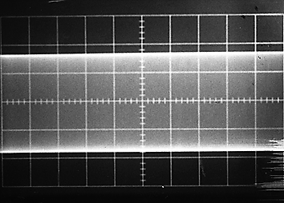
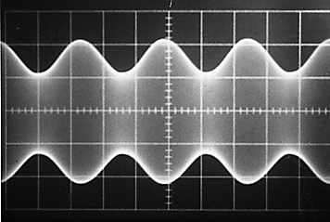
Amplitude Modulation
An unmodulated RF
carrier wave
A carrier wave amplitude
modulated (AM) with a simple audio tone
Notes:
Note the identical sidebands. They peak and dip together.

Slide 11
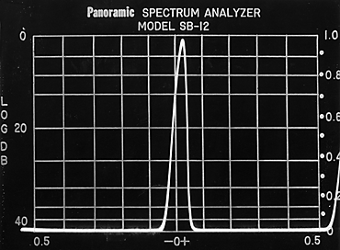
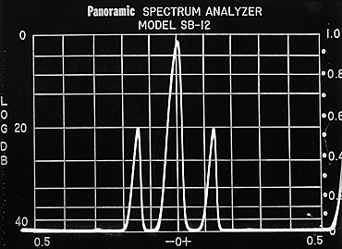
Amplitude Modulation
An unmodulated RF
carrier requires narrow
bandwidth
Modulation of the carrier
creates sidebands. This
requires more bandwidth.
Transmitter power is spread across this bandwidth

Slide 12

AM and SSB
The carrier contains no
audio information.
The sidebands contain
duplicate audio information
By filtering out the carrier and one sideband,
we save spectrum and concentrate our RF
energy into a narrower bandwidth. SSB is
therefore more efficient.

Slide 13
Frequency Modulation
Unmodulated carrier, full power at all times
Waveform of modulating signal
Modulated carrier with frequency deviation and constant amplitude
“Over modulation” called “over deviation” on FM, causes the signal to become wider and potentially cause adjacent channel interference

Slide 14
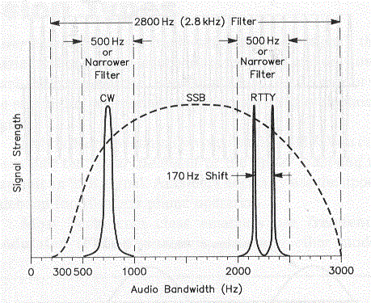
Common required Bandwidth
CW – 5-10Hz
Phone / Voice
  SSB - 2-3 kHz
  AM – 4-6 kHz
  FM – 5-15 kHz
Digital
  PSK31 – 31 Hz
  RTTY – 250 Hz
Slow Scan TV – 3KHz
Fast Scan TV – 6Mhz

Slide 15
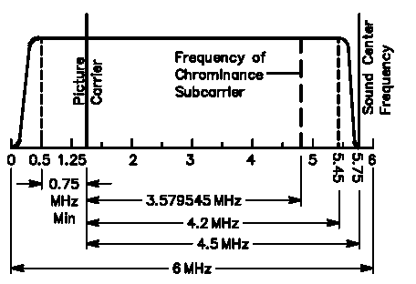
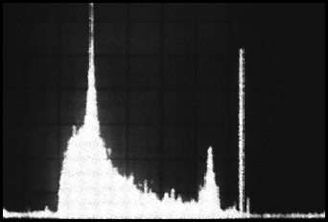
Amateur Television Signal
A 6 MHz ATV video channel with the video carrier 1.25 MHz up from the lower edge. The color subcarrier is at 3.58 MHz and the sound subcarrier at 4.5 MHz above the video carrier.
The Luminance, Chrominance and Audio carriers are visible in the spectrum plot at left

Slide 16
T5B01 How many milliamperes is 1.5 amperes?
  A. 15 milliamperes
  B. 150 milliamperes
  C. 1,500 milliamperes
  D. 15,000 milliamperes

Slide 17
T5B01 How many milliamperes is 1.5 amperes?
  A. 15 milliamperes
  B. 150 milliamperes
C. 1,500 milliamperes
  D. 15,000 milliamperes

Slide 18
T5B02 What is another way to specify a radio signal frequency of 1,500,000 hertz?
  A. 1500 kHz
  B. 1500 MHz
  C. 15 GHz
  D. 150 kHz

Slide 19
T5B02 What is another way to specify a radio signal frequency of 1,500,000 hertz?
A. 1500 kHz
  B. 1500 MHz
  C. 15 GHz
  D. 150 kHz

Slide 20
T5B03 How many volts are equal to one kilovolt?
  A. One one-thousandth of a volt
  B. One hundred volts
  C. One thousand volts
  D. One million volts

Slide 21
T5B03 How many volts are equal to one kilovolt?
  A. One one-thousandth of a volt
  B. One hundred volts
C. One thousand volts
  D. One million volts

Slide 22
T5B04 How many volts are equal to one microvolt?
  A. One one-millionth of a volt
  B. One million volts
  C. One thousand kilovolts
  D. One one-thousandth of a volt

Slide 23
T5B04 How many volts are equal to one microvolt?
A. One one-millionth of a volt
  B. One million volts
  C. One thousand kilovolts
  D. One one-thousandth of a volt

Slide 24
T5B05 Which of the following is equivalent to 500 milliwatts?
  A. 0.02 watts
  B. 0.5 watts
  C. 5 watts
  D. 50 watts

Slide 25
T5B05 Which of the following is equivalent to 500 milliwatts?
  A. 0.02 watts
B. 0.5 watts
  C. 5 watts
  D. 50 watts

Slide 26
T5B06 If an ammeter calibrated in amperes is used to measure a 3000-milliampere current, what reading would it show?
  A. 0.003 amperes
  B. 0.3 amperes
  C. 3 amperes
  D. 3,000,000 amperes

Slide 27
T5B06 If an ammeter calibrated in amperes is used to measure a 3000-milliampere current, what reading would it show?
  A. 0.003 amperes
  B. 0.3 amperes
C. 3 amperes
  D. 3,000,000 amperes

Slide 28
T5B07 If a frequency readout calibrated in megahertz shows a reading of 3.525 MHz, what would it show if it were calibrated in kilohertz?
  A. 0.003525 kHz
  B. 35.25 kHz
  C. 3525 kHz
  D. 3,525,000 kHz

Slide 29
T5B07 If a frequency readout calibrated in megahertz shows a reading of 3.525 MHz, what would it show if it were calibrated in kilohertz?
  A. 0.003525 kHz
  B. 35.25 kHz
C. 3525 kHz
  D. 3,525,000 kHz

Slide 30
T5B08 How many microfarads are 1,000,000 picofarads?
  A. 0.001 microfarads
  B. 1 microfarad
  C. 1000 microfarads
  D. 1,000,000,000 microfarads

Slide 31
T5B08 How many microfarads are 1,000,000 picofarads?
  A. 0.001 microfarads
B. 1 microfarad
  C. 1000 microfarads
  D. 1,000,000,000 microfarads

Slide 32
T5B12 Which of the following frequencies is equal to 28,400 kHz?
A. 28.400 MHz
B. 2.800 MHz
C. 284.00 MHz
D. 28.400 kHz

Slide 33
T5B12 Which of the following frequencies is equal to 28,400 kHz?
A. 28.400 MHz
B. 2.800 MHz
C. 284.00 MHz
D. 28.400 kHz

Slide 34
T5B13 If a frequency readout shows a reading of 2425 MHz, what frequency is that in GHz?
A. 0.002425 GHZ
B. 24.25 GHz
C. 2.425 GHz
D. 2425 GHz

Slide 35
T5B13 If a frequency readout shows a reading of 2425 MHz, what frequency is that in GHz?
A. 0.002425 GHZ
B. 24.25 GHz
C. 2.425 GHz
D. 2425 GHz

Slide 36
T3B01 What is the name for the distance a radio wave travels during one complete cycle?
  A. Wave speed
  B. Waveform
  C. Wavelength
  D. Wave spread

Slide 37
T3B01 What is the name for the distance a radio wave travels during one complete cycle?
  A. Wave speed
  B. Waveform
C. Wavelength
  D. Wave spread

Slide 38
T3B04 How fast does a radio wave travel through free space?
  A. At the speed of light
  B. At the speed of sound
  C. Its speed is inversely proportional to its wavelength
  D. Its speed increases as the frequency increases

Slide 39
T3B04 How fast does a radio wave travel through free space?
A. At the speed of light
  B. At the speed of sound
  C. Its speed is inversely proportional to its wavelength
  D. Its speed increases as the frequency increases

Slide 40
T3B05 How does the wavelength of a radio wave relate to its frequency?
  A. The wavelength gets longer as the frequency increases
  B. The wavelength gets shorter as the frequency increases
  C. There is no relationship between wavelength and frequency
  D. The wavelength depends on the bandwidth of the signal

Slide 41
T3B05 How does the wavelength of a radio wave relate to its frequency?
  A. The wavelength gets longer as the frequency increases
B. The wavelength gets shorter as the frequency increases
  C. There is no relationship between wavelength and frequency
  D. The wavelength depends on the bandwidth of the signal

Slide 42
T3B06 What is the formula for converting frequency to approximate wavelength in meters?
A. Wavelength in meters equals frequency in hertz multiplied by 300
B. Wavelength in meters equals frequency in hertz divided by 300
C. Wavelength in meters equals frequency in megahertz divided by 300
D. Wavelength in meters equals 300 divided by frequency in megahertz

Slide 43
T3B06 What is the formula for converting frequency to approximate wavelength in meters?
A. Wavelength in meters equals frequency in hertz multiplied by 300
B. Wavelength in meters equals frequency in hertz divided by 300
C. Wavelength in meters equals frequency in megahertz divided by 300
D. Wavelength in meters equals 300 divided by frequency in megahertz

Slide 44
T3B07 What property of radio waves is often used to identify the different frequency bands?
  A. The approximate wavelength
  B. The magnetic intensity of waves
  C. The time it takes for waves to travel one mile
  D. The voltage standing wave ratio of waves

Slide 45
T3B07 What property of radio waves is often used to identify the different frequency bands?
A. The approximate wavelength
  B. The magnetic intensity of waves
  C. The time it takes for waves to travel one mile
  D. The voltage standing wave ratio of waves

Slide 46
T3B08 What are the frequency limits of the VHF spectrum?
  A. 30 to 300 kHz
  B. 30 to 300 MHz
  C. 300 to 3000 kHz
  D. 300 to 3000 MHz

Slide 47
T3B08 What are the frequency limits of the VHF spectrum?
  A. 30 to 300 kHz
B. 30 to 300 MHz
  C. 300 to 3000 kHz
  D. 300 to 3000 MHz

Slide 48
T3B09 What are the frequency limits of the UHF spectrum?
  A. 30 to 300 kHz
  B. 30 to 300 MHz
  C. 300 to 3000 kHz
  D. 300 to 3000 MHz

Slide 49
T3B09 What are the frequency limits of the UHF spectrum?
  A. 30 to 300 kHz
  B. 30 to 300 MHz
  C. 300 to 3000 kHz
D. 300 to 3000 MHz

Slide 50
T3B10 What frequency range is referred to as HF?
  A. 300 to 3000 MHz
  B. 30 to 300 MHz
  C. 3 to 30 MHz
  D. 300 to 3000 kHz

Slide 51
T3B10 What frequency range is referred to as HF?
  A. 300 to 3000 MHz
  B. 30 to 300 MHz
C. 3 to 30 MHz
  D. 300 to 3000 kHz

Slide 52
T3B11 What is the approximate velocity of a radio wave as it travels through free space?
  A. 3000 kilometers per second
  B. 300,000,000 meters per second
  C. 300,000 miles per hour
  D. 186,000 miles per hour

Slide 53
T3B11 What is the approximate velocity of a radio wave as it travels through free space?
  A. 3000 kilometers per second
B. 300,000,000 meters per second
  C. 300,000 miles per hour
  D. 186,000 miles per hour

Slide 54
T5A12 What term describes the number of times per second that an alternating current reverses direction?
  A. Pulse rate
  B. Speed
  C. Wavelength
  D. Frequency

Slide 55
T5A12 What term describes the number of times per second that an alternating current reverses direction?
  A. Pulse rate
  B. Speed
  C. Wavelength
D. Frequency

Slide 56
T5C05 What is the unit of frequency?
  A. Hertz
  B. Henry
  C. Farad
  D. Tesla

Slide 57
T5C05 What is the unit of frequency?
A. Hertz
  B. Henry
  C. Farad
  D. Tesla

Slide 58
T5C06 What does the abbreviation “RF” refer to?
A. Radio frequency signals of all types
B. The resonant frequency of a tuned circuit
C. The real frequency transmitted as opposed to the apparent frequency
D. Reflective force in antenna transmission lines

Slide 59
T5C06 What does the abbreviation “RF” refer to?
A. Radio frequency signals of all types
B. The resonant frequency of a tuned circuit
C. The real frequency transmitted as opposed to the apparent frequency
D. Reflective force in antenna transmission lines

Slide 60
T1B09 Why should you not set your transmit frequency to be exactly at the edge of an amateur band or sub-band?
  A. To allow for calibration error in the transmitter frequency display
  B. So that modulation sidebands do not extend beyond the band edge
  C. To allow for transmitter frequency drift
  D. All of these choices are correct

Slide 61
T1B09 Why should you not set your transmit frequency to be exactly at the edge of an amateur band or sub-band?
  A. To allow for calibration error in the transmitter frequency display
  B. So that modulation sidebands do not extend beyond the band edge
  C. To allow for transmitter frequency drift
D. All of these choices are correct

Slide 62
T2B05 What determines the amount of deviation of an FM signal?
  A. Both the frequency and amplitude of the modulating signal
  B. The frequency of the modulating signal
  C. The amplitude of the modulating signal
  D. The relative phase of the modulating signal and the carrier

Slide 63
T2B05 What determines the amount of deviation of an FM signal?
  A. Both the frequency and amplitude of the modulating signal
  B. The frequency of the modulating signal
C. The amplitude of the modulating signal
  D. The relative phase of the modulating signal and the carrier

Slide 64
T2B06 What happens when the deviation of an FM transmitter is increased?
  A. Its signal occupies more bandwidth
  B. Its output power increases
  C. Its output power and bandwidth increases
  D. Asymmetric modulation occurs

Slide 65
T2B06 What happens when the deviation of an FM transmitter is increased?
A. Its signal occupies more bandwidth
  B. Its output power increases
  C. Its output power and bandwidth increases
  D. Asymmetric modulation occurs

Slide 66
T2B07 What could cause your FM signal to interfere with stations on nearby frequencies?
A. Microphone gain too high, causing over-deviation
B. SWR too high
C. Incorrect CTCSS Tone
D. All of these choices are correct

Slide 67
T2B07 What could cause your FM signal to interfere with stations on nearby frequencies?
A. Microphone gain too high, causing over-deviation
B. SWR too high
C. Incorrect CTCSS Tone
D. All of these choices are correct

Slide 68
T8A01 Which of the following is a form of amplitude modulation?
  A. Spread-spectrum
  B. Packet radio
  C. Single sideband
  D. Phase shift keying

Slide 69
T8A01 Which of the following is a form of amplitude modulation?
  A. Spread-spectrum
  B. Packet radio
C. Single sideband
  D. Phase shift keying

Slide 70
T8A02 What type of modulation is most commonly used for VHF packet radio transmissions?
  A. FM
  B. SSB
  C. AM
  D. Spread Spectrum

Slide 71
T8A02 What type of modulation is most commonly used for VHF packet radio transmissions?
A. FM
  B. SSB
  C. AM
  D. Spread Spectrum

Slide 72
T8A03 Which type of voice mode is most often used for long-distance (weak signal) contacts on the VHF and UHF bands?
A. FM
B. DRM
C. SSB
D. PM

Slide 73
T8A03 Which type of voice mode is most often used for long-distance (weak signal) contacts on the VHF and UHF bands?
A. FM
B. DRM
C. SSB
D. PM

Slide 74
T8A04 Which type of modulation is most commonly used for VHF and UHF voice repeaters?
  A. AM
  B. SSB
  C. PSK
  D. FM

Slide 75
T8A04 Which type of modulation is most commonly used for VHF and UHF voice repeaters?
  A. AM
  B. SSB
  C. PSK
D. FM

Slide 76
T8A05 Which of the following types of emission has the narrowest bandwidth?
  A. FM voice
  B. SSB voice
  C. CW
  D. Slow-scan TV

Slide 77
T8A05 Which of the following types of emission has the narrowest bandwidth?
  A. FM voice
  B. SSB voice
C. CW
  D. Slow-scan TV

Slide 78
T8A06 Which sideband is normally used for 10 meter HF, VHF and UHF single-sideband communications?
  A. Upper sideband
  B. Lower sideband
  C. Suppressed sideband
  D. Inverted sideband

Slide 79
T8A06 Which sideband is normally used for 10 meter HF, VHF and UHF single-sideband communications?
A. Upper sideband
  B. Lower sideband
  C. Suppressed sideband
  D. Inverted sideband

Slide 80
T8A07 What is the primary advantage of single sideband over FM for voice transmissions?
  A. SSB signals are easier to tune
  B. SSB signals are less susceptible to interference
  C. SSB signals have narrower bandwidth
  D. All of these choices are correct

Slide 81
T8A07 What is the primary advantage of single sideband over FM for voice transmissions?
  A. SSB signals are easier to tune
  B. SSB signals are less susceptible to interference
C. SSB signals have narrower bandwidth
  D. All of these choices are correct

Slide 82
T8A08 What is the approximate bandwidth of a single sideband voice signal?
  A. 1 kHz
  B. 3 kHz
  C. 6 kHz
  D. 15 kHz

Slide 83
T8A08 What is the approximate bandwidth of a single sideband voice signal?
  A. 1 kHz
B. 3 kHz
  C. 6 kHz
  D. 15 kHz

Slide 84
T8A09 What is the approximate bandwidth of a VHF repeater FM phone signal?
A. Less than 500 Hz
B. About 150 kHz
C. Between 10 and 15 kHz
D. Between 50 and 125 kHz

Slide 85
T8A09 What is the approximate bandwidth of a VHF repeater FM phone signal?
A. Less than 500 Hz
B. About 150 kHz
C. Between 10 and 15 kHz
D. Between 50 and 125 kHz

Slide 86
T8A10 What is the typical bandwidth of analog fast-scan TV transmissions on the 70 cm band?
  A. More than 10 MHz
  B. About 6 MHz
  C. About 3 MHz
  D. About 1 MHz

Slide 87
T8A10 What is the typical bandwidth of analog fast-scan TV transmissions on the 70 cm band?
  A. More than 10 MHz
B. About 6 MHz
  C. About 3 MHz
  D. About 1 MHz

Slide 88
T8A11 What is the approximate maximum bandwidth required to transmit a CW signal?
  A. 2.4 kHz
  B. 150 Hz
  C. 1000 Hz
  D. 15 kHz

Slide 89
T8A11 What is the approximate maximum bandwidth required to transmit a CW signal?
  A. 2.4 kHz
B. 150 Hz
  C. 1000 Hz
  D. 15 kHz

Slide 90
T1F09 What type of amateur station simultaneously retransmits the signal of another amateur station on a different channel or channels?
  A. Beacon station
  B. Earth station
  C. Repeater station
  D. Message forwarding station

Slide 91
T1F09 What type of amateur station simultaneously retransmits the signal of another amateur station on a different channel or channels?
  A. Beacon station
  B. Earth station
C. Repeater station
  D. Message forwarding station

Slide 92
T7A02 What is a transceiver?
A. A type of antenna switch
B. A unit combining the functions of a transmitter and a receiver
C. A component in a repeater which filters out unwanted interference
D. A type of antenna matching network

Slide 93
T7A02 What is a transceiver?
A. A type of antenna switch
B. A unit combining the functions of a transmitter and a receiver
C. A component in a repeater which filters out unwanted interference
D. A type of antenna matching network

