Slide 1
echoes
Meteor scatter detection program
Clint Parrish
4/18/2022

Slide 2
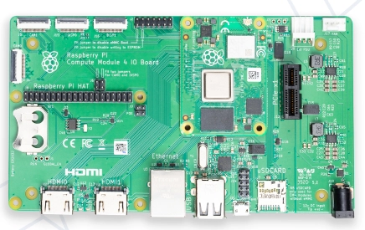
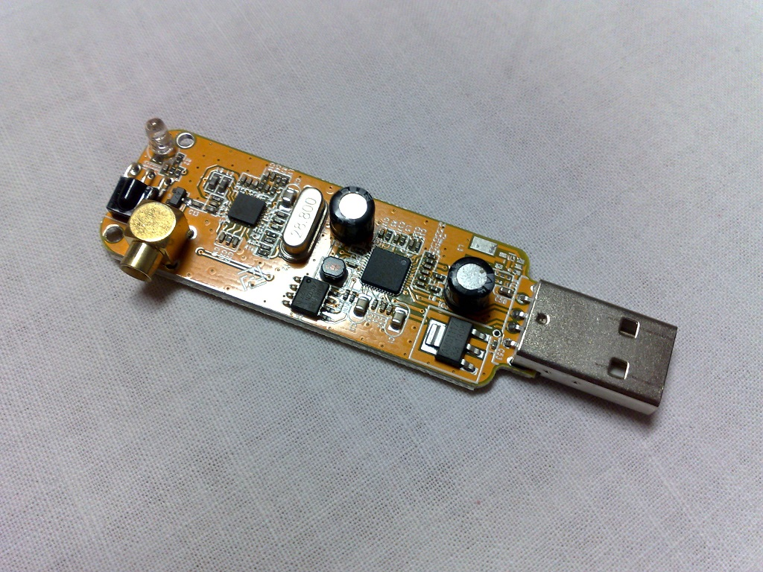
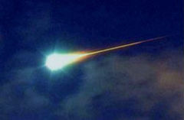
Some of my favorite hobbies
Meteorology
Astronomy
Amateur Radio
Computers
Music
Where do these hobbies meet?
METEORS!

Slide 3
METEORS
Meteors are space dust and occasionally small asteroids that burn up in the upper atmosphere.
About 56 to 93 miles above the surface.
Small mass but incredible energy due to high velocity (25,000 mph – 160,000 mph!). $K.E. = \frac{1}{2}mv^{2}$
Some of that energy becomes light, some may become sound, and some of that energy ionizes atoms.
Most meteors originated from comets. Some comets have orbits around the Sun and even though many of those orbits have long periods, the dust that they have left behind continue to follow the comet’s orbit for many years.
If Astronomers can determine the orbit of the comet, they can determine where the dust intersects with our own orbit and figure out when and where in the sky Meteor Showers will occur.
Current shower: Lyrids (mid to late April every year).

Slide 4
What is echoes?
Software for Linux and Windows for monitoring and recording of meteor scatter events.
Download location: sourceforge.net/projects/echoes/
Mainly written by Giuseppe M. Bertani of Italy.
The software only works with RTL-SDR dongles.
It requires a computer, a dongle, and an antenna designed for the frequency used to monitor for meteors.

Slide 5
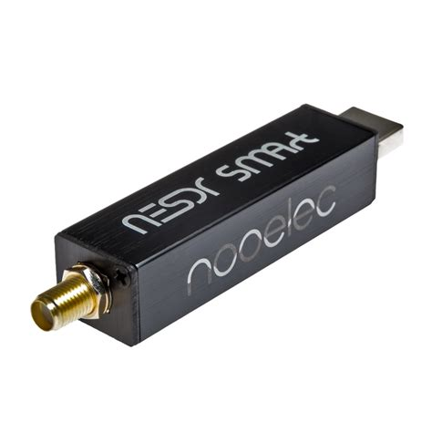
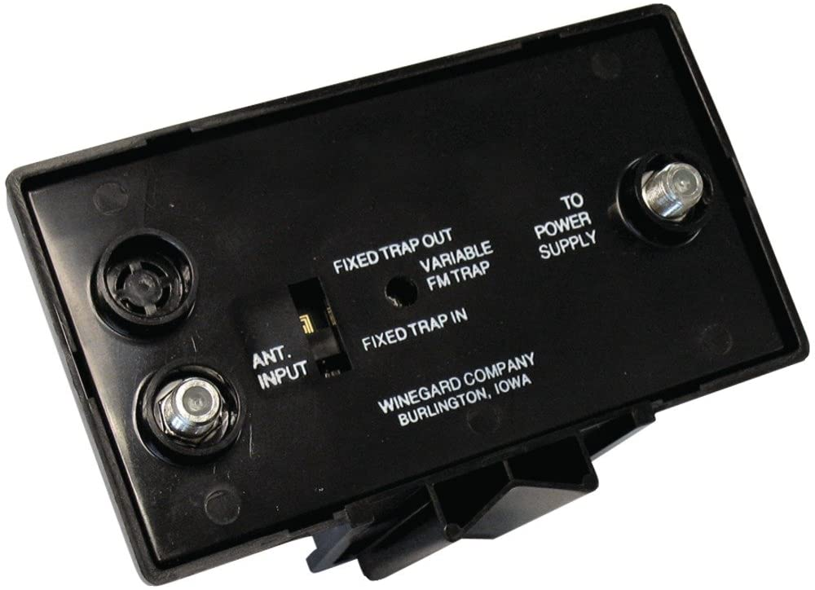
My setup…
Raspberry Pi 4 running the Bullseye version of Raspbian (Raspbian 11).
RTL-SDR dongle
6 meter ringo ranger antenna (AR-6)
Winegard 82 channel TV preamp

Slide 6
Wait, did he say tv preamp?
In order to detect meteors a constant signal must be monitored.
FM Broadcast Radio Stations (somewhat useful)
WWV (preferably 25 MHz signal which is intermittent)
Analog TV channels
Because of physics, frequencies from 30 MHz – 70 MHz are the best suited to pick up meteor reflections.
TV Channel 2 (pilot frequency 55.25 MHz) is the best for picking up meteors.

Slide 7
BUT ALL THE ANALOG STATIONS ARE GONE, RIGHT?
There remains one analog TV station left in North America, CTV affiliate CHBX in Sault Sainte Marie, Ontario, Canada.
100 kW ERP on 55.25 MHz.
Digital stations have been proven to work however their power is lower. One of the closest TV Channel 2 stations to Central IL, WDPN-TV in Wilmington, DE, has an ERP of 34 kW.
CHBX is widely used by North American meteor detectors and can cover most of the U.S. east of the Rockies.
There have been threats in the last few years to pull the plug on this station but for now it is the “light” that shines on the meteor “mirrors”.
GRAVES is used in Europe. This is a continuous “space radar” that is transmitted up into space on 143.050 MHz and is used to detect reflections from man-made objects entering the atmosphere as well as meteors.

Slide 8
WHAT DOES ECHOES LOOK LIKE?
Waterfall – plot of frequency (horizontal axis) and time (vertical axis).
Power plot.

Slide 9
Correlation

Slide 10
Visual Reports FROM AMS

Slide 11
Observations
Picking up meteor trails on both 55.240 MHz and 55.260 MHz.
This does not appear to be “ghosting” or “splatter” as the signals are independent.
My theory…
The radio signature of the meteor sometimes resembles meteors that I have observed visually.
There are typically over 1200 events per day during times when there is no shower. Only about half of these are likely real meteors. This averages to 25 meteors per hour during non-shower days.

Slide 12
DOUBLE DETECTION

Slide 13
Why is this important?
Low power modes such as FT8 and CW benefit greatly from Meteor Scatter Propagation.
These effects are found primarily on 6m and 2m due to ionized trails in the E layer.
Programs like Echoes could run in the background while operating FT8 and other digital modes to see when Meteor Scatter conditions are present.
On the astronomy side, programs like Echoes and contributions from amateur radio astronomers could track meteor outbursts and meteor “storms”.
Visible confirmation of meteors is useful at night but useless in the daytime. Echoes helps to bridge the gap.

Slide 14
ANY QUESTIONS?
Happy World Amateur Radio Day (April 18).
Thank you!

