Slide 1
OPENWEBRX
Remote SDR CONTROL USING RASPBERRY PI
Clint parrish, kc9s

Slide 2
What is openwebrx?
OpenWebRX is an open-source program for Linux systems that allows users all over the world to control a radio receiver via the internet. Users may control, listen, and decode signals from a single receiver and any frequency within bands. These bands are setup by the administrator. The administrator also determines the number of users allowed.
In my case, I allow 4 users to control the receiver at the same time but I may open it up to more users as my internet has been recently upgraded.

Slide 3
features
Digital voice decoding including
D-STAR, C4FM (Fusion), P25, NXDN, DMR, DRM, FreeDV, M17
Digital mode decoding including
PSK31, FT4, FT8, WSPR, JT65, CW, Packet, PSK63, JT9, Pocsag
Analog voice
AM, FM, USB, LSB
Users may set bookmarks
Waterfall
Multiple users may get on and listen to the same band. Once one user changes the band, however, the other users migrate to the new band.
All of the features that modern software defined radios have.

Slide 4
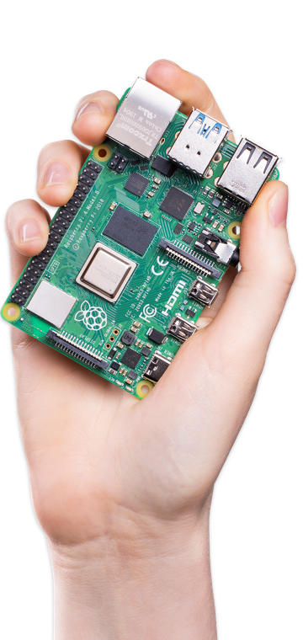
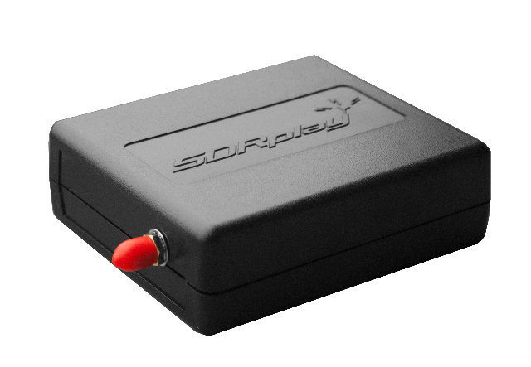
My setup
Computer: Raspberry Pi 4 with 2 GB RAM.
Radios: SDR Play RSP1 and RTL SDR
Currently 60 bands from AM broadcast to 933 MHz with the ability to add more.
Antennas: Sloper and Discone
URL: http://kc9s.ddns.net:100

Slide 5
Bookmarks
Frequency Dial
Current Position and Bandwidth
FT8 Transmissions
Voice Transmissions
CW Transmissions
Waterfall
Receiver Settings
Server Settings

Slide 6
Frequency
Bookmarks
Band Selection
Mode Selection
Digital Mode Drop-Down
Waterfall Adjustments
Volume
Squelch
Zoom Settings
Signal Strength

Slide 7
Setup your own openwebrx server
Installing and operating your own OpenWebRX server is not for the faint of heart. It is recommended that you get your feet wet with the Linux operating system and running a Raspberry Pi before you install OpenWebRX. If you need help setting up your own server let me know.
Visit https://www.openwebrx.de/ for documentation and how to download and install OpenWebRX.

Slide 8
Additional information
If you ever have trouble using my OpenWebRX remember to hit “refresh” on your web browser.
Attenuated reception
Audio sounds distorted
Openwebrx Groups.io site: https://groups.io/g/openwebrx

