Slide 1
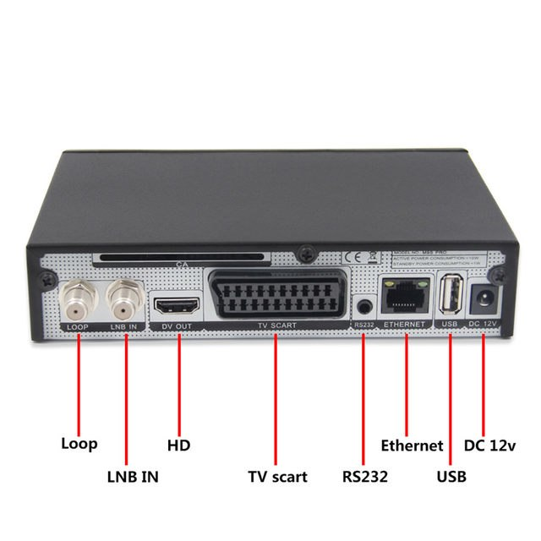
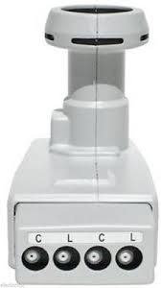
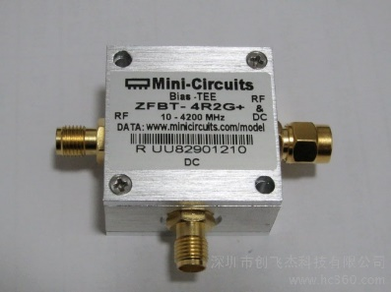
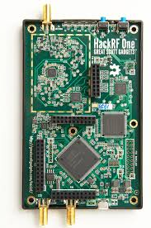
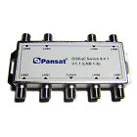
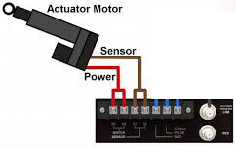
Configuration A
N/A
TX
0Vdc RX
12Vdc TX
RX /TX
switch
RX
No DC
12Vdc
12Vdc

Slide 2
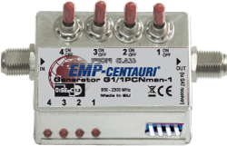
Configuration B
N/A
TX
0Vdc RX
12Vdc TX
RX /TX
switch
RX
12Vdc
12Vdc
12Vdc

Slide 3
Configuration C
N/A
TX
0Vdc RX
12Vdc TX
RX /TX
switch
RX
12Vdc
12Vdc
12Vdc

Slide 4
Configuration D
N/A
TX
0Vdc RX
12Vdc TX
RX /TX
switch
RX
12Vdc
12Vdc
12Vdc

Slide 5
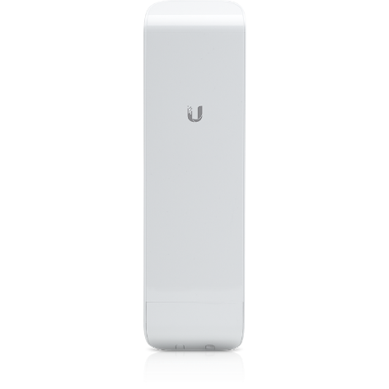
Cross band Hub, duel sector, duel channel
2.397ghz
Cross band Hub, single sector, single channel
2.402ghz
2.397ghz
5.905ghz
5.905ghz
5.885ghz
12v or 24v POE Injector
LAN to Lan for Simple DtD link
VLAN Switch for Advanced DtD link

