Slide 1
Casual remote operating By G4AON
Remote operating without the hassle of router configurations, and without the expense of a fixed IP address.
You really can operate a server through a Carrier Grade Network Address Translation (CGNAT) setup at your ISP.
The easy networking solution is to use Tailscale or ZeroTier, both currently free for personal use. These companies provide a means of creating a secure virtual private network in just a few minutes, without needing network skills, and without needing to touch your router. These solutions also allow you to connect to your home PC when using a mobile (cellular) connection, at both your home and your remote location.

Slide 2
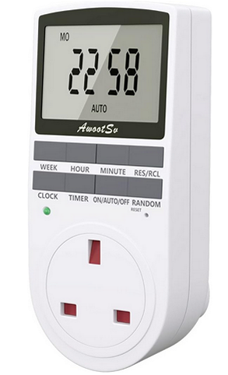
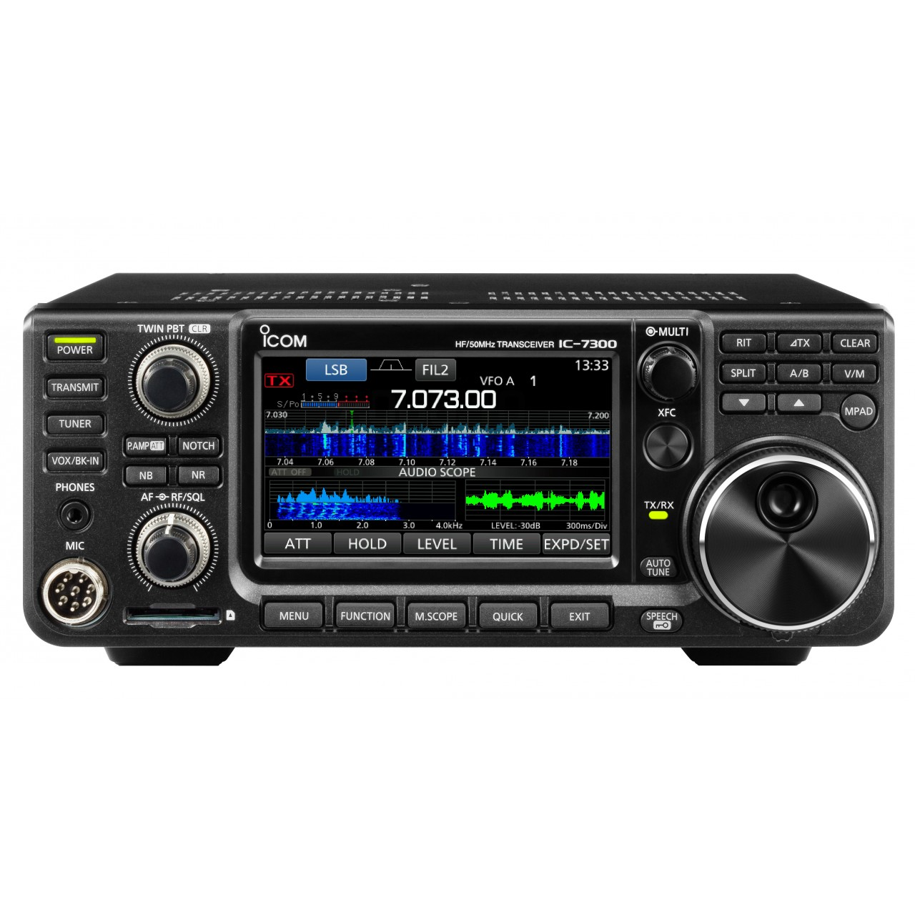
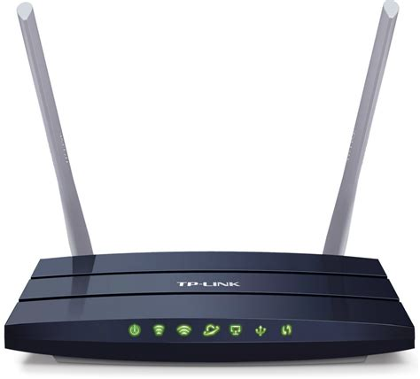
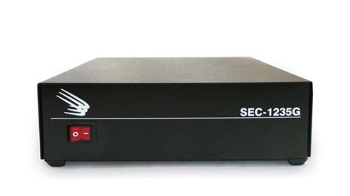
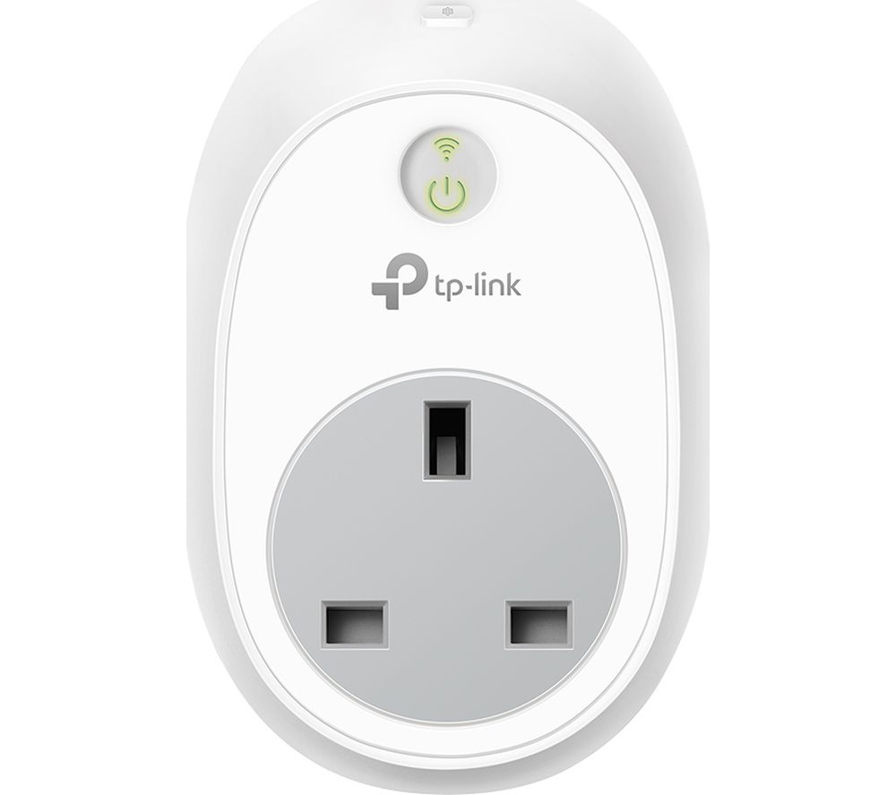
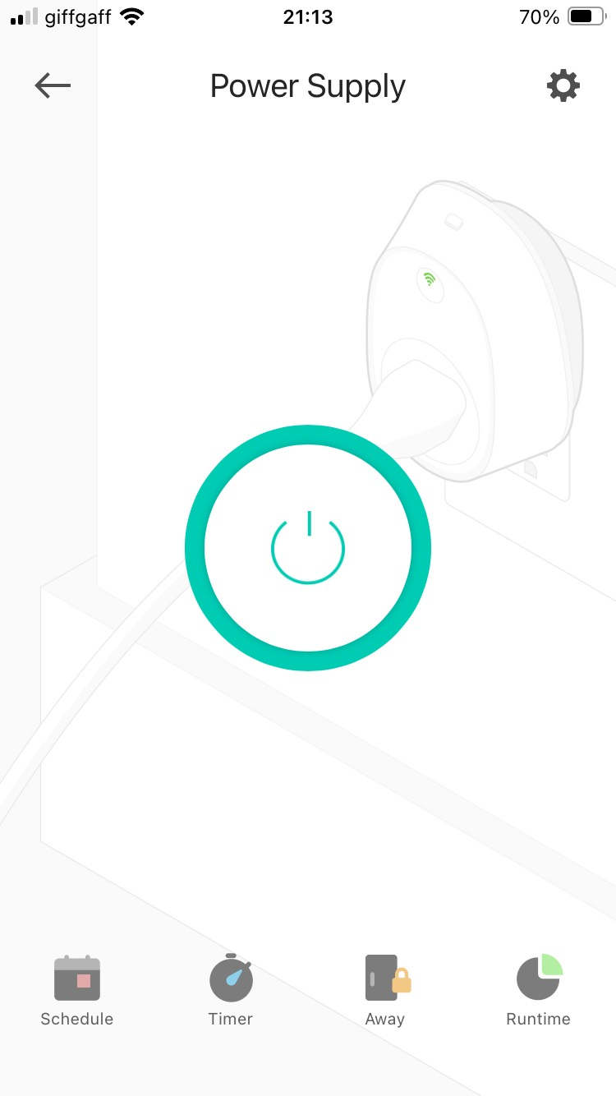
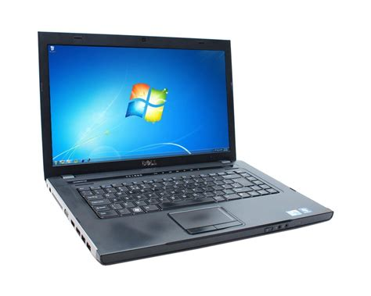
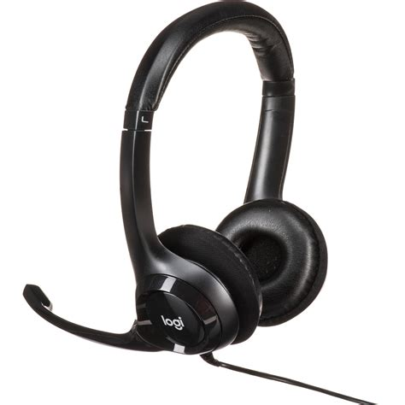
Overall system setup
IP Address 100.73.xx.xx
Timer switch
USB
Ethernet
TP-Link AC1200 4G+ routers
WiFi connection
Cellular network
WiFi connection
TP-Link Kasa HS100 remote switch
IP Address 100.113.xxx.xx
TP-Link Kasa mobile phone app
USB

Slide 3
Hardware setup
As routers can sometimes need a power cycle, the mains power to the router is via a low cost plug-in timer which turns off the power once per day.
The TP-Link AC1200 router is fitted with a SIM card to use it with a cellular network. You can use any router, I just happen to prefer to use cellular networks as in the UK it is currently much cheaper than a landline or fibre connection, and there is less likelihood of RF disrupting the connection.
Mains power to the radio power supply is remotely turned on with a WiFi connected switch. There are no “hubs”, or anything else needed with a TP-Link Kasa HS100 remote switch.
Note; Icom radios will respond to a USB command to turn on, there is no need to leave anything powered except the PC and router.
The antenna for HF is a doublet, with a manual ATU. It is normally left set for the 20m band around 14.105 MHz

Slide 4
Software setup
Both the desktop PC and laptop run Tailscale software to create an encrypted virtual network.
Note the IP address of the PC connected to the radio, this is allocated by Tailscale and will remain the same address for any subsequent connections.
On the desktop you run the Win4Icomsuite server program, change the ports from 50001/2/3 if necessary to avoid a clash with AnyDesk, if you use that program.
On the laptop, run the Win4Icom sound client and the Win4Icomsuite programs.
In order to be able to remotely make changes on the desktop PC, use either VNC software (poor), AnyDesk (better), or TeamViewer (best). Some users report that the free version of TeamViewer ceases working after a few sessions and requires the software to be purchased, your mileage may vary, so far I have not encountered that issue. AnyDesk and VNC are free.
The TP-Link Kasa HS100 remote mains switch is controlled from a mobile phone app. The Icom radios can be remotely switched on and off, turning off the power supply is not an issue.

Slide 5
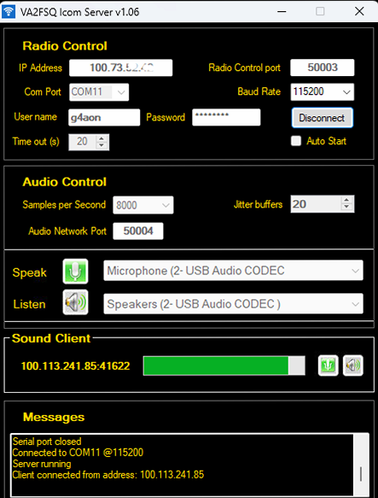
Software setup of the desktop PC (server)
This is the Win4Icomsuite server program running on the desktop PC connected to the radio.
On a network with less latency than this cellular connection, you can use a lower jitter setting.
The IP address is the one of your desktop PC on the Tailscale network. It is not a local 192.168.1.xxx one.
Note that the radio control and audio ports have been changed from the defaults.
The “Speak” and “Listen” settings depend on your radio USB connection.

Slide 6
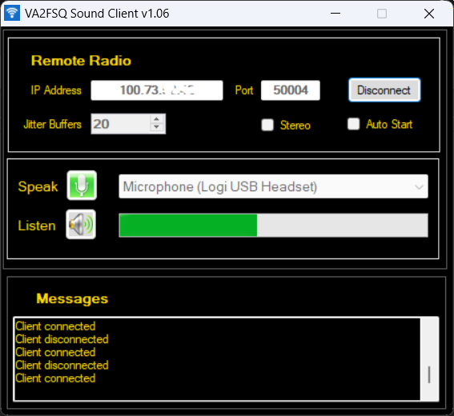
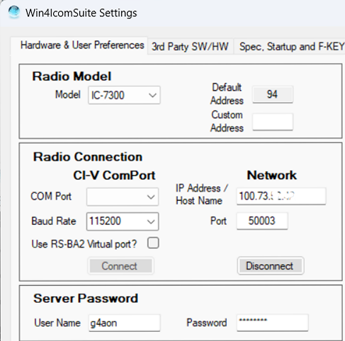
Software setup of the laptop
These are the sound settings on the remote PC (laptop). The “Speak” and “Listen” settings are for a USB headset.
These are the control settings for the remote PC (laptop). You connect the Network, leave the CI-V settings alone as these are for a locally connected radio.

Slide 7
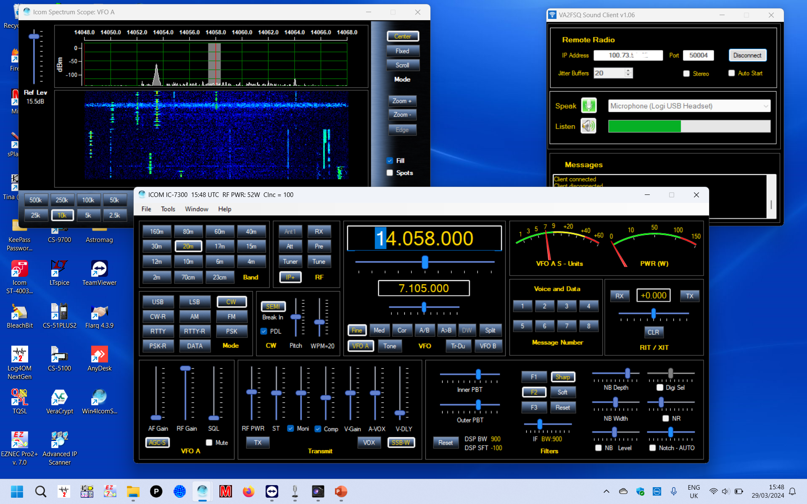
Win4IcomSuite running on the laptop
Note the AF Gain is set low, this is the local radio audio (speaker) output

Slide 8
Clever tricks
The standard setup where you run the radio control software on the laptop, and route audio across the network. This is OK for SSB, and to some extent it is also fine for CW and perhaps simple data operating, such as RTTY.
Unfortunately ARQ data modes, such as Vara and Pactor, are fouled up by the delays through the system when running the data software on the laptop.
The solution is to run the data software on the PC with a direct connection to the radio, then operate the data software by remote access using TeamViewer or AnyDesk.
You can either setup the radio using Win4Icomsuite on the PC, or on the laptop, the latter saves changing settings from normal voice modes. You can shut down the Win4Icomsuite leaving the radio running. Programs such as VarAC directly control the radio and send logging data directly to the log program running on the same PC.

Slide 9
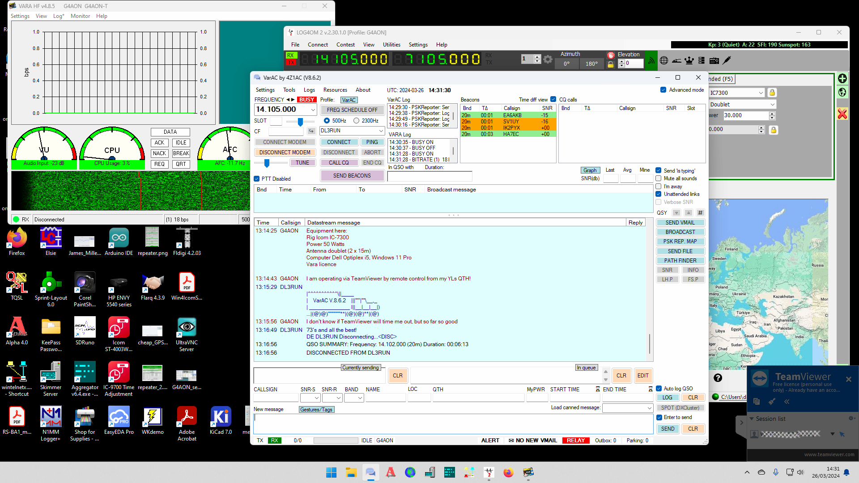
Screen image of a remote VarAC session

Slide 10
Software and hardware used
The desktop PC is a Dell Optiplex i5 running Windows 11 Pro, direct from Dell
The laptop is a Dell Vostro 16” screen i5 running Windows 11 Pro, direct from Dell
The USB headset is a Logitech H390 from Amazon
Routers are TP-Link AC1200 4G+ from Amazon
The TP-Link Kasa HS100 switch was second hand from eBay
The mains timer switch is from Amazon
The power supply for the radio is an SEC 1235G
Win4Icomsuite https://icom.va2fsq.com/
Tailscale https://tailscale.com/
TeamViewer https://www.teamviewer.com/en/

Slide 11
And finally…
While I have mentioned Win4Icomsuite as the software that I currently use to control an IC-7300 and an IC-9700, similar software is available for other brands.
By using a PC at the home site, it makes for easy configuration of a secure network connection as Tailscale provides Wireguard end to end encryption for your virtual network.
The TP-Link Kasa remote power switch provides a means of turning your power supply on/off. The IC-7300 and IC-9700 can be switched on/off by software command over USB.
As routers can sometimes need a power down reset, consider using a simple mains time switch to turn off the router for a few minutes once or twice a day. Note that using a pre-boot PIN with Windows Bitlocker will prevent your home PC running if there has been a power interruption.
Don’t forget to set the time out timer in your transceiver(s), typically set at 5 minutes.
Remember the clash of ports (50001/2/3), if using the default Icom ports and AnyDesk. In that case change the ports in the Win4Icomsuite software to a higher number such as 50004/5/6

