Slide 1
DMR With DroidStar
Do DMR from an Android Phone
By Dave Mosteller KC3JNW

Slide 2
DMR With DroidStar
First Step – Get a DMR ID
Go to radioid.net
Sign up for a DMR ID
You may have to wait for 24 hours for your ID to populate the database.

Slide 3
DMR With DroidStar
Second Step – Setup a Brandmeister Account
Go to brandmeister.network
Register for an account
Click on your callsign
Click on SelfCare
Make sure Brand is Motorola
Turn on Hotspot Security
Enter a Password
This is the password you will use on your hotspot or your DroidStar

Slide 4
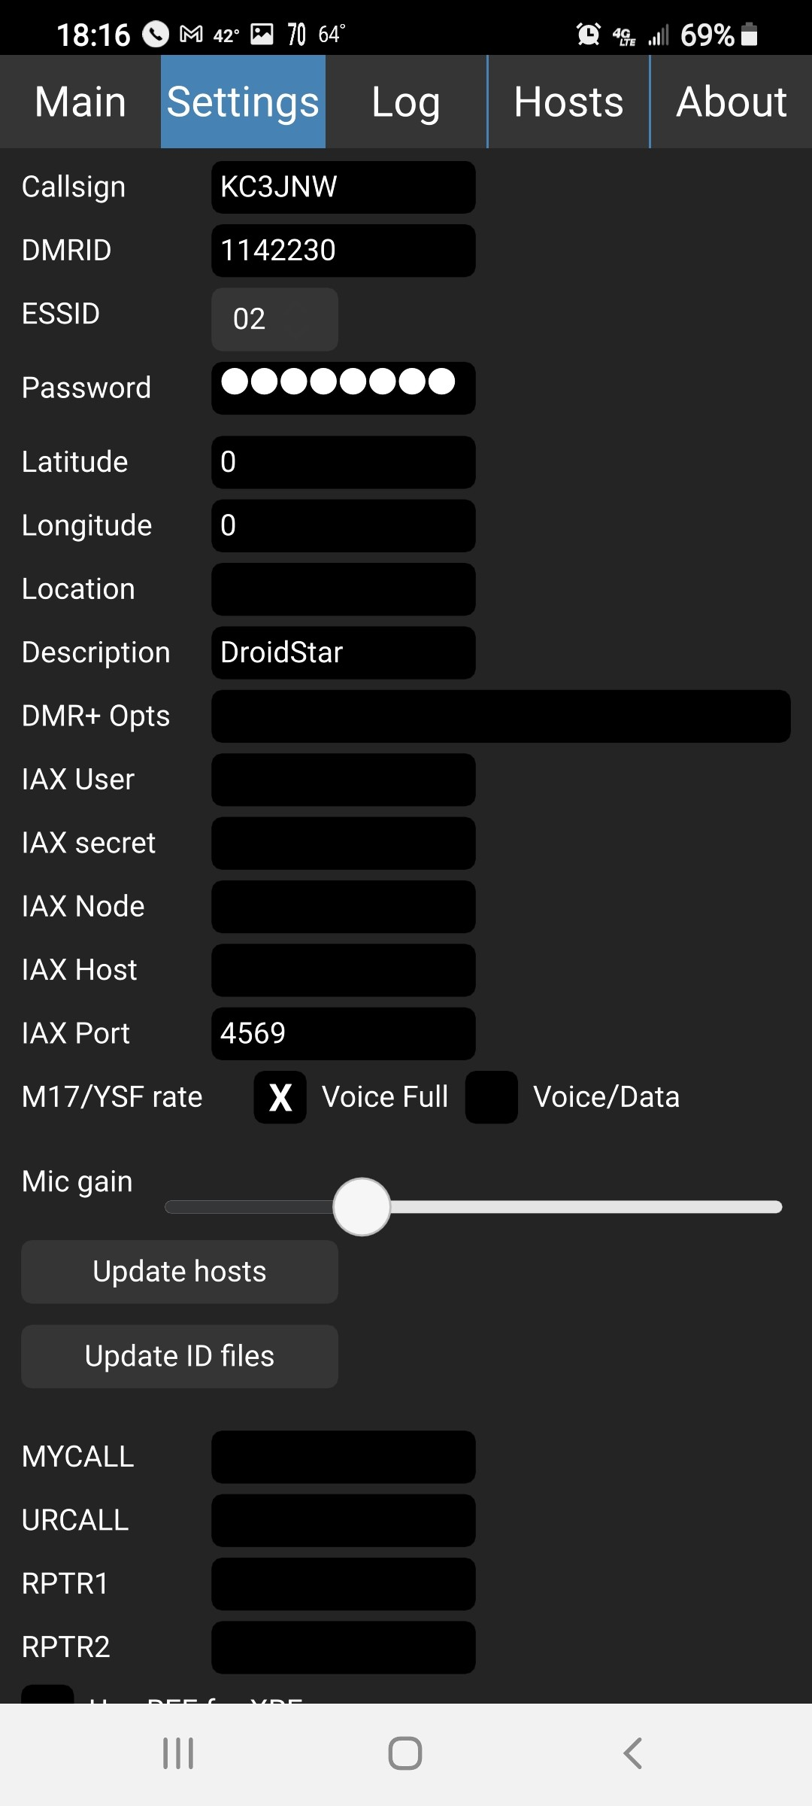
SETTINGS
Enter your call sign
Enter your DMR ID
ESSID should be a number other than blank for second radio
Enter the password you entered in BrandMeister account

Slide 5
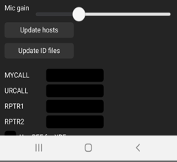
Bottom of the Settings Screen
Click “Update Hosts” button
Click “Update ID files” button

Slide 6
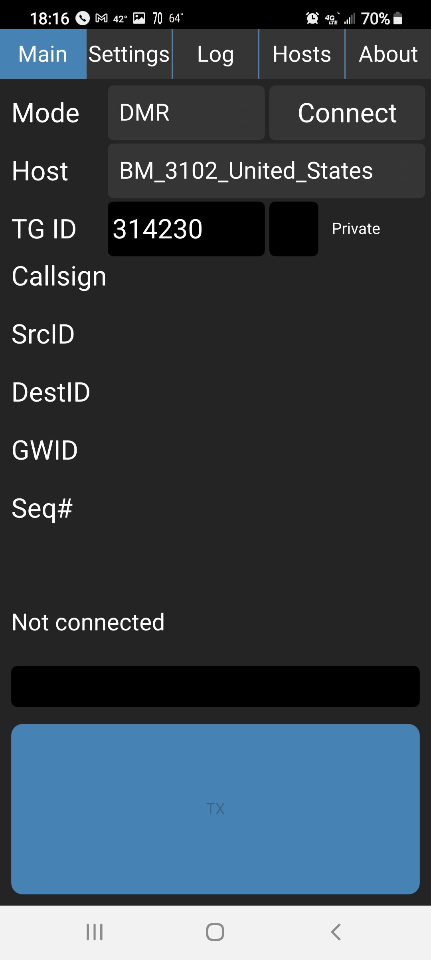
Main Screen
Change the Mode to DMR
Change the Host to BM_3102_United_States
Enter the talkgroup you want to go to
Press the Connect button
Press the big blue button and speak

