Slide 1
Traffic Handling and Amateur Radio
R.F. Hill Amateur Radio Club
Jim Cottrell KB3DEN

Slide 2
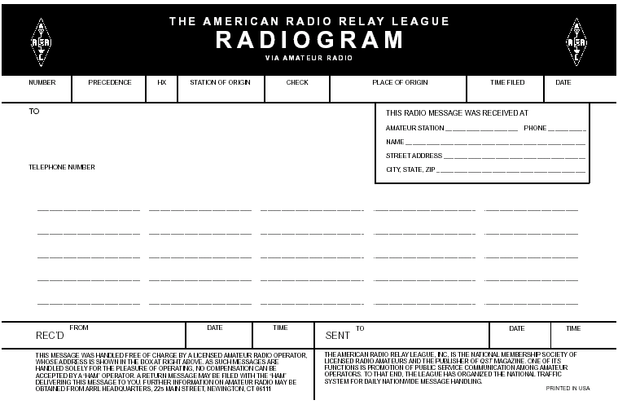
Standard Message Form
Page 3

Slide 3
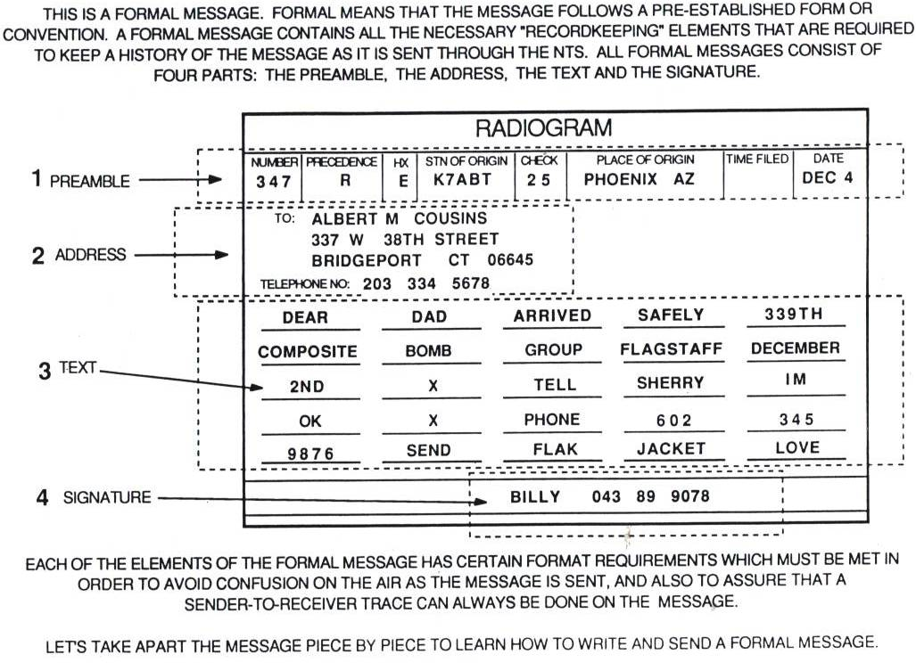
Page 4

Slide 4
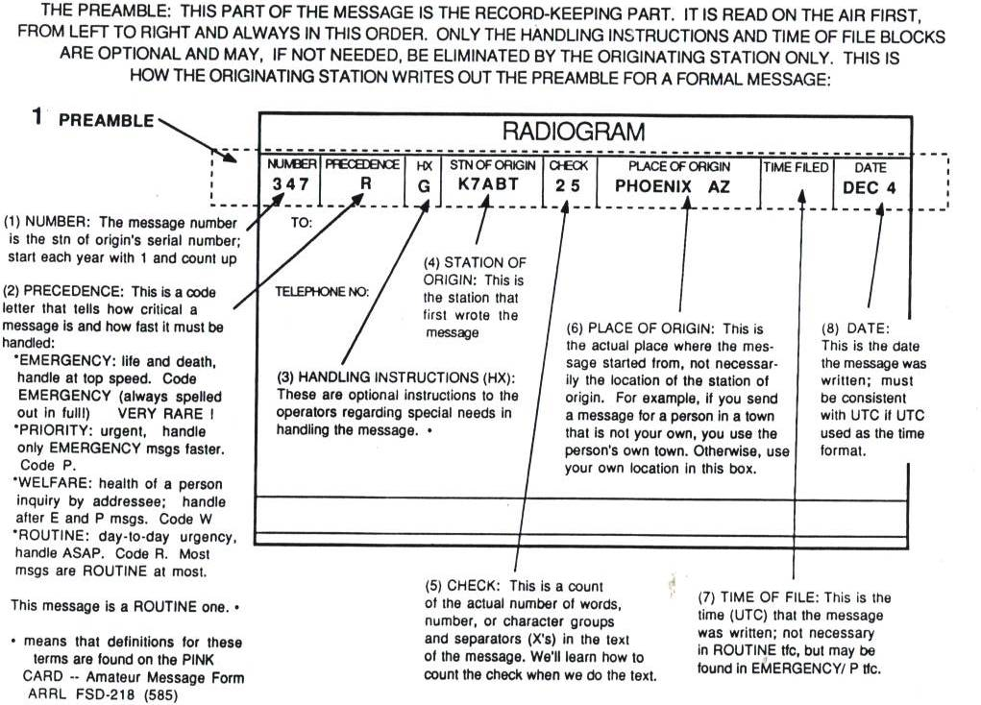
Page 5

Slide 5
Handling Instructions
HXA__ | (Followed by number.) Collect landline delivery authorized by addressee within [....] miles, (If no number, authorization is unlimited.).
HXB__ | (Followed by number.) Cancel message if not delivered within [....] hours of filing time; service originating station.
HXC | Report date and time of delivery of the message back to the originating station.
HXD | Report to originating station the identity of station from which received, plus date and time. Report identity of station to which relayed, plus date and time, or if delivered, report date and time and method of delivery (by service message).
HXE | Delivering station get reply from addressee, originate message back.
HXF__ | (Followed by a number.) Hold delivery until [date].
HXG | Delivery by mail or landline toll call not required. If toll call or other expense involved, cancel message and send service message back to originating station.
Page 6

Slide 6
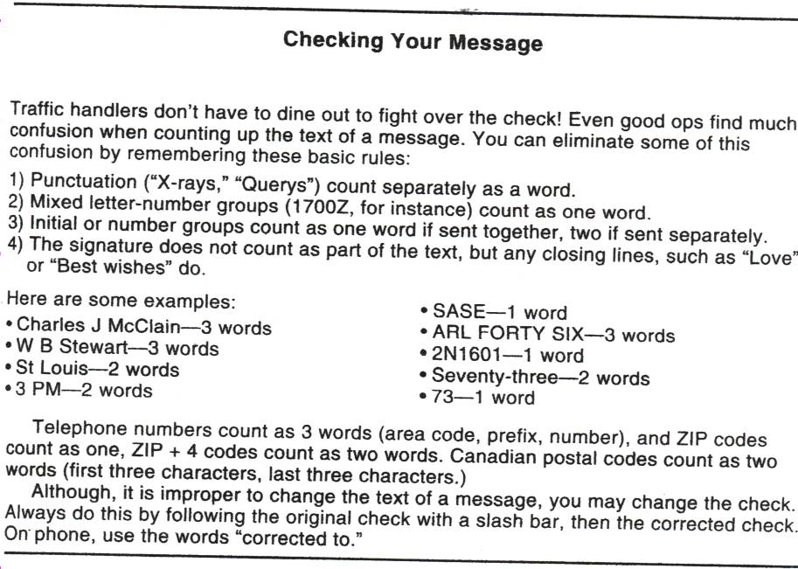
Page 7

Slide 7
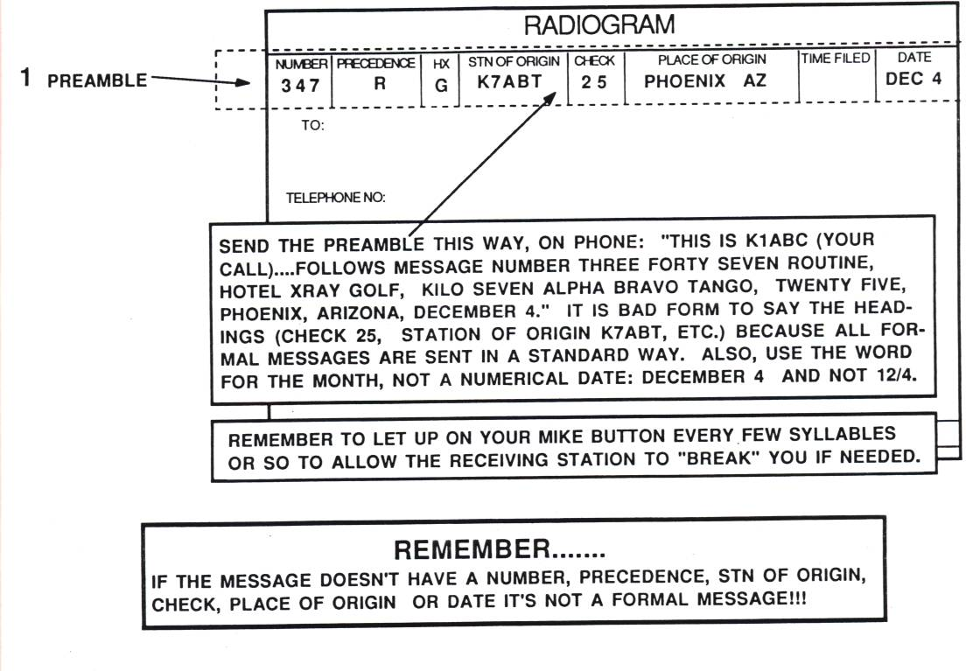
Page 8

Slide 8
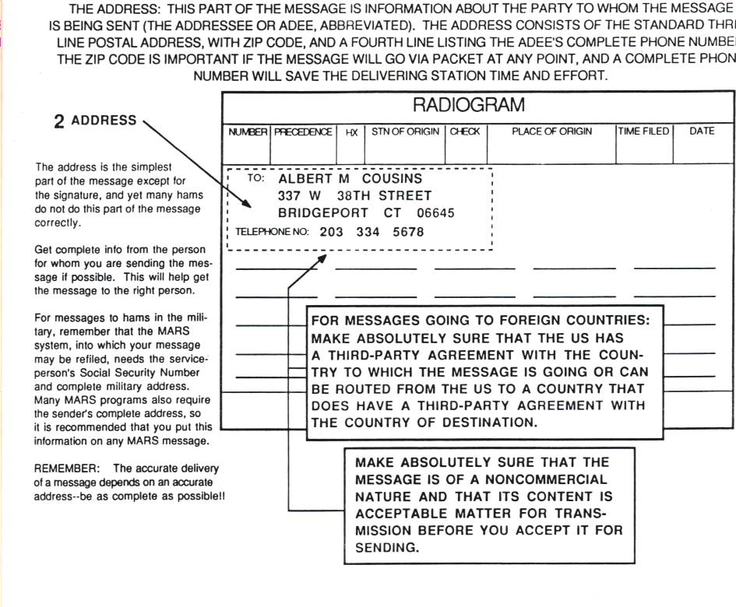
Page 9

Slide 9
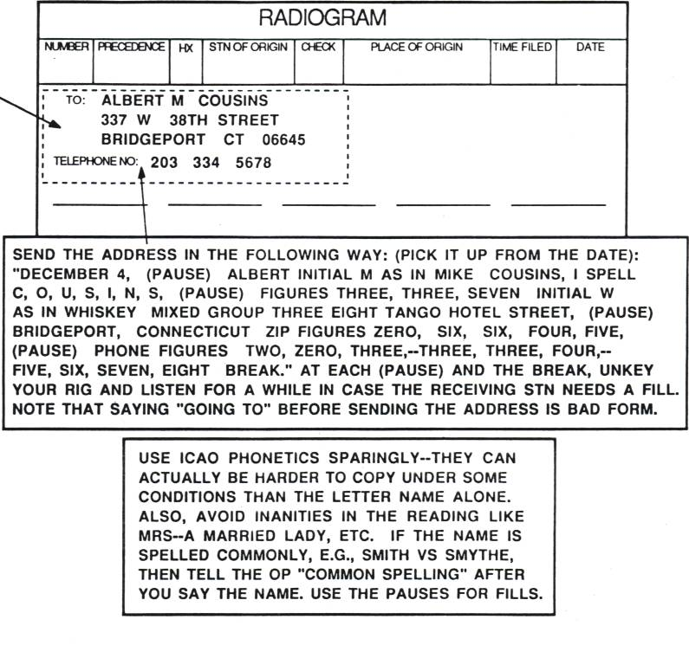
2 Address
Page 10

Slide 10
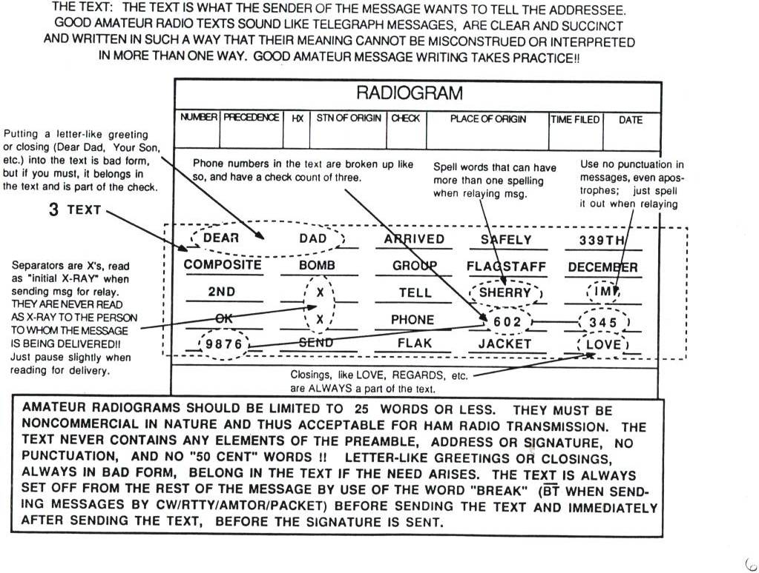
Source: ARRL Handbook, 2000
Page 11

Slide 11
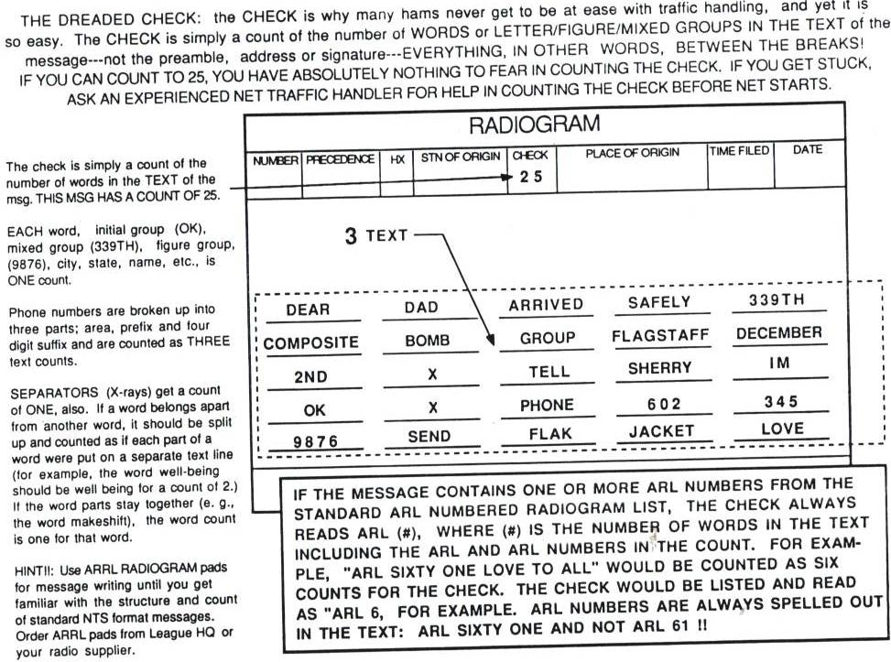
Page 12

Slide 12
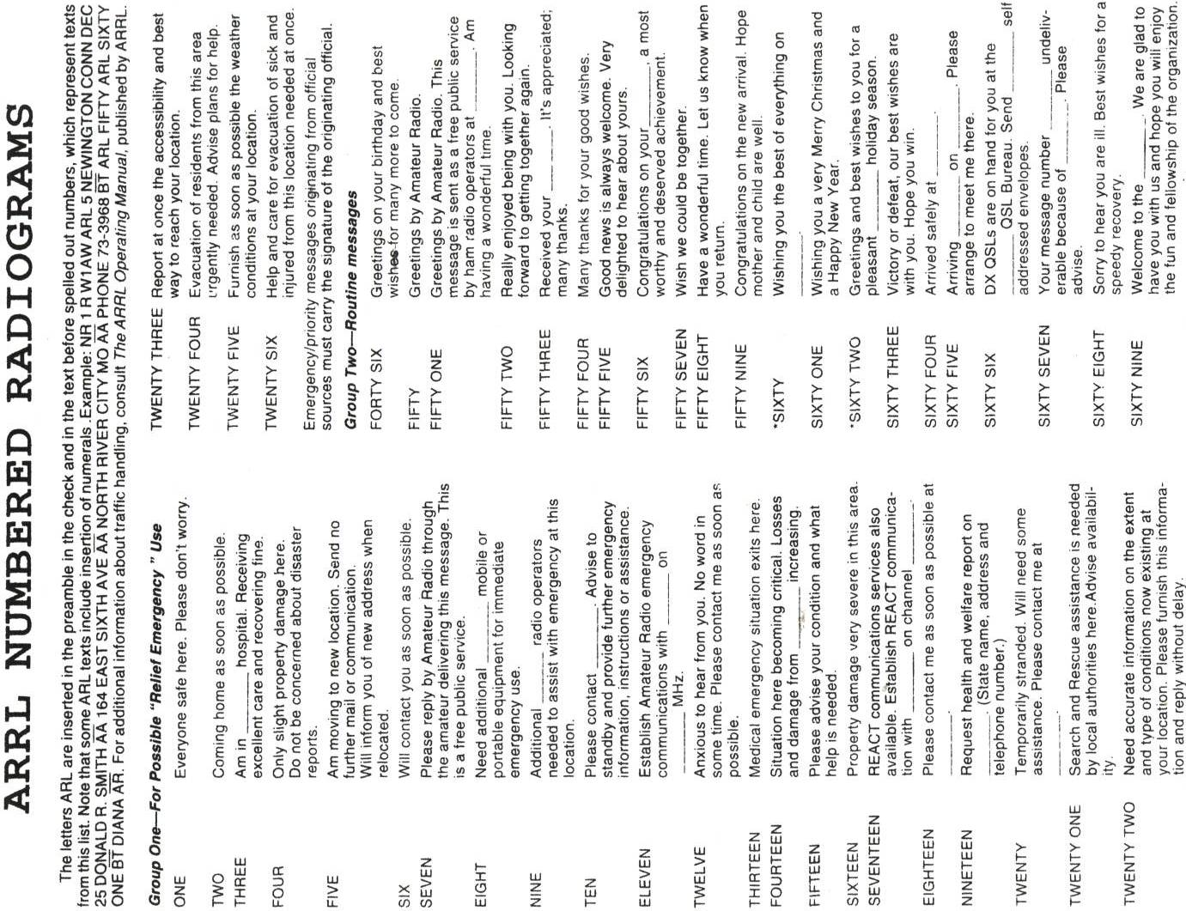
Source: ARRL Handbook, 2000

Slide 13
Page 14

Slide 14
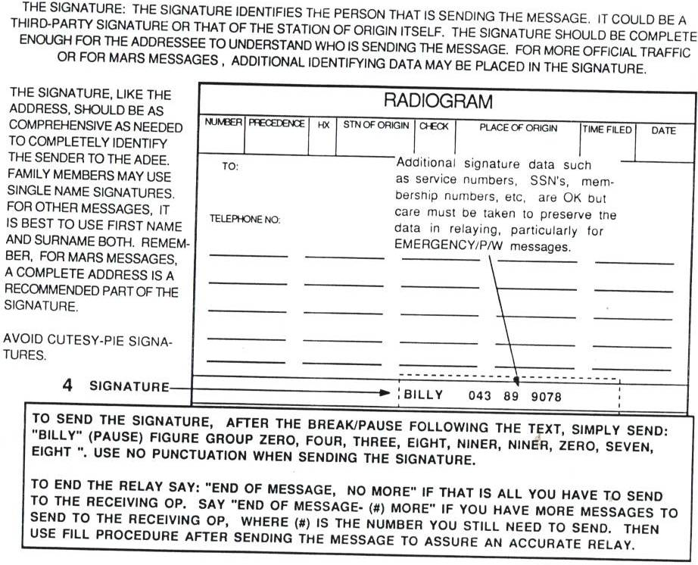
Page 15

Slide 15
Page 16

Slide 16
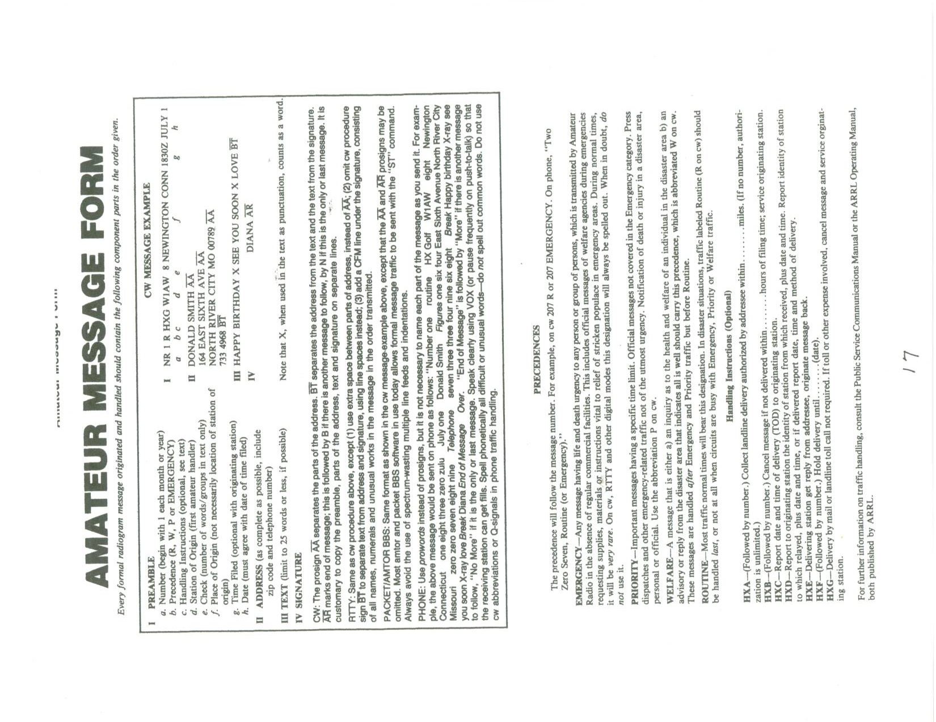
Source: ARRL Handbook, 2000

